Slide 1
Enterprise Architecture Value Drivers
Luís Silva Rodrigues
Programa Doutoral em
Tecnologias e Sistemas de Informação
Supervisor: Luís Amaral (Departamento de Sistemas de Informação)

Slide 2
Agenda
Enterprise Architecture
Enterprise Architecture Value
Research Questions
Delphi Study
Delphi Study Results
Contributions & Future Work

Slide 3
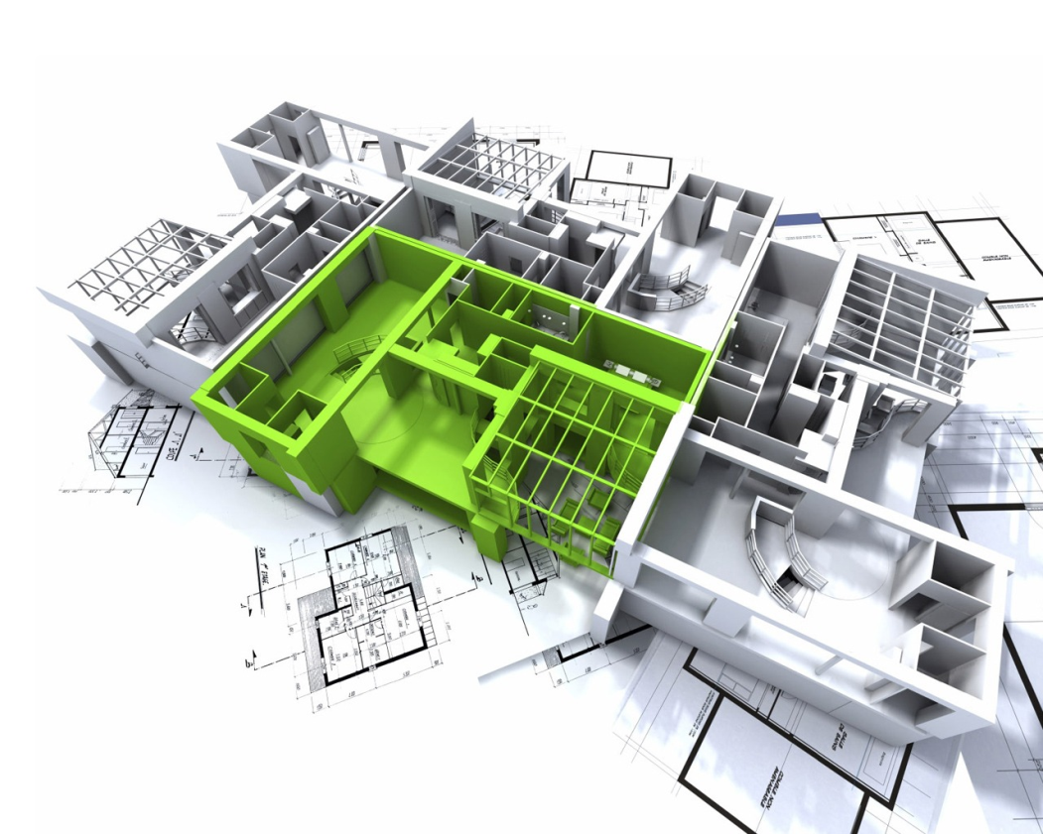
Enterprise Architecture
What is an Enterprise Architecture?
Architecture Concept

Slide 4
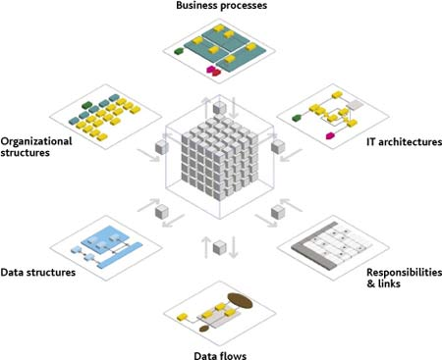
Enterprise Architecture
What is an Enterprise Architecture?
Business
Information
Applications
Technology

Slide 5
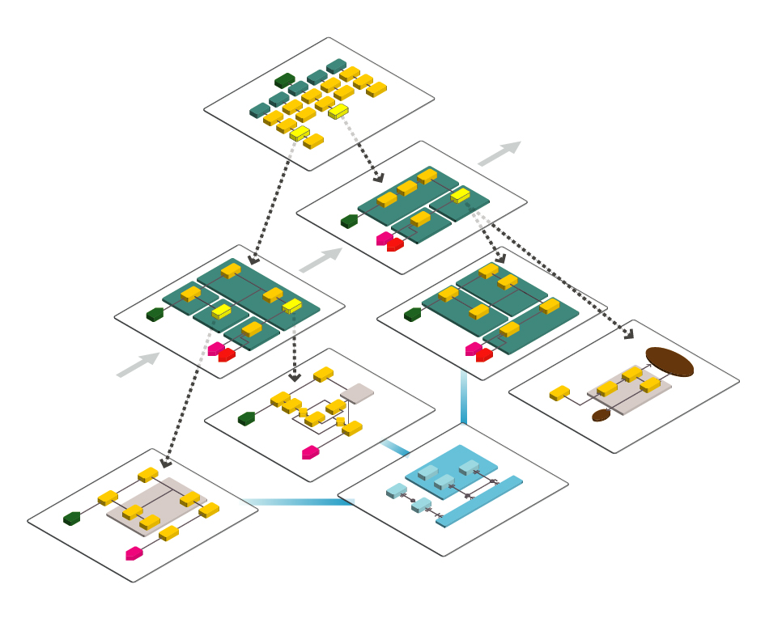
Enterprise Architecture
What is an Enterprise Architecture?
Business
Information
Applications
Technology
AS-IS
TO-BE

Slide 6
Enterprise Architecture Value
Why?
Need to justify the Enterprise Architectures investments
Estimated costs per year: more than $50.000
Current economic pressures
Issues:
Lack of a clear understanding on what is important for Enterprise Architecture value assessment
Need to quickly demonstrate the Enterprise Architecture’s value
Intangible nature of some benefits/results

Slide 7
Research Questions
R1: What are the key value drivers of Enterprise Architectures for organizations and what is their ranking of importance?
Value driver: any variable that affect the value of Enterprise Architecture to the organization. These variables can be characteristics or actions (activities) in the organization that are affected by an Enterprise Architecture and on a short or long term basis influence the performance of the organization (and creates value).
R2: Which value drivers of Enterprise Architectures can be realized in short term (less than a year).
R3: Which value drivers of Enterprise Architectures are of tangible nature?

Slide 8
Delphi Study
Delphi Method
… the aim of employing the Delphi method is to achieve consensus through a structured and iterative process of listing, refining and aggregating the opinions and perceptions of a group of people, called the expert panel, that could make valuable contributions to the resolution or understanding of a complex topic or problem in order to create a consensual shared vision on the matter under discussion (Soares and Amaral 2011).
Main characteristics:
the feedback of individual contributions of information and knowledge
an assessment of the group judgment or view
opportunity for individuals to revise their views
some degree of anonymity for the individual response

Slide 9
Delphi Study
Expert Panel
Expert selection criteria
Panel Composition
Study Execution

Slide 10
Delphi Study - Results
Position Round3 | Item (Value Driver)
1 | (Improved) Alignment
2 | (Improved) Decision Making
3 | (Improved) Governance
4 | (Increased) Agility
5 | (Improved) Change Management
6 | (Improved) Planning
7 | (Improved) Knowledge & Understanding
8 | (Enhanced) Enterprise Integration & Consolidation
9 | (Reduced) Complexity
10 | (Increased) Flexibility
11 | (Improved) Communication
12 | (Improved) Interoperability
13 | (Increased) Process Improvement & Standardization
14 | (Increased) Reuse
15 | (Improved) Portfolio Management
16 | (Reduced) Costs
17 | (Improved) Risk Management
18 | (Improved) IT Integration
19 | (Improved) Quality
20 | (Fostered) Innovation
21 | (Improved) Customer Orientation
22 | (Improved) IT Delivery
23 | (Improved) Time to Market
24 | (Increased) Compliance
25 | (Increased) Management Satisfaction
26 | (Enhanced) Assurance
27 | (Improved) Security Management
28 | (Enhanced) Technological Evolvability
29 | (Facilitated) Outsourcing
Value Drivers:
Global Rank of
Importance

Slide 11
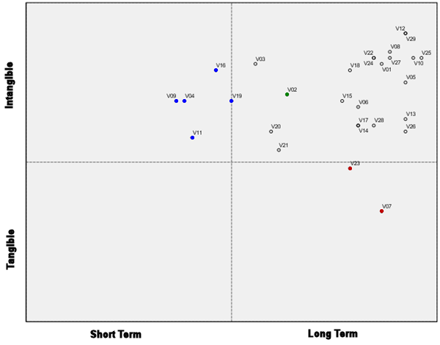
Delphi Study - Results
V02 - (Improved) Alignment
V09 - (Improved) Decision Making
V11 - (Improved) Governance
V01 - (Increased) Agility
V03 - (Improved) Change Management
V19 - (Improved) Planning
V16 - (Improved) Knowledge & Understanding
V28 - (Enhanced) Enterprise Integration & Consolidation
V05 - (Reduced) Complexity
V10 - (Increased) Flexibility
V04 - (Improved) Communication
V13 - (Improved) Interoperability
V21 - (Increased) Process Improvement & Standardization
V23 - (Increased) Reuse
V20 - (Improved) Portfolio Management
V07 - (Reduced) Costs
V24 - (Improved) Risk Management
V15 - (Improved) IT Integration
V22 - (Improved) Quality
V12 - (Fostered) Innovation
V08 - (Improved) Customer Orientation
V14 - (Improved) IT Delivery
V26 - (Improved) Time to Market
V06 - (Increased) Compliance
V17 - (Increased) Management Satisfaction
V27 - (Enhanced) Assurance
V25 - (Improved) Security Management
V29 - (Enhanced) Technological Evolvability
V18 - (Facilitated) Outsourcing
Short Term & Tangible Value Drivers

Slide 12
Contributions & Future Work
Contributions
Comprehensive list of 29 key value drivers of Enterprise Architectures
Solid basis for the future development of a value model and a measuring system for Enterprise Architectures
Future Work
Identification of key measures and metrics for value drivers

