Slide 1
Algorithms for the leather nesting problem: application to a real automotive industry instance
Pedro Brás
Supervision:
Cláudio Alves and José Valério de Carvalho
Universidade do Minho
Escola de Engenharia
Doctoral Program in
Industrial and Systems Engineering
SEEUM 2011

Slide 2
Presentation Structure
Introduction: Leather Nesting Problem
Case Study
Geometrical aspects
Constructive algorithm
VNS algorithm
GRASP algorithm
Computational results
Conclusions

Slide 3
Introduction
Case study
Geom. aspects
Construct. algorithm
VNS algorithm
GRASP algorithm
Results
Conclusions
Introduction
Nesting Problem
Cutting and packing problem with strong geometrical component
Elements
Small objects: car seat pieces
Large objects: leather hides
Problem
Find a configuration of a given set of pieces on leather hides
Objective
Minimize waste / Maximize the space occupied by the pieces on the leather hide
Restrictions
Non-overlapping
Quality zones and defects in small and large objects

Slide 4
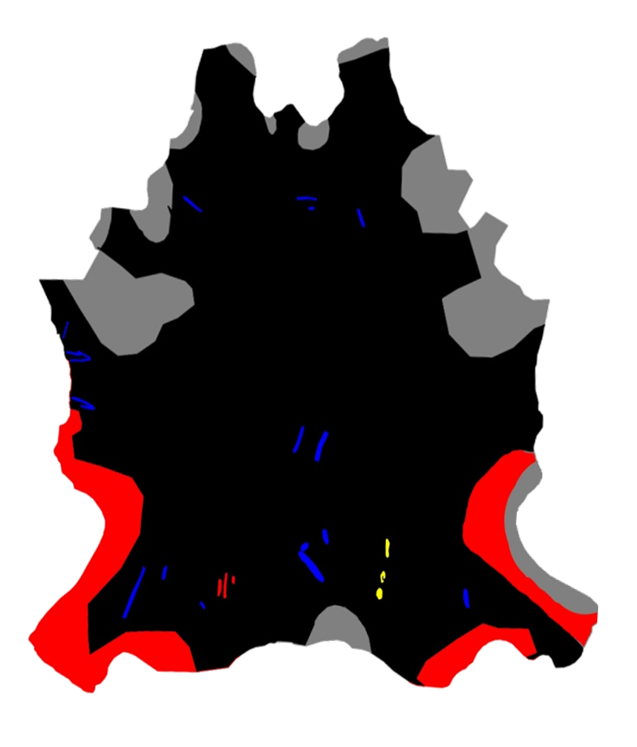
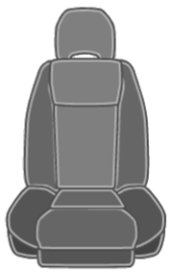
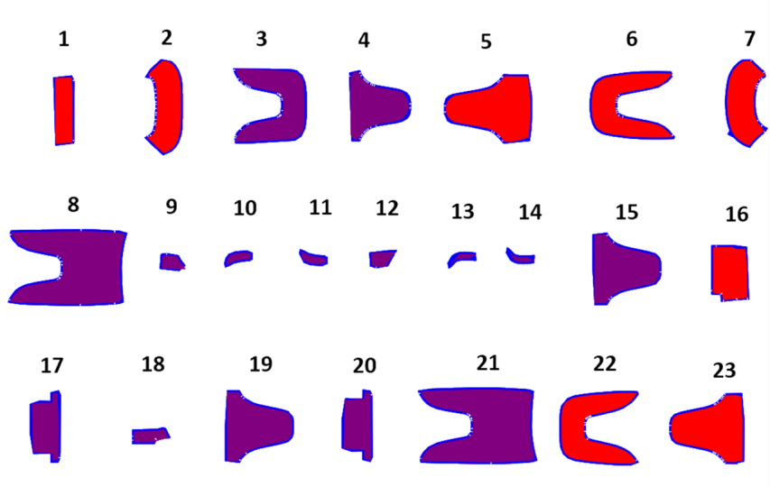
Case Study
Case study
Geom. aspects
Construct. algorithm
VNS algorithm
GRASP algorithm
Results
Conclusions
Introduction

Slide 5
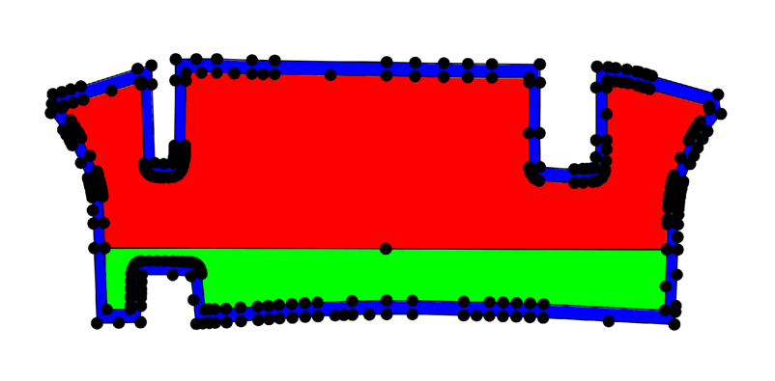
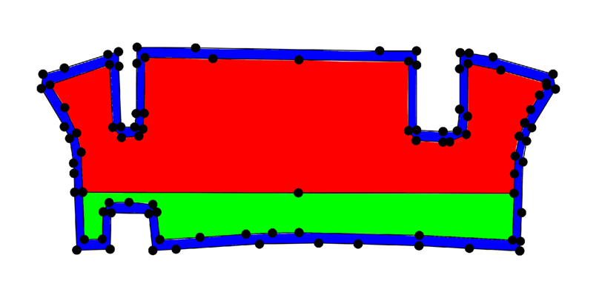
Geometrical aspects Shapes representation
Case study
Geom. aspects
Construct. algorithm
VNS algorithm
GRASP algorithm
Results
Conclusions
Introduction
Notes:
Número médio de vértices por:
. Peça: 200 (antes) e 80 (depois)
. Pele: 800 (antes) e 300 (depois)

Slide 6
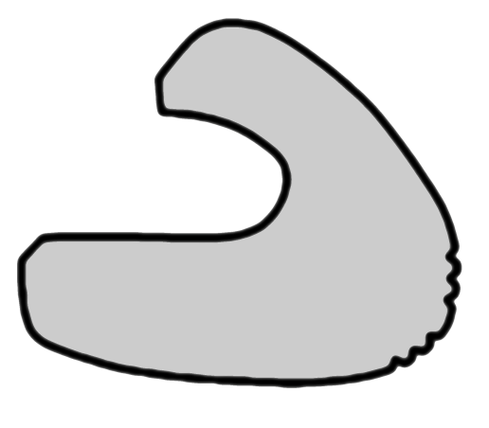
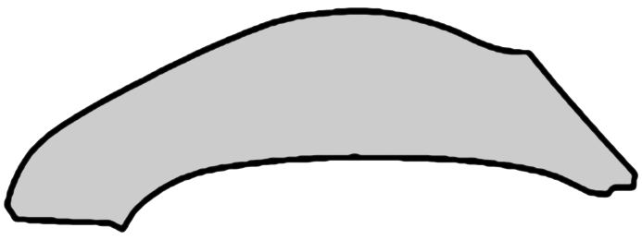
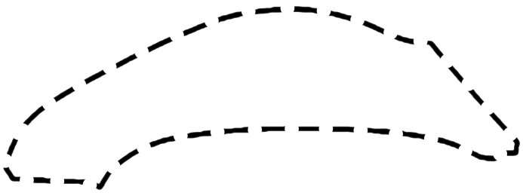
Geometrical aspects No-Fit-Polygon
Case study
Geom. aspects
Construct. algorithm
VNS algorithm
GRASP algorithm
Results
Conclusions
Introduction
Polygon representing the region that divides a legal placement of an illegal one (overlapping).
Given two polygons A and B, the NFP_{AB} (No-Fit-Polygon) is the polygon that results from the locus of a reference point of polygon A when this polygon travels around the polygon B.
A
B
Reference point

Slide 7
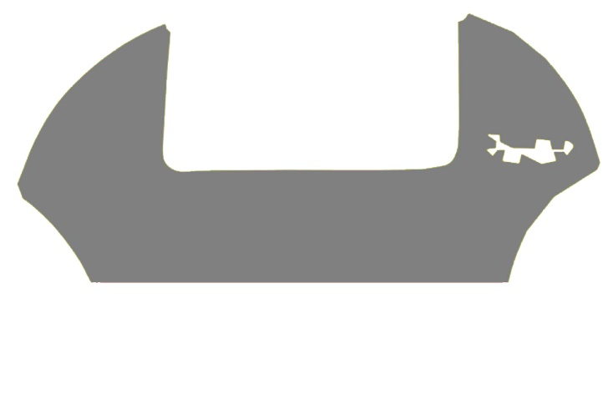
Geometrical aspects No-Fit-Polygon
Case study
Geom. aspects
Construct. algorithm
VNS algorithm
GRASP algorithm
Results
Conclusions
Introduction
B
C
D
W
C
D
W
A
B
D
W
W
C
D

Slide 8
Constructive algorithm
Case study
Geom. aspects
Construct. algorithm
VNS algorithm
GRASP algorithm
Results
Conclusions
Introduction
Strategies
Grouping the pieces (GRP)
Selecting the next piece to place (SEL)
Selecting a feasible placement region inside the hide (PLAC)
Evaluate a given placement position (EVAL)

Slide 9
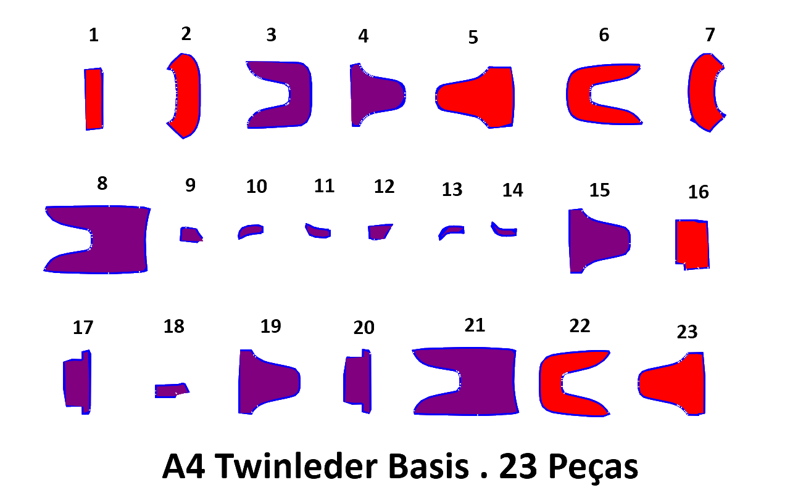
Constructive algorithm Strategies for grouping the pieces (GRP)
Case study
Geom. aspects
Construct. algorithm
VNS algorithm
GRASP algorithm
Results
Conclusions
Introduction
Area
Irregularity
Concavity
Length/height ratio
Quality area value
Homogeneity between quality zones
Mix function
a
l

Slide 10
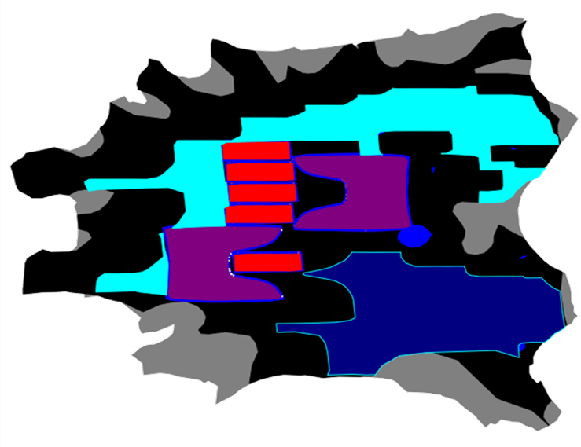
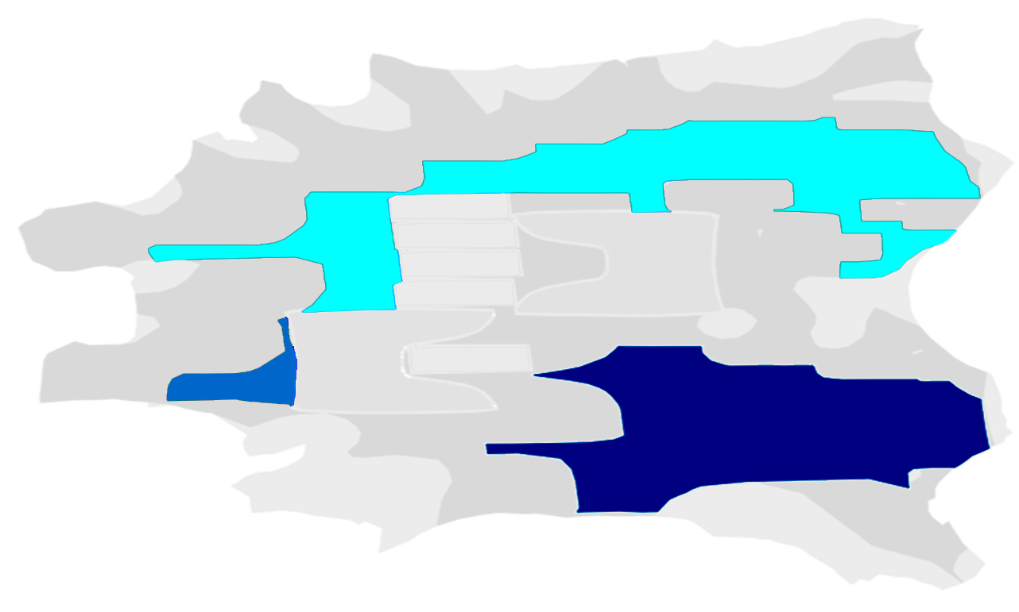
Constructive algorithm Strategies for selecting the next piece to place (SEL)
Case study
Geom. aspects
Construct. algorithm
VNS algorithm
GRASP algorithm
Results
Conclusions
Introduction
By decreasing weight value;
Smallest IFP;
Biggest IFP;
Value provided by the function used to evaluate the placement positions.

Slide 11
Constructive algorithm Strategies for selecting a feasible region where to place the next piece (PLAC)
Case study
Geom. aspects
Construct. algorithm
VNS algorithm
GRASP algorithm
Results
Conclusions
Introduction
All the empty spaces on the hide;
Vertical levels;
IFP features:
Smallest piece IFP;
Biggest piece IFP;
Smallest or biggest IFP, depending on the group of the selected piece;
Hide empty spaces features:
Smallest/biggest empty space;
Worst/Better overall quality;
More/Less irregularity.

Slide 12
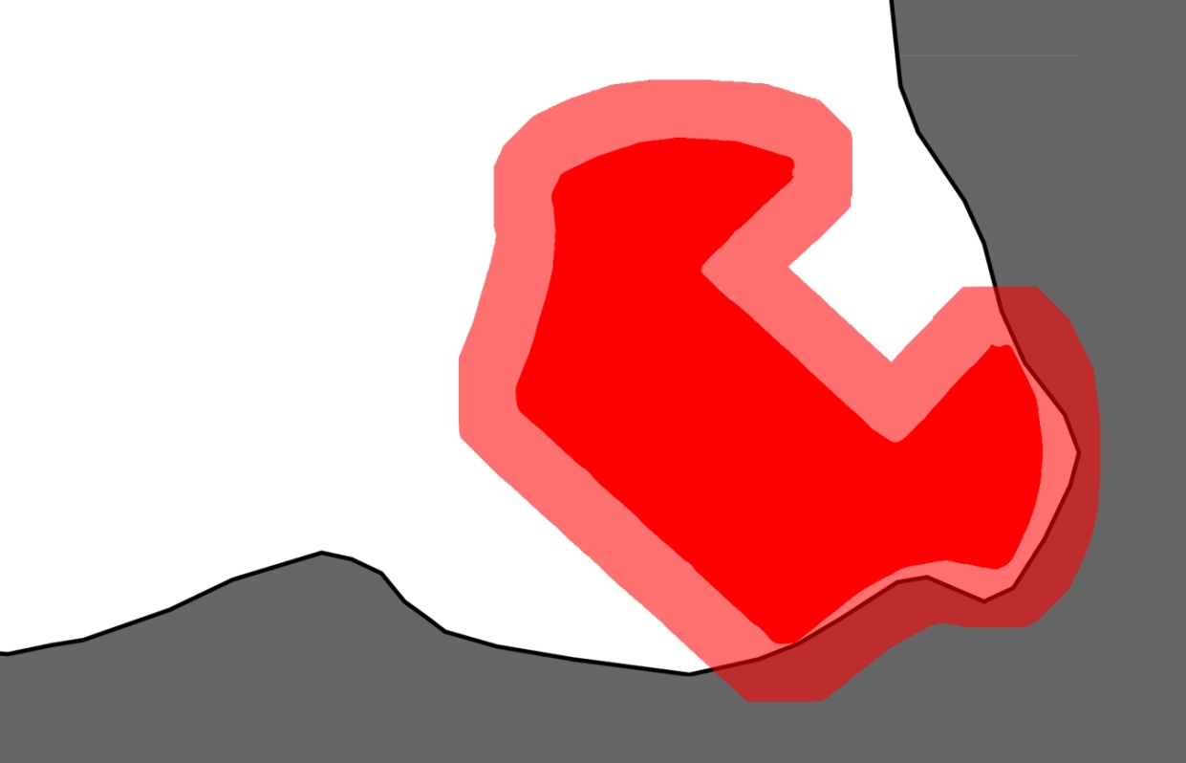
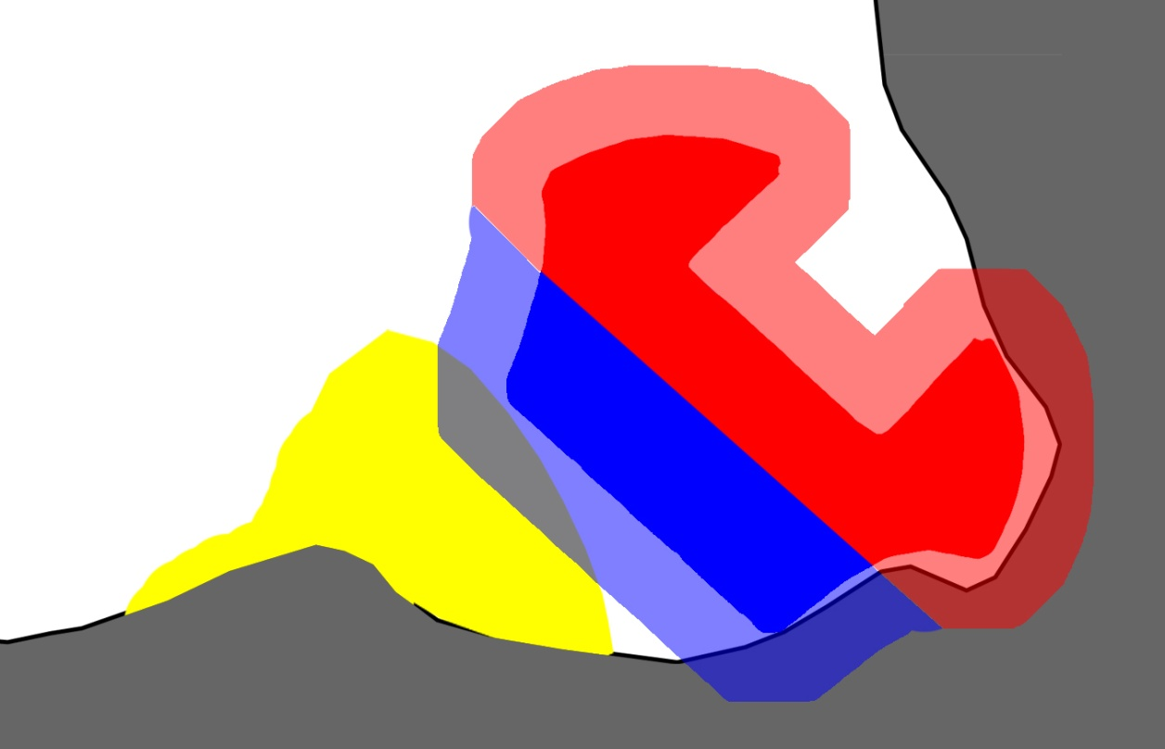
Constructive algorithm Strategies to evaluate a given placement position (EVAL)
Case study
Geom. aspects
Construct. algorithm
VNS algorithm
GRASP algorithm
Results
Conclusions
Introduction
Area of intersection between piece offset and layout:
Total or partial area;
Quality zones matching;
Absolute and relative values;
Number of empty spaces;
Created waste;
Piece distance to:
Hide border/center;
Best/worst quality zones.
Piece offset
Piece offset
Piece
Piece
Offset intersection 2
Q1
Q2
Qx
Offset intersection
Offset intersection 1

Slide 13
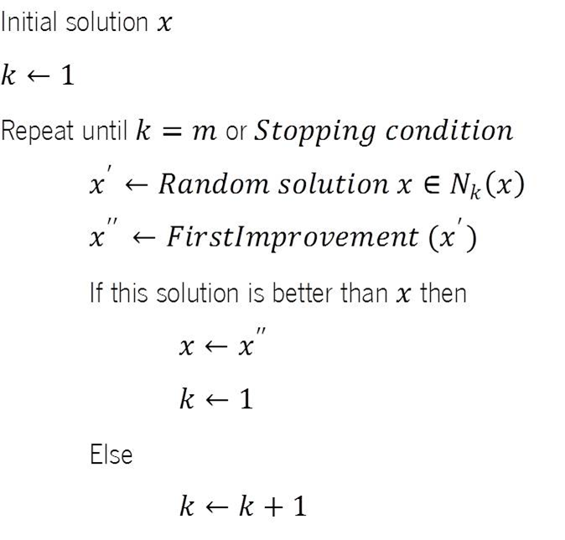
VNS algorithm
Case study
Geom. aspects
Construct. algorithm
VNS algorithm
GRASP algorithm
Results
Conclusions
Introduction

Slide 14
VNS algorithm
Case study
Geom. aspects
Construct. algorithm
VNS algorithm
GRASP algorithm
Results
Conclusions
Introduction
Initial solution given by constructive algorithm:
(G1) Piece area;
(S2.D.1.c) Selection of the piece with the largest or smallest IFP depending on the selected group of pieces;
(P6) The largest or smallest IFP depending on the group of the selected piece;
(E11) Distance to the border of the hide.
Neighborhood structures:
4 types of distinct movements.

Slide 15
VNS algorithm Movement M₁
Case study
Geom. aspects
Construct. algorithm
VNS algorithm
GRASP algorithm
Results
Conclusions
Introduction
1: | s₁ |  | s₂ |  | s₃ |  | s₄ |  | s₅ |  | s₆ |  | s₇ |  | s₈ |  | s₉ |  | s₁₀ |  | … |  | s_{|S|} | Placement sequence S
 | u₁ |  | u₂ |  | u₃ |  | u₄ |  | u₅ |  | u₆ |  | u₇ |  | u₈ |  | u₉ |  | u₁₀ |  | … |  | u_{|S|} | (Material usage)
2: | s₁ |  | s₂ |  | s₃ |  | s₄ |  | s₅ |  | s₆ |  | s₇ |  | s₈ |  | s₉ |  | s₁₀ |  | … |  | s_{|S|} | Material usage window
 | u₁ |  | u₂ |  | u₃ |  | u₄ |  | u₅ |  | u₆ |  | u₇ |  | u₈ |  | u₉ |  | u₁₀ |  | … |  | u_{|S|}
3: | s₁ |  | s₂ |  | s₃ |  | s₄ |  | s₅ |  | p |  | s₇ |  | s₈ |  | s₉ |  | s₁₀ |  | … |  | s_{|S|} | Worst fitness value
4: | s₁ |  | s₂ |  | s₃ |  | s₄ |  | s₅ |  | p’ |  | _{Constructive heuristic} |  |  | Replace piece p by piece p’

Slide 16
VNS algorithm Movement M₂
Case study
Geom. aspects
Construct. algorithm
VNS algorithm
GRASP algorithm
Results
Conclusions
Introduction
1: | s₁ |  | s₂ |  | s₃ |  | s₄ |  | s₅ |  | s₆ |  | s₇ |  | s₈ |  | s₉ |  | s₁₀ |  | … |  | s_{|S|} | Placement sequence S
 | u₁ |  | u₂ |  | u₃ |  | u₄ |  | u₅ |  | u₆ |  | u₇ |  | u₈ |  | u₉ |  | u₁₀ |  | … |  | u_{|S|} | (Material usage)
2: | s₁ |  | s₂ |  | s₃ |  | s₄ |  | s₅ |  | s₆ |  | s₇ |  | s₈ |  | s₉ |  | s₁₀ |  | … |  | s_{|S|} | Material usage window
 | u₁ |  | u₂ |  | u₃ |  | u₄ |  | u₅ |  | u₆ |  | u₇ |  | u₈ |  | u₉ |  | u₁₀ |  | … |  | u_{|S|}
3: | s₁ |  | s₂ |  | s₃ |  | s₄ |  | s₅ |  | p |  | s₇ |  | s₈ |  | s₉ |  | s₁₀ |  | … |  | s_{|S|} | Worst fitness value
4: | s₁ |  | s₂ |  | s₃ |  | s₄ |  | s₅ |  | p’ |  | s₇ |  | s₈ |  | s₉ |  | s₁₀ |  | … |  | s_{|S|} | Replace piece p by piece p’

Slide 17
VNS algorithm Movement M₃
Case study
Geom. aspects
Construct. algorithm
VNS algorithm
GRASP algorithm
Results
Conclusions
Introduction
1: | s₁ |  | s₂ |  | s₃ |  | s₄ |  | s₅ |  | s₆ |  | s₇ |  | s₈ |  | s₉ |  | s₁₀ |  | … |  | s_{|S|} | Placement sequence S
 | u₁ |  | u₂ |  | u₃ |  | u₄ |  | u₅ |  | u₆ |  | u₇ |  | u₈ |  | u₉ |  | u₁₀ |  | … |  | u_{|S|} | (Material usage)
2: | s₁ |  | s₂ |  | s₃ |  | s₄ |  | s₅ |  | s₆ |  | s₇ |  | s₈ |  | s₉ |  | s₁₀ |  | … |  | s_{|S|} | Material usage window
 | u₁ |  | u₂ |  | u₃ |  | u₄ |  | u₅ |  | u₆ |  | u₇ |  | u₈ |  | u₉ |  | u₁₀ |  | … |  | u_{|S|}
3: | s₁ |  | s₂ |  | s₃ |  | s₄ |  | s₅ |  | p |  | s₇ |  | s₈ |  | s₉ |  | s₁₀ |  | … |  | s_{|S|} | Worst fitness value
4: | s₁ |  | s₂ |  | s₃ |  | s₄ |  | s₅ |  | p |  | s₇ |  | s₈ |  | s₉ |  | p’ |  | … |  | s_{|S|} | Swap piece p with piece p’

Slide 18
VNS algorithm Movement M₄
Case study
Geom. aspects
Construct. algorithm
VNS algorithm
GRASP algorithm
Results
Conclusions
Introduction
1: | s₁ |  | s₂ |  | s₃ |  | s₄ |  | s₅ |  | s₆ |  | s₇ |  | s₈ |  | s₉ |  | s₁₀ |  | … |  | s_{|S|} | Placement sequence S
 | u₁ |  | u₂ |  | u₃ |  | u₄ |  | u₅ |  | u₆ |  | u₇ |  | u₈ |  | u₉ |  | u₁₀ |  | … |  | u_{|S|} | (Material usage)
2: | s₁ |  | s₂ |  | s₃ |  | s₄ |  | s₅ |  | s₆ |  | s₇ |  | s₈ |  | s₉ |  | s₁₀ |  | … |  | s_{|S|} | Material usage window
 | u₁ |  | u₂ |  | u₃ |  | u₄ |  | u₅ |  | u₆ |  | u₇ |  | u₈ |  | u₉ |  | u₁₀ |  | … |  | u_{|S|}
3: | s₁ |  | s₂ |  | s₃ |  | s₄ |  | s₅ |  | p |  | s₇ |  | s₈ |  | s₉ |  | s₁₀ |  | … |  | s_{|S|} | Worst fitness value
4: | s₁ |  | s₂ |  | s₃ |  | s₄ |  | s₅ |  |  |  | s₇ |  | s₈ |  | s₉ |  | s₁₀ |  | … |  | s_{|S|} | Remove piece p

Slide 19
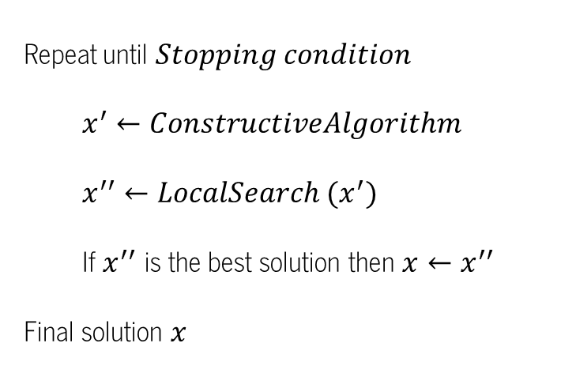
GRASP algorithm
Case study
Geom. aspects
Construct. algorithm
VNS algorithm
GRASP algorithm
Results
Conclusions
Introduction

Slide 20
GRASP algorithm Constructive phase
Case study
Geom. aspects
Construct. algorithm
VNS algorithm
GRASP algorithm
Results
Conclusions
Introduction
Restricted candidate list (RCL): 10 pieces with the smallest IFP area;
Next piece to place: Random selection from RCL;
Feasible placement region: Selection of the smallest piece IFP;
Placement position evaluation: Distance between piece and the border of the hide.

Slide 21
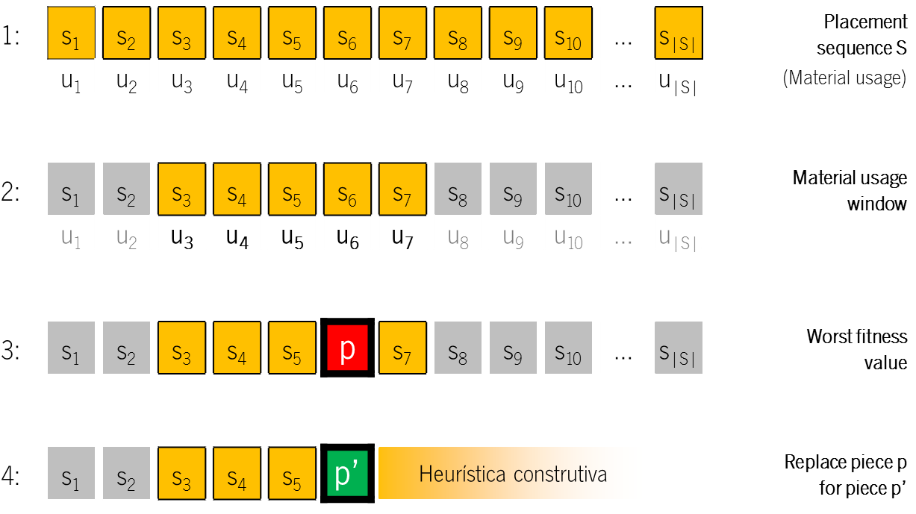
GRASP algorithm Improvement phase
Case study
Geom. aspects
Construct. algorithm
VNS algorithm
GRASP algorithm
Results
Conclusions
Introduction
Local search procedure;
Neighborhood given by M₁ movement

Slide 22
Computational results: Constructive algorithm
Case study
Geom. aspects
Construct. algorithm
VNS algorithm
GRASP algorithm
Results
Conclusions
Introduction
Strategies comparative analysis
Grouping the pieces (GRP):
Area;
Quality zones;
Selecting the next piece to place (SEL) and selecting a feasible region where to place the next piece (PLAC):
IFP features;
Placement evaluation (EVAL):
Offset intersection between piece and layout.

Slide 23
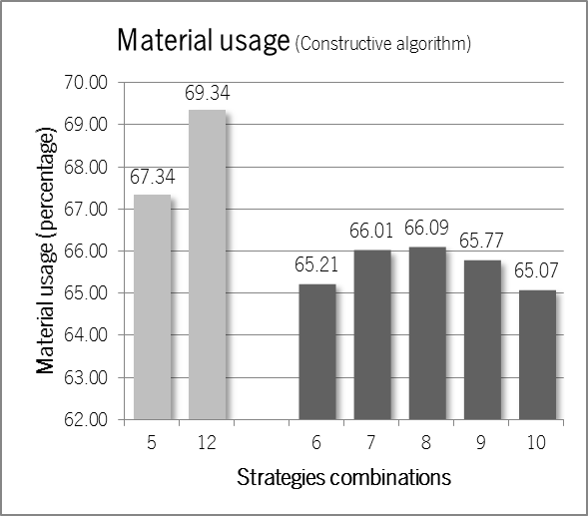
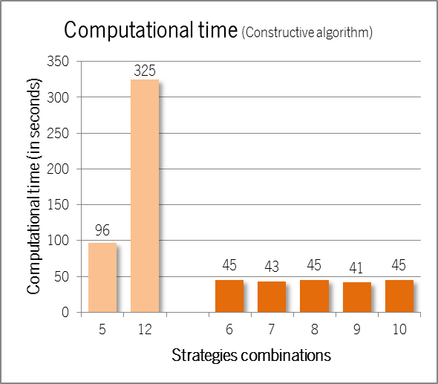
Computational results: Constructive algorithm
Case study
Geom. aspects
Construct. algorithm
VNS algorithm
GRASP algorithm
Results
Conclusions
Introduction
Performance results

Slide 24
Computational results: VNS algorithm
Case study
Geom. aspects
Construct. algorithm
VNS algorithm
GRASP algorithm
Results
Conclusions
Introduction
Tuning stage
Neighborhood structures performances:
Best performance for combination of all neighborhood;
Size of material usage window:
Best results for window [10%;50%] of hide yield;
Size of candidate list for removal:
Best results considering 3 candidates for removal
Size of candidate list for insertion:
Best results considering 3 candidates for insertion
Neighborhood exploration sequence
Best results for sequence N₁, N₂, N₃ e N₄.

Slide 25
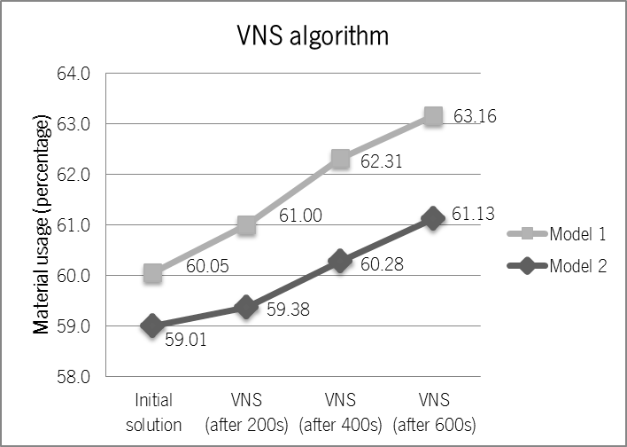
Computational results: VNS algorithm
Case study
Geom. aspects
Construct. algorithm
VNS algorithm
GRASP algorithm
Results
Conclusions
Introduction
Performance results

Slide 26
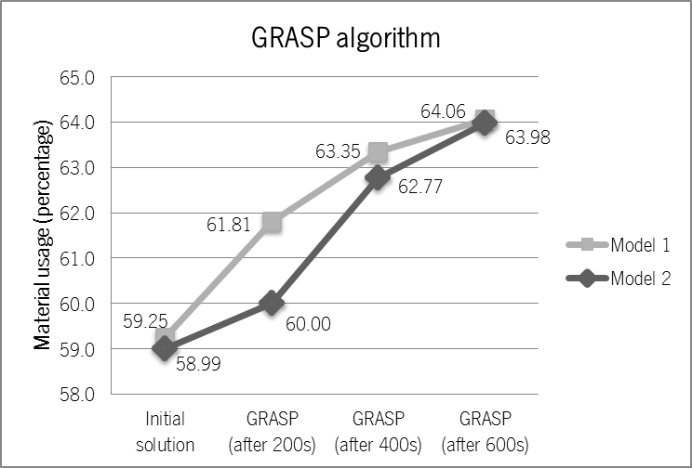
Computational results: GRASP algorithm
Case study
Geom. aspects
Construct. algorithm
VNS algorithm
GRASP algorithm
Results
Conclusions
Introduction
Performance results

Slide 27
Conclusions
Case study
Geom. aspects
Construct. algorithm
VNS algorithm
GRASP algorithm
Results
Conclusions
Introduction
Algorithms development for leather nesting problems::
Constructive heuristic;
VNS meta-heuristic;
GRASP meta-heuristic;
Accomplishment of extensive computational experiments:
Quality of material usage efficiency;
Clear improvements given by VNS and GRASP meta-heuristics;
Feasible algorithm integration into:
Decision support tools;
Automation of leather cutting process.

Slide 28
Publications
Alves, C., Brás, P., Valério de Carvalho, J., and Pinto, T.
New constructive algorithms for leather nesting in the automotive industry.
Computers & Operations Research, (2011).
Alves, C., Brás, P., Valério de Carvalho, J., and Pinto, T.
A variable neighborhood search algorithm for the leather nesting problem.
(accepted) Mathematical Problems in Engineering, (2011).
Brás, P., Alves, C., Valério de Carvalho, J., and Pinto, T.
Exploring New Constructive Algorithms for the Leather Nesting Problem in the Automotive Industry. 5th International Conference on Management and Control of Production and Logistics, International Federation of Automatic Control (IFAC), Coimbra, Portugal, (2010).
Brás, P., Alves, C., Valério de Carvalho, J., and Pinto, T.
Irregular Shape Packing on Leather Hides using GRASP: a Real Case Study.
International Conference on Engineering UBI2011 – “Innovation and Development”, Covilhã, Portugal, (2011).
Brás, P., Alves, C. and Valério de Carvalho, J.
Algorithms for industrial process optimization: An application in the automotive industry.
Semana da Escola de Engenharia, (2011).

Slide 29
Obrigado!
Thank you!

