Slide 1


Semana da Engenharia
UMA ESCOLA A
REINVENTAR O FUTURO
24-27 Outubro de 2011
Influence of DBD plasma modification in the dyeing process Of Polyamide
Fernando Ribeiro Oliveira
Textile Engineering Department
University of Minho, Guimarães/Portugal
Notes:
1

Slide 2
Presentation Outline
Objectives
Introduction
  What is Plasma?
  DBD Plasma Machines
Materials and Methods
Results and Discussions
Conclusions

Slide 3
Objectives
To study the physical and chemical surface modifications on polyamide 6.6 after DBD plasma treatment.
To dye these fabrics (untreated and plasma treated) with non conventional dye regarding polyamide (direct dye).
To verify the dyeing behaviour (exhaustion, fixation, kinetics and washing fastness).
Notes:
First, the objective of this research is to study---

Slide 4
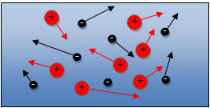
What is Plasma?
Plasma is described as the fourth state of matter and is often defined as a partly or fully ionized gas.
Gas Diagram
Plasma Diagram
Notes:
For the surface modification of polymers the energy is usually coming from electric field, that is responsible to accelerates electrons, which have collision with molecules or atoms and ionize them, producing new charged particle (photons, atomic or molecules ions, electrons).
Several researches have explored the use of plasma technology to study the dyeing behaviour of several textile materials, such as (PET, PA, PAC, AC, CO, PP, JUT

Slide 5
Plasma
Sir William Crookes was the first to, in 1879, identify a fourth state of matter where the individual atoms break apart into electrons and positively charged ions.
Plasma is the dynamic mixture of energetic species such as ions, electrons, free radicals, excited atoms, molecular and polymeric fragments, ultraviolet, visible and Infra-Red photons.
Dep. Engenharia Têtxtil

Slide 6
Plasma
DBD Plasma consists on the application of an electrical discharge of high voltage (around 10.000V) through air between two electrodes, using frequencies around 40kHz, at normal atmospheric, temperature and pressure, on dry material, moving continuously at controlled velocity.
Several researchers have explored the use of plasma technology to study the dyeing behaviour of several textile materials, such as (PET, PA, PAC, AC, CO, PP, JUTE....).
Dep. Engenharia Têtxtil

Slide 7
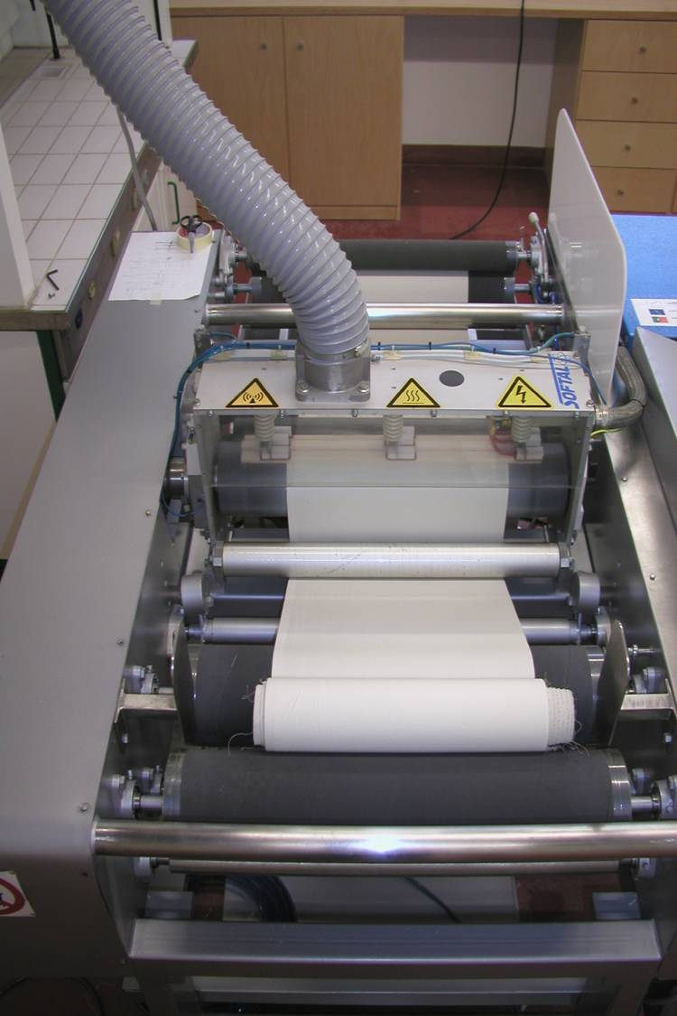
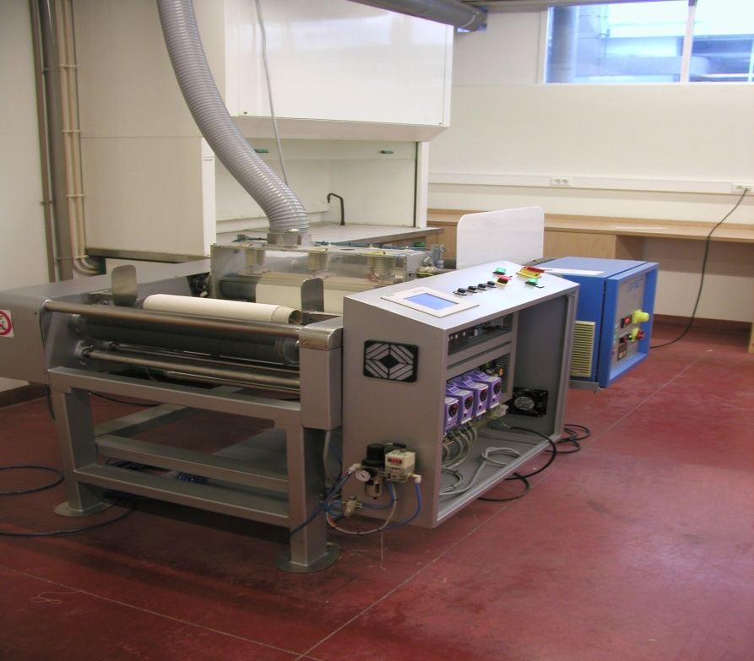
Semi-Industrial DBD Prototype
Installed at Textile Department, University of Minho
Prototype “Lisboa-Softal” adapted to work in continuous
for woven and knitted fabrics with 50 cm width.

Slide 8
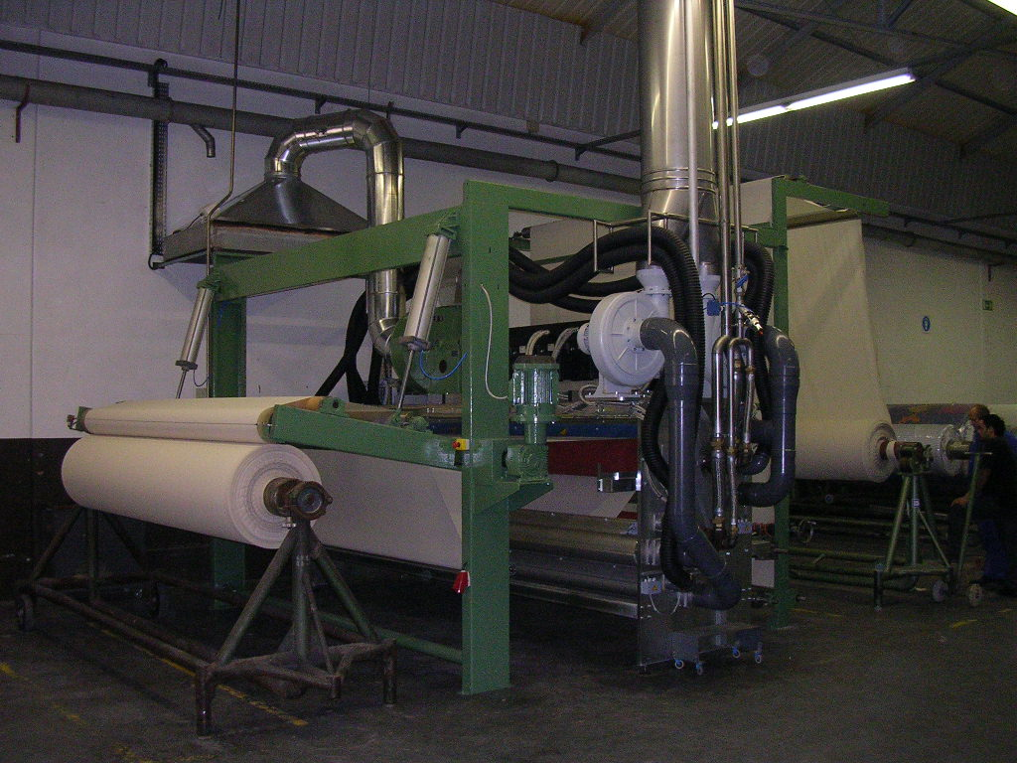
Continuous DBD Machine
Installed in Lameirinho SA - Portugal
Patent University Minho/Softal PCT/PT 2004/000008 (2004)

Slide 9
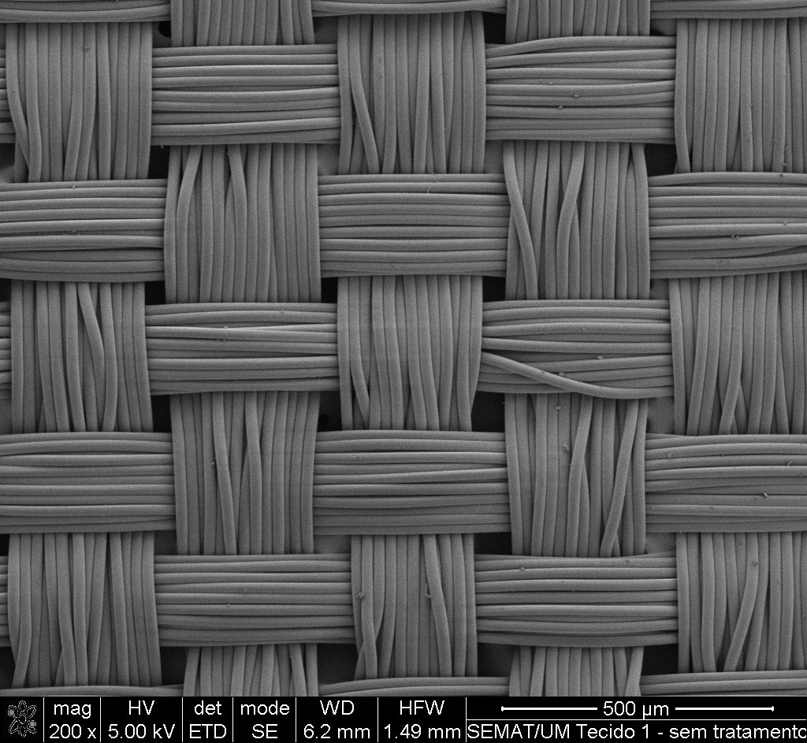
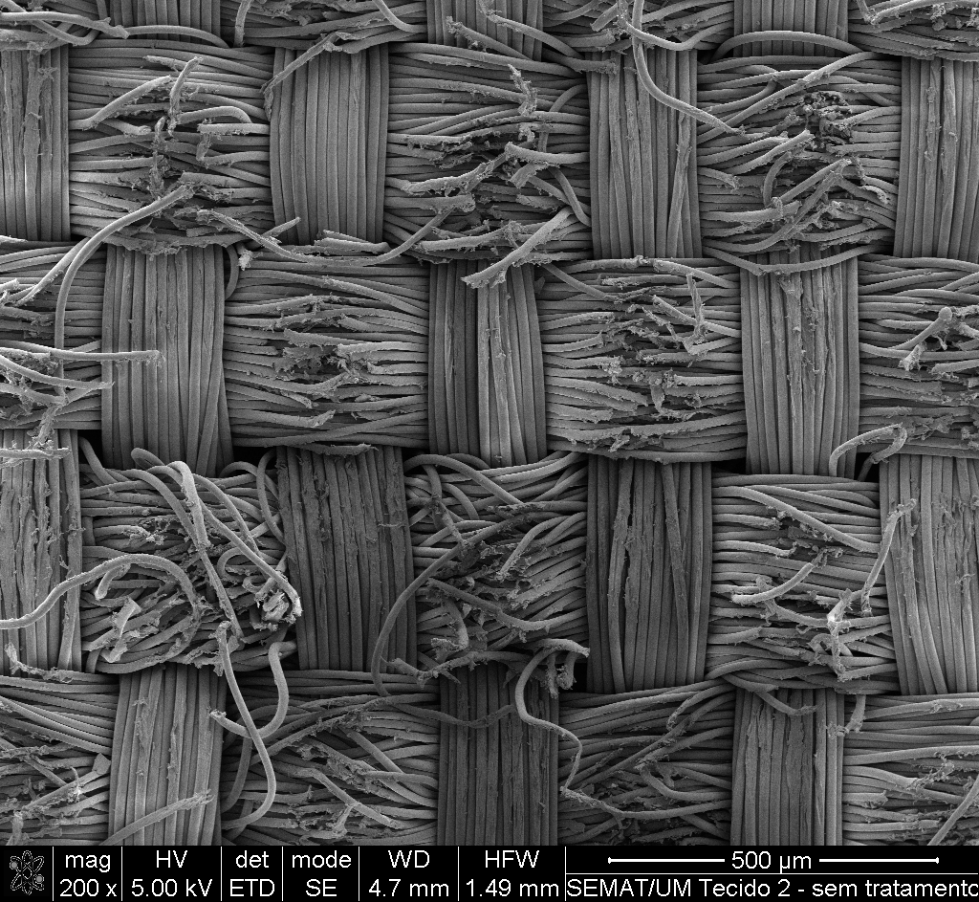
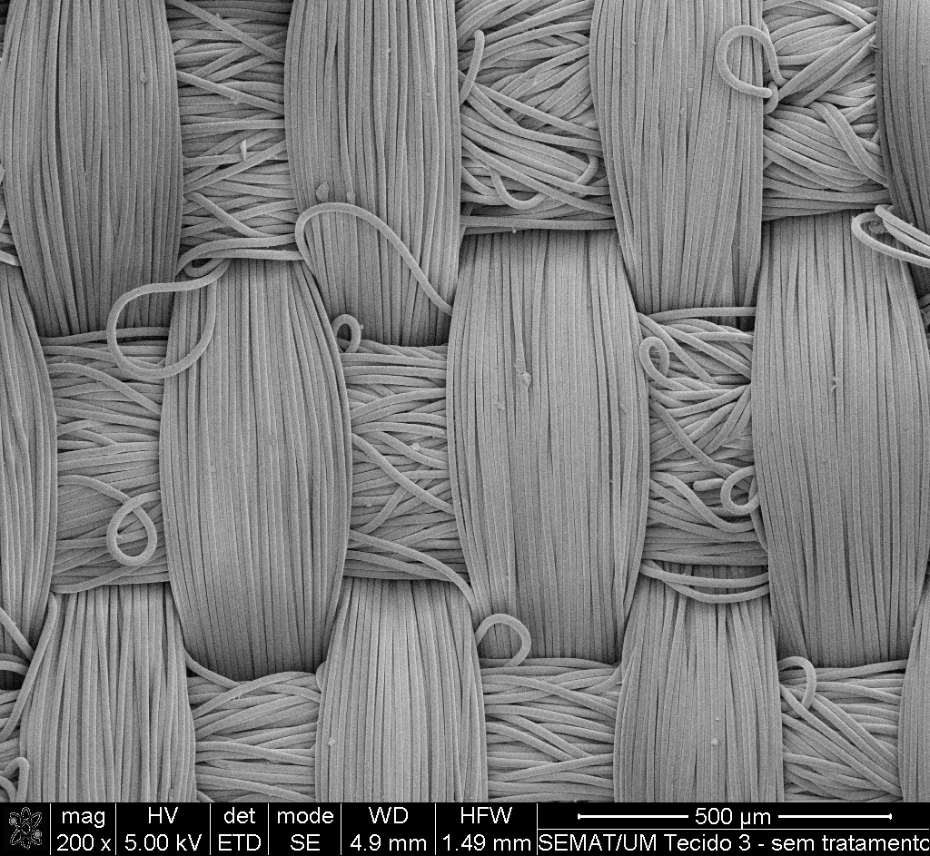
Materials and Methods
Fabrics
PA1
PA2
PA3
Specific weight (g/m²)
61
95
135
Yarn count Weft (Tex)
8
18
37
Yarn count Warp (Tex)
8
8
18
Weft density (thread/cm)
42 – PA 6.6
42 – PA 6.6
40 – PA 6.6
Warp density (thread/cm)
32 – PA 6
30 – PA 6.6
18 – PA 6.6
Dye
Commercial Name: Sirius Orange 3GDL

Slide 10
Materials and Methods
Dosage = (Power x Number of passage) / (Velocity x 0,5m)
Power (W) | Passages Numbers | Velocity (m/min) | Dosage (W.min/m²)
1000 | 1 | 4,0 | 500
1000 | 2 | 4,0 | 1000
1000 | 3 | 4,0 | 1500
1000 | 4 | 4,0 | 2000
1000 | 5 | 4,0 | 2500
1000 | 6 | 4,0 | 3000
1000 | 7 | 4,0 | 3500
1000 | 8 | 4,0 | 4000
1000 | 9 | 4,0 | 4500
Notes:
Now, I will talk about plasma treatment. In this table, the dosage was obtained with three factors such as power, velocity and passages numbers-. These differentes dosages was utilized on material for to choose the best results in K/S after dyeing.

Slide 11

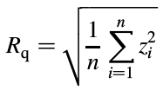
Materials and Methods
Scanning Electron Microscopy
Ultra-high resolution Field Emission Gun Scanning Electron Microscopy (FEG-SEM), NOVA 200 Nano SEM;
Atomic Force Microscopy
A multimode SPM microscope controlled by a Nanoscope III;
(Ra) - average surface roughness
(Rq) – rootmean-square surface roughness
Energy Dispersive Spectroscopy
EDAX Si(Li) detector and aceleration of 5kV;
Dep. Engenharia Têtxtil

Slide 12
Materials and Methods
X-Ray Photoelectron Spectroscopy
VG Scientific ESCALAB 200A equipment;
Contact Angle Measurement
Dataphysics equipment using OCA software;
Conductivity and pH of Aqueous Extract
WTW pH meter 538;
Dep. Engenharia Têtxtil

Slide 13
Materials and Methods
Dyeing Method
1 – 10 Samples taken during dyeing process.
Dyeing tests were performed for different temperatures (80ºC and 98ºC).
Dye concentrations owf (1%, 2% and 3%).
All the samples were dyed with a liquor ratio of 40:1.
The pH of dye solution was between 4.5 and 5.0.
No auxiliaries reagents were used.
Dep. Engenharia Têtxtil

Slide 14
Materials and Methods
Color Strength (K/S) on Dyed Fabric
Datacolor Spectraflash SF 600 Plus CT spectrophotometer for D65 illuminant and 10º observer;
Washing Fastness
Standard ISO 105 C06, method A1S;
Dep. Engenharia Têtxtil

Slide 15
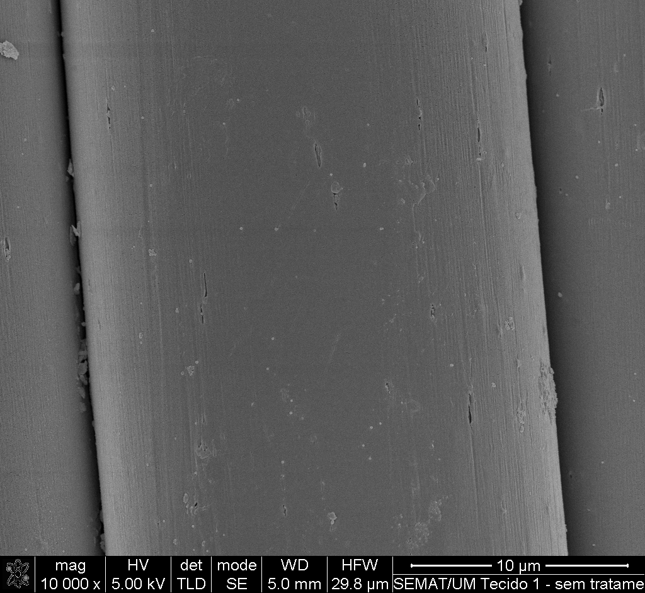
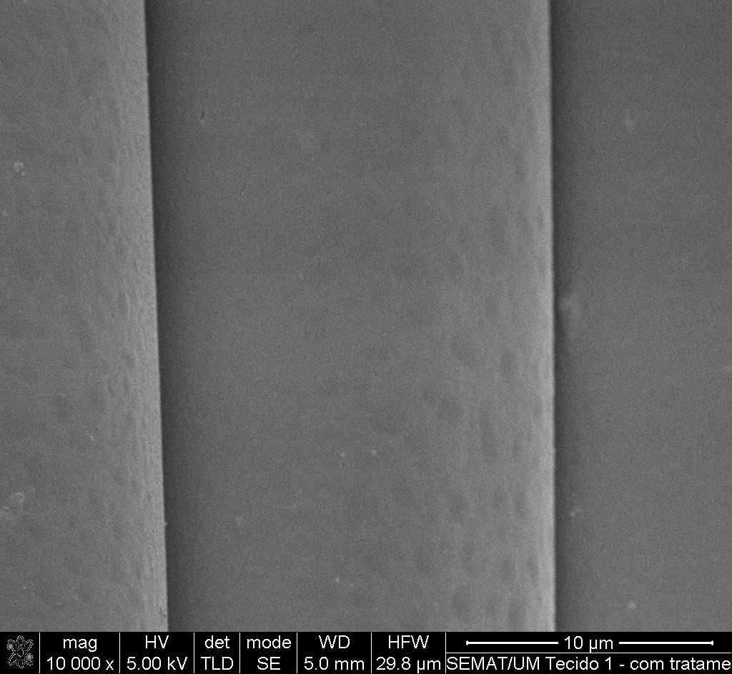
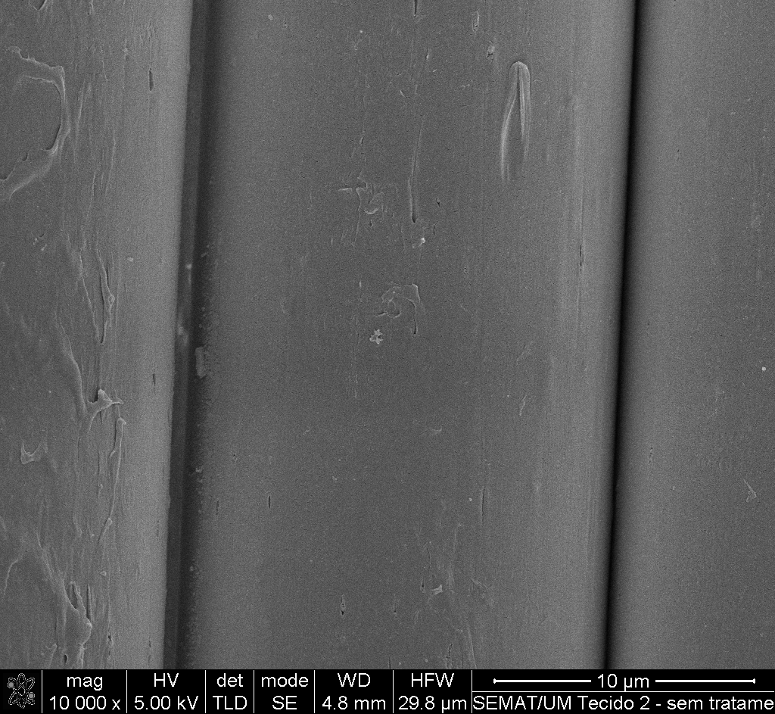
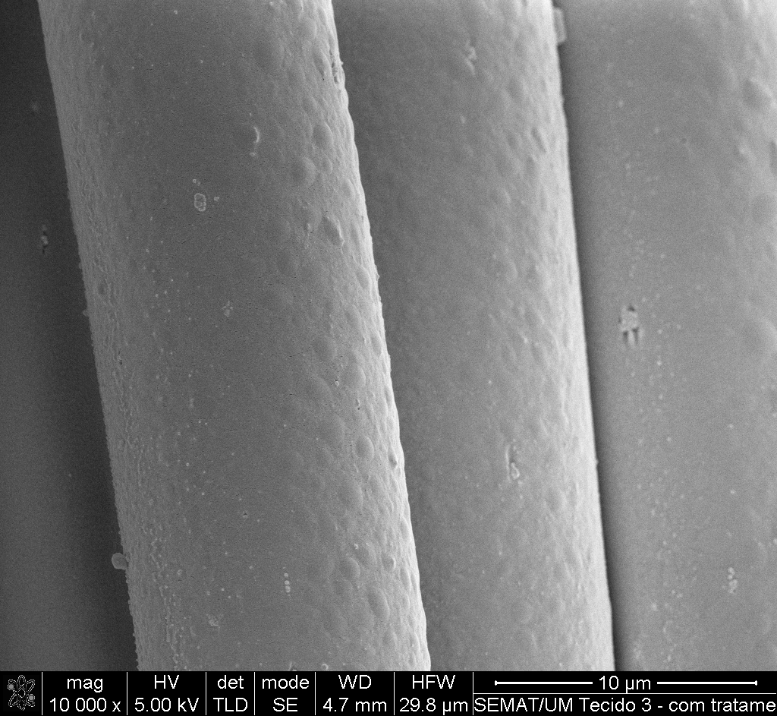
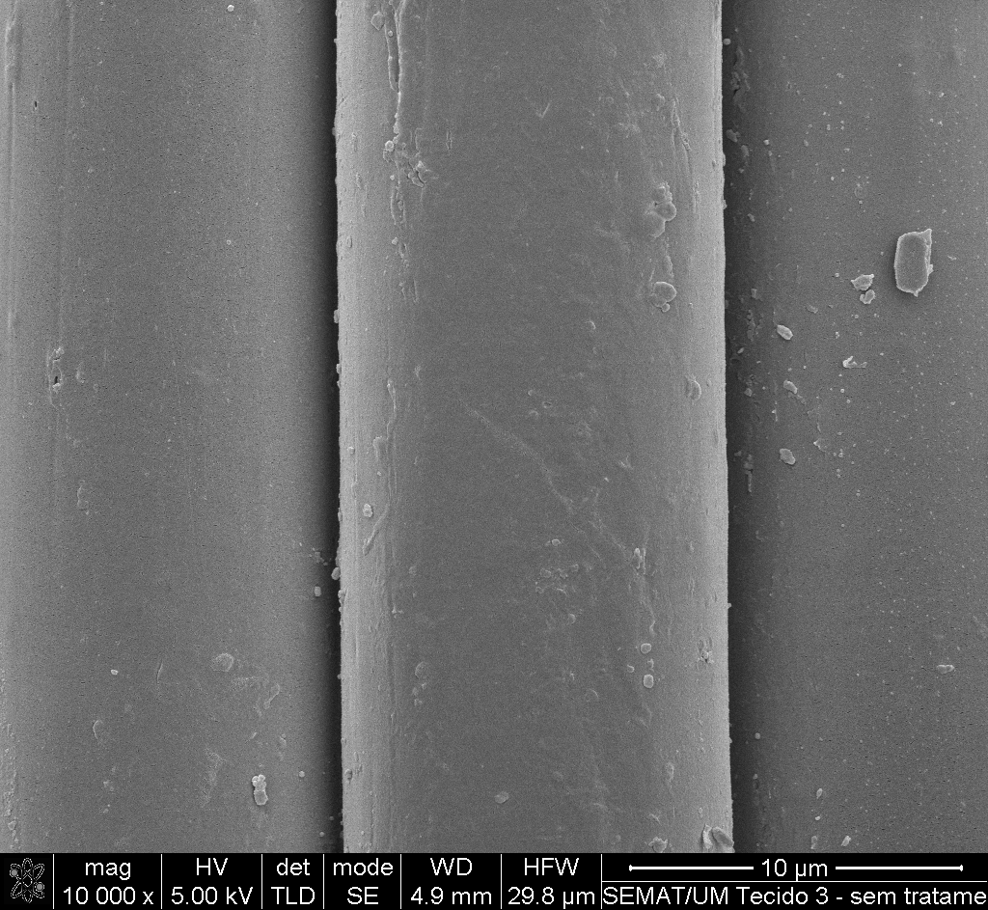
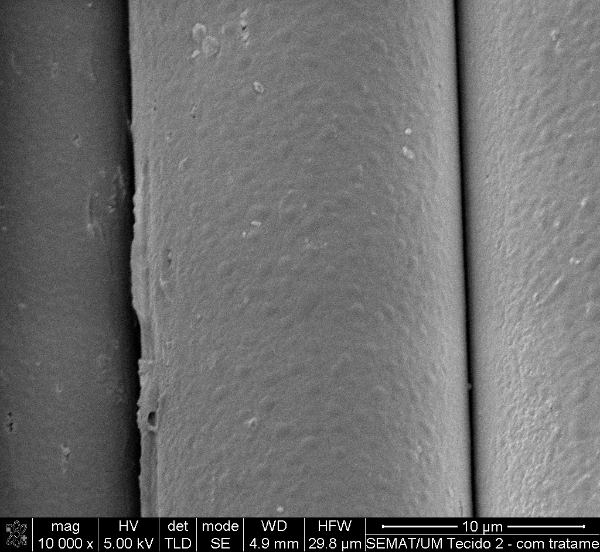
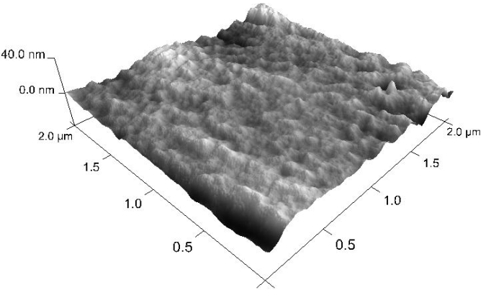
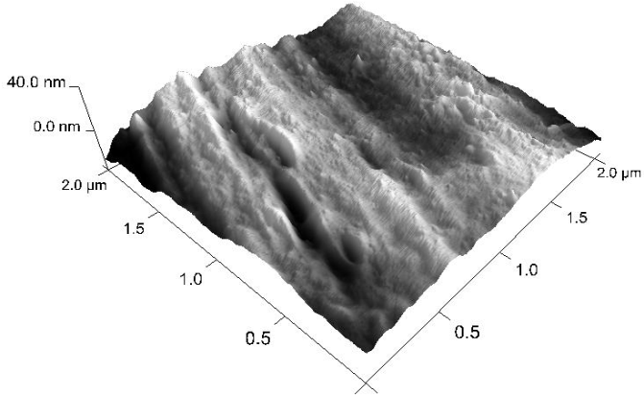
Results and Discussion
SEM and AFM
PA1
PA2
PA3
Untreated
Treated
PA1
Samples | Ra (nm) | Rq (nm) | Rmax (nm)
Untreated | 2.36 | 3.21 | 29.2
Treated | 6.50 | 7.99 | 48.0

Slide 16

Results and Discussion
Energy Dispersive Spectroscopy
Atoms | PA 1 At (%) |  | PA2 At (%)
 | UT | T | UT | T
Carbon | 67.38 | 64.05 | 67.56 | 63.55
Nitrogen | 9.95 | 10.82 | 10.40 | 11.39
Oxygen | 22.67 | 25.13 | 22.04 | 25.06
Ratio O/C | 0.33 | 0.39 | 0.33 | 0.39
Ratio N/C | 0.15 | 0.17 | 0.15 | 0.18
Oxygen
Nitrogen
Carbon
X-Ray Photoelectron Spectroscopy
Sample | At (%) |  |  | Atomic Ratio
 | C | O | N | O/C | N/C
Untreated | 74.67 | 17.75 | 7.58 | 0.23 | 0.10
DBD Treated | 70.25 | 19.83 | 9.92 | 0.28 | 0.14

Slide 17
Results and Discussion
Contact Angle

Slide 18
Results and Discussion
Wetting time
Conductivity and pH of aqueous extraction

Slide 19
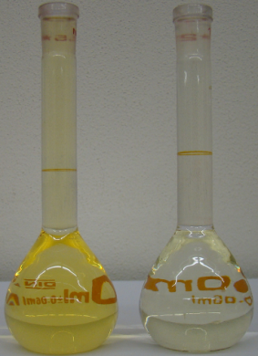
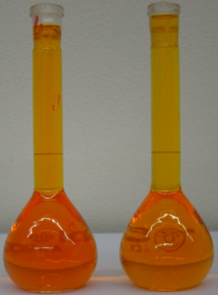
Results and Discussion
Dyeing – Influence of dosage applied

Slide 20


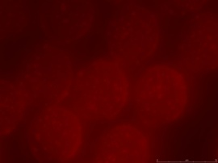
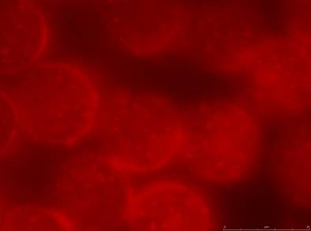
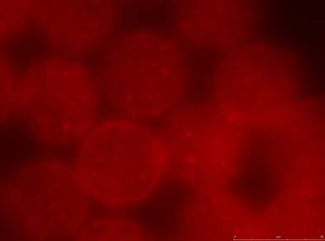
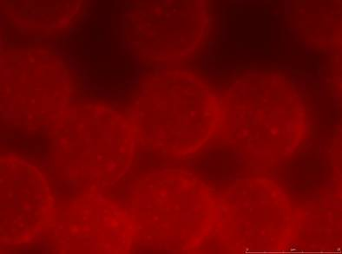
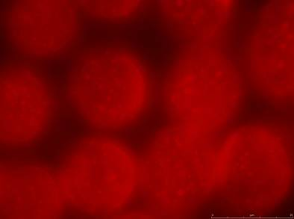






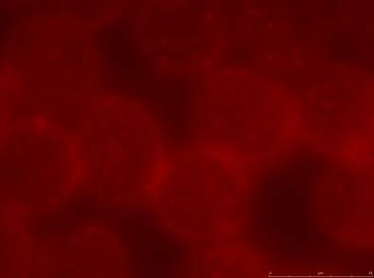
Results and Discussion
Dyeing – Samples taken during dyeing process
Polyamide 1
Polyamide 2
Dyeing – Fluorescence Microscopy
1 – 22ºC
4 – 68ºC
5 – 80ºC
6 – 98ºC
7 – 98ºC
9 – 98ºC
10 – 70ºC
With Treatment
Without Treatment

Slide 21
Results and Discussion
Dyeing – Exhaustion
99.7%
99.7%
99.7%
96.9%
99.7%
75.6%
99.7%
36.7%
99.7%
75.9%
99.7%
29.8%

Slide 22
Results and Discussion
Dyeing – Washing Fastness
Samples | Dye Concentration (%) | AC | CO | PA | PES | PAC | WO | Color Change
PA1 (Untreated - Treated) | 1% | 5 - 5 | 4/5 - 5 | 5 - 5 | 5 - 5 | 5 - 5 | 5 - 5 | 4/5 - 5
 | 2% | 5 - 5 | 4/5 - 5 | 5 - 5 | 5 - 5 | 5 - 5 | 5 - 5 | 5 - 5
 | 3% | 5 - 5 | 4 - 4 | 5 - 5 | 5 - 5 | 5 - 5 | 5 - 5 | 5 - 4/5
PA2 (Untreated - Treated) | 1% | 5 - 5 | 4/5 - 5 | 5 - 5 | 5 - 5 | 5 - 5 | 5 - 5 | 5 - 4/5
 | 2% | 5 - 5 | 4/5 - 4 | 5 - 5 | 5 - 5 | 5 - 5 | 5 - 5 | 4/5 - 4/5
 | 3% | 5 - 5 | 4/5 - 4 | 5 - 5 | 5 - 5 | 5 - 5 | 5 - 5 | 4/5 - 5
PA3 (Untreated - Treated) | 1% | 5 - 5 | 4/5 - 5 | 5 - 5 | 5 - 5 | 5 - 5 | 5 - 5 | 5 - 5
 | 2% | 5 - 5 | 4/5 - 4 | 5 - 5 | 5 - 5 | 5 - 5 | 5 - 5 | 5 - 5
 | 3% | 5 - 5 | 4/5 - 4 | 5 - 5 | 5 - 5 | 5 - 5 | 5 - 5 | 5 - 5

Slide 23
Conclusions
SEM and AFM techniques detected an increase of roughness in polyamide fabrics treated with plasma.
According to EDS and XPS measurements, plasma reactions change the chemistry of the polyamide surface with an increase of polar groups with oxygen and nitrogen.
The treated polyamide fabrics showed significant improvement in wettability.
Notes:
The treated polyamide fabrics showed significant improvement in wettability, the static contact angle and the wetting time values were found to depend on the dosage applied, higher dosage lower the contact angle and the time of water absorption.

Slide 24
Conclusions
The static contact angle and the wetting time values have a correlation with the dosage applied, higher dosage implies lower contact angle and lower time of water absorption.
Conductivity and pH of the aqueous extract show an increase of the polar groups at the surface after DBD plasma treatment.
Atmospheric plasma treatment is able to modify either chemically or physically the polyamide fibers.
Dep. Engenharia Têtxtil
Notes:
The treated polyamide fabrics showed significant improvement in wettability, the static contact angle and the wetting time values were found to depend on the dosage applied, higher dosage lower the contact angle and the time of water absorption.

Slide 25
Conclusions
All these modifications of the fiber led to a remarkable increase in dyeing rate and the equilibrium exhaustion was established in a much faster way and it reaches almost the maximum value.
When DBD treatment is applied to polyamide in the dyeing process, lower temperature, dye concentration and operation time can be used, which is an excellent opportunity to reduce costs in energy, dyes and chemicals, promoting sustainable solutions for industrial application.
Dep. Engenharia Têtxtil
Notes:
The treated polyamide fabrics showed significant improvement in wettability, the static contact angle and the wetting time values were found to depend on the dosage applied, higher dosage lower the contact angle and the time of water absorption.

Slide 26
Authors want to acknowledge:
for the financial support FCT - The Science and Technology Foundation of Portugal, for the doctoral grant SFRH / BD / 65254 / 2009
Dep. Engenharia Têtxtil

Slide 27
Thank you for your attention!
University of Minho, Guimarães / Portugal
Textile Engineering Department
fernando.oliveira@uminho.pt
Dep. Engenharia Têtxtil

