Slide 1
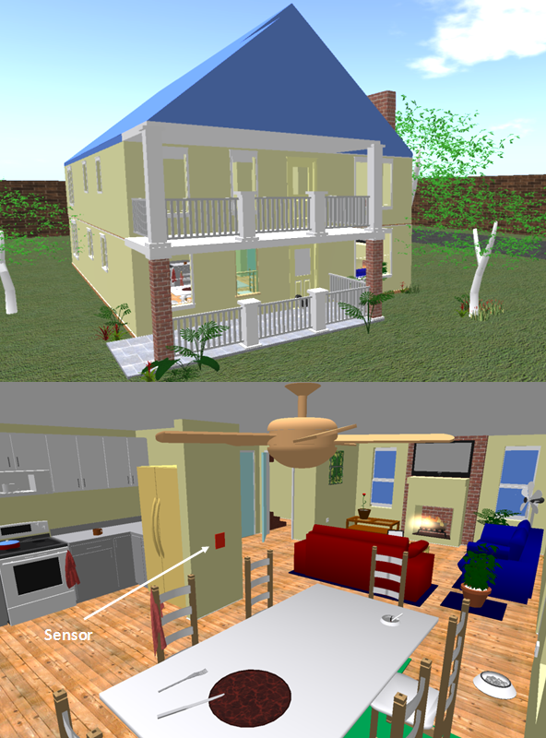
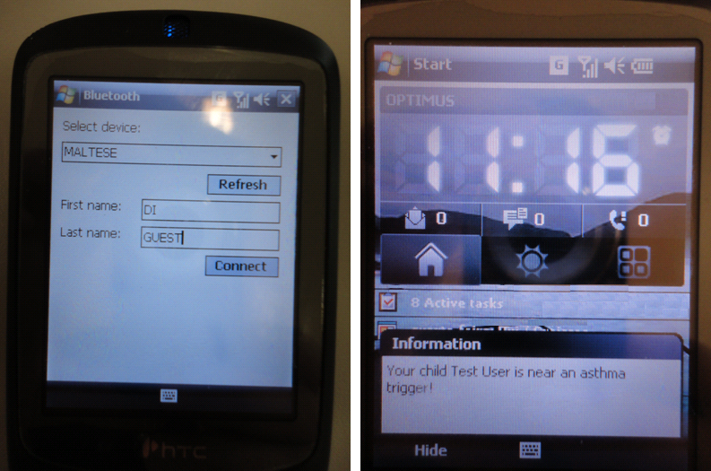
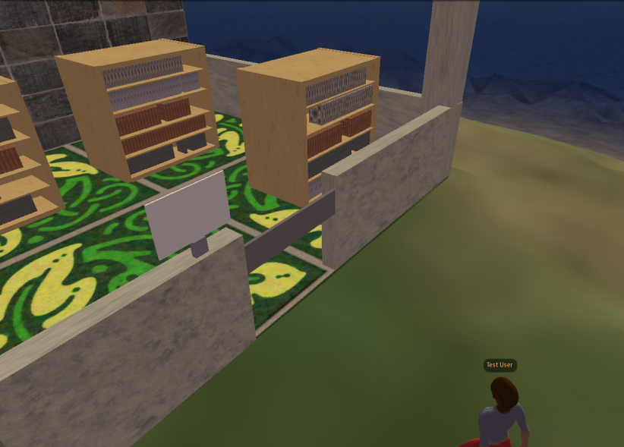
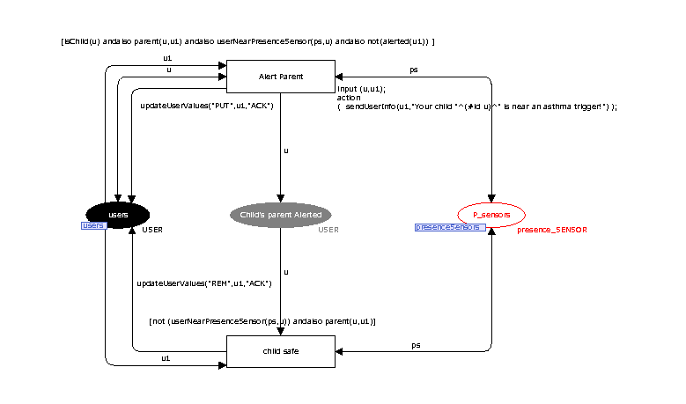
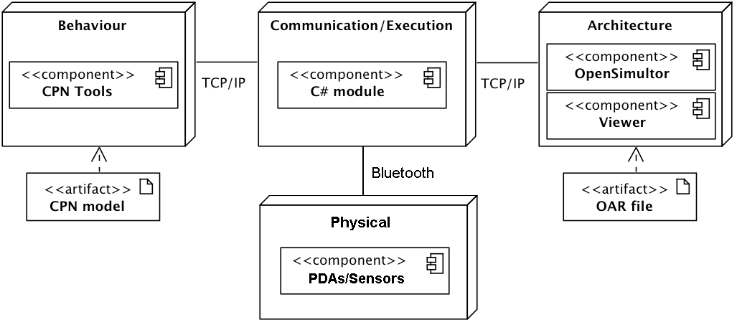
University of Minho School of Engineering Computer Science and Technology Center (CCTC)
THE APEX FRAMEWORK: PROTOTYPING OF UBIQUITOUS ENVIRONMENTS BASED ON PETRI NETS
JOSÉ LUÍS CARDOSO SILVA*
Supervisor: José C Campos, Co-Supervisor : Michael Harrison
* jlsilva@di.uminho.pt
Abstract
The user experience of ubiquitous environments is a determining factor in their success. The characteristics of such systems must be explored as early as possible to anticipate potential user problems, and to reduce the cost of redesign. However, the development of early prototypes to be evaluated in the target environment can be disruptive to the ongoing system, and therefore unacceptable. This poster reports on an ongoing effort to explore how model-based rapid prototyping of ubiquitous environments might be used to avoid actual deployment while still enabling users to interact with a representation of the system. This briefly describes APEX [1], a framework that brings together an existing 3D Application Server with CPN Tools. APEX-based prototypes enable users to navigate a virtual world simulation of the envisaged ubiquitous environment.
Development of a framework for the rapid prototyping and analysis of ubiquitous environments
Ubiquitous systems modeling with focus on context;
Able to navigate, and interact, both explicitly and implicitly, with (virtual) devices;
Supports evaluation of the usability and social impact of the design;
Modeling and analysis using CPN tools;
Autonomous users versus real users.
Modeling and Analyses
APEX
User Experience
APEX
OpenSimulator
CPN tools
Proposed Process
Prototyping and experiencing ubiquitous environments
Architecture
[1] José Luís Silva, Oscar R. Ribeiro, João M. Fernandes, José Creissac Campos and Michael D. Harrison. 2010. The APEX framework: prototyping of ubiquitous environments based on Petri nets. In Proceedings of the Third international conference on Human-centred software engineering (HCSE'10), Regina Bernhaupt, Peter Forbrig, Jan Gulliksen, and Marta Lárusdóttir (Eds.). Springer-Verlag, Berlin, Heidelberg, 6-21.
Uma Escola a Reinventar o Futuro – Semana da Escola de Engenharia - 24 a 27 de Outubro de 2011

