Slide 1


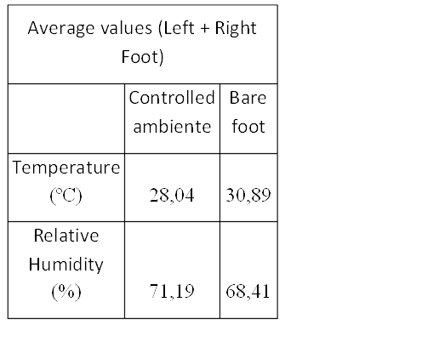
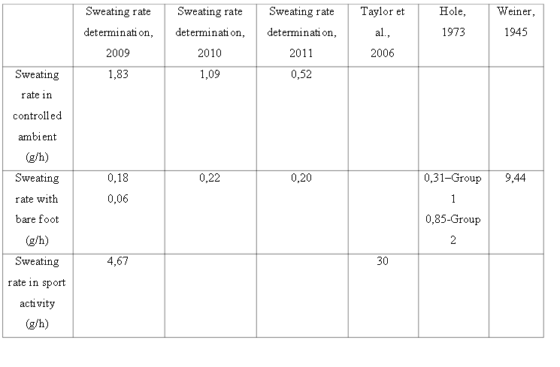
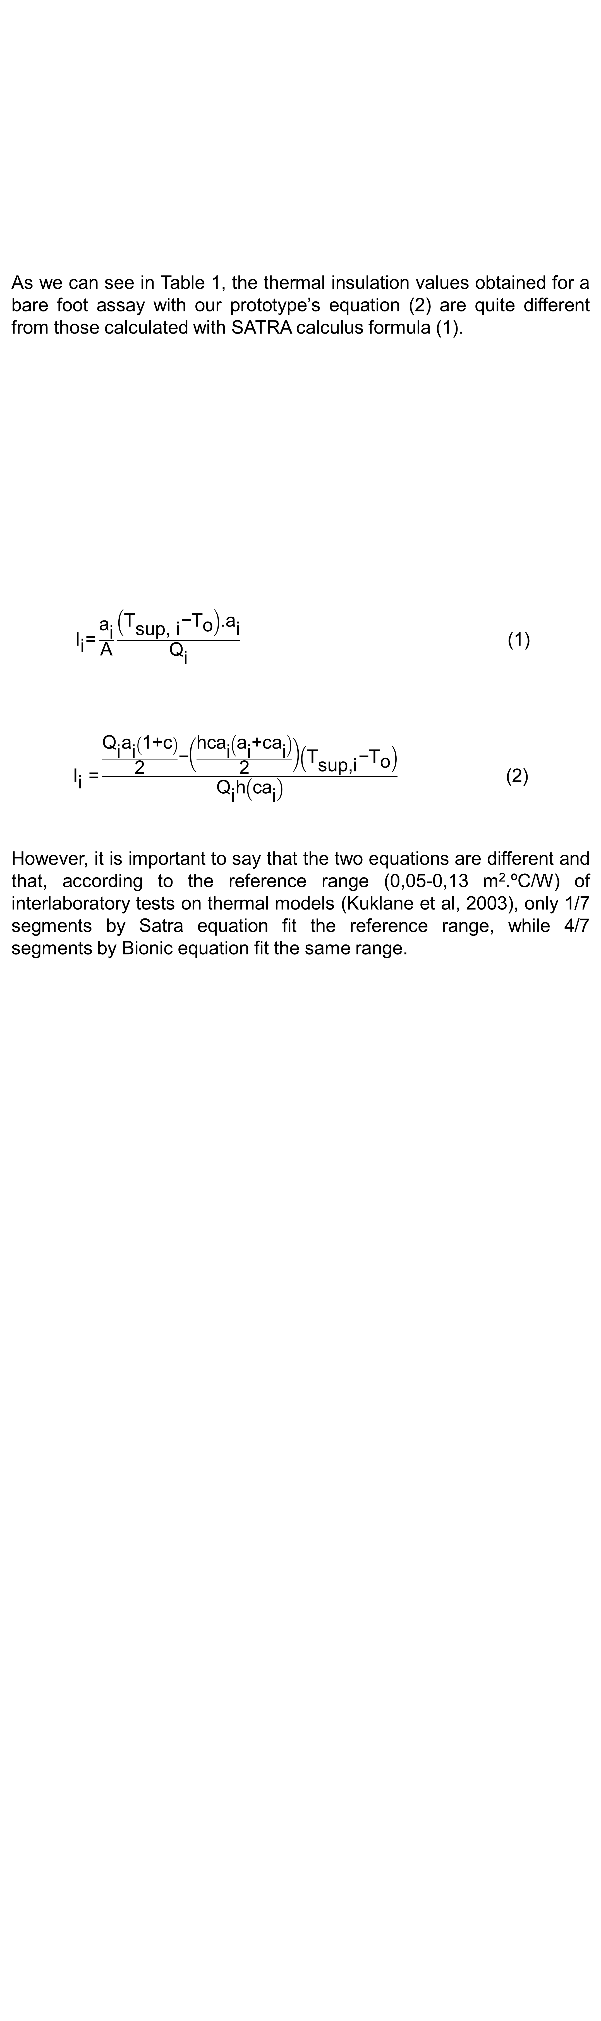

University of Minho School of Engineering Department of Mechanical Engineering
DEVELOPMENT OF AN ARTIFICIAL MULTIFUNCTIONAL FOOT
JOÃO DUARTE P. ALMEIDA
Supervisors: Maria José Ferreira, Pedro Lobarinhas, Luís Ferreira da Silva
* biomedical.eng@sapo.pt
INTRODUCTION
Human thermal regulation is mainly done by the extremities like feet and hands, footwear as an essential role in maintaining the thermal balance of the body (Strickland et al., 1997).
The cold perception on feet as a correlation with low skin temperatures, due to perspiration. The shoe may have a proper thermal insulation, but when the foot begins getting cold, it generates discomfort. In situations of low temperatures and high humidity, moisture will condensate easier, which will induce a faster foot cooling (Taylor et al., 2006).
Unfortunately, most of the footwear is quite impermeable to moisture in addition to a high thermal resistance, two factors that contribute to deep variations on the temperature of foot’s skin (Kuklane, 1999; Yuhong and Zhihua, 2001).
In this context, the design and development of a human foot prototype, capable of simulating thermal gradients and sweating rates close to the ones occurring physiologically in the human body, is a great improvement and competitive advantage in the process of testing footwear and developing or improving materials whose effect is important in the wet/wicked perception and consequently in the individuals’ thermal comfort.
RESULTS AND DISCUSSION
It was developed a prototype with 7 independent segments, each one with own temperature and sweating rate control. Each segment has its specific heating power as well as terminals for water release into its surface. There is a total of 7 sweating terminals distributed all over the prototype’s surface, allowing sweating rates from 0,20-15 mL/h. It was also designed a software capable of controlling and interacting with this artificial foot.
The thermophysiological inputs for the prototype were obtained either on literature or in assays specifically designed for this purpose.
CONCLUSIONS
The novel aspects of this prototype, comparing it with other similar models already developed, are its anthropometric shape and dimensions, which make these assays much more realistic and accurate. This allows they approach to the results obtained with human volunteers, without the subjective bias factor.
Furthermore, this thermal foot model allows that footwear tests are done either in a dry mode or in a sweat mode (in this case the prototype releases water in flow rates adjustable by the human sweating rates).
However, more experiences must be conducted with footwear. Besides, the equation for thermal insulation (2) is passible of being reformulated in order to make the results more accurate and close to the ones referenced in the interlaboratory tests.
REFERENCES
Kuklane, K., 1999. Footwear for cold environments: Thermal properties, performance and testing, Lulea University of Technology.
Kuklane, K. et al, 2003. “Interlaboratory tests on thermal foot models”, Thermal Environment Laboratory, EAT report, Lund University, Sweden.
Strickland, P., Reid, G., Burrows, B., 1997. “Thermal Profiles in Footwear Design: An in-sole measurement system”, 4th Annual Conference on Mechatronics and Machine Vision in
Practice, Toowoomba, Australia.
Taylor, N.A.S; Caldwell, J.N.; Mekjavic, I.B.,2006. “The Sweating Foot: Local Differences in Sweat Secretion During Exercise-Induced Hyperthermia”, Aviation, Space and Environmental Medicine, Vol. 77, nº10.
Yuhong, S. and Zhihua, J., 2001. “Measurement and evaluation of heat-moisture comfort of footwear”, Proceedings of the Fourth International Meeting on Thermal Manikins, EMPA Switzerland.
As we can see in Table 1, the thermal insulation values obtained for a bare foot assay with our prototype’s equation (2) are quite different from those calculated with SATRA calculus formula (1).
${ \text{I}}_{\text{i}}\text{=}\frac{{\text{a}}_{\text{i}}}{\text{A}}\frac{\left({\text{T}}_{\text{sup}\text{, }\text{i}}\text{−}{\text{T}}_{\text{o}}\right)\text{.}{\text{a}}_{\text{i}}}{{\text{Q}}_{\text{i}}}$ (1)
${\text{I}}_{\text{i}}\text{ =}\frac{\frac{{\text{Q}}_{\text{i}}{\text{a}}_{\text{i}}\left(\text{1}\text{+}\text{c}\right)}{\text{2}}\text{−}\left(\frac{\text{hc}{\text{a}}_{\text{i}}\left({\text{a}}_{\text{i}}\text{+}\text{c}{\text{a}}_{\text{i}}\right)}{\text{2}}\right)\left({\text{T}}_{\text{sup}\text{,}\text{i}}\text{−}{\text{T}}_{\text{o}}\right)}{{\text{Q}}_{\text{i}}\text{h}\left(\text{c}{\text{a}}_{\text{i}}\right)}$ (2)
However, it is important to say that the two equations are different and that, according to the reference range (0,05-0,13 m².ºC/W) of interlaboratory tests on thermal models (Kuklane et al, 2003), only 1/7 segments by Satra equation fit the reference range, while 4/7 segments by Bionic equation fit the same range.
Table 2 – Temperature and relative humidity average values gathered in a group of 4 volunteers.
Table 3 – Thermal insulation values for each segment calculed based on equations (1) and (2)
Table 1 – Sweating rate values gathered in bibliography and estimated in independent assays designed in the ambit of this PhD project.
Uma Escola a Reinventar o Futuro – Semana da Escola de Engenharia - 24 a 27 de Outubro de 2011

