Slide 1

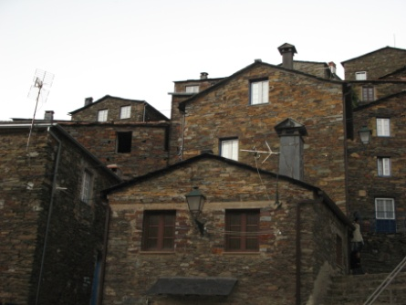
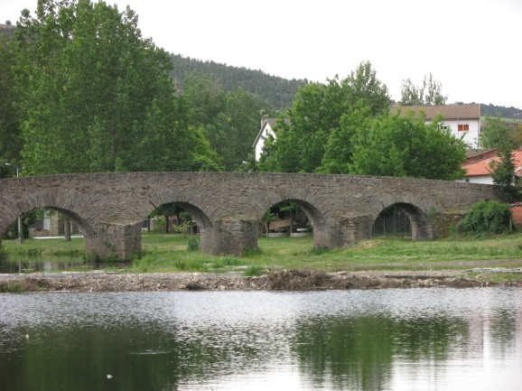
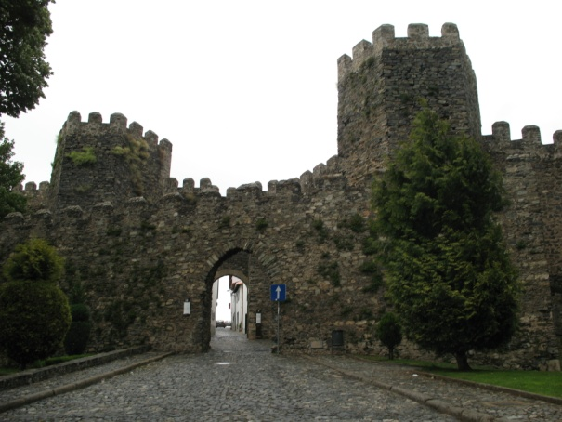
University of Minho School of Engineering ISISE – Department of Civil Engineering
CHARACTERIZATION OF THE SCHIST IN THE PORTUGUESE TRADITIONAL CONSTRUCTIONS
Author* RICARDO S. BARROS
Supervisors: Daniel V. Oliveira, Co-Supervisor : Humberto Varum
* rbarros@ufp.edu.pt
Introduction
Within the broad traditional Portuguese architectural heritage, traditional schist masonry buildings are spread over several regions from North to South, varying the typology, construction methods and even the schist material itself, which, depending on the area where it is extracted, may have very different properties and characteristics
The present study aims to characterize the schist as construction material. The attainment of the properties of the different types of schist is essential to the comprehension of the schist constructions.
Traditional schist constructions
Schist characterization
Understand that the properties of the rocks derived from the physical and chemical characteristics of the materials that they are made and the geometric characteristics of the structures is essential for a perfect analysis and understanding of the schist constructions.
Taking into account the representativeness of the traditional schist constructions in the regions of Minho, Beiras e Trás-os-Montes, the following laboratory tests were performed for the samples from the three regions:
Axial compression test;
Schmidt hammer test;
Point load test;
Capillarity water absorption test;
Atmospheric water absorption test;
Salt crystallization test;
Ultrasounds test.
Next will be presented comparative results obtained in the laboratory tests made to the specimens from the three regions.
For a better analysis, the distinction between regions is carried out corresponding different colors to each region.
- Blue color is referred to the region of Minho;
Red color to the region of Trás-os-Montes;
Green color to the region of Beiras.
The tests were performed in both directions of the anisotropy plane of the rock, i.e. parallel and normal directions.
Regarding the results obtained from the mechanical tests:
The schist from the Beiras regions is the hardest material;
The point load index increases with the mechanical compressive stress
Comparison between compressive stress and point load index.
Regarding the comparison between the axial compressive test and other tests:
Comparison between compressive stress and ultrasound.
- The Beiras region has higher quality than the other regions tested
The best quality material gets the higher wave speed in the ultrasound test.
The results from the atmospheric water absorption are smaller for the compact materials.
Comparison between compressive stress and atmospheric water absorption.
The mass variation in the salt crystallization tests presents the higher results of gains or losses for the regions of Minho and Trás-os-Montes.
Comparison between compressive stress and salt crystallization.
Regarding the results obtained from the capillarity water absorption tests the schist from the region of Beiras gets the lower results :
- In the order of 720 g/m² in the normal direction;
- In the order of 425 g/m² in the parallel direction.
Final considerations
The traditional schist constructions have greater predominance in the Beiras region, this fact is related, not only with abundance of material in the soil, but also with the quality of the schist, as seen in performed tests. The performed laboratory tests confirmed that the schist from the Beiras region is the hardest material and it has higher quality than the schist from the other regions tested. In all the performed tests the schist from Beiras region obtains best results than the schists from de Minho and Trás-os-Montes regions. Future work involves the study of the types of schist constructions in others Portuguese regions, as well as to characterize the schist as a construction material and the mechanical characteristics of schist structures.
Uma Escola a Reinventar o Futuro – Semana da Escola de Engenharia - 24 a 27 de Outubro de 2011

