Slide 1
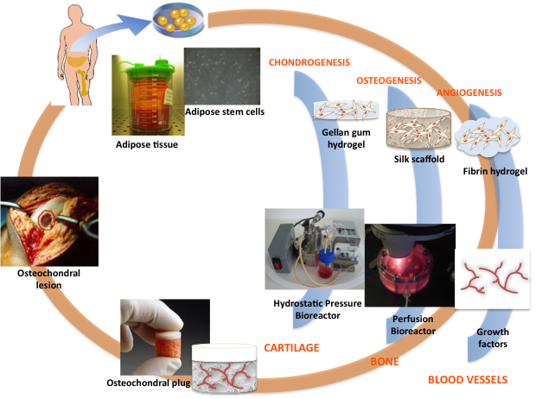
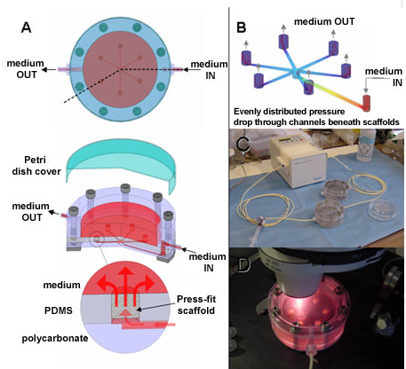
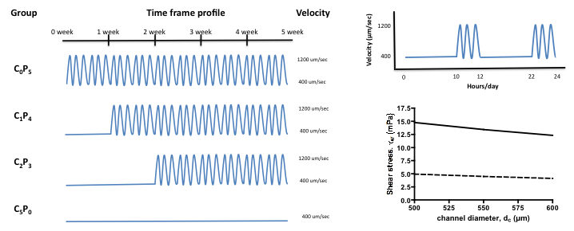
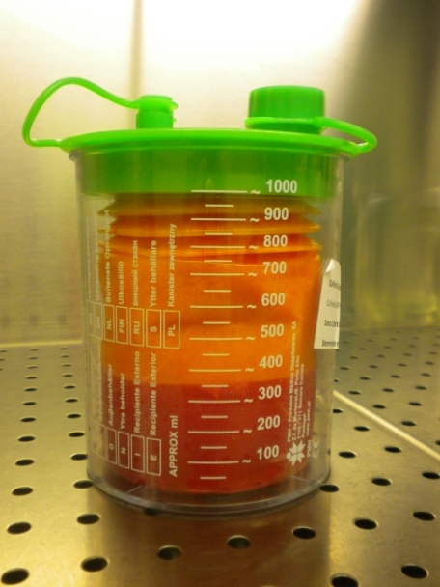
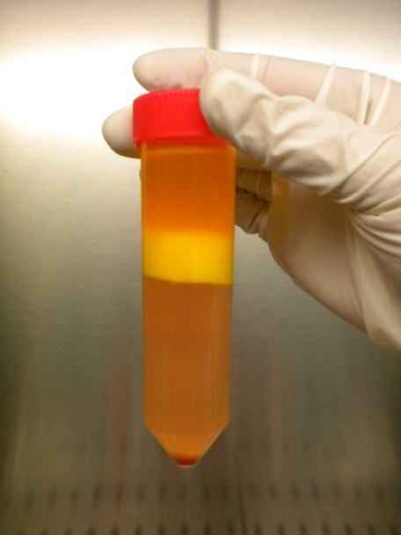
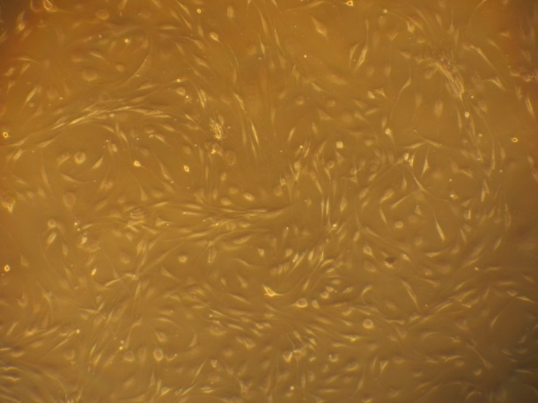
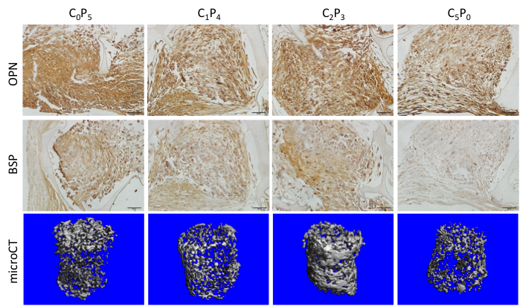
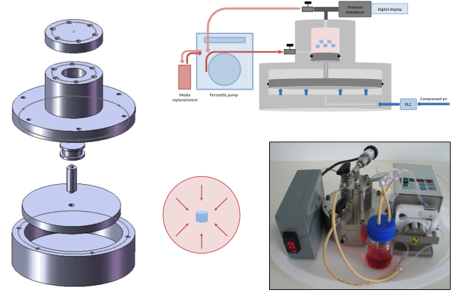
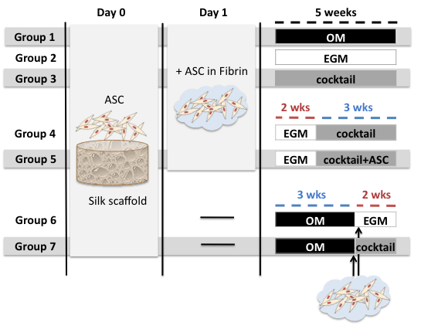
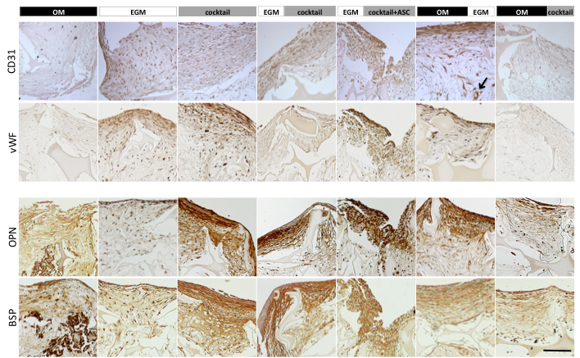
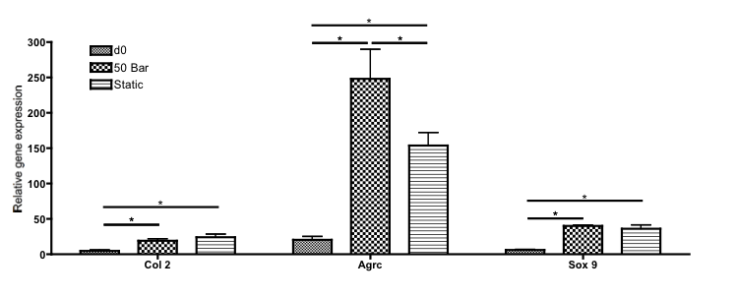
University of Minho School of Engineering 3B’s Research Group
ENGINEERING OSTEOCHONDRAL TISSUE BY HUMAN ADIPOSE STEM CELLS USING BIOMECHANICAL AND BIOCHEMICAL STIMULI
CRISTINA CORREIA*
Supervisors: Rui L. Reis, Rui A. Sousa, Gordana Vunjak-Novakovic
* ccorreia@dep.uminho.pt
Columbia University
Engineering Osteochondral Tissue
Human Adipose Stem Cell (hASC) isolation, characterization and multi-lineage differentiation potential
Engineering Bone Tissue
hASC stimulation with Pulsatile Fluid Flow
A
B
C
1200 µm/sec
400 µm/sec
Enzymatic digestion of lipoaspirate
hASC isolation and expansion
Characterization of cell surface markers by flow cytometry
Bone proteins
Chondrogenic (B), Adipogenic (C), and Osteogenic (D) differentiation
Mineral
Pre-differentiation of hASC at continuous fluid flow, before application of pulsatile fluid flow increased bone tissue development
Material: Gellan gum hydrogel
suitable matrix and mechanical properties¹
Stimuli: Hydrostatic pressure
major force acting in vivo on articular cartilage²
Engineering Cartilage Tissue
hASC stimulation with Pulsatile Hydrostatic Pressure
Vascularizing Engineered Bone
hASC stimulation with temporal growth factor (GF) nourishment
Material: Silk fibroin sponge
adequate structure and mechanical properties³
Stimuli: Shear stress
major force detected by bone cells in vivo⁴
A
B
Pressure | Frequency | Duration
50 Bar | 0.5 Hz | 4h/day
Material: Fibrin hydrogel
angiogenic properties⁵
Stimuli: Growth factors
temporal nourishment with angiogenic growth factors⁶
C
D
A) HP vessel assembly;
B) Schematic representation of HP bioreactor;
C) Direction of forces applied to construct during stimulation;
D) Photograph of HP bioreactor
Conclusions
The adoption of a holistic approach concerning the single use of hASCs for the full engineering of osteochondral tissues proved successful. In this regard, the combined application of dynamic culturing conditions, namely of hydrostatic pressure and fluid flow, with biochemical cues, such as chondrogenic, osteogenic and angiogenic growth factors can be integrated in the manufacturing of osteochondral grafts.
Vascular proteins
Immunolocalization
Bone proteins
Hydrostatic pressure culture of hASC for 4 weeks increased aggrecan (cartilage protein) gene expression relatively to static culture (p<0.001)
In order to develop both tissues, a sequential induction of cells and GF was critical. Osteogenic induction should precede vasculogenesis.
Acknowledgments: Sarindr Bhumiratana, Warren Grayson, Rita Duarte, Adriano Pedro, Luisa Pereira, for technical support; Portuguese Foundation for Science and Technology for PhD grant SFRH/BD/42316/2007.
References: ¹Oliveira JT et al, JBMR (2009), ²Hu JC et al, TE (2006); ³Kim UJ et al , Biomat (2005); ⁴Weinbaum et al , J Biomech (1994); ⁵Dvorak HF et al, Lab Invest (1987); ⁶Correia C et al (subm.)
Uma Escola a Reinventar o Futuro – Semana da Escola de Engenharia - 24 a 27 de Outubro de 2011

