Slide 1
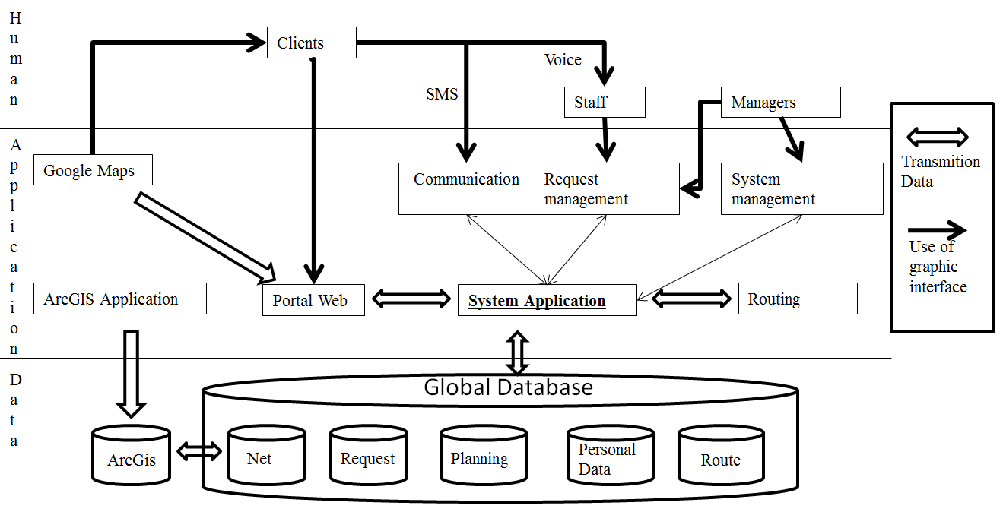
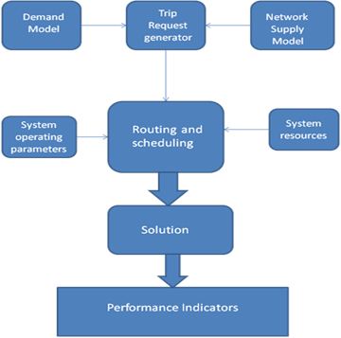
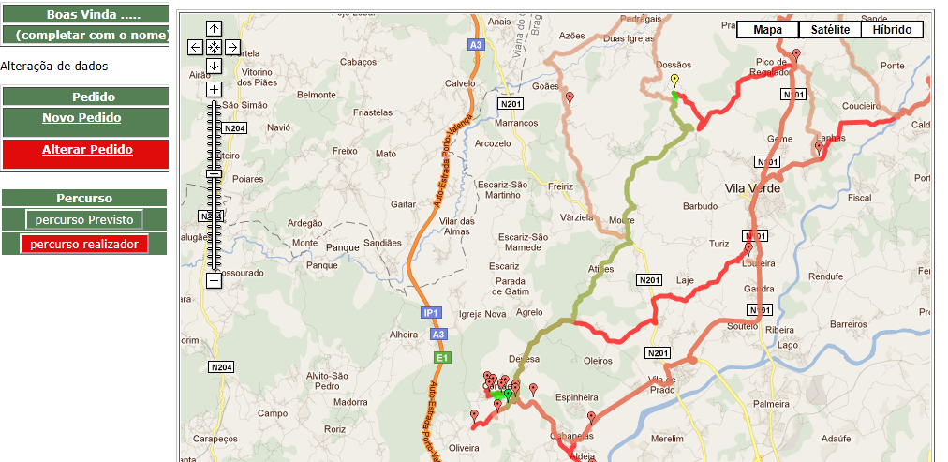
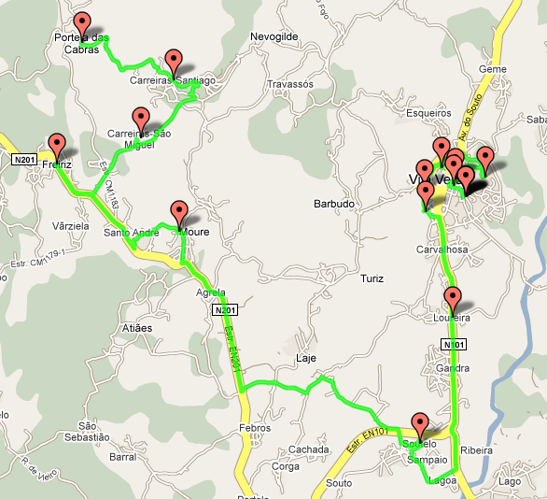
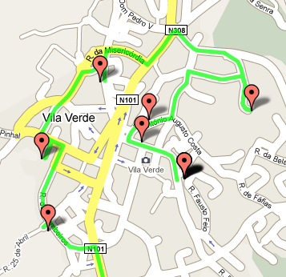
University of Minho School of Engineering Centre Algoritmi
A SIMULATION APPROACH TO SUPPORT THE DESIGN OF FLEXIBLE PUBLIC TRANSPORT SYSTEMS
ANA DIAS*
Supervisor: José Telhada, Co-Supervisor: Maria do Sameiro Carvalho
* anadias@dps.uminho.pt
Introduction
Low levels of population density in rural areas usually leads to the inefficiency of conventional public transport services for passengers, increasing social exclusion and forcing people to use private cars.
To overcome these problems, Demand Responsive Transport (DRT) systems can be adopted, satisfying users mobility needs by supplying flexible routes and stops.
Trip requests are made by telephone or internet, stored in a database system. A travel dispatch centre (TDC) coordinates a heterogeneous fleet of vehicles involving information and communication technologies.
DRT success depends on the use of intelligence solutions to process trip requests, to optimize routes and schedules in order to respond in real time to users. Additional issues are related to system sustainability (economic, financial and environmental), and to the legal framework of the real context.
The objective of this research project is to developed an integrated decision support system (DSS) to help decision makers developing intelligent strategic solutions at the design phase.
The main objective of the DSS is to configure a DRT system that incorporates a high level of flexibility and that responds in real-time to users demand taking into account the real context: socio-economic, demographic, legal, etc.
According to the literature review, there is a lack of comprehensive methodologies to address the problem of designing and planning DRT systems.
The decision support system methodology
The DSS incorporating mathematical models (optimization, simulation and statistical methods) and integrating important characteristics of real context, such as, area characteristics and population demographics, will provide an effective support in the decision making process.
The conceptual model includes demand, and supply for transport services collected and stored in a database. A simulator model will allow to simulate different alternatives in order to assess, in advance, wide-ranging scenarios or management strategies. The simulator based on data on the transport network and trip requests uses routing and schedule algorithms to provide solutions in dynamic environments.
The solution consists on a set of routes and schedules but also a series of performance indicators (economic operational financial and environmental).
The result of the assessment process will provide guidelines and the required feedback to adjust system resources and operating parameters.
Performance measurement is essential to monitor progress toward a result or goal.
Both advanced booking and on-line trip request are accepted and, therefore, a highly dynamic routing and scheduling approach is highly desirable.
Scenarios that can be performed are differentiated by, for example: spots of population concentration within counties; different routes and stops in a particular area; DRT system integration with regular transport service; flexibility of services as a function of economic efficiency, costs effectiveness and resources availability (fleet size).
The analytical tool to be used depends on the typology of the problem to address and the time available to calculate the solution (e.g. can range from an exact dynamic programming method to alternative heuristic procedures).
The software application has the ability to choose the best method(s), allowing planning effectiveness and efficiency.
A data warehouse for the DSS system is used to assemble, organize and link all the relevant data: transportation network, trip requests, user’s data, available resources, network, scheduling plans, etc.
The information system will be able to combine data with analytical tools, and also used as an operational tool.
Conclusions
Prior to the implementation of a DRT system there are many issues to be properly addressed.
The convergence of methods for costs and benefits assessment turns difficult to measure or evaluate impacts in monetary terms, which is a complex task and is needed to develop models and ITS.
The DSS framework enable decision makers to perform systematic analysis leading to intelligent strategic solutions.
Acknowledgments
The authors acknowledge the financial support provided by the European Commission and the Portuguese Government through the research grant FCT/TRA/72871-2006 and QREN.
Supply and demand data
System operating parameters
Simulator
System resources
Performance Indicators
System evaluation
Sustainable solution
Uma Escola a Reinventar o Futuro – Semana da Escola de Engenharia - 24 a 27 de Outubro de 2011

