Slide 1
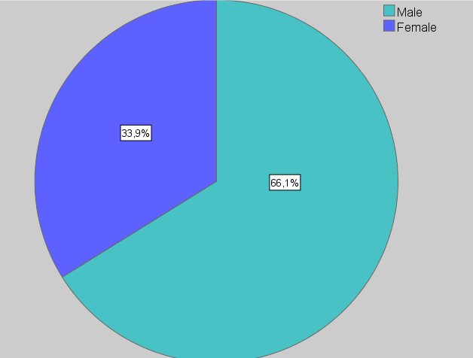
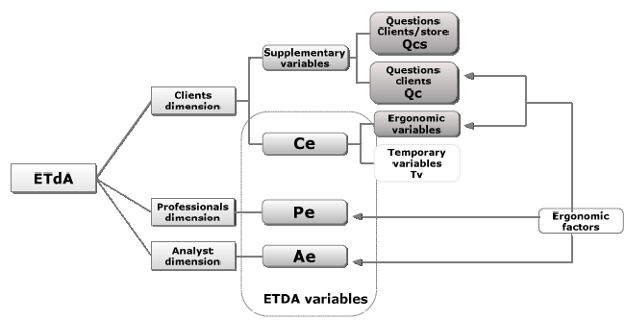
University of Minho School of Engineering Algoritmi Center
ETDA: A CHALLENGE IN THE FUTURE OF ERGONOMICS
Isabel F. Loureiro *
Supervisors: Celina P. Leão, Pedro M. Arezes
* Id2500@alunos.uminho.pt
Purpose and Method
In human work activities, different ergonomic methodologies are used to evaluate two groups of ergonomic factors (EF):
intrinsic (individual) and,
extrinsic (environmental or occupational).
This will helps the activity characterization and identification of critical situations that need ergonomic intervention.
Processes of improvements are often multidimensional (considering all the organizational participants), cross and serially correlated. So, the client becomes an important participant and their opinion relevant in the ergonomic analysis.
The Ergonomic Tridimensional Analysis (ETdA) is an auxiliary tool on the ergonomic analysis and intervention in common areas. The ETdA goals are:
diagnosis of the studied conditions,
identification of the critical Efs and,
development of the ETdA weight table to help the Analyst decision making to ergonomic intervention.
ETdA variables
In order to define the ETdA weight table, firstly it is necessary to categorize the results obtained through the observation tools. Several variables can be defined according to their relevance in the ergonomic analysis: supplementary, temporary and ETdA variables (Figure1).
ETdA dimensions and observation tools
Specific observation tools were assembled to ETdA dimensions:
an evaluation form to professionals’ dimension,
a checklist for direct and indirect observations to Analyst’ dimension and,
ETdA questionnaire to Clients’ dimension. The questionnaire was pre-tested to be used in the survey and the results of validation (sensibility, validity and reliability) contributed for its improvement.
Ergonomic factors: ETdA levels analysis
A model framework was developed to study the defined ergonomic variables: supplementary, temporary and ETDA variables (Figure 2).
With this procedure, the dimensions’ profile definition is made. With the defined profiles and the different answer categories, several correlations can be studied. Standard residuals procedure can be use to increase the meaningful of the obtained results Through a multivariate analysis an inter and intra dimension analysis of the ergonomic factors’ correlations is then made.
Experimental study
A case study was performed on three different stores, namely a wholesale retailer, entertainment retail chain and a sports store. Modus operandi of the multidimensional process is described in Figure 3.
Findings and discussion
The critical ergonomic factors identified with the ETdA methodology; Thermal environment, Noise, Postures and movements and Lifting, accomplished by the three level analyses (Table 1).
Considering the critical EF identified, ETdA weight tables are obtained representing the simplification and summarization of the ETdA dimensions results (Table 2). There are differences between the three ETdA dimensions evaluations.
Clients’ ergonomic evaluation will reproduce organizational adjustments, which will also benefit the professionals’ ergonomic context, facilitating the ergonomic intervention.
Clients’ age ranged between 17 to 76 years old, with a mean age of 49. About 66.1% of the respondents were male.
From a total of 183 professionals, 58% reported a positive answer classification.
The temperature evaluation was the only EF that reveals substantial differences.
In each common areas section, risk ergonomic factors were identified according to negatives professionals’ evaluation.
Figure 4. Clients’ gender distribution
Level 3
Intra dimension analysis
inter dimension analysis
Level 2
Level 1
Clients’ profile
Professionals ‘ profile
Answers’ categories vs. Dimensions’ profile
Table 1. Level 2 and 3 analysis of the ETdA results
Ergonomic Factor | Inter analysis (Professionals dimension & Clients dimension)
Thermal Environment (Pe, Tv) | Inter analysis not related (χ2 (2) =0.801, p<.05).; thermal evaluation distribution is ETdA dimension’ independent (p>.001)
Noise (Pe, Ce) | Evaluation distribution is significantly independent of the ETdA dimension (p>0.05) and they are not significantly related (χ2 (4) = 7.794, p>0.05).
Postures and movements (Pe, Tv) | Distribution of the results for the EFs for postures and movements is independent from the evaluation dimensions (p>.05)
Lifting (Pe, Ce) | Professionals dimension’ classification is lower than the clients’ dimension (Standard residuals procedure).
Figure 2. Three level analysis of the ETdA results
Table 2. Level 2 and 3 analysis of the ETdA results
EF | Professionals dimension | Clients dimension | Analyst dimension
Thermal environment | 1 | 2 | 2
Noise | 1 | 2 | 3
Postures and movements | 1 | 1 | 1
Lifting | 1 | 2-3 | 1
Manager and Analyst oncoming
Observation tools’ aplication
Data collection and tri-dimensional results’ analysis
Figure 1. ETdA variables:: Ae, Pe, Ce or temporary (Tv) variables
Figure 3. ETdA modus operandi
Uma Escola a Reinventar o Futuro – Semana da Escola de Engenharia - 24 a 27 de Outubro de 2011

