Slide 1
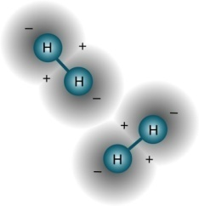
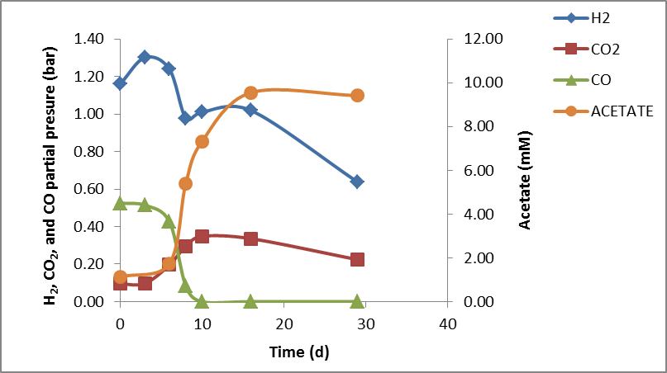
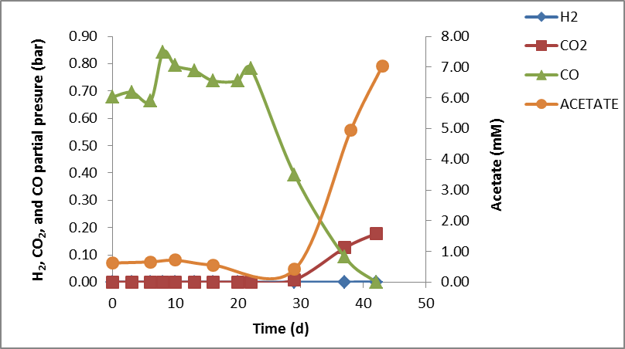
University of Minho School of Engineering Centre of Biological Engineering
microbial syngas conversion by MESOPHILIC AND thermophilic anaerobic mixed-cultures
JOANA I. ALVES*
Supervisors: Madalena Alves, Diana Z. Sousa
* joana.alves@deb.uminho.pt
Introduction
Results
I
T1
I
T2
Desulfotomaculum sp. Hbr7 (99% identity)
Synthesis gas (or syngas) can be produced from the gasification of a variety of recalcitrant or biodegradable waste materials. Syngas is a mixture composed of mainly H₂, CO and CO₂ that can be used in a biological process for the production of fuels or usable chemicals. The main goal of this work was to study the physiology and microbial composition of anaerobic cultures able to utilize syngas.
After 2 transfers there were no growth, neither syngas or CO conversion.
Mesophilic enrichment series
Desulfotomaculum australicum str. AB33 (98%)
Substrate: CO concentration: | Syngas (3 transfers) 5% to 10%
M1
After 2 transfers the biomass also lost the ability to produce methane, that was being produced during 1st transfer.
>
>
>
>
>
1
>
>
>
>
1
Thermophilic anaerobic bacterium K1L1 (96%)
>
>
>
>
>
2
>
>
>
>
2
Thermoanaerobacterium aotearoense (86%)
Thermophilic enrichment series
Conclusions
Substrate: CO concentration: | Syngas (4 transfers) Syngas (12 transfers) 5% to 50% | Syngas (4 transfers) CO (8 transfers) 5% to 50%
CO, H₂ and CO₂
Fuels
Usable chemicals
T1
T2
Regarding CO consumption, the thermophilic suspended sludge offers potential advantages over the mesophilic suspended sludge.
Methods
CO degradation was faster on T1, probably because the substrate used during the initial 4 transfers was the same as during the entire experiment.
Enrichment cultures
Substrate (series M1, T1 and T2)
T1
(after 16 transfers)
 | CO | H₂ | CO₂
Syngas from coal gasification | 60% | 30% | 10%
The diversity of the microbial community present, decreased drastically from the inoculum sample, suggesting a fast specialization of microbial community on this type of substrate.
Syngas was diluted with H₂/CO₂ (80:20 v/v) to provide CO concentrations ranging from 5% to 50% CO to the cultures.
Substrate (series T2)
This work gave insight into the microbiology and physiology of syngas and carbon monoxide conversion by anaerobic mixed culture.
CO diluted with N₂ to provide CO concentrations from 10% to 50% CO to the cultures.
Total pressure = 1.75 bar
References
Thermophilic
suspended slugde from a reactor treating organic municipal solid wastes
Basu R et al. (1993) Report for U.S. Department of Energy, 1-32.
Henstra AM et al. (2007) Current Opinion in Biotechnology, 18(3) 200-206.
Hussain A et al. (2011) Appl Microbiol Biotechnol, 90:827-836.
Oelgeschlager E and Rother M (2008) Arch Microbiol, 190:257-269.
Sipma J et al. (2006) Critical Reviews in Biotechnology, 26:41–65.
Sokolova TG et al. (2009) FEMS MicrobiolEcol, 68:131-141.
Worden RM et al. (1997) American Chemical Society, 321-335.
Mesophilic suspended slugde from a labscale bioreactor
T2
(after 12 transfers)
37 °C
55 °C
Monitoring
Gas composition (gas chromatography), soluble fermentation products (liquid chromatography)
Microbial growth (spectrophotometry, abs 600 nm)
Microbial communities (16S rRNA based PCR-DGGE, cloning and sequencing)
Acknowledgements
The financial support from Fundação para a Ciência e Tecnologia (FCT) and European Social Fund (POPH-QREN) trough PhD grant SFRH/BD/48965/2008 given to Joana Alves is gratefully acknowledged.
Uma Escola a Reinventar o Futuro – Semana da Escola de Engenharia - 24 a 27 de Outubro de 2011

