Slide 1
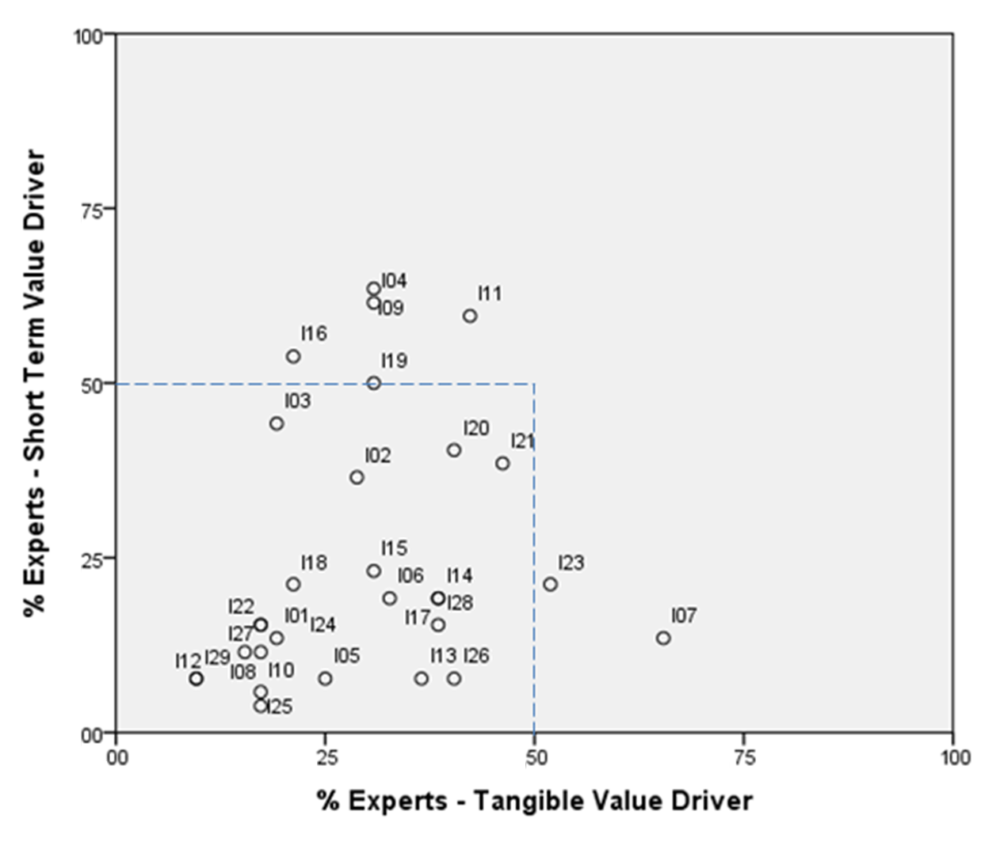
University of Minho School of Engineering R&D Centre ALGORITMI / Department of Information Systems
ENTERPRISE ARCHITECTURE VALUE DRIVERS
LUIS SILVA RODRIGUES*
Supervisors: Luis Amaral
* lsr@iscap.ipp.pt
Background
In last two decades, there has been a growing interest and development in Enterprise Architectures. The importance given to the subject resulted in a significant number of initiatives, either at corporate or governmental level, which resulted in different approaches, frameworks, methods, models and languages for building and maintaining an Enterprise Architecture.
The current economic pressures and the need to justify the usefulness and investment on Enterprise Architectures are increasingly demanding an assessment and demonstration of its value. Despite the interest and need it is widely recognized that it still is very difficult for organizations to assess and measure the Enterprise Architecture value. The lack of a clear understanding on what is important for Enterprise Architecture value assessment, the intangible nature of some benefits and the need to quickly demonstrate the Enterprise Architecture value are some of the main reasons for this difficulty.
Research Questions
In this study we intended to identify, systemize and prioritize the responses of some key Enterprise Architecture stakeholders to the following research questions:
R1: What are the key value drivers of Enterprise Architectures for organizations and what is their ranking of importance?
R2: Which value drivers of Enterprise Architectures can be realized in short term (less than a year)?
R3: Which value drivers of Enterprise Architectures are of tangible nature?
Research Design - Delphi Survey
This research incorporated a web-based modified Delphi survey based on an initial value drivers list generated from a literature review. The study was conducted between May 9 and July 20, 2011 and involved the completion of three rounds.
Expert Panel
From the 166 experts invited, 75 (45%) accepted to participate in the Delphi study, but only 63 (40%) actually participated at least in one of the three rounds of this study.
The 63 participants were from 17 different countries: South Africa (4), Australia (4), Brazil (2), Canada (1), South Korea (1), Denmark (3), Slovenia (1), United States (9), France (1), Netherlands (5), Ireland (1), Japan (1), Portugal (18), United Kingdom (3), Singapore (2), Sweden (2) and Switzerland (5).
In terms of professional background, 42 participants reported that they had an IT background (67%), 11 a Management background (17%), 6 reported a both IT and Management background (10%) and 4 other professional areas (6%). In terms of experience in positions, 33 participants referred that they already had experience as Enterprise Architect, 19 as Enterprise Architecture project leader/manager, 14 as senior manager and 38 as Enterprise Architecture researchers.
Delphi Results
Table 1 presents the consolidated results of the experts' answers to research question R1 on what are the key value drivers of Enterprise Architectures and how they rank them according to its importance for organizations. The table shows the 29 key value drivers (26 of which resulted from an extensive literature review and 3 were identified and
Table 1: Key Value Drivers of Enterprise Architectures - Delphi results
proposed by the expert panel) ordered by the degree of importance attributed by the 52 experts that completed the Round 3.
Figure 1 presents the consolidated results of the answers to research questions R2 and R3. The figure shows and relates, for each value driver, the percentage of experts that specified the value driver as realizable in the short term and the percentage of experts that have specified that it is of tangible nature (note: the codes used in Figure 1 are available in the Table 1).
Figure 1: Short Term and Tangible Value Drivers
Contributions & Future Research
Given the fact that this study focuses on an area of interest that has not been extensively explored, we believe that we have generated a comprehensive list of 29 key value drivers of Enterprise Architectures that can be considered as a valid contribution to a better comprehension of the important issues to Enterprise Architectures value assessment and we also believe that this provides a solid basis for the future development of a value measuring system for Enterprise Architectures.
Acknowledgements
We are thankful to the 63 members of expert panel that participated in this study.
Round 3 Rank | Value Drivers |  | Mean | Standard Deviation | Round 1 Rank | Round 2 Rank
1 | I02 | (Improved) Alignment | 5,10 | 5,78 | 1 | 1
2 | I09 | (Improved) Decision Making | 6,94 | 6,38 | 3 | 2
3 | I11 | (Improved) Governance | 8,15 | 5,44 | 4 | 3
4 | I01 | (Increased) Agility | 9,60 | 7,03 | 2 | 4
5 | I03 | (Improved) Change Management | 10,60 | 7,61 | 6 | 5
6 | I19 | (Improved) Planning | 11,27 | 8,01 | 8 | 6
7 | I16 | (Improved) Knowledge & Understanding | 11,37 | 6,72 | 12 | 9
8 | I28 | (Enhanced) Enterprise Integration & Consolidation | 11,69 | 6,63 | * | 8
9 | I05 | (Reduced) Complexity | 12,83 | 7,95 | 7 | 10
10 | I10 | (Increased) Flexibility | 12,85 | 6,34 | 10 | 15
11 | I04 | (Improved) Communication | 13,13 | 7,90 | 5 | 7
12 | I13 | (Improved) Interoperability | 13,83 | 7,00 | 14 | 12
13 | I21 | (Increased) Process Improvement & Standardization | 14,10 | 7,37 | 11 | 13
14 | I23 | (Increased) Reuse | 14,23 | 7,10 | 17 | 16
15 | I20 | (Improved) Portfolio Management | 14,23 | 7,14 | 9 | 11
16 | I07 | (Reduced) Costs | 15,56 | 7,38 | 13 | 14
17 | I24 | (Improved) Risk Management | 16,00 | 6,41 | 18 | 17
18 | I15 | (Improved) IT Integration | 17,19 | 7,31 | 15 | 18
19 | I22 | (Improved) Quality | 17,50 | 6,46 | 19 | 20
20 | I12 | (Fostered) Innovation | 17,60 | 8,40 | 20 | 21
21 | I08 | (Improved) Customer Orientation | 17,98 | 8,06 | 16 | 19
22 | I14 | (Improved) IT Delivery | 18,23 | 8,14 | 22 | 24
23 | I26 | (Improved) Time to Market | 18,48 | 8,22 | 23 | 23
24 | I06 | (Increased) Compliance | 18,60 | 6,17 | 21 | 22
25 | I17 | (Increased) Management Satisfaction | 20,13 | 7,79 | 25 | 28
26 | I27 | (Enhanced) Assurance | 20,23 | 7,24 | * | 27
27 | I25 | (Improved) Security Management | 21,79 | 5,84 | 24 | 26
28 | I29 | (Enhanced) Technological Evolvability | 21,81 | 5,85 | * | 25
29 | I18 | (Facilitated) Outsourcing | 24,00 | 6,31 | 26 | 29
* These items were suggested by experts after the Round 1 of the study.
Uma Escola a Reinventar o Futuro – Semana da Escola de Engenharia - 24 a 27 de Outubro de 2011

