Slide 1

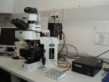

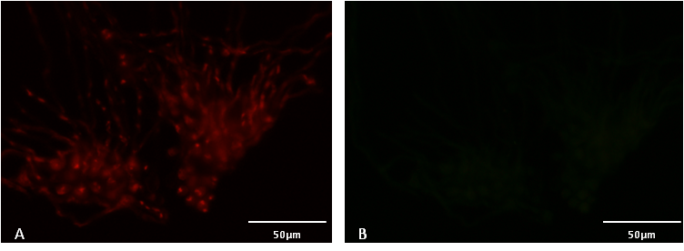
University of Minho School of Engineering CEB – Centre of Biological Engineering
DEVELOPMENT OF A NEW PNA-FISH BASED METHOD FOR THE SPECIFIC IDENTIFICATION OF Aspergillus fumigatus.
Author* LAURA CERQUEIRA
Supervisors: Maria João Vieira, Nuno Azevedo
* lauracerqueira@deb.uminho.pt
Introduction
Aspergillus fumigatus is a saprophyte filamentous fungus that feeds on decaying organic matter (Dagenais and Keller 2009) and produces conidia, which can survive in a wide range of aggressive environments (Abad et al. 2010). Depending on the host immunologic system (Dagenais and Keller 2009), the inhaled conidia can be determinative of disease (Invasive Aspergillosis) especially in immunocompromised patients (McCormick et al. 2010).
After deposition in the pulmonary space, A. fumigatus may start a pathogenic behavior in vulnerable hosts by epithelial tissue adherence and endocytosis. Within epithelial cells, conidia start swelling and begin to germinate. The germinated hyphae can escape from the epithelial cells and infiltrate blood vessels and induce endothelial cell damage (McCormick et al. 2010).
In here we describe the development of a new fluorescent-labelled PNA probe for the specific detection of Aspergillus fumigatus by Fluorescence in situ hybridization (FISH). PNA probes are synthetic DNA mimics that have a modified negatively charged chemical structure although specific hybridization between the PNA and nucleic acid complementary sequences still occurs according to the Watson-Crick rules. PNA probes normally have smaller sequences (13-18 nucleotides) than DNA sequences (at least 18 nucleotides), higher thermal stability and a greater resistance to nucleases and proteases than DNA molecules (Stender et al. 2002). Several PNA probes have been developed and optimized for a wide range of microorganisms, including bacteria, Candida species and filamentous fungi.
FISH protocol:
Table 1 – Results of A. fumigatus probe specificity test
Sample
Epifluorescence microscopy
(or flow cytometry)
FIXATION
Detection
Application of chemical fixatives (formalin, paraformaldehyde and ethanol)
Permeabilized cells
WASHING
All loosely bound or unbound labelled probes are removed from the sample providing specificity to the detection
HYBRIDIZATION
Temperature, pH, ionic strength and formamide concentrations
The probe accesses and hybridizes with the target sequence on the rRNA of the cell
FIG. 1 – Squematic PNA-FISH proceedment.
Results and Discussion
As expected, for the optimized hybridization conditions, the probe only hybridized with Aspergillus fumigatus strains (Table 1).
Therefore, in practical terms, specificity and sensitivity) were 100% showing the good quality of the selected sequence regarding the capacity of discriminating A. fumigatus among other strains.
FIG. 2 – Epifluorescence microscope visualization of A. fumigatus ATCC 46645. Visualization of the same microscopic field at the green channel (negative control of FUM628) (B). Images were obtained with equal exposure times.
Methods
Specificity and sensitivity determination was accessed using Aspergillus fumigatus strains and other microorganisms that can be related with pulmonary diseases, by fluorescence microscopy.
The hybridization procedure is represented in Figure 1.
-Abad A, Victoria Fernandez-Molina J, Bikandi J, Ramirez A, Margareto J, Sendino J, Luis Hernando F, Ponton J, Garaizar J, Rementeria A. 2010. “What makes Aspergillus fumigatus a successful pathogen? Genes and molecules involved in invasive aspergillosis.” Rev Iberoam Micol, 27(4):155-182.
-Dagenais TR and Keller NP. 2009. „Pathogenesis of Aspergillus fumigatus in Invasive Aspergillosis”. Clin Microbiol Rev, 22(3):447-465.
-McCormick A, Loeffler J, Ebel F. 2010. ”Aspergillus fumigatus: contours of an opportunistic human pathogen.” Cell Microbiol, 12(11):1535-1543.
-Stender H, Fiandaca M, Hyldig-Nielsen JJ, Coull J: PNA for rapid microbiology. J Microbiol Methods 2002, 48(1):1-17.
Conclusion
In here, a new molecular diagnostic method is proposed using a specific peptide nucleic acid (PNA) probe for direct visualization of A. fumigatus by fluorescence in situ hybridization (FISH), in a very specific and sensitive way.
Uma Escola a Reinventar o Futuro – Semana da Escola de Engenharia – 24 a 27 de Outubro de 2011

