Slide 1

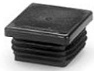
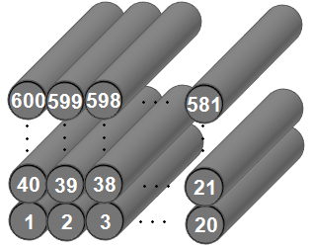
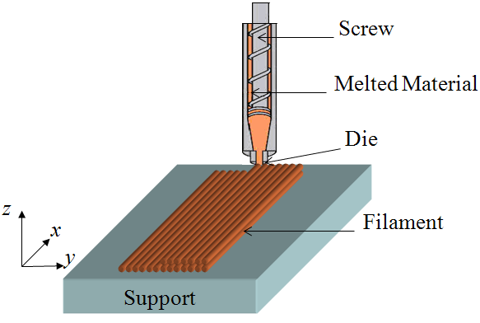
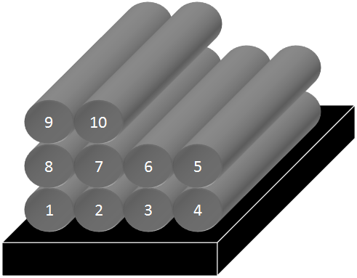
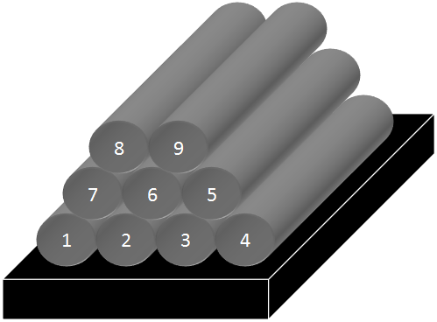
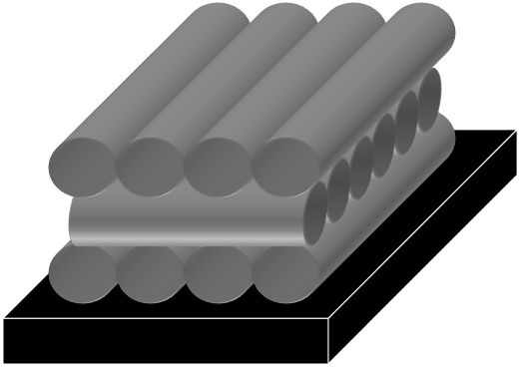

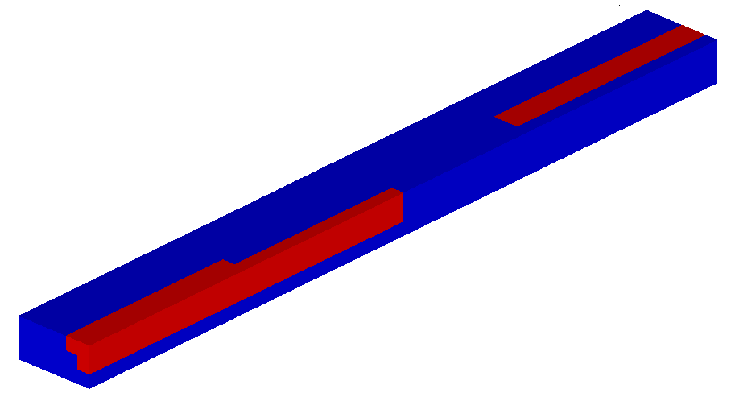
University of Minho School of Engineering Department of Polymer Engineering and I3N
FREE FORM EXTRUSION: EXTRUSION OF 3D COMPONENTS USING COMPLEX POLYMERIC SYSTEMS
Sidónie. F. COSTA*
Supervisors: F. M. Duarte, J. A. Covas
* sidonie@dep.uminho.pt
The process:
In Free Form Extrusion (FFE), an extruded semi-molten filament is deposited on the x-y plane following a sequence that is dictated by the part geometry. Then, the platform holding the part moves vertically in the z plane to deposit a new layer on top of the previous one. The process is repeated until the part is generated.
Problems occurring in FFE:
The sequential deposition of filaments induces inadequate bonding between adjacent filaments, which reduces the mechanical resistance of parts: each filament must remain sufficiently hot during enough time to ensure adhesion, but simultaneously, to cool down fast enough to avoid excessive deformation due to gravity and weight of top filaments.
Solution for these problems: modelling of heat transfer in FFE
The objective is to create a heat transfer model, able to determine how the adhesion can be improved. In a first phase, an energy balance is made, where the heat flux with support, with the surrounding environment, with colder filaments deposited before and with younger hotter filaments deposited afterwards are considered. A differential equation was then obtained and solved using the polynomial characteristic method. Finally, by using the analytical solution, a MatLab® computer code was developed.
Some parts with some geometrical features may require the use of a support material, to be removed after manufacture. This possibility is considered in the algorithm for unidirectional and aligned filaments.
Coupling this to an assessment of the adhesion quality between adjacent filaments, a new code was developed in order to determine the operating conditions that maximize the adhesion.
Case study:
As a case study, a square bottle cap with the following geometry is considered and the processing conditions are described in the following table (computation time: 35 hours).
Case 1 (lower environment temperature, 70.ºC):
Case 2 (higher environment temperature, 80.ºC):
Conclusions:
The modelling of heat transfer in Free Form Extrusion is mandatory to determine how the adhesion can be improved between filaments. An analytical solution for this problem is proposed and used to develop a code that tests the adhesion quality between filaments after construction of a bimaterial part by FFE. The operation variables can be then modified until achievement of a high quality part, and important relationships between variables and objectives can be established.
10 mm
10 mm
6 mm
6 mm
9 mm
9 mm
Definition of the energy balance
Property | Value
Extrusion Temperature (ºC) | 270
Environment Temperature (ºC) | Case 1: 70 ºC / Case 2: 80 ºC
Extrusion velocity (m/s) | 0.025
Cross section geometry | Circle
Cross section diameter (m) | 0.0003
Deposition type | Unidirectional - Aligned
Adhesion Criteria | T_{bond} = 95.ºC and t_{bond} = 1 sec
Translation into mathematical language
(differential equation)
Solving of the differential equation in order to obtain an analytical expression for the temperature along time
Free Form Extrusion (FFE)
By using the solution of the equation, creation of a MatLab® code that allows to obtain the temperature along time for all the filaments of three possible deposition sequences: unidirectional and aligned filaments, unidirectional and skewed filaments and perpendicular filaments.
6% of problematic adhesion volume: the part has not the maximal resistance.
With visualization of the support material
Without visualization of the support material
Unidirectional and aligned filaments.
Unidirectional and skewed filaments.
Perpendicular filaments.
0% of problematic adhesion volume: with a raised environment temperature, the resistance of the part is maximal.
High temperatures
High mechanical resistance
Poor dimensional stability
Good adhesion
Excessive deformation
With visualization of the support material
Without visualization of the support material
INPUT
OUTPUT
Low temperatures
Low mechanical
resistance
Good dimensional
stability
Part dimensions;
Bond and time temperature;
Process variables (extrusion temperature and oven temperature, deposition velocity, etc.);
Material variables (density, conductivity, etc.).
Problematic locals of the part.
MaLab® code
Poor adhesion
Low deformation
Good adhesion
Problematic adhesion
Uma Escola a Reinventar o Futuro – Semana da Escola de Engenharia - 24 a 27 de Outubro de 2011

