Slide 1

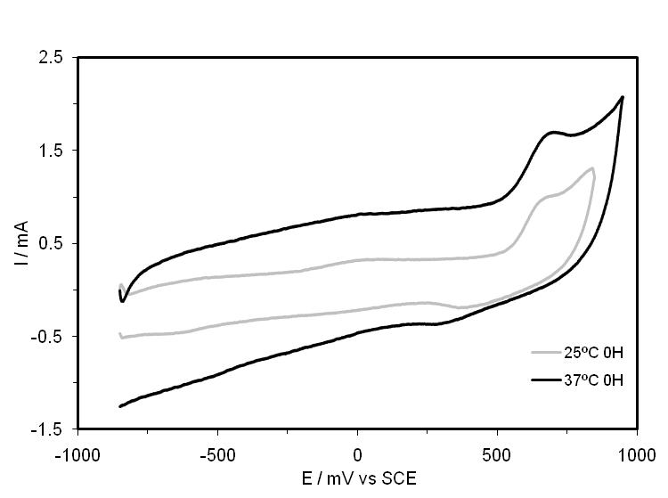

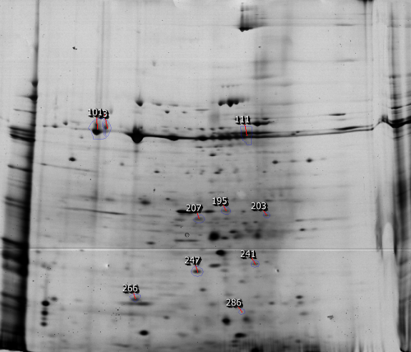
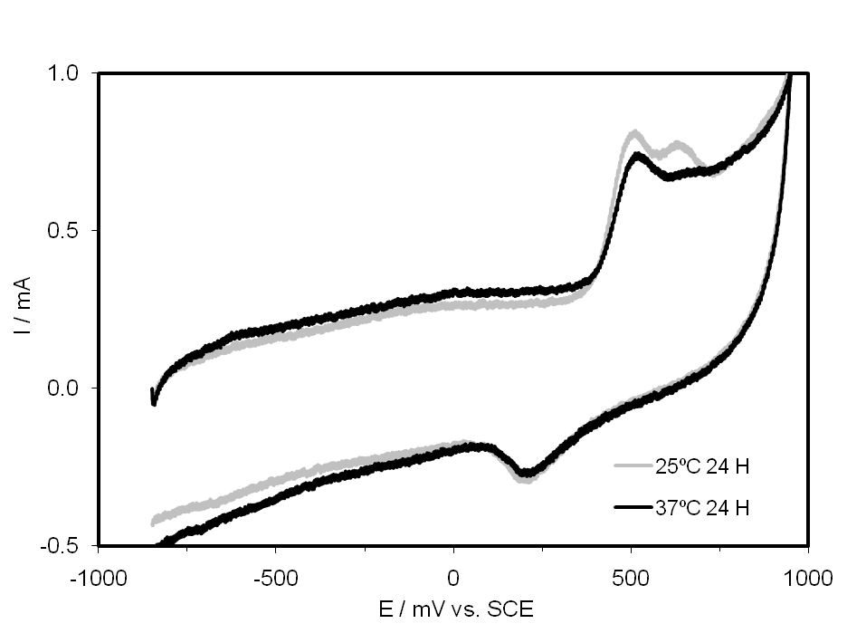
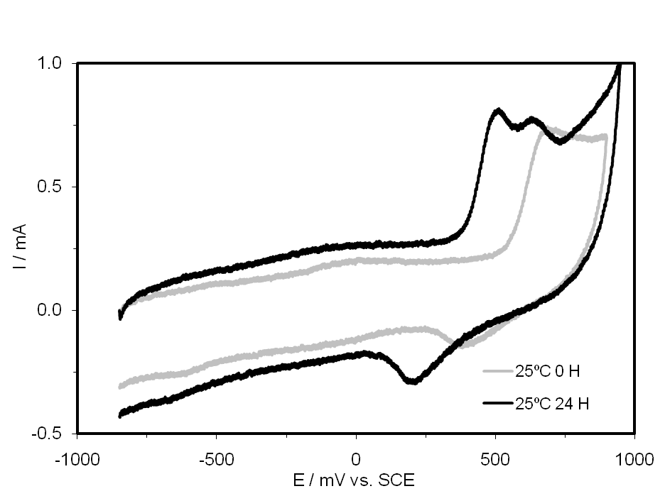
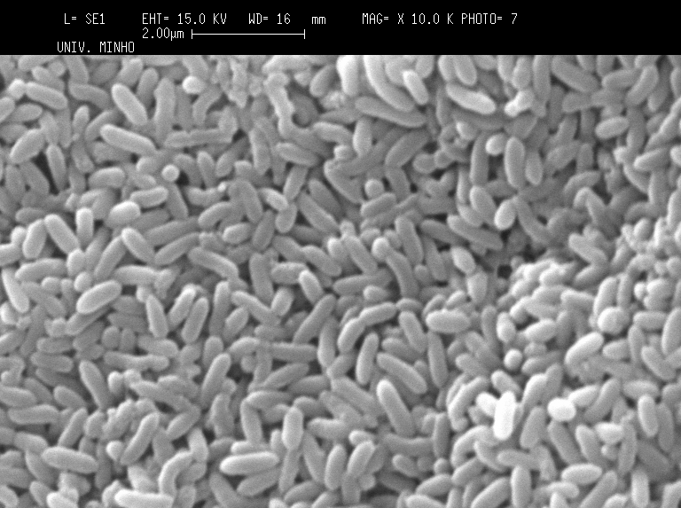
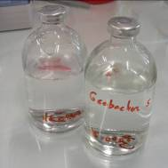
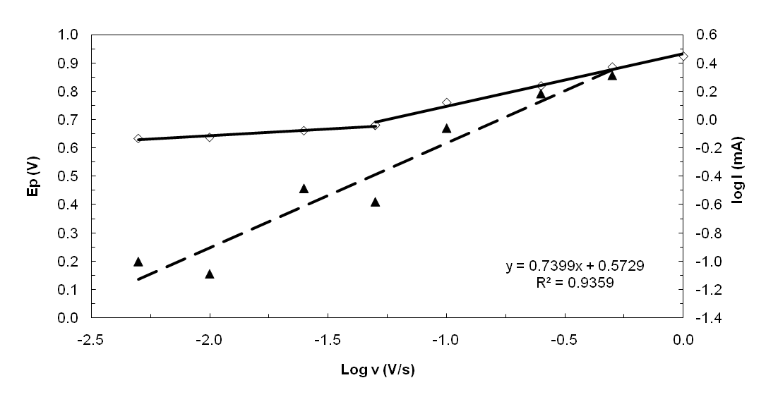
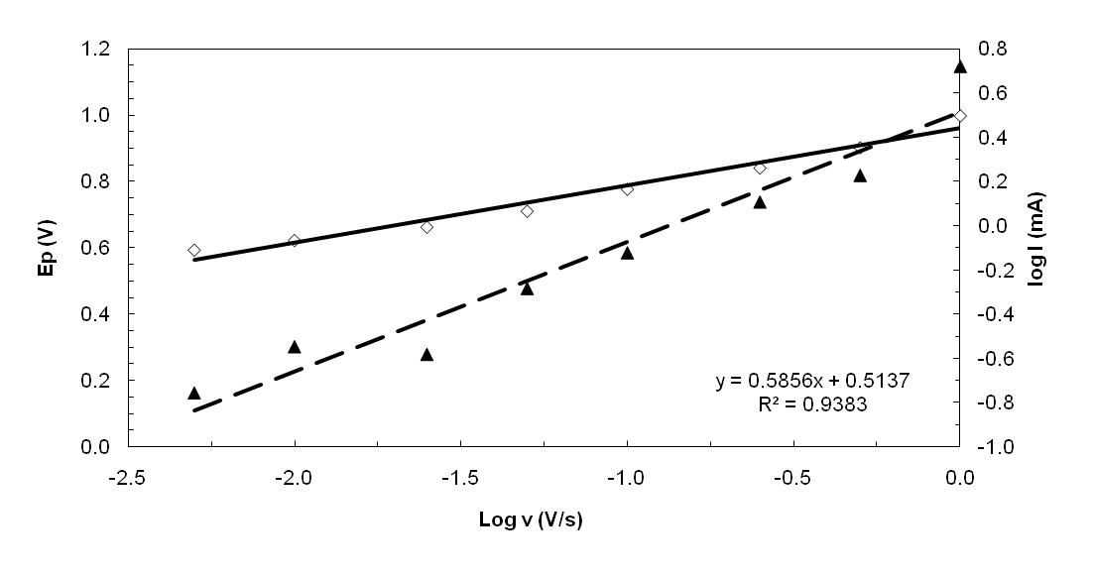
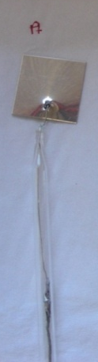

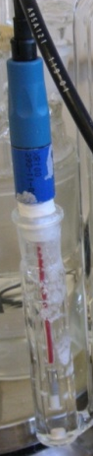

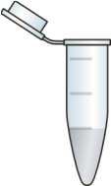
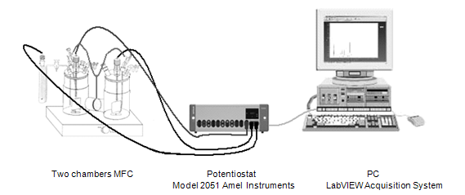
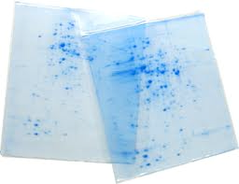
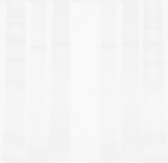
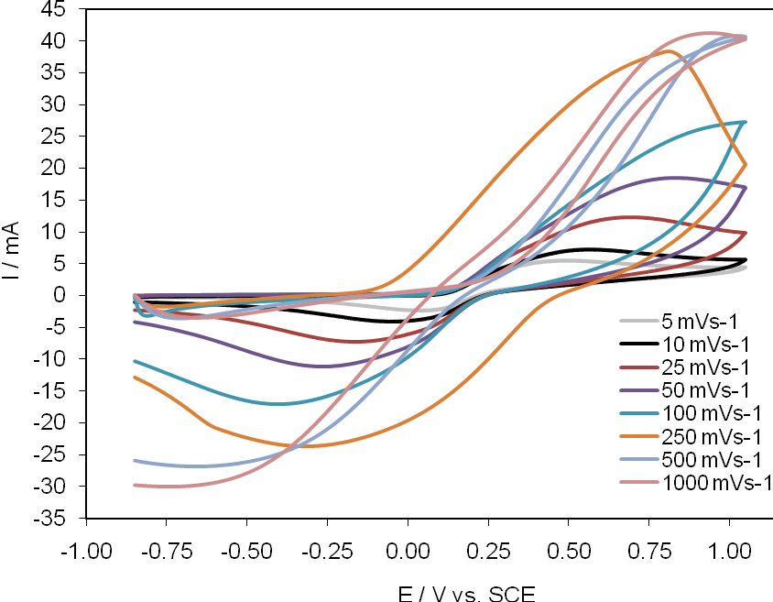

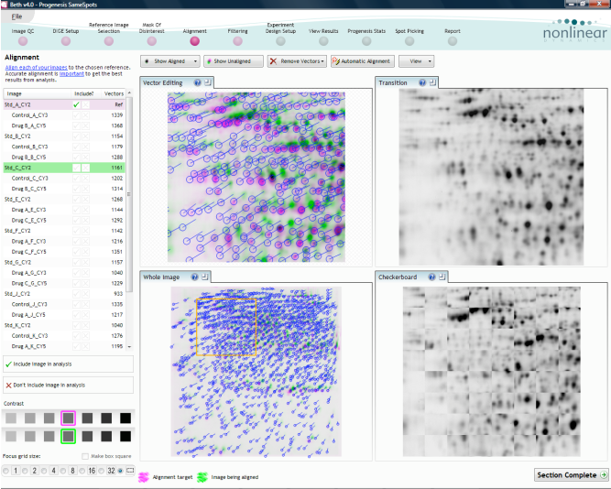
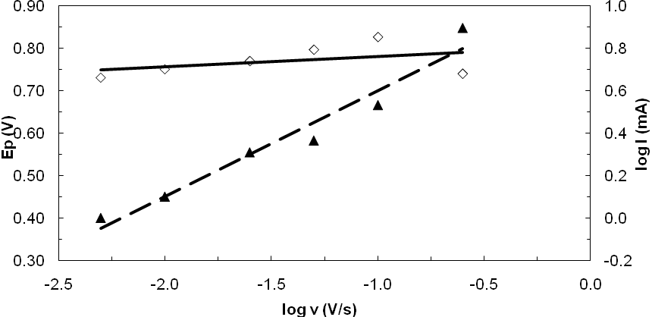
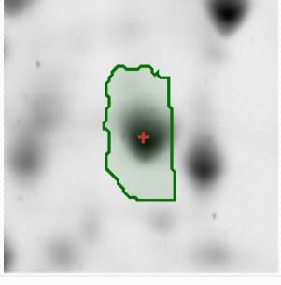
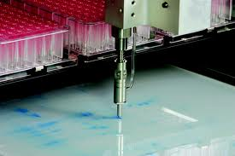
University of Minho School of Engineering Biological Engineering Center
Electronic transference assessment of the redox processes at carbon electrodes coated with Geobacter sulfurreducens that grown at different temperatures
L. PEIXOTO*, A. F. S. Santos, I. Machado, A. M. Sousa, A. G. Brito, P. Parpot, M. O. Pereira, R. Nogueira
* luciana.peixoto@deb.uminho.pt
Geobacter sulfurreducens is a bacteria that can transfer electrons directly to the electrode from different external membrane cytochromes. Each cytochrome is associated with a range of redox potentials, being energetically more favourable than some others (Logan and Regan, 2006). Different bacterial growth conditions,, such as temperature, may influence the prevalence of certain cytochromes in the external membrane (Peixoto et al. 2011). The aim of this work was to evaluate the effect of the growth temperature on the electrochemical behavior of G. sulfurreducens.
RESULTS AND DISCUSSION
INTRODUCTION
kDa m 1 2 1 2 m
CYCLIC VOLTAMMETRY
A ´
225
150
100
75
50
35
25
15
10
Different bands were observed
PROTEOMICS
A
4.0
pI
7.0
Fig 1. Voltammograms of carbon Toray with a suspension of G. sulfurreducens that grew at 25 ºC and 37 ºC (50 mVs⁻¹). (essays at room temperature)
a
A B
b
A B
Fig 4. 12% SDS-PAGE of G. sulfurreducens proteins (1.6 μg), that grown at 25 ºC (1) and at 37 ºC (2); Molecular weight markers (m).
METHODOLOGY
MW
Geobacter sulfurreducens DSMZ
Fig 2. Voltammograms of carbon Toray with a suspension of G. sulfurreducens that grew at 25 ºC and 37 ºC (25 mVs⁻¹), after 24 hours stabilize (a). (essays at room temperature). Comparison with the result obtained in time 0 H (b).
Fig 5. 2-DE of outer membrane proteins of G. sulfurreducens (protein load: 200 μg). Proteins that revealed differential expression from bacteria that grow at 25 ºC and 37 ºC are indicated by their index number given in the Table. Proteins were visualized by silver staining.
Different growth condictions
100 rpm & 25 ºC
100 rpm & 37 ºC
a
b
Electrodes
Membrane Protein Extraction
Fig 3. log I vs. log v (▲) and E versus log v (◊) curves for the oxidation (Fig. 1) of a pure culture of G. sulfurreducens in suspension that grew at 25 ºC (a) and 37 ºC (b).
About 100 spots discriminated on the different conditions;
Gel analysis of Outer Membrane Proteome at different growth conditions revealed:
Up-regulation of 9 spots at 37 ºC;
Down-regulation of just one spot at 37 ºC;
The spot picking and protein identification are in progress.
Table 2 Normalised intensity of spots in the proteome profile of G. sulfurreducens grown at 25 ºC and 37 ºC. Protein spots were considered to display significant quantitative differences if they fulfilled the following criteria: p values ≤ 0.05 (t-test); detection threshold, average volume ≥ 20 (n = 3); differential tolerance, fold change ≥ 2
1)
2)
3)
4)
Bacteria in growth medium
Centrifuge at 4 000 g
15min at 4 ºC
Pellet diluted in Tris-buffer
Sonication
6 x 10 s
Table 1 Electrochemical data obtained for bacteria grown at two different temperature. (room temperature essays).
Ultra-Centrifuge at 257 000 g
60min
Solubilize in 1% Sodium laurylsarcosine
Electron Transfer Mechanisms
25 ºC 0h | - Reversible charge transfer between 5 mV/s and 50 mV/s and irreversible to higher sweeps scan rates. - Mixed control | 25 ºC 24 h at room T | - Irreversible charge transfer - Diffusion controlled
37 ºC 0h | - Irreversible charge transfer - Limited by diffusion | 37 ºC 24 h at room T | - Irreversible charge transfer - Mixed control | 37 ºC 48 h Last 24 h at 37 ºC | - Irreversible charge transfer - Limited by diffusion
Platin as cathode
+
Carbon Toray as anode
+
SCE as reference
5)
6)
7)
 | Average normalized volumes mean (SD)
Spot # | 25 ºC | 37 ºC
93 | 1293,967 | 4751,629
101 | 5612,445 | 1,983e+004
111 | 7505,605 | 2,135e+004
195 | 485,974 | 1623,547
203 | 233,095 | 633,443
207 | 759,898 | 1962,325
241 | 636,831 | 1622,581
247 | 2487,584 | 3847,489
266 | 455,310 | 3266,062
286 | 1281,760 | 299,479
Scan Rate at 50 mVs⁻¹
Sucrose gradient
30% 50%70%
Ultra-Centrifuge at 82 500 g
17 h at 4ºC
Ultra-Centrifuge at 257 000 g
60min
SDS- PAGE and Two-Dimensional Gel Electrophoresis
For Bacteria that growth at different temperatures, the oxidation peaks potentials and current intensities were different;
Higher current intensities were found for bacteria grown at higher temperatures;
the potential of the oxidation peak obtained with bacteria grown at higher temperature was more anodic, thus more energy was required;
At lower sweep rates, it was possible to observe two oxidation processes, that are better defined in bacteria grown at 25 ºC;
Comparing the oxidation potential with literature (Richter et al. 2009), it was possible to conclude that different types of cytochromes can be established as responsible for heterogeneous electronic transfer.
CYCLIC VOLTAMMETRY
PROTEOMICS
Different sweep scan rates
Gel Analysis
CONCLUSIONS
The difference observed in voltammetric study can be related to the structural differences in bacteria that grown at different temperatures. Changes in the Geobacter sulfurreducens growth temperature promotes different protein expression that can be responsible for different redox centers.
REFERENCES
Logan, B.E. and Regan, J.M. (2006). “Electricity-producing bacterial communities in microbial fuel cells.”, Trends in Microbiology 14, No.12, 512-518.
Qian, X. (2009). “Investigation of fe(iii) reduction in Geobacter sulfurreducens characterization of outer surface associated electron transfer components”. PhD Dissertations.
Richter, H.; Nevin, K.P.; Daniel, H.J.; Lowy, A.; Lovley, D.R. and Tender, L.M. 2009. “Cyclic voltammetry of biofilms of wild type and mutant Geobacter sulfurreducens on fuel cell anodes indicates possible roles of OmcB, OmcZ, type IV pili, and protons in extracellular electron transfer.” Energy Environ Sci 2, 506-516.
Peixoto L., Santos A.F.S., Machado I., Sousa A.M., Brito A.G., Parpot P., Pereira M.O., Nogueira R. 2011. “Influence of the Temperature in the electronic transfer mechanism of Geobacter sulfurreducens” In proceedings of the 3rd Microbial Fuel Cell Conference (Leeuwarden, Netherland. 6-8 Jun). 145.
Voltammograms Analysis
Next step
Ep vs. Log v – reversibility
+
Log I vs. Log v – limiting step
Protein Identification and Spot Picking
Uma Escola a Reinventar o Futuro – Semana da Escola de Engenharia - 24 a 27 de Outubro de 2011

