Slide 1
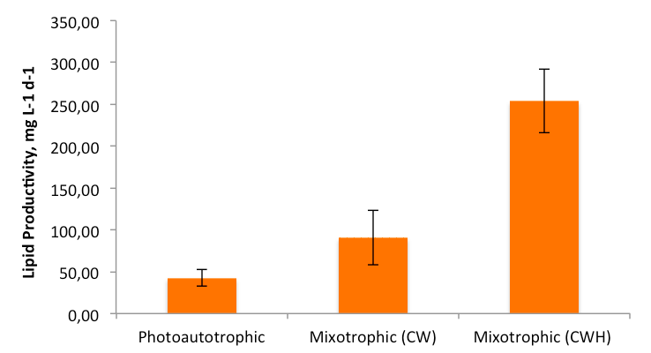
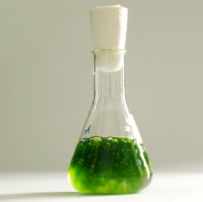
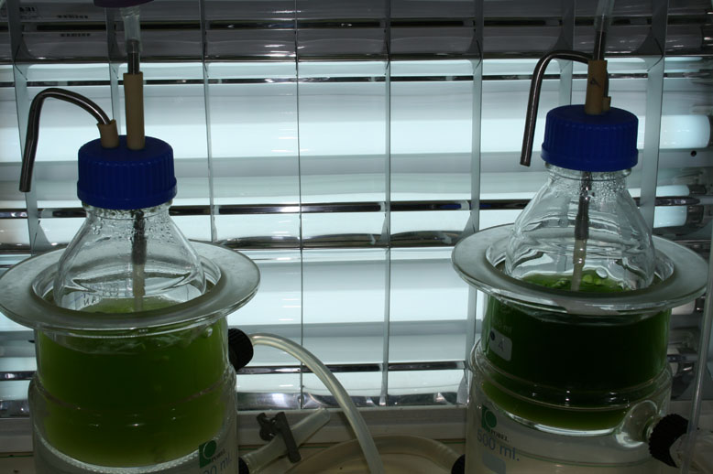
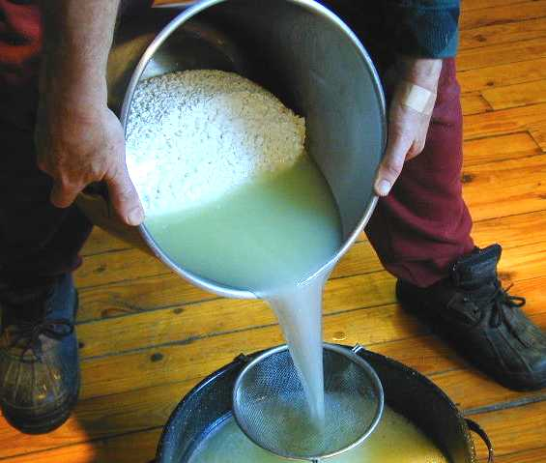
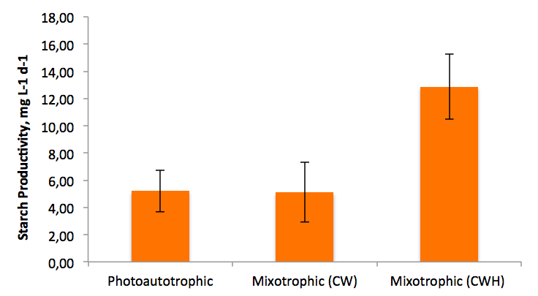
University of Minho School of Engineering Centre of Biological Engineering
UTILIZATION OF DAIRY INDUSTRY BY-PRODUCTS AS SUBSTRATES TO ENHANCE THE PRODUCTIVITY OF MICROALGAE PRODUCTION SYSTEMS
Author* FERNANDES, BRUNO.
Supervisors: Vicente, António; Teixeira, José.
* brunofernandes@deb.uminho.pt
Introduction
Aim
Evaluate the possibility of using cheese whey (CW) or cheese whey hydrolysate (CWH) as carbon source for mixotrophic culture of Chlorella vulgaris.
Methods
The experiment consisted of 3 conditions, summarized in Table 1, each one performed in duplicate. All assays were performed in batch system, in 0.5 L flasks containing 400 mL of medium at 30 ºC and the pH was kept around 7.5.
Table 1 - Summary of culture conditions and respective carbon source
⁽¹⁾ Equivalent to 10 g L⁻¹ lactose
⁽²⁾ Equivalent to 5 g L⁻¹ glucose + 5 g L⁻¹ galactose
All the cultures were aerated with CO₂-enriched air (2% v/v CO₂) at a rate of 0.4 vvm and illuminated with continuous light (70 mmol m⁻² s⁻¹).
The productivity of each cell in terms of different components (starch and lipids) was calculated using the equation:
P_{Component} = P_{max} x F_{component}
where P_{component} is the productivity of Chlorella vulgaris in term of one of the components in study (starch, lipids and proteins), P_{max} is the maximum biomass productivity and F_{component} is the fraction of component (w w⁻¹) in the cell.
Results
Table 2 – Growth parameters for Chlorella vulgaris cultivated photoautotrophically and mixotrophically, with different carbon sources
¹ μ_{max} = max. specific growth rate (d⁻¹); X_{max} = max. biomass concentration (g L⁻¹); P_{max} = max. biomass productivity (g L⁻¹ d⁻¹).
Table 3 – Consumption of the different organic carbon sources during mixotrophic growth of Chlorella vulgaris
Figure 1 – Comparison of lipid productivity between photoautotrophic and mixotrophic growth of Chlorella vulgaris
Figure 2 – Comparison of starch productivity between photoautotrophic and mixotrophic growth of Chlorella vulgaris
Conclusions
Biomass productivity and, inherently, the lipid and starch productivity was stimulated by CW and CWH, suggesting that this industrial by-product could be used as a low-cost supplement for the mixotrophic growth of Chlorella vulgaris.
Acknowledgements
This work was supported by Fundação para a Ciência e a Tecnologia through B. Fernandes grant SFRH/BD/44724/2008 and G. Dragone grant SFRH/BPD/44935/2008.
Microalgae
Accumulate high amounts of lipids and starch, used to produce biodiesel and bioethanol.
Mitigation of approximately 500 kg of CO₂ per 400 kg of microalgal biomass
Traditional growth techniques, presents several drawbacks, with consequent limitation on algal productivity.
Cheese Whey (CW)
By-product derived from cheese making process, which major components are lactose, proteins and lipids.
Polluting waste stream - To make 1 kg of cheese, 10 L of whey is generated
Biological treatment by conventional aerobic process is very expensive
Growth Conditions | Growth Parameters ¹
 | μ_{max} (d⁻¹) | X_{max} (g L⁻¹) | P_{max} (g L⁻¹ d⁻¹)
Photoautotrophic | 0.13 ± 0.04 a | 1.22 ± 0.12 a | 0.103 ± 0.022 a
Mixotrophic _{CW} | 0.13 ± 0.04 a | 1.98 ± 0.43 b | 0.316 ± 0.101 b
Mixotrophic _{CWH} | 0.42 ± 0.16 a | 3.58 ± 0.12 c | 0.739 ± 0.035 c
Growth Conditions | Carbon Source
Photoautotrophic | CO₂
Mixotrophic _{CW} | CO₂ + Cheese whey⁽¹⁾
Mixotrophic _{CWH} | CO₂ + Cheese whey hydrolysate⁽²⁾
Growth Conditions | Organic Carbon Source Consumption (%)
 | Glucose | Galactose | Lactose
Mixotrophic _{CW} | - | - | 59.0 ± 9.8
Mixotrophic _{CWH} | 100 ± 0.0 | 96.0 ± 0.2 | -
Uma Escola a Reinventar o Futuro – Semana da Escola de Engenharia - 20 a 26 de Outubro de 2011

