Slide 1
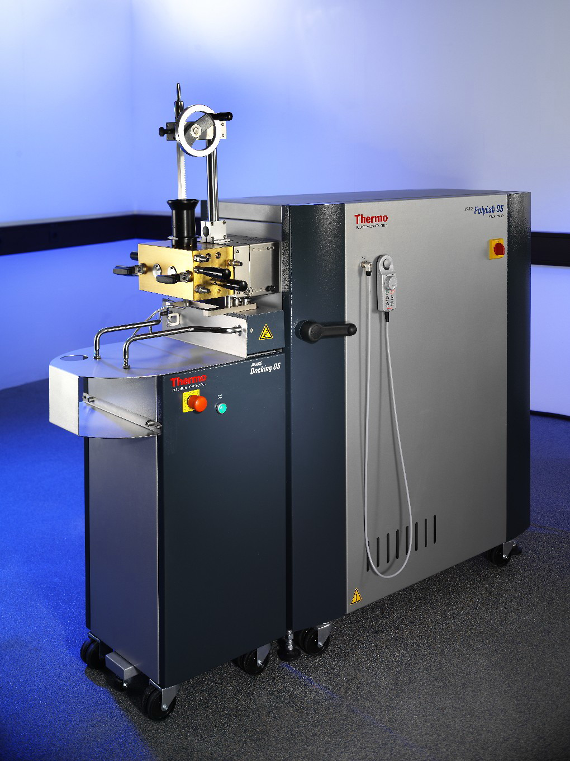
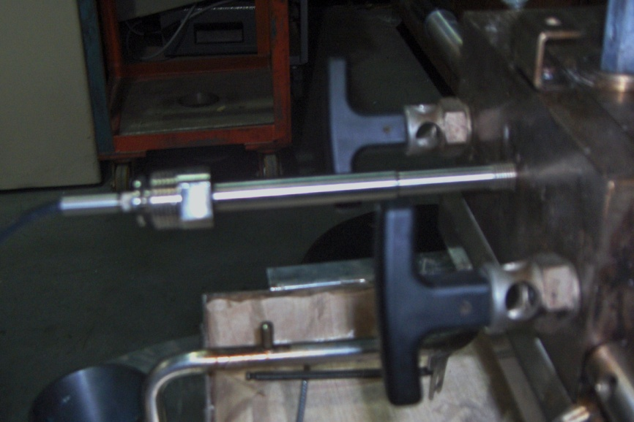
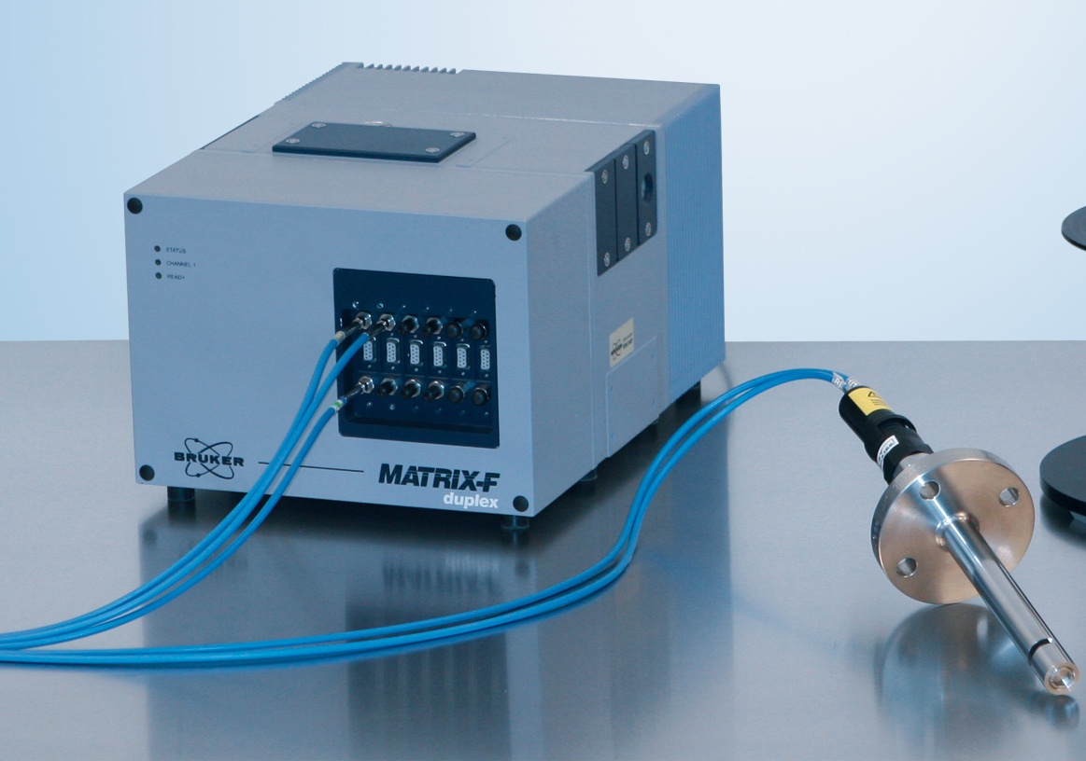
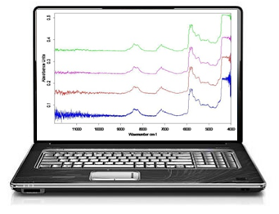
University of Minho School of Engineering Institute for Polymers and Composites/I3N
IN-LINE CHARACTERIZATION OF PP/CLAY NANOCOMPOSITES PREPARATION BY NIR SPECTROSCOPY
JOANA BARBAS*
Supervisors: Ana Vera Machado, José António Covas
* joana.barbas@dep.uminho.pt
IP 026685-2IP project
6th Framework EC Program
ABSTRACT
Polymer-clay nanocomposites have found wide practical application, due to their good performance even at low clay loadings. Nevertheless, the production of these compounds continues to face difficulties in establishing clear correlations between processing conditions and mixing quality. Therefore, the availability of fast-responsive on-line techniques continues to be of great practical interest. In recent years, NIR spectroscopy became a routinely used tool for monitoring and control purposes in the industrial scene. This work uses on-line NIR to monitor the evolution of mixing upon the preparation of polymer nanocomposites by melt compounding. The corresponding chemometric model uses parameters derived from rheology and FT-IR and data provided by the compounding equipment. The method is successfully applied in the prediction of the dispersion level of PP matrix nanocomposites during mixing time.
OBJECTIVES
To develop a general chemometric model able to correlate NIR spectral data with nanocomposites degree of mixing. To monitor the evolution of the clay dispersion in real-time conditions.
CALIBRATION PARAMETERS
Maximum torque from the mixing equipment
Wavenumber shift of the
Si-O peaks at 1050 and 1080 cm⁻¹
IN-LINE SET-UP
Rheological data derived from the η* (yield stress and power law index), G’ and G’’ curves
Batch mixer
Haake Rheomix OS600
(Thermo Scientific Inc.)
CHEMOMETRIC RESULTS
Attachment of the
Diffuse Reflectance probe
(Axiom Analytical Inc.)
EXPERIMENTAL
Materials
Acronym | PP | PP-g-MA | C20A
Grade | Moplen HP500N | Polybond 3200 | Closite 20 A
Supplier | Lyondell-Basell | Crompton | Southern Clay Products
Formulation (%wt.)
Matrix | 95 | 5
Composite | 95 | 5 | 5
Processing conditions
Temperature = 200 ºC
Rotor speed = 50, 100, 150 and 200 rpm
Example of NIR spectra measured during mixing
Chemometric model calibration data
connection with
fiber optic cables
REAL-TIME PREDICTIONS
Prediction results show that the dispersion state increases during the initial phase of mixing and stabilizes after a certain time – ± 180 seconds for 125 rpm and ± 120 seconds for 175 rpm.
The final dispersion levels predicted by NIR are of ± 42% for 125 rpm and ± 78% for 175 rpm. These are in agreement with the calibration values determined for the samples prepared at 50 rpm (15.4%),100 rpm (24.1%), 150 rpm (58.4%) and 200 rpm (90.1%).
Spectrophotometer
Matrix® F (Bruker Opts.)
ethernet connection
(LAN wire)
Workstation with OPUS® Quant2
software (Bruker Opts.)
Uma Escola a Reinventar o Futuro – Semana da Escola de Engenharia - 24 a 27de Outubro de 2011

