Slide 1
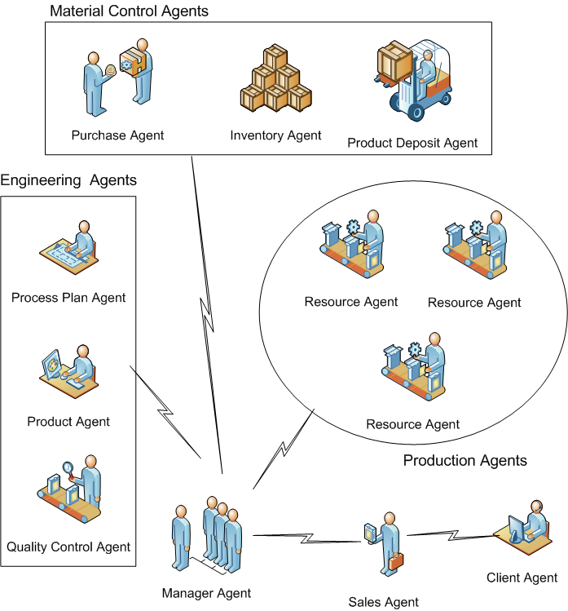
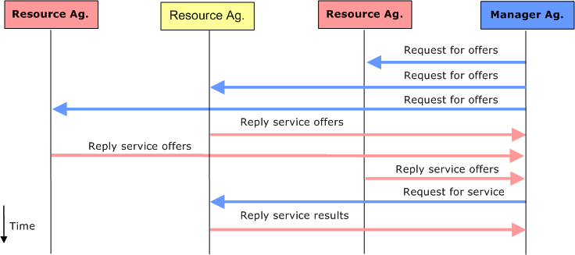
University of Minho School of Engineering Department of Production and Systems
Architecture for an Order Oriented Distributed Production System: Interoperability between Production Planning and Control and Industrial Automation
Author* FÁBIO DE SOUSA CARDOSO
Supervisors: Rui M. Lima, Rui Manuel Sousa
* fcardoso@uea.edu.br
INTRODUCTION
The production systems managers have new challengers due not just high complexity of processes and products, but also the increase variety of these products that should be put in the market in less time (the lifecycle is shorter). Additionally, the companies, in an environment of free concurrence, are looking new and modern methods to become more agile and flexible, totally adaptable to changes.
The tendency to product personalization implies in improve consistently the integration between the industries and the consumers. In the last years a set of architectures for production systems appeared that answer to these requirements, and they are based on distributed units of production, cooperative and autonomous. These proposal architectures are normally adherent in these three paradigms (Tharumarajah et al. (1996)), nominated: BMS - Bionic Manufacturing System; Holonic production systems; Fractal factory systems (Warnecke (1993)). These paradigms have coincident concepts characterized by distributed and autonomous units that can cooperate and manage production processes.
AIM
The main objective of this research project is to propose an distributed production architecture, based on the multi-agent paradigm, dealing with production scheduling problem and planning reconfiguration. The challenger of production scheduling problem is to allocate available manufacturing resources for required production jobs. It is necessary to identify the sequence and timing parameters of the tasks of each production order. The set of tasks or jobs related to each production order are defined in process plan, considering the product design. The result can be a schedule with a shorter production time, providing cost reduction.
METHOD
For Fletcher (2002) the increasing complexity of the production systems and the search for production process more flexible has stimulated the development of decentralized control system like the holonic multi-agent systems. The holonic multi-agent production systems are based on productive units, called holons, that are part of a holarchy called organization. This holons can be composited by other holons (subsystems), and then they can form a production system. Van Brussel et al. (1998) presented the most cited reference of architectures (PROSA) of the holonic multi-agent production systems, based on “product”, “order” and “resource” holons.
The distributed production systems have been created to propitiate efficiency and rationality in the process of distribute the use of production resource, in order to provide dynamic and fast manufacture. The production units must have capacity to be intelligently and efficiently reactive in case of not predictable changes in the external environment, keeping the production controlled and continuous.
Considering the necessity of a planning and control system that can be adaptable to use local and distributed resources and materials, it is mandatory the creation of a generic model generic to permits the selection, the allocation and the operation of the production resources, to accelerate planning process. This model can be the base to construct a system based on agents. A multi-agent system can still support the experimentation and the study of the dynamic characteristics of the distributed model of the production planning and control.
The Proposed Architecture
The model assume that agents “resource” have knowledge of the resource capability. Considering the transformation knowledge, the agent can get production orders through a negotiation process using Contract Net Protocol (Figure 1), within a multi-agent distributed system.
Figure 1 – Contract Net Protocol (CNP)
The information regarding to the availability and the specialty of the resources is can be valuable to the multi-agent system. With the vision of the capacity and the availability of each productive unit, the system is capable to send and to control production orders.
In previous works presented by Lima (2003) and Lima et al. (2006) it is possible to verify the interest in order oriented distributed production systems using multi-agent technology.
Figure 2 – High-level vision of Proposed Architecture
In the architecture proposed the resource agents (see Figure 2), that personify particular machines like surface mount technology machines, interacts with Manager agents, that personify the production planning and control, to negotiate production orders. The architecture should coexist with the industrial network environment.
The manager agents should interact with engineering agents to get information about the process and the product, to start the negotiation with others agents.
RESULTS
This proposed architecture is being modeled and simulated. Several multi-agent development environments and multi-agents frameworks have been analyzed, such as: JADE, AgentsServices, JASON, VisualBots, NetLogo, and others. It was choose to use Jason and NetLogo (alternatively). Jason is a platform, java developed, for the development of multi-agent systems. An extension of the Agent Speak language is used to program the behavior of individual agents.
The contract net protocol was simulated in Jason Platform, following the specification. The next steps of this research are: define in details the behavior for each agent; propose an solution (an algorithm) to deal with scheduling and the reconfiguration; integrate this solutions in the Jason platform; and simulate considering disturbs.
Some generic guidelines for helping on creating a Scientific Poster:
http://anil.cchmc.org/Poster.html
http://www.nuffieldfoundation.org/fileLibrary/pdf/Sc_poster_pages.pdf
http://www.ehow.com/how_2101913_prepare-proper-scientific-poster-presentation.html
http://dept.lamar.edu/Chemistry/martincb/comp/Scientific%20Posters%20-%20Computational.pdf
Uma Escola a Reinventar o Futuro – Semana da Escola de Engenharia - 24 a 27 de Outubro de 2011

