Slide 1
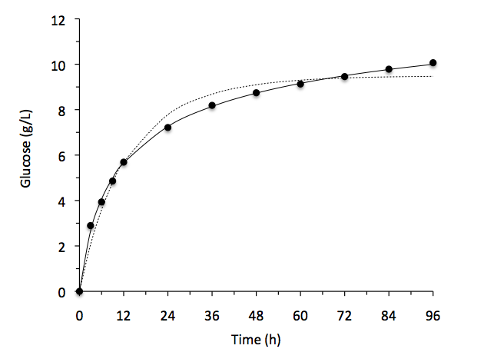
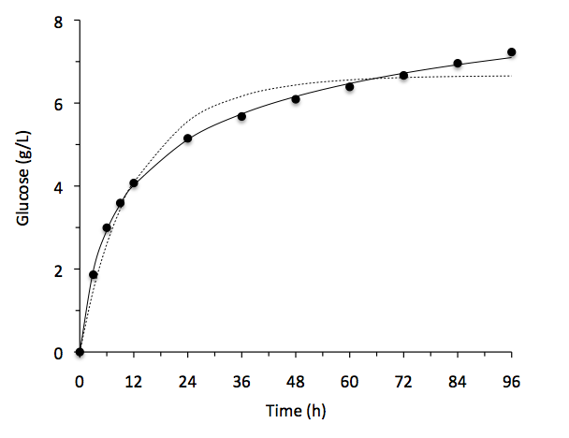
University of Minho School of Engineering Centre of Biological Engineering
SIMULATION OF ENZYMATIC HYDROLYSIS OF WHEAT STRAW USING AUTOHYDROLYSIS AND ORGANOSOLV
HECTOR A. RUIZ *
António A. Vicente, José A. Teixeira
* hector_ruiz@deb.uminho.pt
Introduction
Enzymatic hydrolysis of cellulose to produce reducing sugars has long been pursued for its large potential value in many industries such as bioenergy, food, textile, detergent, animal feed, pulp and paper.
To render the enzymatic process of lignocellulosic biomass is still a critical cost center in the overall bioconversion process. A kinetic model of enzymatic hydrolysis could be a useful forecasting tool in this context.
Empirical models such as artificial neural network and response surface methodology models could accurately predict the enzymatic reaction, and the reaction conditions could always be optimized using these models. However, such models could not provide any insight into the mechanistic details of the process and be applied outside the conditions under which they are developed.
It has been generally accepted that cellulase deactivation during the enzymatic hydrolytic process results in some hydrolytic rate slowdown. Cellulase could be deactivated by many factors including shear force, temperature, ion strength, product inhibition, and ineffective adsorption of cellulase.
This work, the modeling and simulation of enzymatic hydrolysis pretreated solids obtained by a sequence of autohydrolysis (solubilization of hemicellulose) and organosolv (solubilization of lignin) were studied.
Methodology
Methodology
The autohydrolysis (APS) and sequence of autohydrolysis and organosolv (OPS) pretreated solids were used as substrate for enzymatic saccharification. Enzymatic saccharification were performed in a jacketed glass reactor with a working volume of 50 mL at 50 ºC by duplicate, using cellulase (Celluclast 1.5 L) and β-glucosidase (Novozyme 188) with a loading of 40 FPU/g and 60 IU/g of cellulose, respectively, in 50 mM citrate buffer (pH 4.8) with 2 % (w/v) sodium azide to inhibit microbial contamination and a final cellulose concentration of 1 % (w/v). Agitation was carried out using a magnetic stirrer (150 rpm) and samples were taken at 3 h intervals for the first 12 h and at 24 h intervals until a total time of 96 h. The samples were kept in boiling water for 5 min to inactive enzymatic activity, and then centrifuged at 8260 x g for 10 min to remove insoluble substrate; the supernatant was filtered through a 0.2 μm sterile membrane filter analyzed for soluble sugars in HPLC.
Modeling and simulation of enzymatic hydrolysis
Cellulase consists of three components is assumed to form a single combined effect on the hydrolysis of insoluble substrate. The assumptions of the model are: 1) cellulase enzyme containing endo-β-1,4-glucanase, exo-β-1,4-cellobiohydrolase and assuming a single combined effect in the hydrolysis of insoluble substrate; 2) surface structure of insoluble substrate was considered homogeneous. It is shown as the following equation.
Applying mass action law and quasi-steady-state theory, a mathematical equation cab be deduced as follow:
where K_{e} is the equilibrium constant. [S₀], [p] and [E] represent concentrations of initial substrate, product and enzyme. When cellulase deactivation is considered as a first order reaction, the deactivation rate can be expressed by:
When cellulase deactivation is considered as a second order reaction, the deactivation rate can be expressed by the following equation:When cellulase deactivation is considered as a second order reaction, the deactivation rate can be expressed by the following equation:
The simulation of first and second order model was performed using Matlab software.
Results and Discussion
Simulation of first and second order model
The experimental glucose data concentration profiles of the enzymatic hydrolysis of APS and OPS, were fitted corresponding to the first and second order kinetic models, are shown in the Fig. 1A-B. In all cases, a good agreement with the experimental results was obtained (correlation coefficient, R² > 0.97).
Conclusion
The model based on the second order kinetics for cellulase deactivation was accurate on the description of the enzymatic saccharification process of all the studied substrates. This model can provide useful indications for the optimization of the kinetics of enzymatic saccharification of insoluble substrate for industrial applications.
(A)
(B)
Wheat straw
Autohydrolysis (180 ºC/ 30 min)
Enzymatic hydrolysis
Organosolv (180 ºC/ 20 min)
Figure 1. Simulation of first and second order model
Modeling and Simulation
Enzymatic hydrolysis
Modeling and Simulation
Uma Escola a Reinventar o Futuro – Semana da Escola de Engenharia - 24 a 27 de Outubro de 2011

