Slide 1
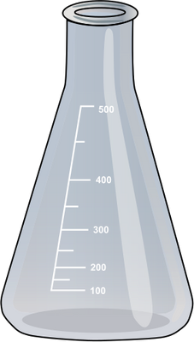
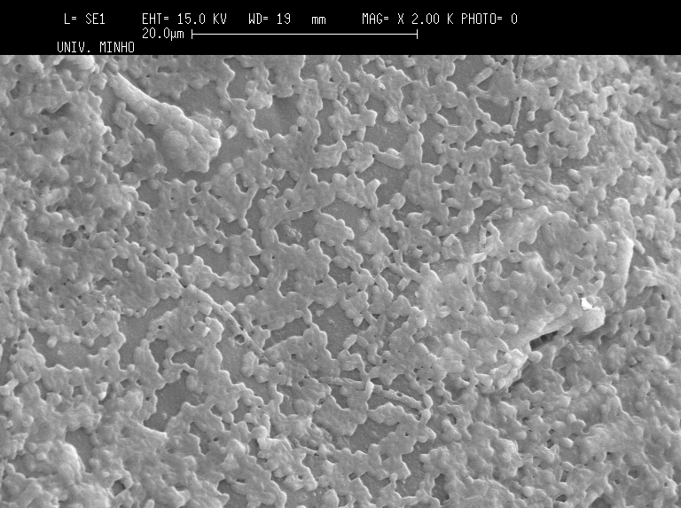
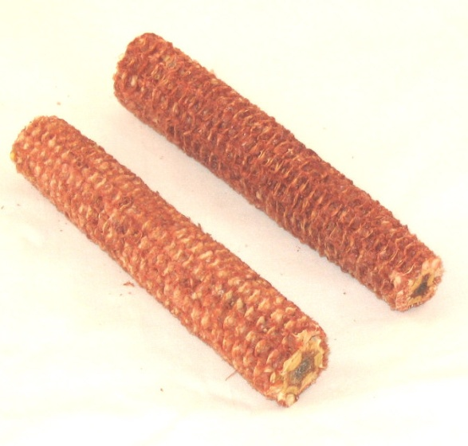
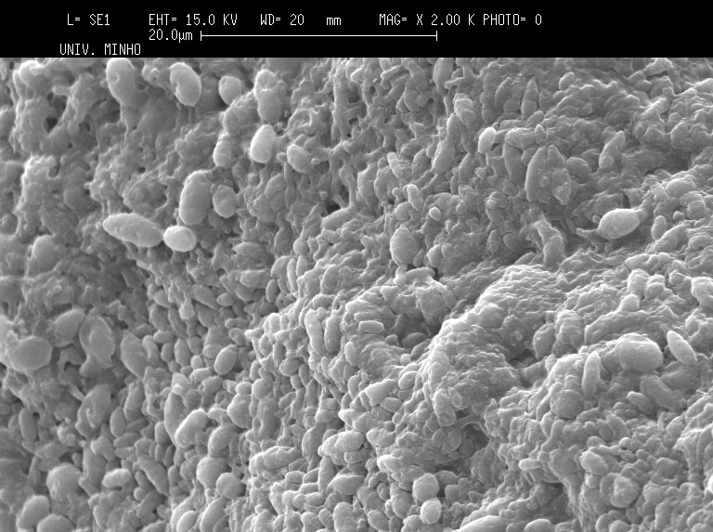
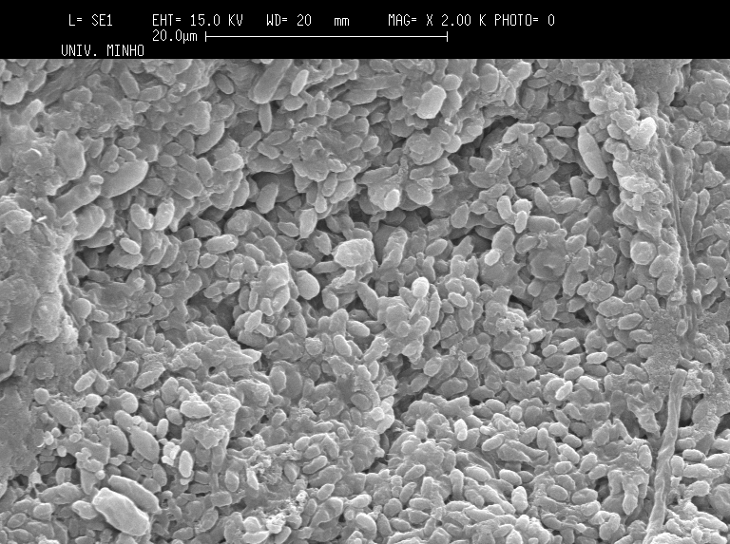
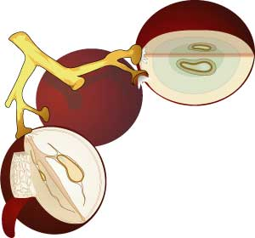
University of Minho School of Engineering Centre of Biological Engineering
INFLUENCE OF CONCENTRATION AND TYPE OF SUPPORT MATERIAL ON THE IMMOBILIZTION OF OENOCOCCUS OENI
Author* ZLATINA GENISHEVA
Supervisors: José A. Teixeira, José M. Oliveira
* zlatina@deb.uminho.pt
ABSTRACT
The malolactic fermentation (MLF) in winemaking is a complex and difficult to control biological process. The implementation of MLF is very important for wines produced in cold regions as it reduces the acidity, brings biological stability and may improve the organoleptic characteristics of the product. MLF normally occurs spontaneously during storage of a new wine and is usually a very slow process that can undergo for weeks and even months, and not always give a satisfactory result. The use of immobilized lactic acid bacteria during MLF helps to accelerate the process and also simplifies the control of its extension. However, the material to be used as immobilization support must be carefully chosen in order to not negatively affect the final product, and should also be cheap, abundant in nature, and of food grade purity.
The aim of the present work was to evaluate different low cost natural materials of food grade purity (namely corn cobs, grape stems and grape skins) and their concentration, for immobilization of Oenococcus oeni for use on MLF.
MATERIALS AND METHODS
Fermentation runs were performed in complex medium with the following composition (g L^{–1}): glucose (15), yeast extract (4.0), meat extract (8.0), bacteriological peptone (10.0), MgSO₄ (0.2), MnSO₄ (0.05), sodium acetate (5.0), tween 80 (1.0), di-potassium hydrogen phosphate (2.0), di-ammonium hydrogen citrate (2.0) and malic acid (5.0).
RESULTS AND DISCUSSION
The statistical analysis clearly showed that fermentation results obtained by using low concentration of support material were different from those achieved when using high amount of support materials (Table 1).
Table 1. Multiple comparison analysis (Tukey’s test; p<0.05) for the concentration of immobilized cells (C_{i,biom}) and lactic acid (C_{lac.ac}), lactic acid yield (Y_{P/S}) and productivity (Q_{p}) during the MLF by O. oeni.
Support and |  | C_{i,biom} |  | C_{lac.ac.} |  | Y_{P/S} |  | Q_{P}
concentration |  | mg g^{–1} |  | g L^{–1} |  | g g^{–1} |  | g L^{–1} h^{–1}
Corn cobs 10 g L^{–1} |  | 32.8 ^{b} |  | 32.52 ª |  | 1.90 ª |  | 4.06 ª
Grape skins 10 g L^{–1} |  | 40.75 ^{b} |  | 27.36 ^{b} |  | 2.01 ª |  | 3.42 ^{b}
Grape stems 10 g L^{–1} |  | 31.0 ^{b} |  | 32.27 ª |  | 1.92 ª |  | 4.03 ª
Corn cobs 30 g L^{–1} |  | 111.0 ª |  | 14.72 ^{c} |  | 1.02 ^{b} |  | 1.84 ^{c}
Grape skins 30 g L^{–1} |  | 108.8 ª |  | 14.07 ^{c} |  | 1.05 ^{b} |  | 1.76 ^{c}
Grape stems 30 g L^{–1} |  | 40.7 ^{b} |  | 14.68 ^{c} |  | 1.09 ^{b} |  | 1.83 ^{c}
Figure 1. Malic acid consumption as a function of the time. A – materials in concentration of 10 g L^{–1}, B – materials in concentration of 30 g L^{–1}.
washed with distilled water
dried at 60 °C
These results are of great interest since demonstrated that all the evaluated support materials may be used without any pretreatment since these materials are new materials for the immobilization of Oenococcus oeni during MLF. As these materials are agricultural and wine industry wastes, their use for cells immobilization could be an alternative for their application and valorization.
10 g/L / 30 g/L support
1 g/L cells
All the fermentation runs with immobilized cells had high percentage of malic acid conversion (> 78 %). Fermentations in presence of 30 g L^{–1} of grape skin showed the highest percentage of malic acid conversion (91 %), while the lowest value (78 %) was detected for fermentations in presence of 10 g L^{–1} of corn cobs.
Corn cobs and grape skins in amounts of 30 g L^{–1} were the best support materials for O. oeni immobilization, since they immobilized the highest amount of cells (111.0 mg g^{–1} and 108.8 mg g^{–1}, respectively). How-ever, fermentation with cells immobilized on 10 g L^{–1} of corn cobs and grape stems gave higher productivity in lactic acid, Q_{p} (4.06 g L^{–1} h^{–1} and 4.03 g L^{–1} h^{–1}, respectively); and the cells immobilized on 10 g L^{–1} of grape skins provided the highest lactic acid yield of 2.01 g g^{–1}. As a whole, fermentations with bacteria immobilized on 10 g L^{–1} support yielded more significant concentrations of lactic acid. Additionally, malic acid consumption was faster in the fermentations with immobilized cells compared to fermentations with free cells, except for the assays with 10 g L^{–1} of grape skins (Figure 1). Figure 2 shows images of the bacteria immobilized on the support materials.
200 mL MRS medium
support materials:
corn cobs
grape skin
grape stems
200 mL complex medium +
5 g/L malic acid
A
B
C
28°C, 48 h
28 °C, 10 h
Inoculum
Fermentation runs
Oenococcus oeni
Figure 2. Scanning electron microscopy of support materials with immobilized cells of O. oeni. A – corn cobs, B – grape skins, C – grape stems.
Uma Escola a Reinventar o Futuro – Semana da Escola de Engenharia - 24 a 27 de Outubro de 2011

