Slide 1
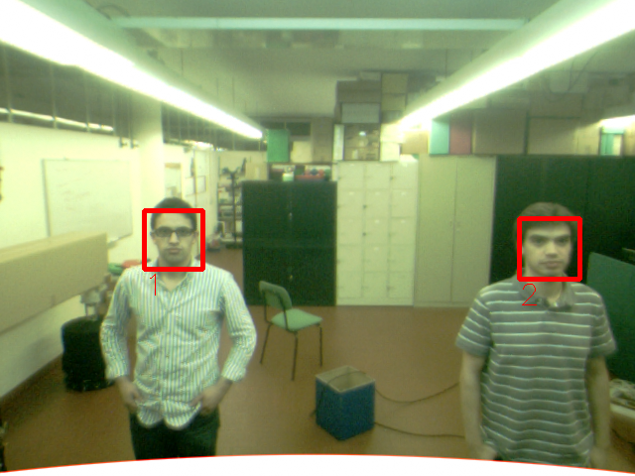
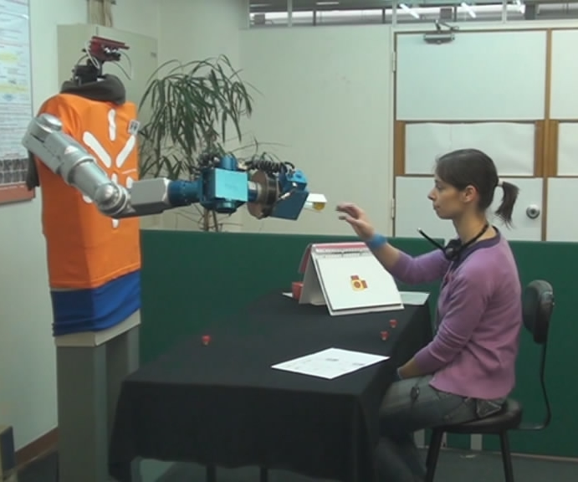
University of Minho School of Engineering Centre ALGORITMI
TOWARD ROBOTS AS SOCIALLY AWARE PARTNERS IN HUMAN-ROBOT INTERACTIVE TASKS
RUI SILVA*
Supervisors: Estela Bicho, Pedro Branco
* rsilva@dei.uminho.pt
Robots beyond tools
Today’s robots are still far from being able to interact with humans in a natural and human-like way (Breazeal, 2003; Fong 2003). Robots should interact actively with humans, rather than be used as mere tools. Hence, non-verbal communication is an essential component for every day social interaction;
We humans continuously monitor the actions and the facial expressions of our partners, interpret them effortlessly in terms of:
Their intention;
Emotional/mental state.
Use these predictions to select an adequate complementary behaviour (Blair, 2003).
Two important (high level) cognitive skills are required:
Understanding human actions;
Understanding/interpreting emotional states;
Increase the acceptance by allowing a fluent adjustment of complementary behaviours in human-robot collaborative tasks, without the need to use explicit communication;
Robotic platform
ARoS (Anthropomorphic Robot System), an anthropomorphic robot composed of:
Static torso;
7 DOF arm;
4 DOF dexterous hand;
Pan-tilt unit;
Stereo vision system.
Cognitive architecture for Joint-Action
The existing cognitive control architecture allows the robot to:
Read motor intentions;
Implement a flexible mapping from action observation onto action execution;
Motivation
Advance towards more socially intelligent robots;
This implies, endowing the robot with additional cognitive skills:
Action and Facial expression understanding and to behave accordingly.
Pay attention!
In order to facilitate interaction, the robot should demonstrate in some way that it’s paying attention to the person working with it.
The implementation of this feature is done integrating multiple facial detection
with an attention system based in a 2D Dynamical Neural Field formalized by:
The system deals with multiple faces being detected as different inputs to the system, this takes into account two parameters measured for every detected face, respectively to the robot:
The position;
The distance.
This information is obtained combining face detection algorithms with stereo image processing. This generates the sensory input to the decision system.
The decision system handles all the inputs provided by the vision system and, using a 2D Dynamical neural field, produces a decision of where the robot should look.
Fig. 4 shows graphs that describe the different steps of the decision process:
Left – inputs directly from the vision system;
Centre – Excitation field with received inputs;
Right – Output decision.
Advantages
This system based in Dynamical Neural Fields, acquires some of the properties demonstrated by this bio-inspired theory, that models the current knowledge about the functions of neuronal circuits in our brains. We use this to endow this system with some cognitive skills present in these systems, such as: memory, decision making and prediction, among others.
Conclusions
The current attention system enables the robot to maintain its attention in one person, even if others appear in its visual field. It is also able to track the person interacting with him, and even predict where it is if the person disappears for some time.
References
Breazeal, C. (2003). Toward sociable robots. Robotics and Autonomous Systems, 42(3-4), 167–175. Elsevier.
Silva, R., Bicho, E., & Erlhagen, W. (2008). ARoS: An Anthropomorphic Robot For Human-Robot Interaction And Coordination Studies. In Proceedings of the CONTROLO'2008 Conference - 8th Portuguese Conference on Automatic Control (pp. 819-826). UTAD - Vila Real, Portugal: UTAD.
Fong, T., Nourbakhsh, I., & Dautenhahn, K. (2003). A survey of socially interactive robots. Robotics and autonomous systems. Elsevier.
Blair, R. J. (2003). Facial expressions, their communicatory functions and neuro-cognitive substrates. Philosophical Transactions of the Royal Society B: Biological Sciences, 358(1431), 561. The Royal Society.
Fig. 4 – 2D Dynamical Neural Field decision system
Fig. 1 – Monitor the
partner’s actions
Fig. 3 – Vision system snapshot
$$τ\frac{du(x,y)(t)}{dt}=−u(x,y)+S(x,y,t)+h+∬F[u(x′,y′)].w(x−x′,y−y′)dx′dy′$$
Fig. 2 - Silva et al. (2008)
Uma Escola a Reinventar o Futuro – Semana da Escola de Engenharia - 24 a 27 de Outubro de 2011

