Slide 1
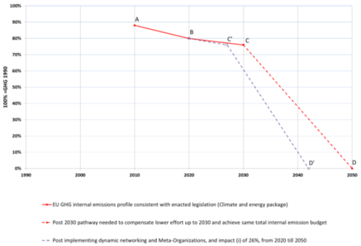
University of Minho School of Engineering CITEPE
EVALUATION OF POTENTIAL OF META-INSTITUTIONS AS DEVELOPMENT SUPPORT FOR VIRTUAL AND UBIQUITOUS ENTERPRISES MODELS – APPLICATION TO REGIONAL CLUSTERS
HÉLIO CASTRO*
Supervisors: Goran D. Putnik, Maria Manuela Cruz-Cunha
* hcastro@dps.uminho.pt
INTRODUCTION
SUPPORTING TOOLS
CASE STUDY
Innovativeness, competitiveness and sustainability are now key aspects for businesses to survive in the current economic context. The definition of new concepts of organizational business is, clearly, a critical factor for success and differentiation.
In order to reinvent the future, new concepts of organizational business, such as Virtual Enterprises and Ubiquitous Enterprises, supported by external organizations, so called Meta-Institutions, are required.
To support the perception of regional companies of the advantages of these new organizational models, two demonstrators were developed:
“Impact of Virtual Enterprise Dynamic Reconfiguration on Product Time-To-Market”;
“Planning vs. Dynamic Reconfiguration”
A case study was developed to present quantitative benefits of new organizational models through the impact of these models in the greenhouse gas (GHG) emissions due to the acceleration of new sustainable products development.
Applying in the demonstrator “Impact of Virtual Enterprise Dynamic Reconfiguration on Product Time-To-Market (TTM)” to the formulated case study, providing real case parameters, has shown the acceleration of new sustainable products development , i.e., a TTM reduction. The conservative hypothesis indicate a TTM reduction of 26%.
Using as reference the commitment of the European Union in the Copenhagen Agreement to achieve the GHG to less than 50% of 1990 levels by 2050 (see Figure 3.) and employing the ImPACT identity model to measure the impact, based on the TTM reduction of the case study, the commitment of the European Union is achieved in 2042 (point D’ in Figure 4), instead of 2050 (point D in Figure 4).
MAIN OBJECTIVES
The main objectives of this research are to prove the following theses:
Regional enterprises are aware of the urgency to adopt Virtual Enterprises (VE) and Ubiquitous Enterprises (UE) as a factor of competitiveness and sustainability;
Regional enterprises are prepared to use Meta-Institutions as a support environment for Virtual and Ubiquitous Enterprises model.
The above theses imply the following activities:
Assess the perception, technological capacity and levels of awareness and preparedness of the enterprises in the region for Meta-institutions in order to implement and use them as a support in the emerging models of VE and UE implementations;
Assessing the potential of environments such as Meta-institutions, to support adoption of Virtual Enterprises and Ubiquitous Enterprises models.
Figure 1: Starting page of the demonstrator a) (http://labve.dps.uminho.pt/demonstrators/demo1/).
Figure 3: Short term EU profile compared to 2ºC compatible long term target .
Figure 2: Starting page of the demonstrator b) (http://labve.dps.uminho.pt/0902//).
Figure 4: Graphical representation of impact reduction of 26%.
Uma Escola a Reinventar o Futuro – Semana da Escola de Engenharia - 24 a 27 de Outubro de 2011

