Slide 1


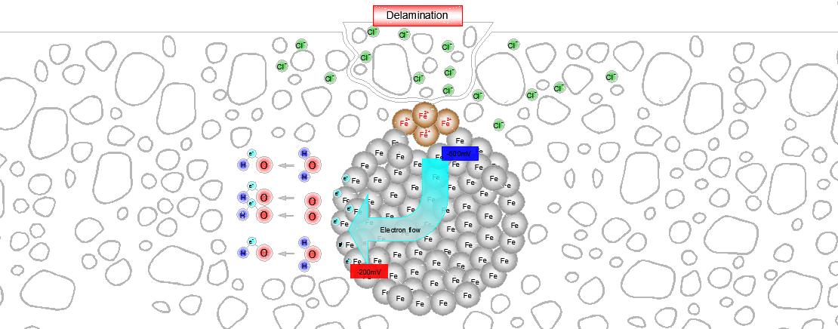
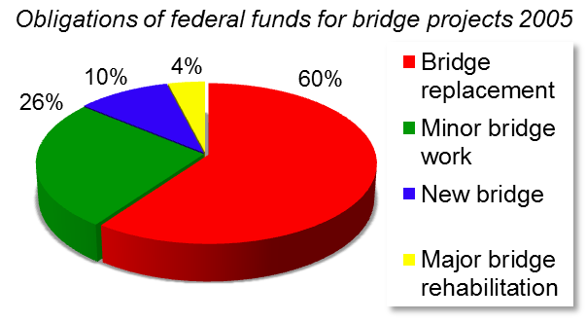

University of Minho School of Engineering ISISE, Department of Civil Engineering
LIFE-CYCLE ANALYSIS OF CONCRETE ROADWAY BRIDGES
Author* JOSÉ CARLOS ALMEIDA
Supervisor: Paulo Cruz; Co-Supervisor: Jorge de Brito.
*jcalmeida73@gmail.com
1. Introduction
Actually one of the most important challenges of our society is to perform the maintenance\repair operations of the existent bridge stock with the scarce resources that are allocated, by governments, to these activities. It is reported that most of the funds are distributed to the existent bridges instead of applying them in new structures. This reality is in fact is because of
New structures
physical barriers;
stainless steel;
epoxy coating of rebar;
concrete mix modifications;
cathodic prevention.
Structures in use
traditional intervention;
physical barriers;
cathodic protection;
concrete realkalinization;
electrochemical chloride removal.
the aging and fast deterioration of the stock of bridges. For instance in the US approximately 25% of the total 600.000 bridges as some kind of abnormality
3rd stage – Optimisation of the investment plan, for a predetermined lifetime value, through the determination of life cycle costs, in net present values, for the different alternatives.
When the carbonation front reaches the embedded steel creates conditions for the start of a generalized corrosion due to the existence, among others elements, of water, oxygen and chlorides.
Quantification the costs of each technique
cost of application;
lifetime of the technique;
number of reapplications.
Quantification of functional costs
delay of users;
diverted traffic;
accidents.
and in that group around 52% of them are classified as obsolete. In the US, and per year in the period of 2003 to 2005, the obligation of federal funds for bridge projects averaged 7.200.000.000 USD!!!
2. Objective
The aim of this research is the creation of a tool that enables the optimization of the funds involved in the maintenance\repair of concrete road bridges. This optimization is performed considering, over the time, the behaviour of materials and establishing different scenarios for the maintenance\repair strategies. The life-cycle costs optimization is performed considering not only the direct costs of the reparation itself (materials, labour, etc.) but also the users costs (detours, delays, etc.). The consideration of the user costs in the analysis is fundamental because, in certain scenarios, the functional costs can be more than 10 times the direct costs.
3. Methodology
The work is based on materialization of three different stages:
Determination of the net present value for each technique
The choice of the timings for the applications of the maintenance measures results from the time of initiation and propagation of corrosion due to the action of chlorides and carbonation.
The intervention strategy is based in the three following effects.
The depth of carbonation:
Effect of chlorides:
Corrosion rate:
4. Conclusions
The application of the proposed methodology, for determination of the life-cycle costs, will allow the optimization of the maintenance strategy for each individual bridge.
The methodology allows even the determination either of the direct costs, of the agencies, and the users costs for all the assumed strategies for new bridges and for bridges in use
1st stage – Modelation of the main mechanisms that lead to corrosion of steel in concrete due to the action of chloride and carbonation and the consequent deterioration of reinforced concrete structures. The simulation of the behaviour of the deterioration is materialized considering the action of chlorides in the reinforced
2nd stage – Determination of the effect of different intervention strategies
scheduling of the first application;
effect on the structure reliability;
possibility of reapplication;
time between reapplications;
life extent.
concrete. The action of chlorides causes a localized corrosion due to the movement of electrons caused by the difference of potential in the concrete, creating a cathode where occurs the formation of the ferrous ions and an anode where occurs the dissolution of the water molecules giving the origin to the hydroxide ions.
Acknowledgements
The author would like to thanks to FCT (Fundação para a Ciência e Tecnologia) for funding the Project PEst-OE/EGE/UI4056/2011 and also for the attribution of the PROTEC scholarship.
Uma Escola a Reinventar o Futuro – Semana da Escola de Engenharia - 24 a 27 de Outubro de 2011

