Slide 1
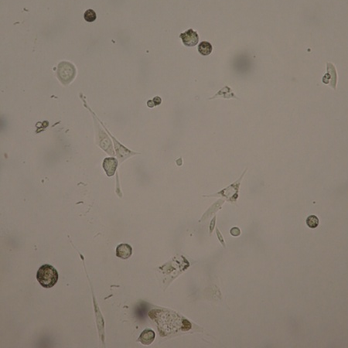
University of Minho School of Engineering Center of Biological Engineering
SERUM-FREE MEDIUM ADAPTATION OF MAB-PRODUCING CHO-K1 CELLS: CRITICAL STEPS AND GUIDELINES
Author* COSTA, A.R.; RODRIGUES, M.E.
Supervisors: Azeredo, J.; Oliveira, R.; Henriques, M.
* anaritamc@deb.uminho.pt
Introduction
Large-scale production of biopharmaceuticals, such as monoclonal antibodies (mAb), commonly requires the use of serum-free (SF) medium for both safety and cost reasons. But since serum is essential for most mammalian cells’ growth, its removal becomes very time-consuming. Therefore, cells are usually subjected to a gradual adaptation consisting of a step-wise decrease of serum concentration. To ease this process, other media supplements such as insulin and trace elements can be used. In this study, strategies for CHO-K1 cell adaptation to SF media using different supplement combinations were assessed, and the most critical steps / problems identified.
Methods
Adaptation methodology: Cells were grown in DMEM supplemented with gradually reduced serum percentages (10 to 0.625%). Different supplement combinations were tested (Table 1). At 0.625 % serum, cells were sequentially adapted to the chemically-defined SF medium EXCELL CHO DHFR-, and the SF adaptation was continued.
First experiment: Cultures were initiated in 24-well plates and all combinations were tested. A CHO-K1 cell line transfected with OSCARTM technology for mAb production was used.
Second experiment: Cultures were initiated in 25 cm² T-flasks and combinations C2, C3 and C5 were tested. Three cell lines were used to assess the impact of transfection on the process of adaptation: (A) CHO-K1 non-transfected; (B) CHO-K1 transfected with a common method; and (C) CHO-K1 transfected with OSCARTM technology.
Results
First experiment
Cells died at: 2.5 % serum for C1 and C4 (ammonium iron citrate); 0.625% serum for C2, C3 and C5. Some procedures should be carefully considered.
Second experiment
Conclusions
The use of media supplements impacts cell adaptation to SF conditions. C3 proved to be the best combination in this study
For the set of conditions evaluated in this study, the mAb-producing cell line C proved to be the one with better ability to adapt to SF medium
The process of adaptation to SF medium is very demanding to the cells, making them more sensitive to procedures that are commonly used in cell culture (centrifugation and trypsinization)
Use higher initial cell concentration to allow higher cell survival
Avoid harsh procedures to the cells (centrifugation, trypsin)
Allow enough time for full cell adaptation at each step.
2.5 %
1.25 %
0.625 %
DMEM
0.625 % EXCELL
0.31 %
0.075 %
C5
Among the three cell lines assessed, cell line C demonstrated better ability to adapt to SF conditions
C3
Cell adaptation from DMEM to EXCELL is easily achieved, as long as some serum supplementation is maintained.
A
C2
Combination C3 provides the better cell adaptation for all cell types assessed in the study
C5
TABLE 1. Composition of the five combinations of media supplements tested
Cells start to detach at 0.31 % serum, and become fully detached at 0.15 %, growing in suspension from this point on.
MEDIA SUPPLEMENT | FUNCTION | COMBINATION
 |  | 1 | 2 | 3 | 4 | 5
rhInsulin | Growth factor | X | X | X | X | X
Copper sulfate (CuSO₄) | Proliferation | X | X |  | X | X
Zinc sulfate (ZnSO₄) | Proliferation | X | X |  | X | X
Sodium selenite (Na₂SeO₃) | Antioxidant | X | X |  | X | X
Ammonium iron citrate (FeC₆H₅O₇.NH₄OH) | Proliferation | X |  |  | X
Ferrous ammonium sulfate (NH₄Fe(SO₄)₂) | Proliferation |  | X |  |  | X
Ammonium metavanadate (NH₄VO₃) | Unknown |  |  | X | X | X
Nickel chloride (NiCl₂) | Unknown |  |  | X | X | X
Tin chloride (SnCl₂) | Unknown |  |  | X | X | X
C3
B
C2
C5
C
C3
C2
Uma Escola a Reinventar o Futuro – Semana da Escola de Engenharia - 20 a 26 de Outubro de 2011

