Slide 1
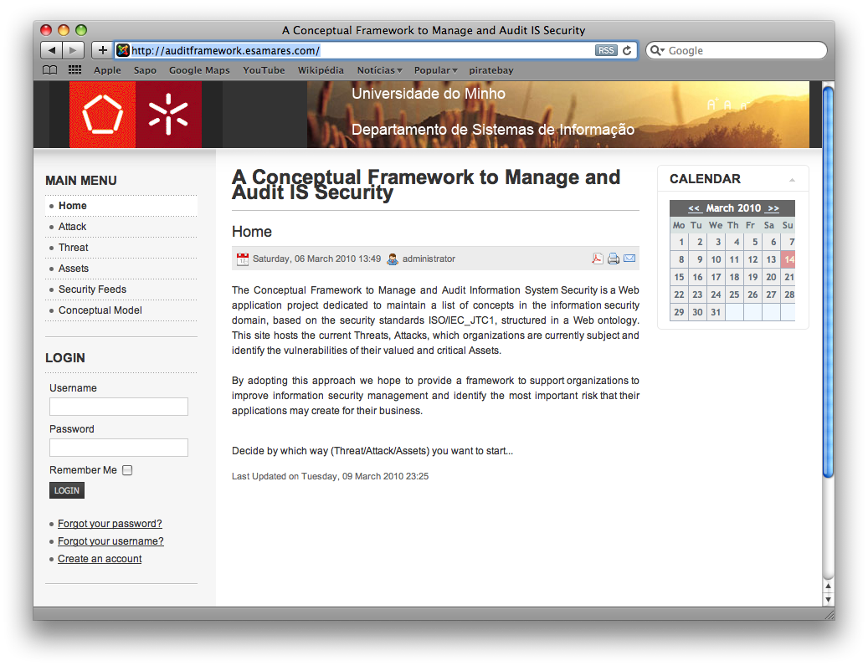
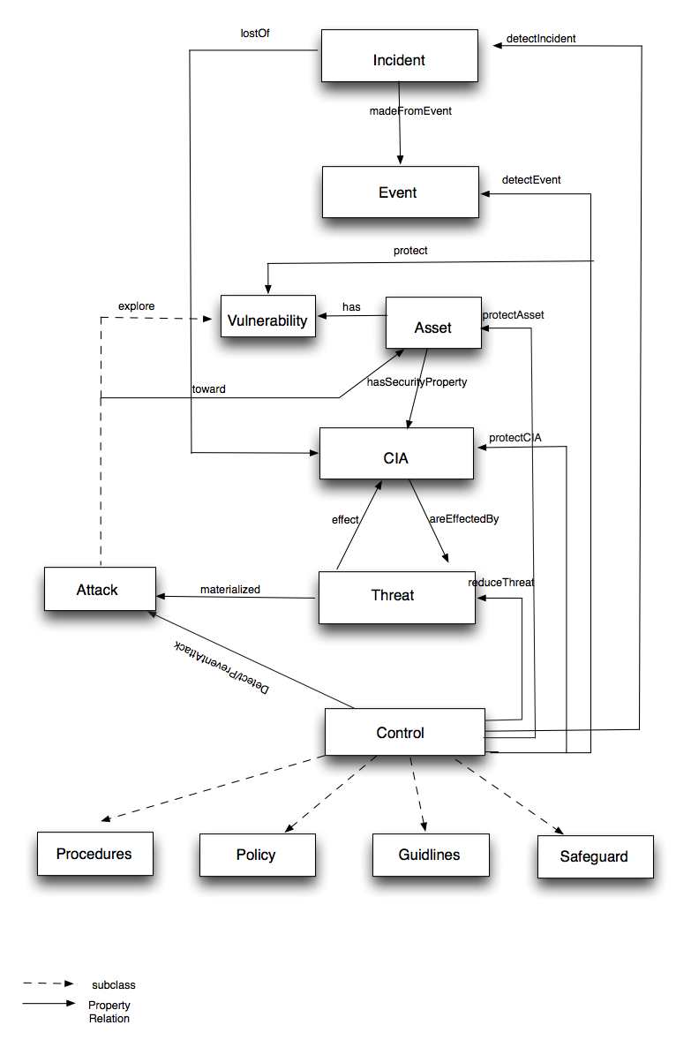
University of Minho School of Engineering Algoritmi Center
A CONCEPTUAL FRAMEWORK TO SUPPORT INFORMATION SYSTEM SECURITY MANAGEMENT
TERESA PEREIRA*
Supervisors: Henrique Santos
* tpereira@esce.ipvc.pt
Problem Statement
Context
Technology evolution
Rapid growth and availability of new services to facilitate accessibility, e.g., cloud computing services
Why
Increasingly dependency on the IS performance
Ensure daily operational activities
Promote competition
New businesses opportunities
Research question:
A conceptual model based on hierarchical concepts structured in an ontology can improve Information System Security Management ?
Research Plan
Research the main ISM models (COBIT, ITIL, OCTAVE and 27000 derived)
Development of an ontology
Security concepts are defined accordingly the established security standards ISO/IEC_JTC1.
Development of a framework based on a conceptual model defined within information security domain.
Evaluate the improvements of the ISM process based on a formal model
Survey with expertise's in the area
Threat - Represents the types of dangers against a given set of properties (security properties). The attributes defined in this concept follow the Pfleeger approach [2].
Control - A mechanisms used to detect an incident or an event, to protect an asset and their security properties, to reduce a threat and to detect or prevent the effects of an attack.
IS Security management become a fundamental principle for businesses performance
Brings unexpected risks, compromising the organization activity => organizations need a proper information security management
Example
Ontology Conceptual Model
Business Objective: Reduce cost of sales
Sales and marketing function has an objective to reduce cost of sales.
Incident - A single or series of unwanted or unexpected events that might have significant probability to compromise the information system security.
(Security) Event - An identified occurrence of a particular set of circumstances that changed the status of the information system security.
Asset- Any resource that has value and importance to the owner of the organization.
Business Process: Online ordering for customers
A key business process to help achieve this to provide an online ordering capability.
Order made by customer online
Receip of products confirmed by supplier and entered “manually” in to suppliers ERP system
Access provide to third parties that provide delivery services of product
Figure 2: Print screen of the developed framework
Conclusions
Non existence of high level conceptual model for ISM prevents the adoption of Information Security practices.
The ontology based approach firm up and unify the concepts and terminology in the security information domain, based on the ISO/IEC_JCT1 standards;
Formal model based on a Information Security standard promote a more efficient ISM implementation.
Ontology formalization in OWL will promote interoperability among different knowledge representation systems;
References
ISO/IEC_JTC1 (2005). ISO/IEC FDIS 27001 Information technology — Security techniques — Information security management systems — Requirements. Geneva, Switzerland, ISO copyright office.
Pﬂeeger, Charles, P., Pﬂeeger, Shari, L. (2007) Security in Computing, 4th ed., Prentice Hall PTR.
Systems that support the business process
The online ordering process is dependent on systems to collect orders, confirm customers transaction and to engage a local third party to deliver the product.
Online Portal
ERP System
Risk: Hacking online portal
Risk: Spoofing website
Risk: Man in the middle attacks
Risk: Data entry error
Risk: Theft of data
Risk: Loss of power
Risk: Misuse of system by third party
Risk: Malware infection from
Risk: Unauthorised deletion of orders
Figure 1: Concepts and relationships defined in the conceptual framework
This business process is exposed to a wide range of risk types.
CIA - The information properties to be ensured.
Vulnerability - Represents any weakness of the system.
Attack - A sequence of actions executed by some agent (automatic or manual) that explore any vulnerability and produce one or more security events.
Source: Reporting information risk. ISF, 2010
Identify the threats and attacks;
Evaluate/examine security procedures in use;
Mitigate the risk.
A proper ISM must allow organizations to:
Protect its valued/critical asset;
Identify their vulnerabilities;
Uma Escola a Reinventar o Futuro – Semana da Escola de Engenharia - 24 a 27 de Outubro de 2011

