Slide 1

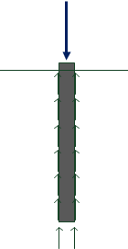
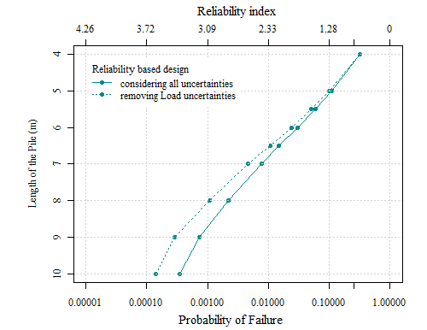
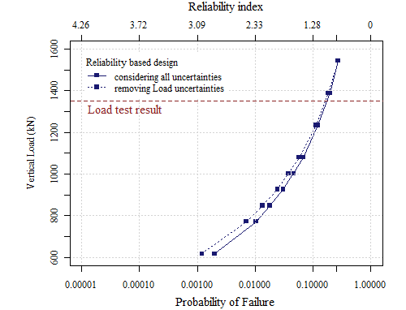


University of Minho School of Engineering Territory, Environment and Construction Centre (C-TAC), DEC
VALUABLE INFORMATION FROM RELIABILITY ANALYSIS OF A PILE FOUNDATION
Author* ANA TEIXEIRA
Supervisors: António Gomes Correia, António Abel Henriques (FEUP)
* AnaCMTeixeira@civil.uminho.pt
SFRH/BD/45689/2008
consistent results with MCS, and both revealing that transformation or model errors (modelling uncertainties) have a high importance in probability of failure.
In Figure 4 are depicted the results of ways of RBD, determination of the maximum load that a pile can withstand to verify the probability of failure. they show a semi-log relationship between probability of failure and the length of the pile while for axial load this relationship is more exponential.
Conclusions and Contributions to pile design
This work wants to demonstrate a simple methodology that is based on reliability theory, for design of pile foundations. Also, this is a more rational way to deal with uncertainties of a problem, instead of just introducing a “blind” factor of safety.
The methodology aims to eliminate the loss of intuitive understanding of the design problem. Furthermore, since in geotechnical problems is difficult to gather the necessary information to characterize the random variables and the recommended values in bibliography are many times not applicable, this study also presents a sensitivity analysis of the type of uncertainties helping save time and optimizing resources on investigations of random variables.
Introduction
Unlike in structural engineering, traditional way of geotechnical design is mainly by introducing the uncertainties through high global safety factors based on past experience. But, of course, this way of treating uncertainties does not give a rational base to understand their influence in design.
Reliability based design (RBD) helps evaluate the probability of a particular behaviour in a time period, with the knowledge of the input parameters randomness (uncertainties). The biggest benefit is that it quantifies and gives information about the parameters that mostly influence the behaviour under study.
Geotechnical environment is very different from structural, therefore, these methodologies require special adaptation. It is our aim to show how an engineer can treat geotechnical uncertainties in a simple way and how can they achieve important information from it. This capacity is important, not only because of the new regulation codes and social concerns, but also because these probabilistic formats support decision making under uncertainties, like qualitative judgments and investments, very important in geotechnical area.
How to do a Reliability Analysis
With this data one can determine the most influential uncertainty in pile design or the minimum dimensions of the pile and maximum axial load that lead to a previously established probability of failure (normally between 10⁻³ and 10⁻⁵). The two most widely known RBD methodologies are level II First Order Reliability Method (FORM) and level III Monte Carlo Simulations (MCS).
FORM has some limitations with complex performance functions, for example, performance functions with a limit condition, therefore sometimes it is not possible to apply. While Monte Carlo simulations is a very simple, does not require deep knowledge and provides a better understanding to apply in practice. This two methods are applied in this study and the results compared.
Application example
The results here presented are from a concrete bored pile foundation in residual soil with 60 centimeters of diameter (static load test result to failure of 1350 kN).
Performance function:
* Resistance is evaluated by an empirical method based on SPT N-value.
Table 1: Uncertainties for the application example
Uncertainties sensitivity analysis
Sensitivity analyses help knowing the most influential variables, this allows a better judgment, justifying extra investments to ensure safety. The uncertainties are studied one by one to determine their influence, for both FORM and MCS methods. Results are depicted in Figure 3.
The impact on the performance of the pile and consequently the reliability can be assessed for the diffe-rent uncertainties, stu-dying at the same time different lengths or loads.
It can be seen that FORM method shows
Real Soil
Modelled soil
Transformation Error
Figure 3: Influence of each uncertainty (%) in pile RBD
Spatial Variability
+
Statistical Estimation Error
Measurement Error
Load Uncertainty
Parameters for design
Design Result
Modelling Uncertainty
Reliability Analysis method
Figure 2: Uncertainties considered in pile RBD
A construction work can be evaluated by different methods, each one with its level of accuracy and way of dealing with uncertainties, as shown in Figure 1.
After selecting the level of reliability, the next step is the definition of the performance function (failure mode) and the evaluation of uncertainties (see Figure 2 and Table 1):
Physical (inherent to the material and equipment),
Statistical (limit size samples)
Modelling (transformation errors)
Spatial variability and
Human errors
Level III ✶✶✶ Full probabilistic Mean, variance and prob. distribution Simulation methods
Level II ✶✶ Approximate probabilistic Mean and variance eg.: FORM
Level I ✶ Semi-probabilistic Partial safety factors and deterministic formulas
$$M={Resistance}^{∗}−Actions$$
$$M=\left(R_{tip}+R_{side}\right)−\left(G+Q\right)=\left(δ_{t}∙Q_{tip}+δ_{f}∙F_{side}\right)−\left(δ_{G}∙G_{k}+δ_{Q}∙G_{k}\right)$$
Figure 4: Results of RBD for application example (pile foundation)
Uncertainty | Variable | Mean | S.D. | Distribution
Soil variability | SPT N-value | 10.26 + 1.91z | 4.6 | Normal
Model error | Factor Q_{tip} | 1.07 | 0.492 | LogNormal
Model error | Factor F_{side} | 1.12 | 0.706 | LogNormal
Action G | Factor G_{k} | 1.0 | 0.10 | Normal
Action Q | Factor Q_{k} | 0.6 | 0.21 | Gumbel
Figure 1: RBD levels
Uma Escola a Reinventar o Futuro – Semana da Escola de Engenharia - 24 a 27 de Outubro de 2011

