Slide 1

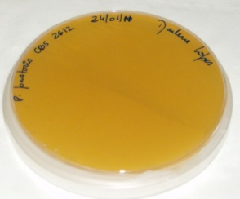

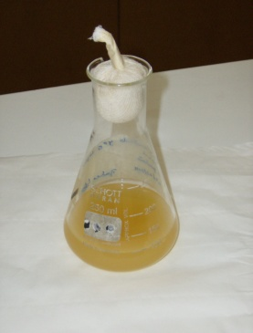
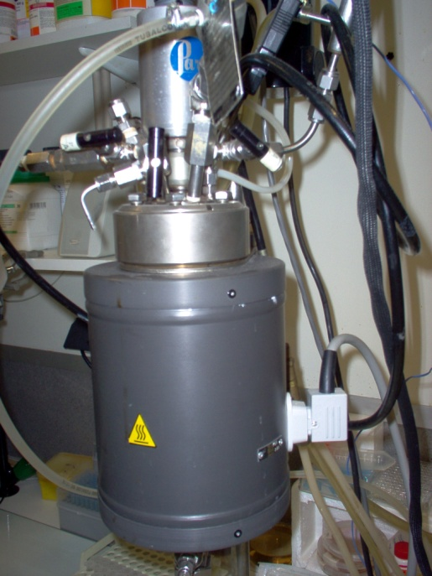
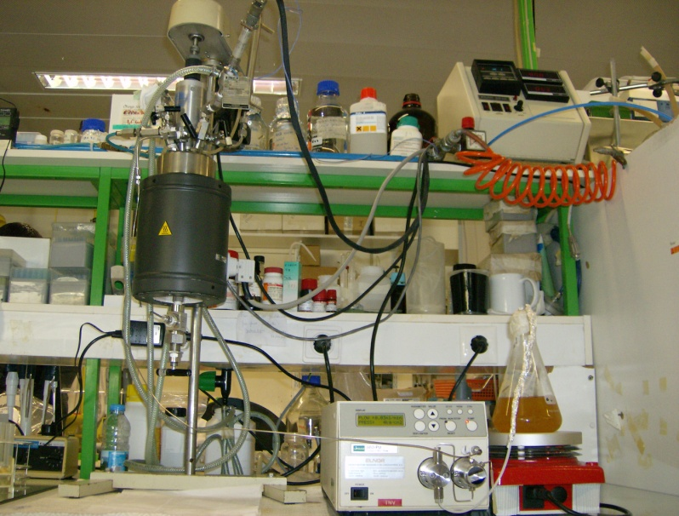
University of Minho School of Engineering Centre of Biological Engineering
FED-BATCH CULTURES OF PICHIA PASTORIS UNDER INCREASED AIR PRESSURE
Author* MARLENE LOPES
Supervisors: Isabel Belo, Co-Supervisor: Manuel Mota
* marlenelopes@deb.uminho.pt
INTRODUCTION
Fed-Batch is the dominating mode of operation in high cell density cultures of P. pastoris in processes such as the production of recombinant proteins, where the high oxygen demand of these cultures makes its supply and important and difficult task. Previous work demonstrated that hyperbaric air could be successfully applied to yeast cultivation, as a way of improving the oxygen transfer rate (OTR) to aerobic cultures. Moreover, the energy and cost efficiencies of high-pressure fermentation for industrial application have already been demonstrated.
AIM
The main goal of the present work was the application of the hyperbaric air in the production of yeast cell mass. Although the fed-batch is the most commonly used mode of operation in P. pastoris cultivation, the use of hyperbaric air as a way to improve the oxygen restriction is still limited.
METHODOLOGY
CONSTANT FLOW RATE
CONSTANT DILUTION RATE
Fig. 1 – Fed-batch growth curves of P. pastoris (● 1 bar, ♦ 5 bar) and glycerol consumption (○ 1 bar, ◊ 5 bar).
Fig. 2 – Real dilution rate (h⁻¹): ● 1 bar, ♦ 5 bar and ▲ flow rate (mL/min) during fed-batch phase. The real dilution rate decreases with time due to increased medium volume inside the bioreactor.
Fig. 3 – Fed-batch growth curves of P. pastoris (● 1 bar, ♦ 5 bar) and glycerol consumption (○ 1 bar, ◊ 5 bar) .
Fig. 4 – Flow rate (mL/min): ● 1 bar, ♦ 5 bar and ▲ dilution rate (h⁻¹) during fed-batch phase.
The application of 5 bar of total air pressure stimulated cell growth compared to the experiment under 1 bar.
A 1.6-fold improvement in biomass production was obtained with the increase of air pressure up to 5 bar compared to 1 bar.
The rise of air pressure up to 5 bar led to a complete glycerol consumption, avoiding its accumulation.
A 2.5-fold improvement in biomass yield was attained at 5 bar of air pressure, comparatively to the yield obtained at 1 bar.
The application of 5 bar of total air pressure stimulated cell growth compared to the experiment under 1 bar.
A 2.9-fold improvement in biomass production was obtained with the increase of air pressure up to 5 bar compared to 1 bar.
The rise of air pressure up to 5 bar led to a complete glycerol consumption, avoiding its accumulation.
A 1.4-fold improvement in biomass yield was attained at 5 bar of air pressure, comparatively to the yield obtained at 1 bar.
P. pastoris CBS 2612
Pre inoculum
30 ºC, 140 rpm
overnight
Centrifuged and resuspended in pure glycerol
Batch fermentation
30 ºC, 400 rpm
24 h
1 vvm
1 bar
Parr 4563, Parr Instruments, USA
5 bar
Fed-Batch fermentations
30 ºC, 400 rpm
Air pressure: 1 bar, 5 bar
1 vvm
MAIN CONCLUSIONS
For the experimental conditions, air pressure rise to 5 bar proved to be applicable to the fed-batch aerobic cultivation of P. pastoris.
For 5 bar of air pressure, the fed-batch culture with constant dilution rate led to a 1.5-fold improvement in cell dry weight comparatively to the culture with constant flow rate.
For 1 bar, the fed-batch culture with constant flow rate led to a 1.2-fold improvement in final biomass comparatively to the constant dilution rate.
Feed: Pure glycerol 50 g/L
CONSTANT FLOW RATE
CONSTANT DILUTION RATE
Flow rate: 0.05 mL/min
Glycerol feed: 0.15 g/Lh
Initial volume: 142 mL
Dilution rate: 0.01 h⁻¹
Glycerol feed: 0.06 – 0.18 g/Lh
Initial volume: 136 mL
Uma Escola a Reinventar o Futuro – Semana da Escola de Engenharia - 24 a 27 de Outubro de 2011

