Slide 1
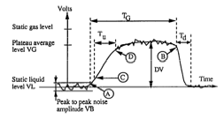
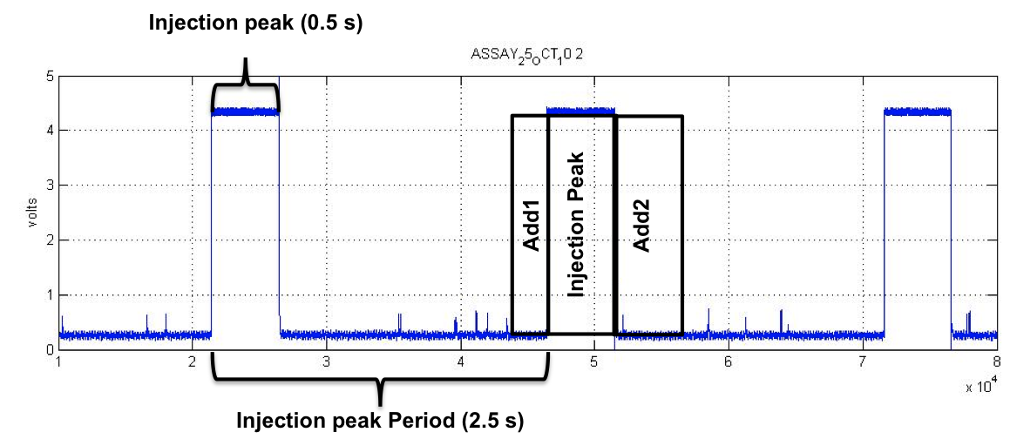
University of Minho School of Engineering Departamento de Engenharia Biologica
MEASUREMENT OF LOCAL GAS-PHASE PROPERTIES USING AN OPTICAL PROBE IN A THREE-PHASE SYSTEMS – PRELIMINAR RESULTS
ANDRÉ MOTA*
José A. Teixeira, António A. Vicente
* amota@deb.uminho.pt
Introduction
Solids influence liquid-gas mixture. In the gas-phase their influence is:
Changing bubbles behaviour (shape, rise and formation);
Altered radial and axial profiles;
Influence mixing and dispersion;
Modified gas hold-up and flow regimes profile
(Mena et al. 2005).
Solid-phase characteristics as size, concentration and their chemical properties (wettability and hydrophobicity) also influence gas hold-up.
Experimental Setup
Results and Discussion
It was found that the new method over estimates the gas-phase properties for 250 mL/min while to 400 mL/min is the opposite.
6
5
A
Experimental Conditions
Two-phase flow
Air-Water
Gas Flow (Q_{G})
250 mL/min
400 mL/min
Acquisition Mode
Without Injection (Cartelier et al 1992)
&
With Injection
A
B
2
4
Increases
Fine particles in small amount
Large particles in high amount
Wettable and hridophilic particles
Decreases
Moderate solid concentrations/sizes;
Non-wettable and hydrophobic particles.
3
1
Gas hold-up
(Zon et al. 2002; Mena et al. 2005)
Figure 2. Experiemntal Setup. Legend: 1. Air-Lift Reactor; 2. Optical Probe; 3. Electro valve; 4. Light source+ Photo detector; 5. Oscilloscope; 6. Acquisition Board
Signal Processing Method
Figure 4 Error obtained at different Add1 and Add 2 for different gas-phase characteristics: Voidage, Bubble velocity and Bubble Chord. A – Q_{G}= 250 mL/min; B – Q_{G}= 400 mL/min;
A
Considering Voidage results, the minor errors obtained were:
250 mL/min → Add1<37.5% and Add2<37.5%
400 mL/min → 25%<Add1<50% and 50%<Add2<100%
Optical Probe Theory
Optical probes allow to measure:(Cartellier 1992)
Concentrations (hold-up);
Bubble velocity;
Bubbles size distributions;
Mean interfacial area;
Mean Sauter diameter;
Flow regimes.
B
dt_{REM}
Figure 3 shows that both Bubble Velocity and Chord Size are not significantly affected by the percentage of signal that is removed.
It is important to have in account that only the gas hold-up is dependent on the overall aquicition time. That is why bigger differences are found in gas hold-up. Thus this is the parameter used to define the amount of signal to cut.
Equations used to evaluate the error difference between the acquisition without using the injection system, and using the injection system.
This method was already successfully applied to Air-Water-Spent Grains systems in Air-lift reactor.
Figure 1. Bubble Detection. Legend:
A – Beginning of Bubble; B – End of Bubble; C – Begin Rising; D – End of Rising (from Cartellier 1992).
Figure 3. A – Optical probe signal. B – Electrovalve Injection signal. Legend: Add1 – Time removed before injection (0 % to 50 % of Injection peak time); Add2 – Time removed after injection (0 % to 100 % of Injection peak time); dt_{REM} – Maximum time removed in Optical Probe Signal.
Conclusion
Generally it was possible to develop a method that allows the use of the optical probe in three-phase systems . This will allow a good understanding of the biotechnological systems where three-phase systems are present.
Signal processing steps:
Recording the signal from the electro-valve and optical probe;
Removing signal on optical probe where the injection was performed to reduce measuring errors.
In the remaining signal from optical probe determine the gas phase properties according the algorithm previously develop by Cartellier et al. (1992).
Gas hold-up Bubble Velocity Bubble Chord
e_{g}=∑T_{G}/t_{acq} v_{B}=A.T_{u}^{B} ch_{B}=v_{B}.T_{G}
Application of this technique in three-phase systems might lead to optical tip contamination (Mena et al. 2008):
Inadequate signals;
Cluster formation around the tip.
Bibliography
Cartellier, A. 1992. Simultaneous void fraction measurement, bubble velocity, and size estimate using a single optical probe in gas-liquid two-phase flows. Review of Scientific Instruments, 63, Nr. 11, 5442-5453.
Mena, P. C., F.A. Rocha. J.A. Teixeira. P. Sechet. A. Cartellier. 2008. Measurement of gas phase characteristics using a monofibre optical probe in a three-phase flow. Chemical Engineering Science, 63, Nr. 16, 4100-4115.
Mena, P. C., M.C. Ruzicka. F.A. Rocha. J.A. Teixeira, J. Drahos. 2005. Effect of solids on homogeneous–heterogeneous flow regime transition in bubble columns. Chemical Engineering Science, 60, Nr. 22, 6013-6026.
Uma Escola a Reinventar o Futuro – Semana da Escola de Engenharia - 20 a 26 de Outubro de 2011

