Slide 1
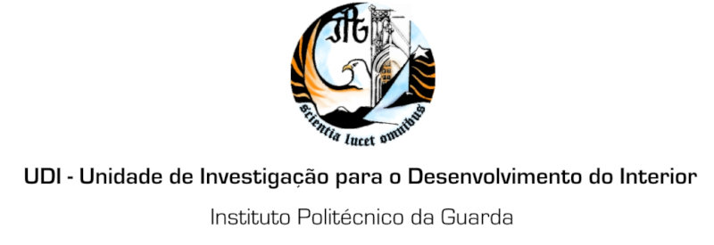
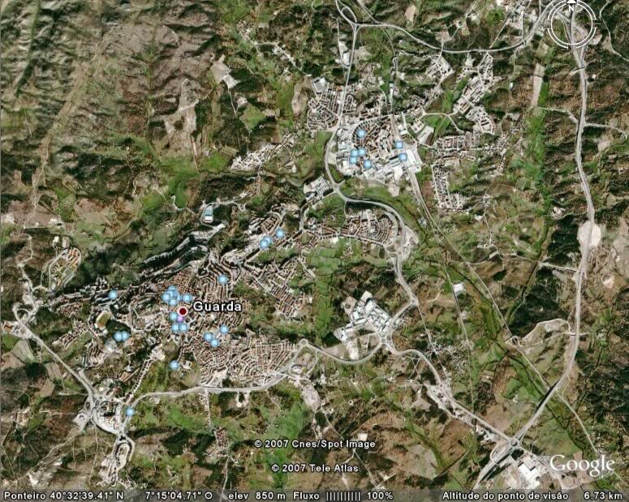
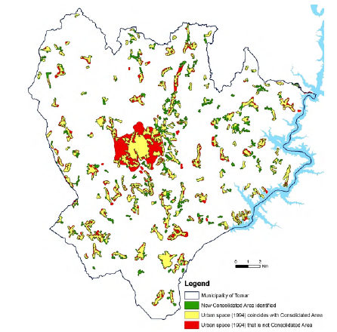
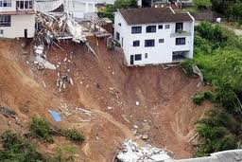
University of Minho School of Engineering Territory, Environment and Construction Centre (C-TAC)
A SUSTAINABLE INDEX FOR URBAN EXPANSION MANAGEMENT
Author* MARIA ELISABETE S. SOARES
Supervisor: Rui A. R. Ramos; Co-Supervisor: Ana Maria D. B. Fonseca
* esoares@ipg.pt
Introduction
Considering that the growth of cities does not always follow the principles of sustainability, it is essential to study this phenomenon in order to be identified current practices of urban planning and propose alternative measures that urban development be undertaken in a more balanced and sustainable way.
The land occupation for urban construction, whether by buildings or by road infrastructures is often done without adequate studies leading to some disordering in the territory.
This event, known as urban sprawl, requires excessive use of motor vehicle to carry out travel between the many urban areas, the implementation of resources necessary to the human habitable, leading to the leaky of natural resources.
Multicriteria analysis model
As a measure for the rapid analysis of the situation in the area and to aid in decision-making more appropriate and balanced, it is important to develop a model that defines a sustainable index of expansion urban.
This model of multicriteria analysis, will aggregate multiple criteria related to the concept of sustainable development of cities, will assess the level of urban sprawl and its implications for sustainable growth of cities (Figure 3).
Case study
The model will be validated by its application to the city of Guarda.
The collection of geographic information for the analysis of urban space occupied will be based on remote sensing techniques and also in city maps.
The validation of the model will start by critical analysis of the results and collection of opinions of decision makers and their recognition, as well as of the local institutions responsible for urban planning and land management.
Figure 1: Expansion of the Porto city.
.
Source: MOLAND (Monitoring Land Use / Cover Dynamics) - http://moland.jrc.ec.europa.eu/
Over the years the largest concentration of population in cities, among other events, has forced to the expansion of urban areas.
Figure 1 shows the example for the city of Porto.
Figure 3: Workflow for the development of multicriteria analysis model and compute of a sustainable index of urban expansion
Geographic Information
- remote sensing
- cartographic databases
- statistic data
Territorial Analysis
Urban Expansion
Urban Sprawl
Urban Sustainability
Figura 2: Example of the dispersion of urban areas in the Municipality of Tomar.
Source: Ferreira, J.A.; Condessa, B.; Almeida, J.C.; Pinto, P. 2010. “Urban settlements delimitation in low-density areas – an application to the municialy of Tomar (Portugal). In Landscape and Urban Planning, No.97, 156-167.
A Sustainable Index of Urban Expansion (SIUE)
The most notorious in almost every city is the degree of scattering of new urban areas around its core, normally consolidated.
Figure 2 presents the case of the municipality of Tomar where the dispersion of urban areas is evident. Although this is an area broader than just a city it is a similar phenomenon.
Geographic Information Systems (GIS)
Multicriteria Analysis Model
Conclusions
The development and application of multicriteria analysis model will help evaluate the level of territorial cohesion of the study area, the integration of infrastructures in the urban area and quantify rates of urban expansion within the defined dimensions of sustainability. Will be still possible to know the kind of urban mobility practiced and confront these data with the concepts associated with sustainable urban mobility. Among the dimensions of sustainability identified, the assessment of negative aspects applied, such as the occupation of environmentally constrained areas and risk areas, will be a support to avoid any future errors in territorial management and urban planning. It is expected that a complete critical analysis of the results allows the conclusion the potentialities of the model as a support tool for urban planning.
Spatial System Decision Support
The model will aggregate multiple urban sustainability indicators related to six main dimensions of the urban structure and considered important for this study. All the indicators will be integrated into a multicriteria analysis model in a hierarchical structure.
Urban sprawl
Level of territorial cohesion
Sustainable urban mobility
Coverage of basic infrastructures in urban space
SIUE
Are often, are assigned to urban use environmentally sensitive areas and areas of risk.
Occupation of environmentally sensitive areas
Acknowledgments
The authors wish to thank to Portuguese Foundation for Science and Technology (FCT) the support given for the doctoral grant SFRH/PROTEC/68084/2010.
Occupation of risk areas
Uma Escola a Reinventar o Futuro – Semana da Escola de Engenharia - 24 a 27 de Outubro de 2011

