Slide 1
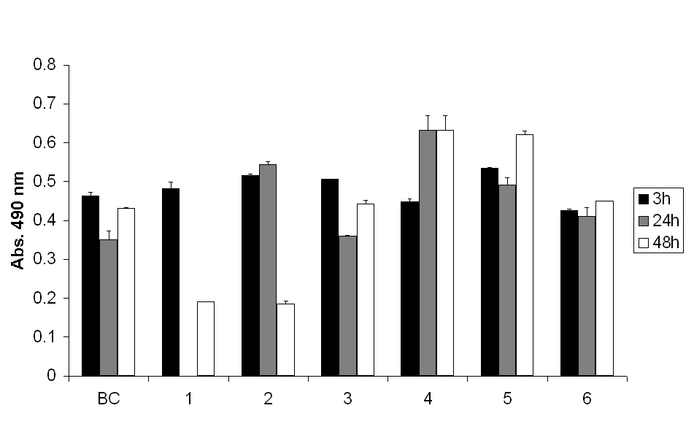
University of Minho School of Engineering Centre of Biological Engineering
SURFACE MODIFICATION OF BACTERIAL CELLULOSE BY PLASMA TREATMENTS
Author* JM MACHADO
Supervisors: F Dourado, Co-Supervisors: FM Gama, S Lanceros-Mendez
* jmachado@deb.uminho.pt
INTRODUCTION
Plasma technique is a convenient method to introduce functional groups or chains onto the materials’ surface, including those with complex shapes; being conducted under vacuum, the treatment is pervasive, an advantage in the case of scaffolds with interpenetrating porous structures, often used for tissue engineering purposes [1].
Bacterial cellulose (BC) is a biocompatible material with unique properties that makes it an attractive material for biomedical applications. With the major goal of improving the biocompatibility of BC, and in line with previous research within our group [2], this work aimed at assessing the effect of plasma treatments on the in vitro interaction of BC with animal cell lines.
MATERIALS AND METHODS
BC production
Cultivation of Gluconacetobacter xylinum (ATCC 53582) in static culture, at 30 ºC in Hestrin-Shramm (HS) medium [3].
Purification BC pellicles in a 4% (w/v) NaOH at 50 ºC, overnight.
Freeze-drying of BC pellicles.
Plasma treatments
Ar flow (80 sccm) and
N₂ flow (40 sccm), current (0.75 A), time (1200 s);
N₂ flow (40 sccm), current (1 A), time (700 s);
N₂ flow (35 sccm), current (0.4 A), time (1800 s);
N₂ flow (50 sccm), current (0.4 A), time (1800 s);
N₂ flow (35 sccm), current (0.5 A), time (600 s);
N₂ flow (35 sccm), current (0.5 A), time (300 s);
N₂ flow (5 sccm), current (0.5 A), time (1200 s);
N₂ flow (5 sccm), current (0.5 A), time (600 s).
Ar flow (80 sccm), current (0.5 A), time (1200 s);
Ar flow (80 sccm), current (0.5 A), time (600 s).
Surface analysis
X-ray photoelectron spectroscopy (XPS);
Scanning electron microscopy (SEM).
Cell adhesion and proliferation assays
Preformed using Human Microvascular Endothelial Cells (HMEC-1) as described by Pertile and co-workers [2].
RESULTS
X-ray photoelectron spectroscopy (XPS)
Table 1 - BC and BCP elemental composition analyzed by XPS. The BC samples were treated using the following conditions: 1) 80 sccm Ar e 40 sccm N₂, 0,75 A, 1200 s; 2) 80 sccm Ar e 40 sccm N₂, 1 A, 700 s; 3) 80 sccm Ar, 35 sccm N₂, 0,4 A, 1800 s; 4) 80 sccm Ar, 50 sccm N₂, 0,4 A, 1800 s.
From table 1 a longer plasma treatment allow for a higher N₂ incorporation.
The N₂ content values of samples 3 and 4 shows that the pellicle which was treated with a higher N₂ flow had more nitrogen incorporation.
Scanning electron microscopy (SEM)
Figure 1 - SEM micrographs of untreated BC a) and treated BC b) to g). The treatment conditions were the following: b) 80 sccm Ar, 35 sccm N₂, 0,4 A, 1800 s; c) 80 sccm Ar, 50 sccm N₂, 0,4 A, 1800 s ; d) 80 sccm Ar, 35 sccm N₂, 0.5 A, 600 s; e) 80 sccm Ar, 35 sccm N₂, 0.5 A, 300 s; f) 80 sccm Ar, 5 sccm N₂, 0.5 A, 1200 s; g) 80 sccm Ar, 5 sccm N₂, 0.5 A, 600 s.
The treatment conditions lead to significant surface morphology change resulting in the destruction of the BC fibres and in the formation of a heterogeneous surface when higher N₂ flows were used as can be evidenced by the image 1c).
Cell adhesion and proliferation assays
Figure 2 - MTS assays of HMEC-1 cultured on untreated BC and BC treated with the following conditions: 1 - 80 sccm Ar, 0.5 A; 1200 s; 2 - 80 sccm Ar, 0.5 A, 600 s; 3 - 80 sccm Ar, 35 sccm N₂, 0.5 A, 600 s; 4 - 80 sccm Ar, 35 sccm N₂, 0.5 A, 300 s; 5 - 80 sccm Ar, 5 sccm N₂, 0.5 A, 1200 s; 6 - 80 sccm Ar, 5 scum N₂, 0.5 A, 600 s.
Ar plasma treated BC cause cell death after 48 h (treatments 1 and 2), it should be mentioned that this effect did not present changes for 600s (treatment 1) or 1200s (treatment 2) treatment times.
The effect above described is reversed by the presence of N₂ on the treatment gas (3 trough 6 treatments).
CONCLUSIONS
The N₂ incorporation is treatment time and N₂ flow dependent;
The plasma treatments induced morphological changes on the BC surface;
Harsher treatments resulted in the formation of heterogeneous surfaces;
BC treated with Ar plasma induced cell death and that this effect was reversed by the presence of N₂ on the treatment gas.
REFERENCES
[1] J. Yang, J.Z. Bei, J. Z., S.G. Wang, Biomaterials, 23(12), 2607–2614 (2002).
[2] R.A.N. Pertile, F.K. Andrade, C. Alves Jr., M. Gama, Carbohyd. Polym., 82, 692 (2010).
[3] S. Hestrin, M. Schramm, Biochem J 58:345–352 (1954).
Uma Escola a Reinventar o Futuro – Semana da Escola de Engenharia - 24 a 27 de Outubro de 2011

