Slide 1
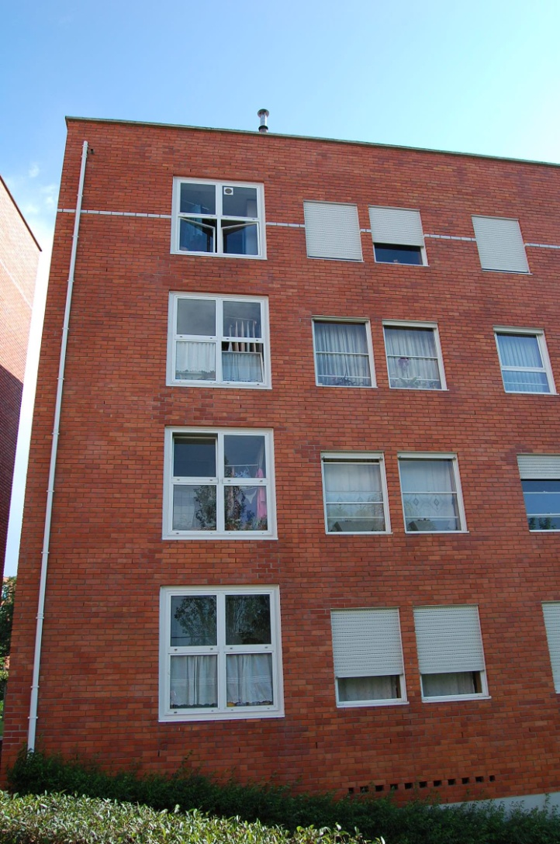
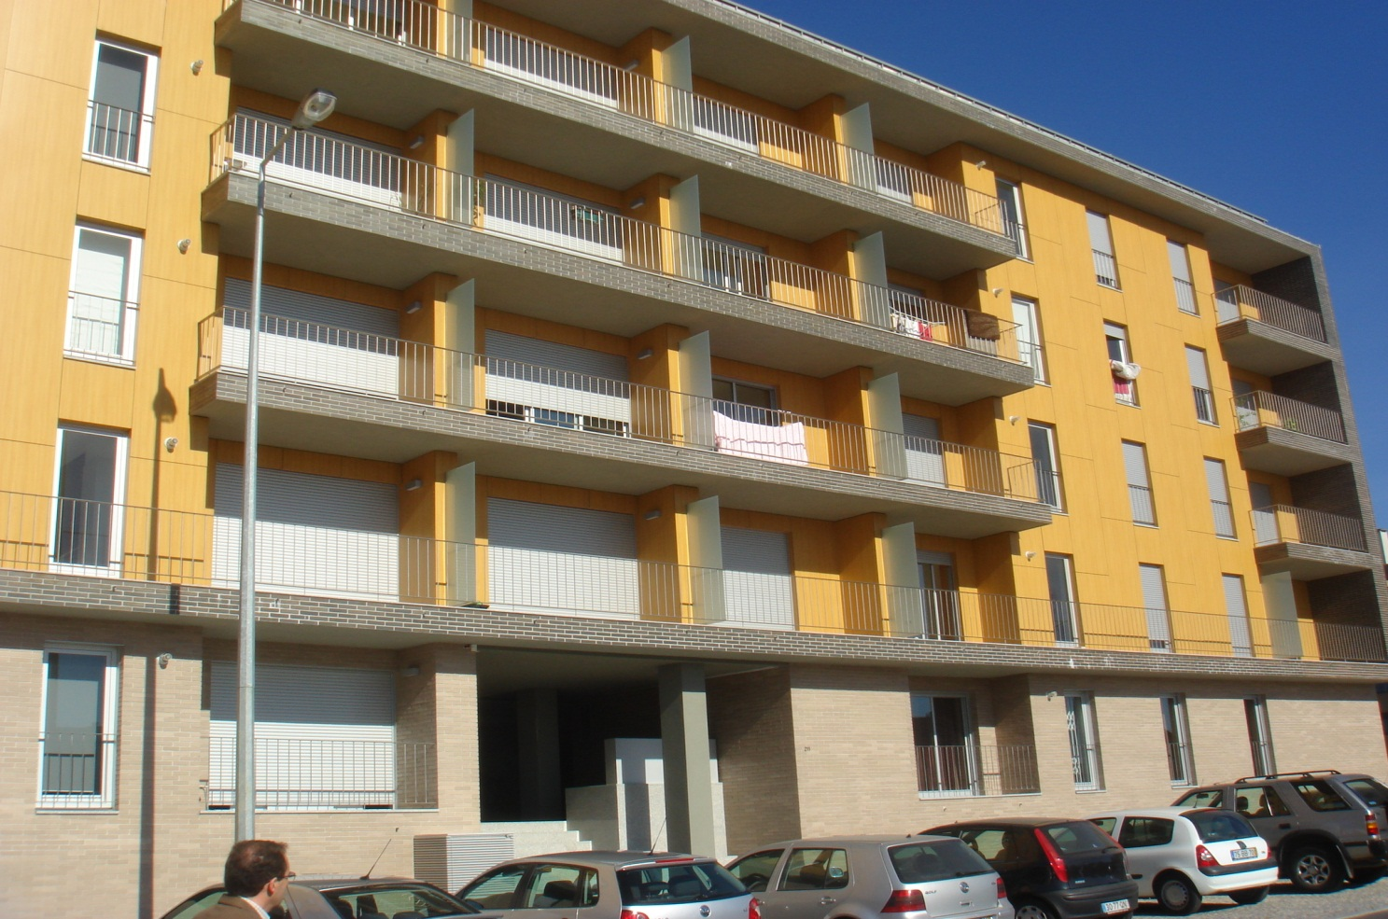
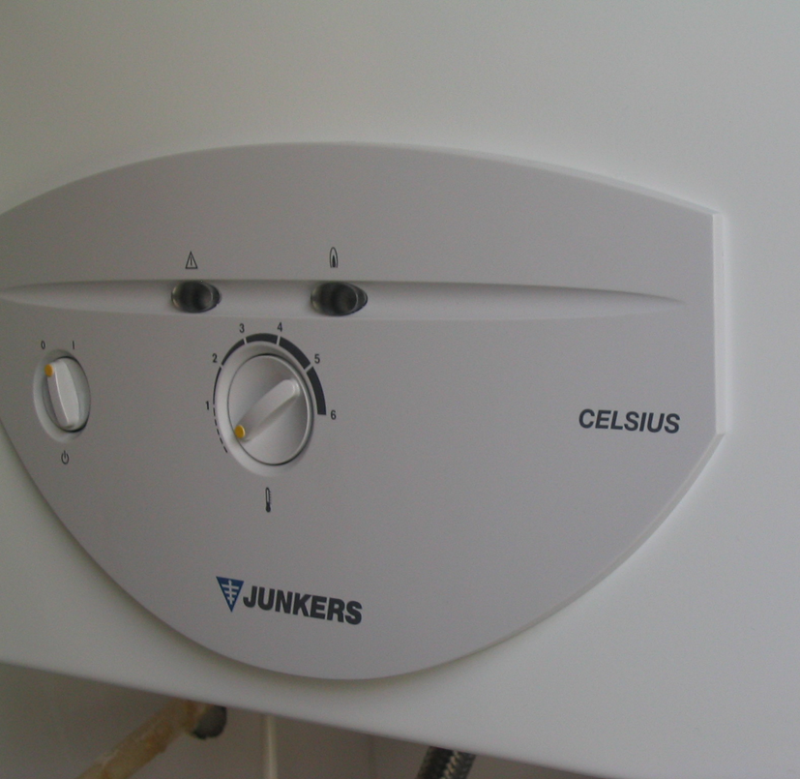
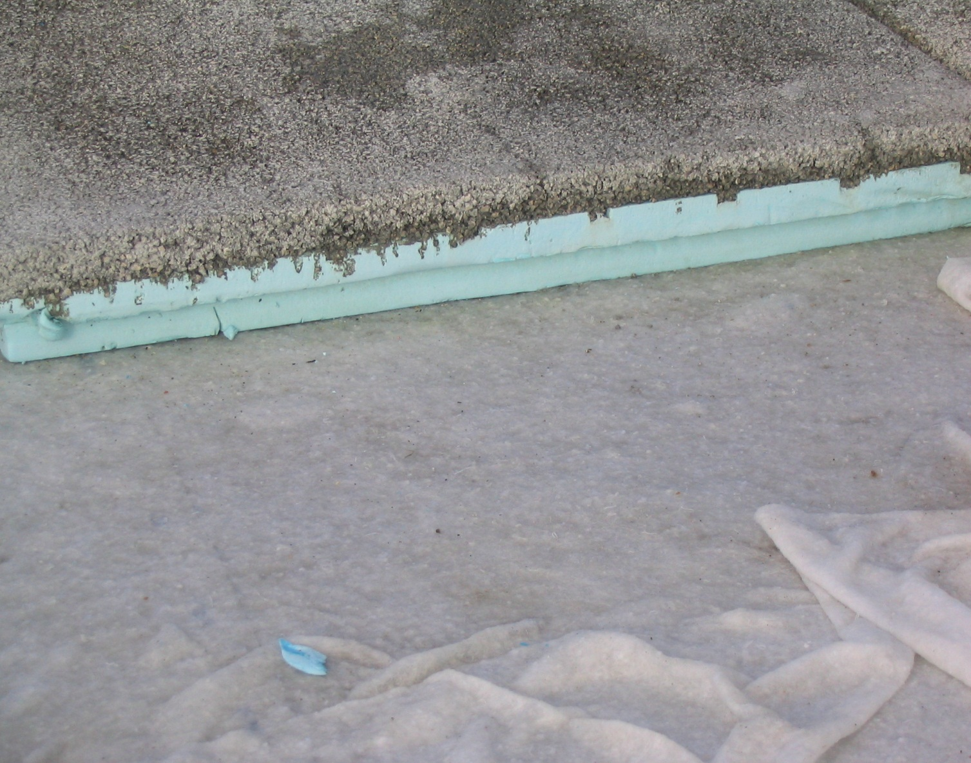
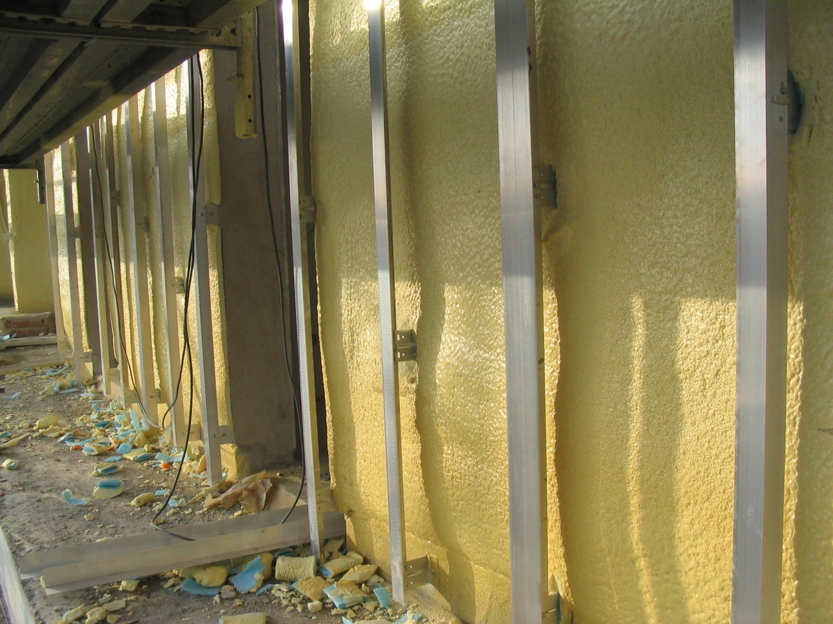
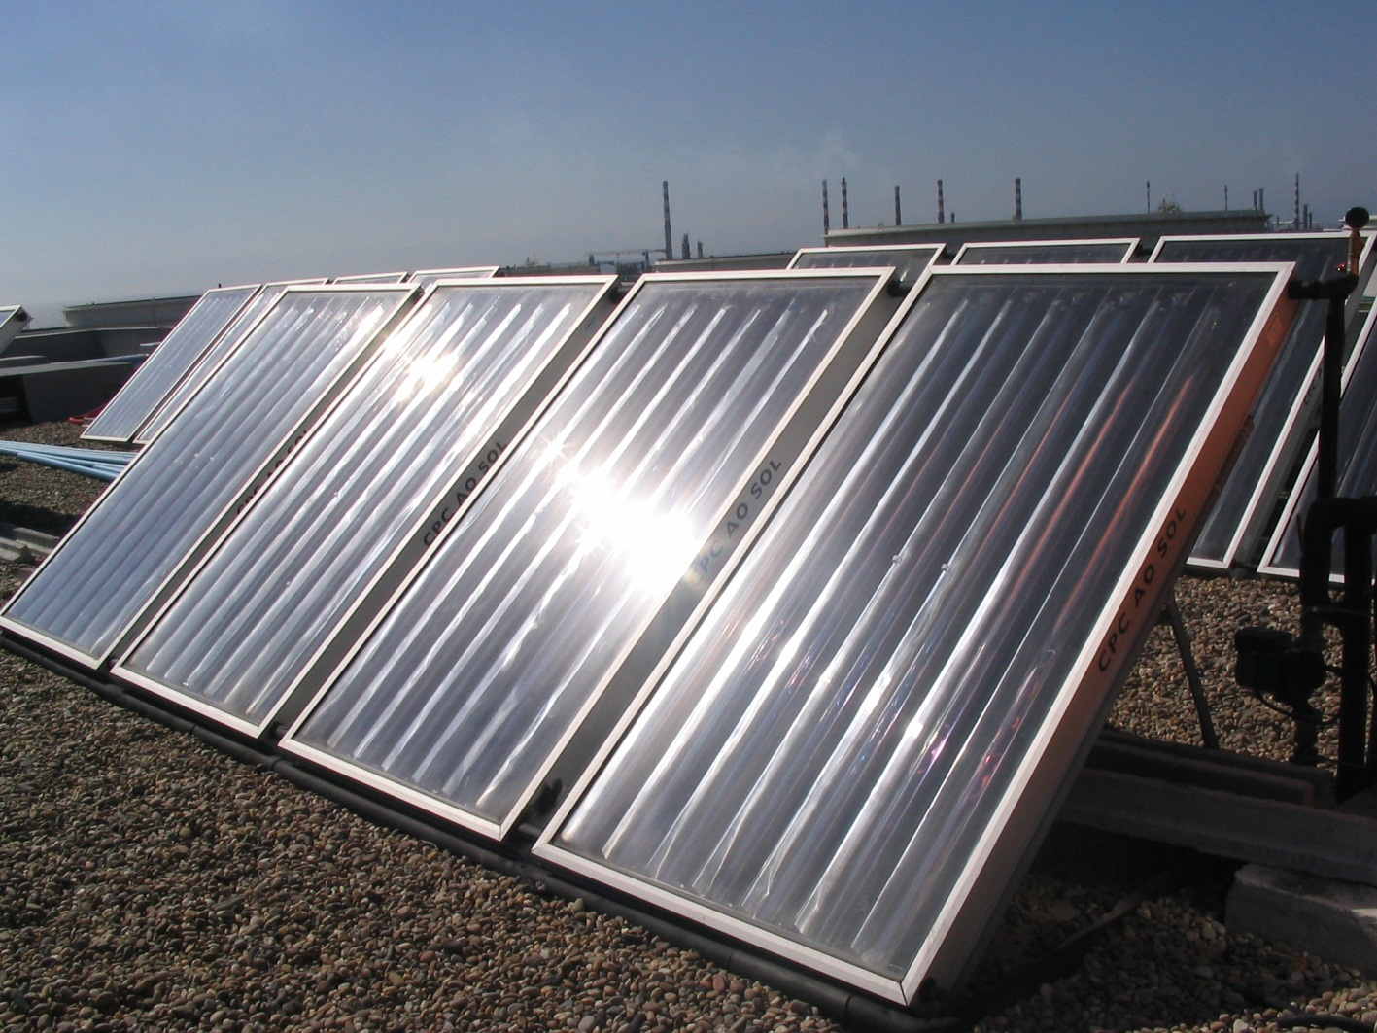
University of Minho School of Engineering Territory, Environment and Construction Centre (C-TAC)
HOW TO BUILD AND USE SUSTAINABLE COOPERATIVE HOUSING UNDER CONTROLLED COSTS IN PORTUGAL
Author* JOSÉ COIMBRA
Supervisor: Manuela Almeida
* jose.coimbra@net.vodafone.pt
Introduction
The present research work considers housing as economically, socially and environmentally feasible and sustainable for the Portuguese families with medium and medium-low income who seek, through cooperative housing, a solution for their housing problem.
Adapting the criteria of sustainable construction and use of sustainable housing to the rules of the cooperative sector, based on the controlled costs legislation, it is possible to assess the performance of cooperative buildings already built under these sustainable rules, to quantify the obtained benefits and to write a manual with full guidance to build and use sustainable cooperative housing. It is also possible to demonstrate the influence of sustainable construction in the inhabitants’ quality of life and in the reduction of the environmental impact of the built patrimony.
Main objectives of sustainable cooperative housing:
Developing an integrated approach aimed at making sustainable housing the rule and reducing the distance between what we know is needed for more sustainable lives, buildings and cities and what is normally done;
Improving energy and environment performance in social housing and the quality of urban life and supplying citizens with a healthy, sustainable environment;
Keep the costs of construction and the costs of purchasing sustainable cooperative housing under the maximum costs allowed by Portuguese controlled costs rules and laws;
Disseminate sustainable cooperative housing in national, regional and local policies, increasing awareness of the various players in urban development to questions of sustainability, especially with respect to global costs and direct and indirect gains from construction sustainable buildings.
Main objectives of this research work:
To prove that sustainable cooperative housing is economically, socially and environmentally feasible and sustainable for the Portuguese families with medium and medium-low income;
To calculate the savings of the average family living in sustainable cooperative housing comparing to the average family living in non-sustainable cooperative housing;
To verify in what measure the environmental indoor and outdoor comfort increases in sustainable cooperative housing comparing to the average family living in non-sustainable cooperative housing;
To analyse which design and construction solutions suit best for new sustainable cooperative housing projects;
To elaborate a Manual with basic and advanced guidance for the construction, use and maintenance of sustainable cooperative housing.
Guidelines for energy efficiency on cooperative housing
Energy efficiency on cooperative construction under controlled costs are based on three main features:
Increase of thermal insulation of walls, window glasses, floors and roofs, either towards the exterior or to non-heated interior areas, over the standard regulations insulation; this improvement has an expected cost of less than 1% of the construction cost, and provides a reduction of about 30% of the energy cost in heating.
Decrease of natural ventilation of the dwellings, by using windows with a certification of permeability to the wind of class 3 or 4, auto-regulated window and the use of double window, thus decreasing the passage of wind through the blind boxes. The adoption of these features decrease 10 – 15% of heating consumption.
Installing high-efficient solar panels and gas heaters with thermostatic valves. The decrease of consumption towards traditional water heaters is of 79%. This difference shows that the option to use in buildings energy-efficient equipment causes high savings in energy over the lifetime of the building.
Conclusion
The results presented point to a positive impact on both the construction and rehabilitation costs of using of high energy efficiency systems on cooperative housing under controlled costs. However, it is necessary to continue to deepen the treatment of data concerning costs of consumptions and techniques used in the operation of energy efficient systems and their impact on social and economic savings by families who live in cooperative housing along the life of the building. The mentioned data collection for the improvement of sustainable construction norms such as energy efficiency, will must also include other features such as environmental comfort, water consumption and waste separation are concerned. In the future, it is interesting, therefore, continue to act to promote sustainable construction and rehabilitation, conveniently designed, to consider, in a comprehensive manner all aspects of sustainable construction.
Preliminary research results
Preliminary results taken from a comparative study about energy efficiency between the dwellings of cooperative sustainable construction located at the Fontainhas building and the dwellings of traditional cooperative construction located at the Azenha de Cima building, both built under the official rules of construction controlled costs, show the difference between gas and electricity average consumption expected to residents of these housing cooperatives. It was completed in this study that, in the first place, in what concerns indoor winter heating, Fontainhas building has a cost of annual energy consumption, per square meter of floor space, 30.8% lower than the building of the Azenha de Cima; second, in what concerns estimated annual consumption of energy to heat water per capita, Fontainhas dwellings spend 79.4% less natural gas than Azenha de Cima dwellings. These results indicate a positive impact on the energy performance of sustainable cooperative housing built under controlled costs, and enhance the use of sustainable design solutions as a factor of savings for users.
Traditional cooperative housing
Sustainable cooperative housing
Solar gas heater
Optimized insulation of roofs
Thermal insulation on façades
Solar panels
Uma Escola a Reinventar o Futuro – Semana da Escola de Engenharia - 24 a 27 de Outubro de 2011

