Slide 1
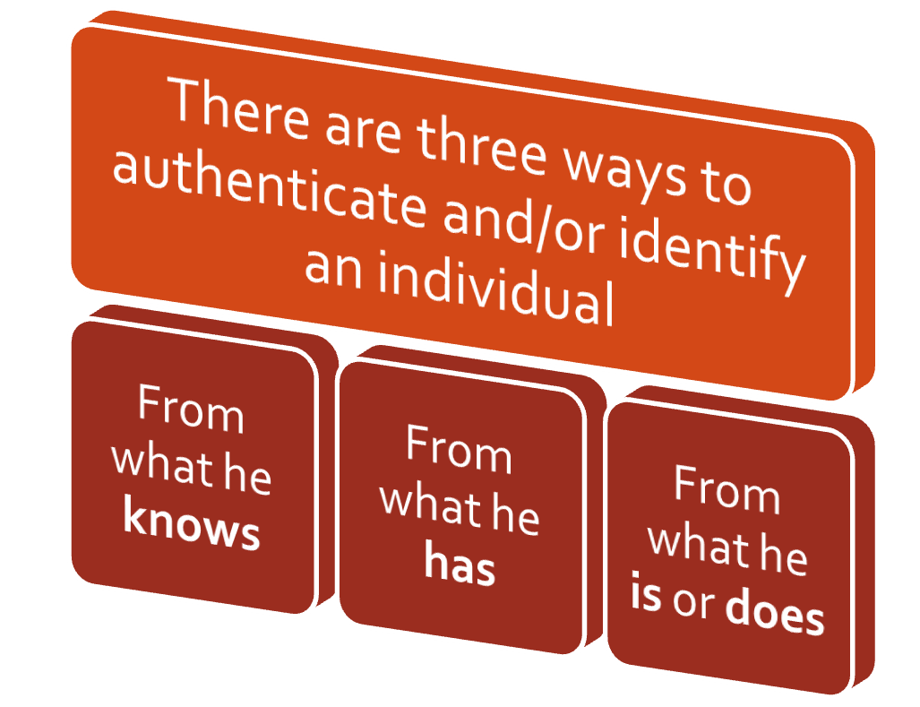
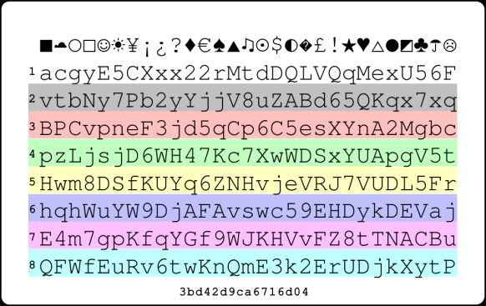

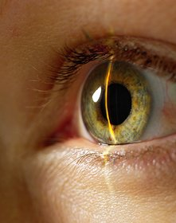
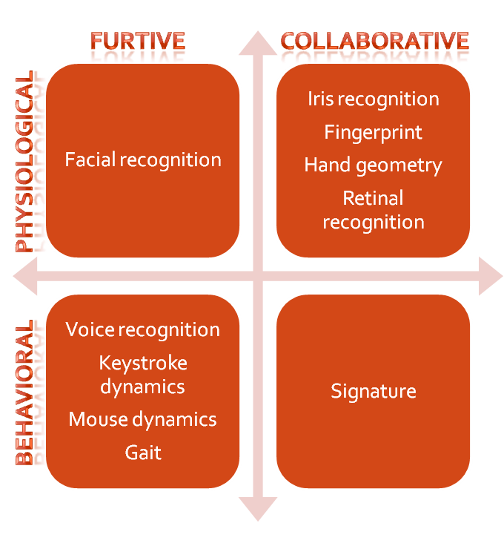
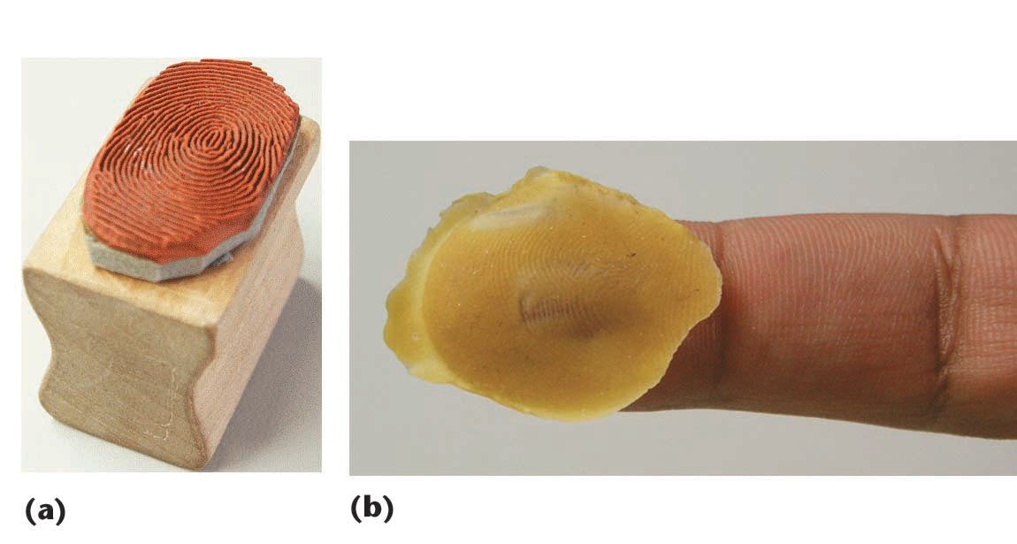
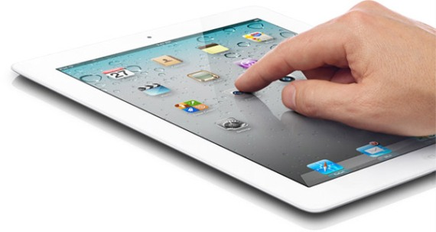
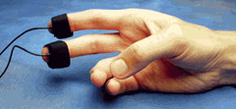
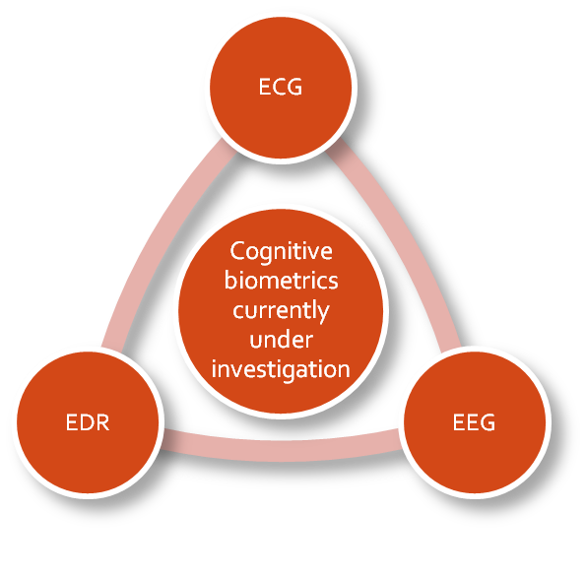

University of Minho School of Engineering Algoritmi Centre
Gesture Dynamics with skin conductivity - a Multimodal Approach to Biometric Authentication
VÍTOR JÚLIO DA SILVA E SÁ *
Supervisor: Henrique Dinis dos Santos
* vitor.sa@braga.ucp.pt
Keywords
Security, authentication, biometry, gesture dynamics, cognitive biometrics, skin conductivity, multimodal.
Motivation
There different ways to recognize an individual.
The latter methods are known as biometrics, which overcomes the problem of transmissibility that the first two ways have.
Biometrics classification:
However, biometrics is not foolproof because it can be replicated. Today there are several fraudulent ways to replicate a biometric characteristic, and this raises new challenges.
A potential solution lies in cognitive biometrics, which uses biological signals representative of the mental and emotional states for the authentication of users.
Problem
In the current solution we have identified the following problems: replicability is possible even with the common biometric technology; requirement of continuous authentication; constant need to improve the accuracy of the systems (information systems with more users imply a need to lower error rates); constant need (inherent in the existence of a business) to lower the cost; need to keep the mobility of the systems, with restrictions on the type of hardware needed (dimension, energy, etc.) and on the use conditions (light, noise, etc.).
There is recent work in cognitive biometrics, particularly in the conductivity of the skin that seems to indicate that this technology has potential (with or without activation of the knowledge component). The current size of the conductivity sensors enables its integration into mobile devices. There is also work done and consolidated in gesture dynamics.
Thus, we intend to prove the following: it is possible to implement, with comparative advantages, a multimodal biometric authentication solution using gesture dynamics with skin conductivity.
Methodological Approach
Given the nature of this work the research methodology is based on a proof of concept with a study of acceptance. For that, it will be developed a prototype for graphical data collection and a prototype for dermoelectric data collection, for further definition of algorithms that determine authentication patterns.
The main challenges will be to find a good algorithm for each of the biometrics and find the thresholds that combine successfully these same algorithms. This does not correspond to the simple junction of the two since it will take advantage of the synergistic multimodal integration or even, in some situations, the alternate one.
Later we will proceed to the test of the defined algorithms, with half of the data to test and half of them to attack.
Developed the solution, the aim is also to evaluate the user acceptance of such a system. We plan to use the Technology Acceptance Model (TAM) for its wide dissemination and acceptance in this context.
Research Plan
For better exposure of the tasks involved, results, goals, resources and timing, the research plan was developed in a project management tool, with the corresponding set of deliverables, activities, effort, duration, dependencies and milestones.
Publications
Borges, D.; Sá, V. J.; Magalhães, S. T.; Santos, H. D. 2011. “Study of the perception on the biometric technology by the Portuguese citizens”. Proceedings of the 7th ICGS3 / 4th e-Democracy Joint Conferences, Salónica, Grécia.
Cerqueira, I.; Sá, V. J.; Magalhães, S. T. 2011. “Study of The Perception on The Portuguese Citizen Card and Electronic Signature”. Proceedings of the 7th ICGS3 / 4th e-Democracy Joint Conferences, Salónica, Grécia.
Faria, L.; Sá, V. J.; Magalhães, S. T. 2011. “Biometrias Multimodais Cognitivas - Uma nova abordagem no reconhecimento de utilizadores”. In Actas da 6ª Conferência Ibérica de Sistemas e Tecnologias de Informação, Chaves, Portugal.
Hildebrand, A. and Sá, V. J. 2001. “EMBASSI: Electronic Multimedia and Service Assistance”. In: Heuer, A., Kirste, T. (eds.) Intelligent Interactive Assistance and Mobile Multimedia Computing, ISBN 3-935319-75-4, pp. 50-59, Neuer Hochschulschriftenverlag, Rostock.
Sá, V. J.; Malerczyk, C.; Schnaider, M. (2002). Vision Based Interaction Within a Multimodal Framework. Selected Readings in Computer Graphics 2001, ISBN: 3-8167-6163-1, Fraunhofer IRB Verlag, Stuttgart.
Uma Escola a Reinventar o Futuro – Semana da Escola de Engenharia - 20 a 26 de Outubro de 2011

