Slide 1
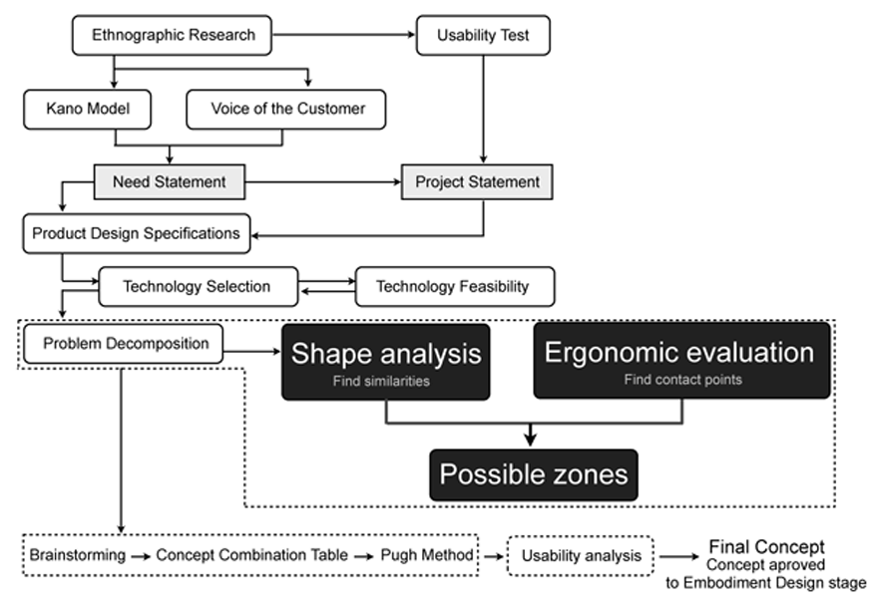
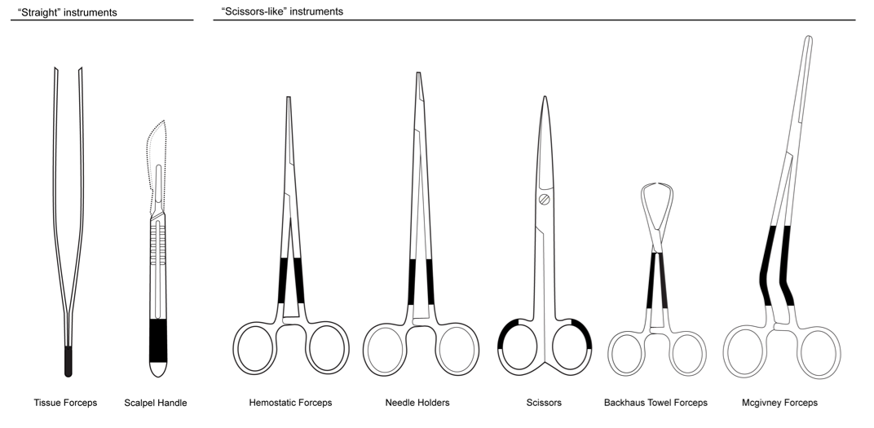
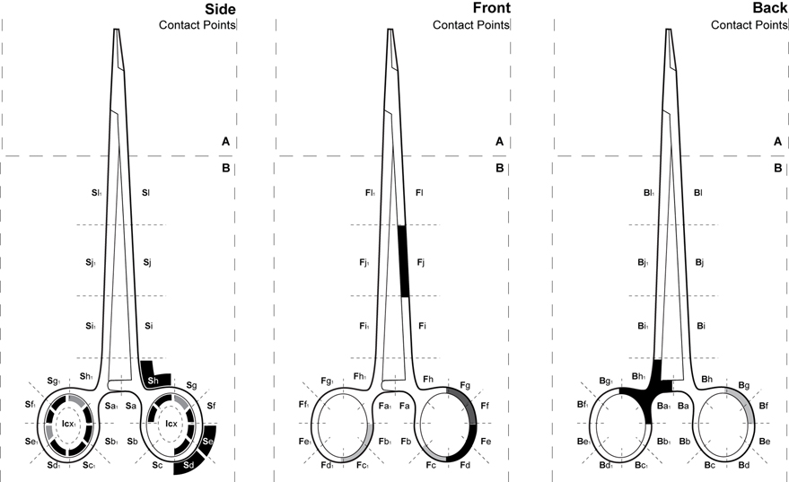
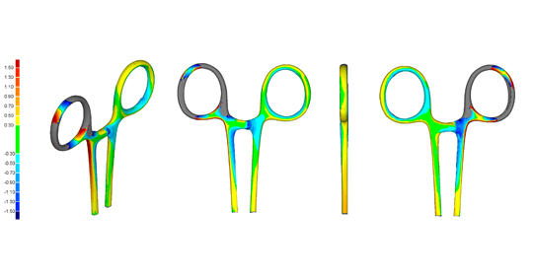
University of Minho School of Engineering Institute of Polymers and Composites
PRODUCT DESIGN AND DEVELOPMENT OF PRODUCTS WITH EMBEDDED MICROELECTRONICS – SURGICAL INSTRUMENTS TRACEABILITY
ÁLVARO M. SAMPAIO
Supervisors: António Pontes, Co-Supervisor: Ricardo Simões
* msampaio@dep.uminho.pt
Introduction
Health care providers are evermore interested in tracking different assets within their facilities.
In most cases they are labeling products with RFID technologies. However, this trend represents a challenge that has limited the feasibility of applying these technologies:
The existence of distinct products in terms of shape, scale and use.
In some cases the existing products are fully optimized and any changes, as little as they can be, are impossible.
This is the case of surgical instruments (SI).
Labeling SI with tracing technologies can reduce task times, and optimize the nurse efforts to manage the number of uses of each instrument and generally improve patient safety.
The Design Approach
Our goal is to achieve a solution trough a polymer-based add-on product that features the embedded RFID, this task unquestionably requires a detail analysis of the shape, size, and other physical and functional characteristics of the SI.
Another issue is that changes or improvements to medical devices, protocols or procedures must be carefully studied, as surgical proceedings cannot be modified easily, nor can these modifications to the surgical instruments hamper the way surgeons handle them.
In this framework, we have developed a method (Figure 1 in black) which did not exist in any of the usual product development processes:
We investigated the shape and functional features of all surgical instruments in a generic surgical instruments set, in order to find similarities and common geometries, and;
Understanding exactly how surgeons use surgical instruments.
These shape-parts ranged within 2.32mm and 2mm, respectively. These measurements can be seen in table 1.
Ergonomic evaluation
In this study individual interviews with fifty-four surgeons, all right-handed, from five different surgical specialties were conducted.
The interviewed were asked to grab a surgical instrument and describe two different types of situations: First, the area of contact of the surgical instrument that touches the patient body (touching was defined by entering the human body), and second, the areas where fingers touch the surgical instrument for any surgical procedure (activity) that the surgeon might need to perform.
From these interviews it was possible to reach a satisfactory understanding of the areas used for each specific instrument (Figure 2 - Results of the needle holder).
From a global point of view, although different percentages have been registered, the areas with percentages of more than 81% account for more than approximately 85% of the total registers. Thus, it can be stated that, in terms of contact points, little differences exist by the different participants.
These areas represent the areas that were not registered during the interviews as being handled by the surgeons. This clearly shows that surgeons have very similar ways of grabbing the devices independently of their specialty.
Conclusions
With this method it was possible to establish the likely areas to couple the add-on on the SI. The match of the data of the two procedures (Shape analysis and ergonomic evaluation of contact points) was the final aim result pretended. Figure 3 shows the final results (in black).
From this method one could understand that the areas for coupling the add-on in the scalpel instrument was the same for the two analysis performed. For all the other instruments some variations exist, although it was possible to find a match for each SI.
The spindles are the most likely area for the majority of the instruments. Just the scissor instrument presents an ellipsoidal handle part has a possible area since all the other ‘scissors-like’ instruments had contact points in that specific area. The Mcgivney forceps instrument is the one that has the biggest area to couple the add-on.
Acknowledgments
Foundation for Science and Technology grant
SFRH/PROTEC/49725/2009
The shape analysis provided us with the knowledge on where to grab the add-on product in a possible universal solution and, in the same way, finding out how surgeons grab the instruments will provide insight about neutral zones. Both studies allowed us to establish which areas of the instruments were candidates for coupling an external component.
Shape analysis
3D models were obtained with a scanner for each type of SI in a generic set.
Models were analyzed in terms of 3D comparison of forms and measurements. To perform this analysis the Geomagic Qualify v.12 software was employed.
As the analysis have been developed, we have focus our investigation on finding similar shape-parts of a combination of instruments and then measuring those shapes in order to had a value on their variations.
The first combination of shape-parts analyzed was the ‘straight’ instruments. Were we had find a common geometry on the extreme top of the instruments and find that this similarity had a range unit of 1.6mm.
The other combinations were centered in the group of the ‘Scissors-like’ instruments. Within this group we have find two common geometries the ellipsoidal handle part and the spindles.
Uma Escola a Reinventar o Futuro – Semana da Escola de Engenharia - 24 a 27 de Outubro de 2011

