Slide 1

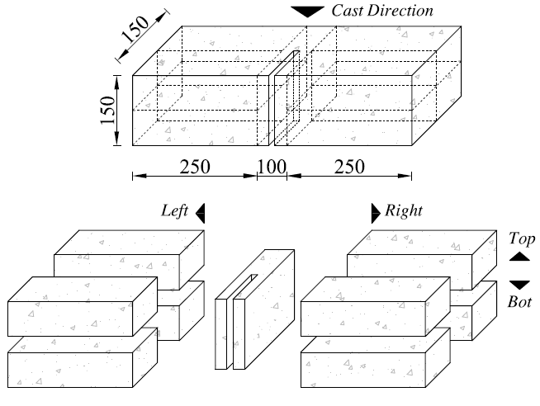
University of Minho School of Engineering ISISE, Civil Engineering Department
ASSESSMENT OF THE POST-CRACKING BEHAVIOUR OF SFRSCC BY FLEXURAL AND TENSILE TESTS
Author: HAMIDREZA SALEHIAN*
Supervisor: JOAQUIM A.O. BARROS
salehian@civil.uminho.pt
INTRODUCTION
To avoid the difficulties of the uniaxial tensile test setup, post cracking behaviour of SFRSCC can be determined indirectly based on flexural responses as recommended by international codes. In the present study the tensile behaviour of a SFRSCC was assessed from flexural and tensile tests and the obtained results were utilized in a proposed design oriented approach to calculate the resisting bending moment of a SFRSCC strip.
FLEXURAL TEST
Six SFRSCC notched beams (S1 to S6) with dimensions of 600x150x150 mm were prepared and tested in a three point bending test configuration. The test was carried out in displacement control, while crack tip opening displacement (CTOD) was measured by an LVDT. Fig. 1 includes the obtained Force-CTOD curves.
UNIAXIAL TENSILE TEST
To determine the tensile behaviour of SFRSCC in tension, each flexural specimen was segmented according to the pattern schematized in Fig. 2, and 8 prismatic specimens were extracted for the uniaxial tensile tests. Each specimen had a length of 250 mm and a cross section of 70x70 mm. Two transverse notches with a width and depth of 5 mm were executed at middle length of each specimen. Regarding the position of specimen in Left or Right side of the notch and in Top or Bottom layer of section with respect to the casting, LT, LB, RT, and RB designations were attributed to the specimens (see Fig. 2). The uniaxial tensile test setup is shown in Fig. 3.
Test results are depicted in Fig 4, where n_{f}. is the number of fibres counted on fracture surfaces. According to the obtained results can be concluded that:
→ Due to the tendency of steel fibres to lie into deeper layers, the n_{f}. was higher in the specimens at bottom.
→ The values of the residual strength parameters of specimens located in top layers (LT1, LT2, and RT2) are significantly lower than those of bottom specimens (LB2 and RB1).
→ The number of fibres has a clear influence on the post-cracking behavior of SFRSCC, with an increase of the performance of the composite with n_{f}.
FLEXURAL CAPACITY OF SFRSCC
Using the values obtained from the experimental tests, the stress-strain diagrams depicted in Figs. 5a and 5b were determined for modeling the tensile and compressive behavior of adopted SFRSCC. The constitutive laws were utilized in FLEX software to calculate moment–curvature response of a cross section of a SFRSCC strip with a width of 1000 mm and height of 300 mm. FLEX is based on a design oriented approach that has been developed by the Authors [1] to predict flexural response of strain softening or strain hardening FRC sections reinforced with longitudinal steel and/or fibre reinforced polymeric (FRP) bars.
FLEX adopts a simplified post peak response in tension as depicted by the dashed line in Fig. 5a, where stress and strain of the first post-peak point coordinate is designated by the ordered pair of (x,y). Assuming the parity of fracture energy (G_{f}), four distinct ordered pair of (x,y), designated POS1 to 4, were adopted, by which the moment curvature relationships of the considered strip were calculated. In Fig. 6 are compared the results determined by FLEX and DOCROS [2], adopting the approach proposed by CEB-FIP Model Code 2010 [3]:
→ Despite significant effects of stress and strain values at the first post peak point on bending responses have already been reported [4], it seems that taking a constant of G_{f} for adopted tensile responses, the dispersion of the flexural responses is relatively low.
→ Taking advantage of simplified post cracking behaviour of FRC utilized in FLEX software, a resisting bending moment of 95.31 kN.m was calculated that is 10% lower than that predicted by [3].
5. REFERENCES
[1] Taheri M., Barros J.A.O., Salehian H., (2011), “A design model for strain-softening and strain-hardening fiber reinforced elements reinforced longitudinally with steel and FRP bars”, Journal of Composites: Part B engineering, 42, 1630–1640.
[2] Basto CAA, Barros JAO. Numeric simulation of sections submitted to bending, Technical report 08-DEC/E-46, Department of Civil Engineering, School Engineering, University of Minho, 2008, 73 pages.
[3] CEB-FIP Model Code 2010, First Complete draft, Volume 1, fib, March 2010.
[4] Taheri M., Barros J.A.O., Salehian H., (2010), “A parametric study on the use of strain softening/ hardening FRC for RC elements failing in bending”, accepted to be published in the ASCE Journal of Materials in Civil Engineering.
Fig. 5: Design constitutive law for SFRSCC (a) in tension, (b) in compression
Fig. 3: Uniaxial tensile test setup
.
Fig. 1: Force versus CTOD responses obtained from three point notched SFRSCC beam bending tests.
Fig. 6: Moment curvature responses obtained by FLEX and DOCROS
Fig. 4: Force-crack width displacement relationship recorded in uniaxial tensile test.
Fig. 2: Segmentation of a notched beam into uniaxial specimens
.
Uma Escola a Reinventar o Futuro – Semana da Escola de Engenharia – 24 a 27 de Outubro de 2011

