Slide 1
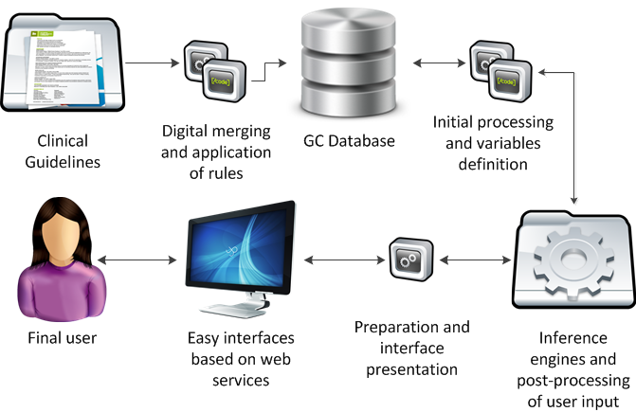
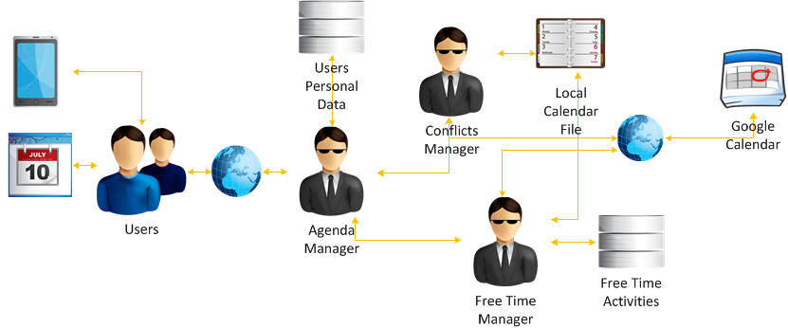
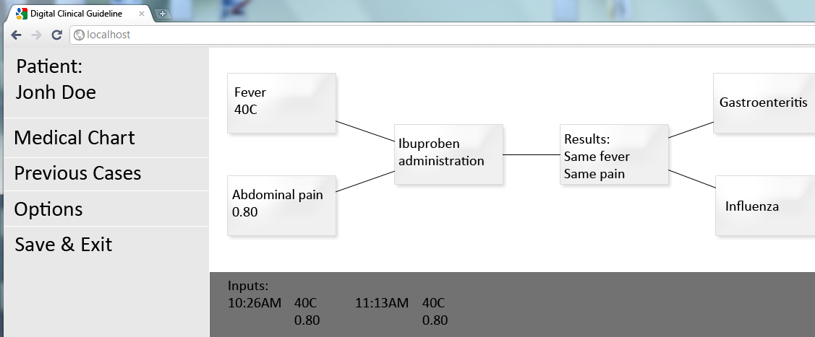
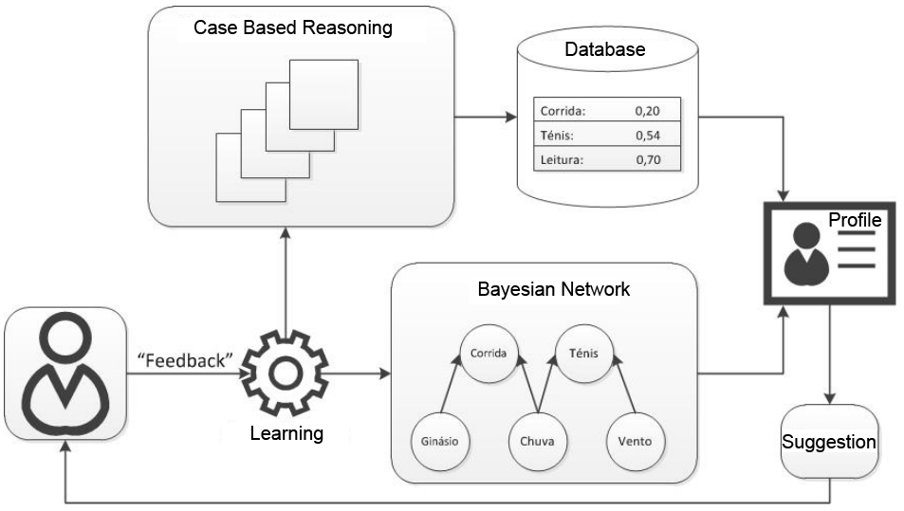
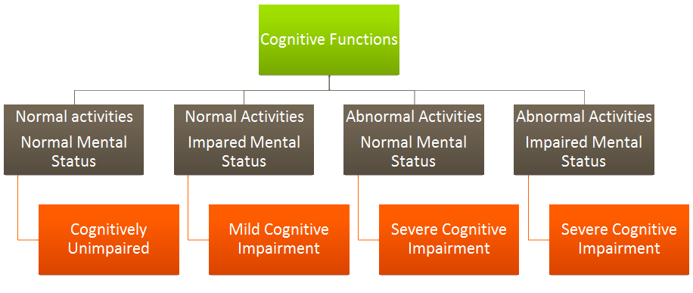
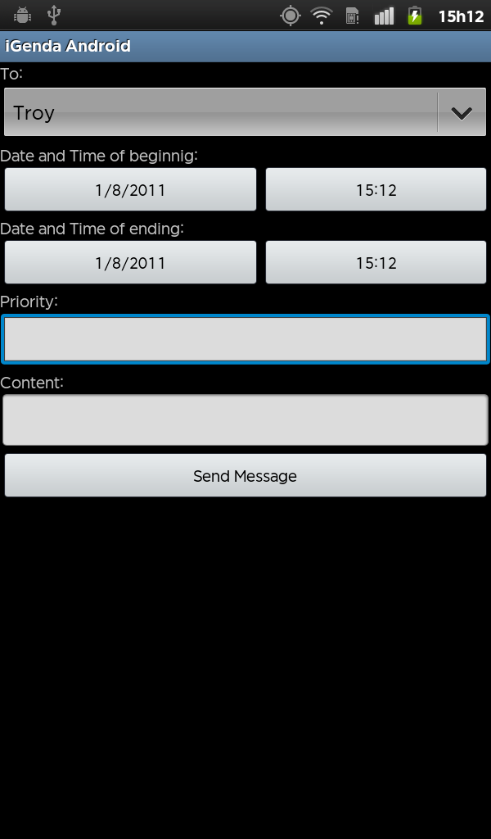
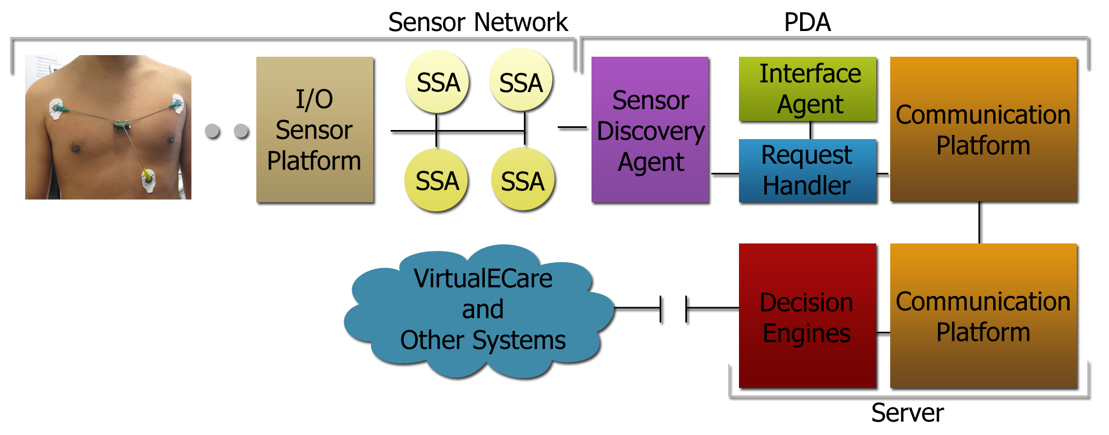
University of Minho School of Engineering CCTC – Centro de Ciências e Tecnologias de Computação
A COGNITIVE IMPAIRMENT HELPER
ÂNGELO GONÇALO COSTA
Supervisor: Paulo Novais
acosta@di.uminho.pt
Intelligent Systems Lab
Islab.di.uminho.pt
Vision
Providence of intelligent computer systems that provide greater independence, security and well-being of cognitive disabled people, such as:
Memory enablers, such as remainders of activities and suggestion systems.
Warning systems that warn and advise accordingly to the current situation and user profile.
Sensory systems that capture data to understand the user behavior and help him by providing just-in-time solutions and suggestions.
Context
iGenda – An Memory Cognitive Impairment Helper
MCI helper through the use of memory aid.
Intelligent event manager, and conflicts resolution.
Social tool with connection with friends and relatives.
Healthcare enabler, with direct connection with medical services.
Emergency tool, panic button and positioning system.
Playful activities generator, in form of free time manager.
Clinical Guidelines
Computerized digital clinical guidelines that help the medical decision and provide insightful suggestions to diagnose the disease and administer the appropriate treatment.
A Decision Support System with evaluation of Quality of Information is used to aid and complement the decision when the knowledge is imperfect.
Profiling System & Medication Remainder
The profile system assures the system is always in sync with user, keeping the general preferences updated, through the use of CBR, Bayesian Networks a learning system and statistical methods.
The medication remainder assures that the user always takes the medication according to the information present in the profile.
Elderly population is growing unprecedented, while the remaining age groups decrease in density.
From 50 years of age Mild Cognitive Impairment (MCI) begins to grow at an accelerated pace.
AI methods to provide better conflict resolution.
Priorities values differentiated by user/service, per user configuration.
Lightweight portable encrypted databases.
Supports Google Calendar and local calendar files.
Stages
Sensoring System
The sensoring system measures data collected from discrete sensors placed on the user body, collecting ECG, Oximetry, Fall Detection System among others, and processing the data collected and taking actions if certain scenarios are presented. The actions are derived from the Clinical Guidelines and the actions are based in logical functions and learning procedures.
MCI Stages
Full integration with Android services, ICS and Google Calendar push and retrieve.
Maximum use of Android’s native apps. GPS, cell network and WiFi position system capture, for indoor and outdoor user localization.
Uma Escola a Reinventar o Futuro – Semana da Escola de Engenharia - 24 a 27 de Outubro de 2011

