Slide 1
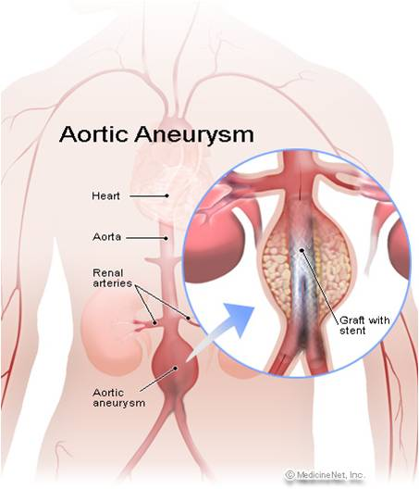
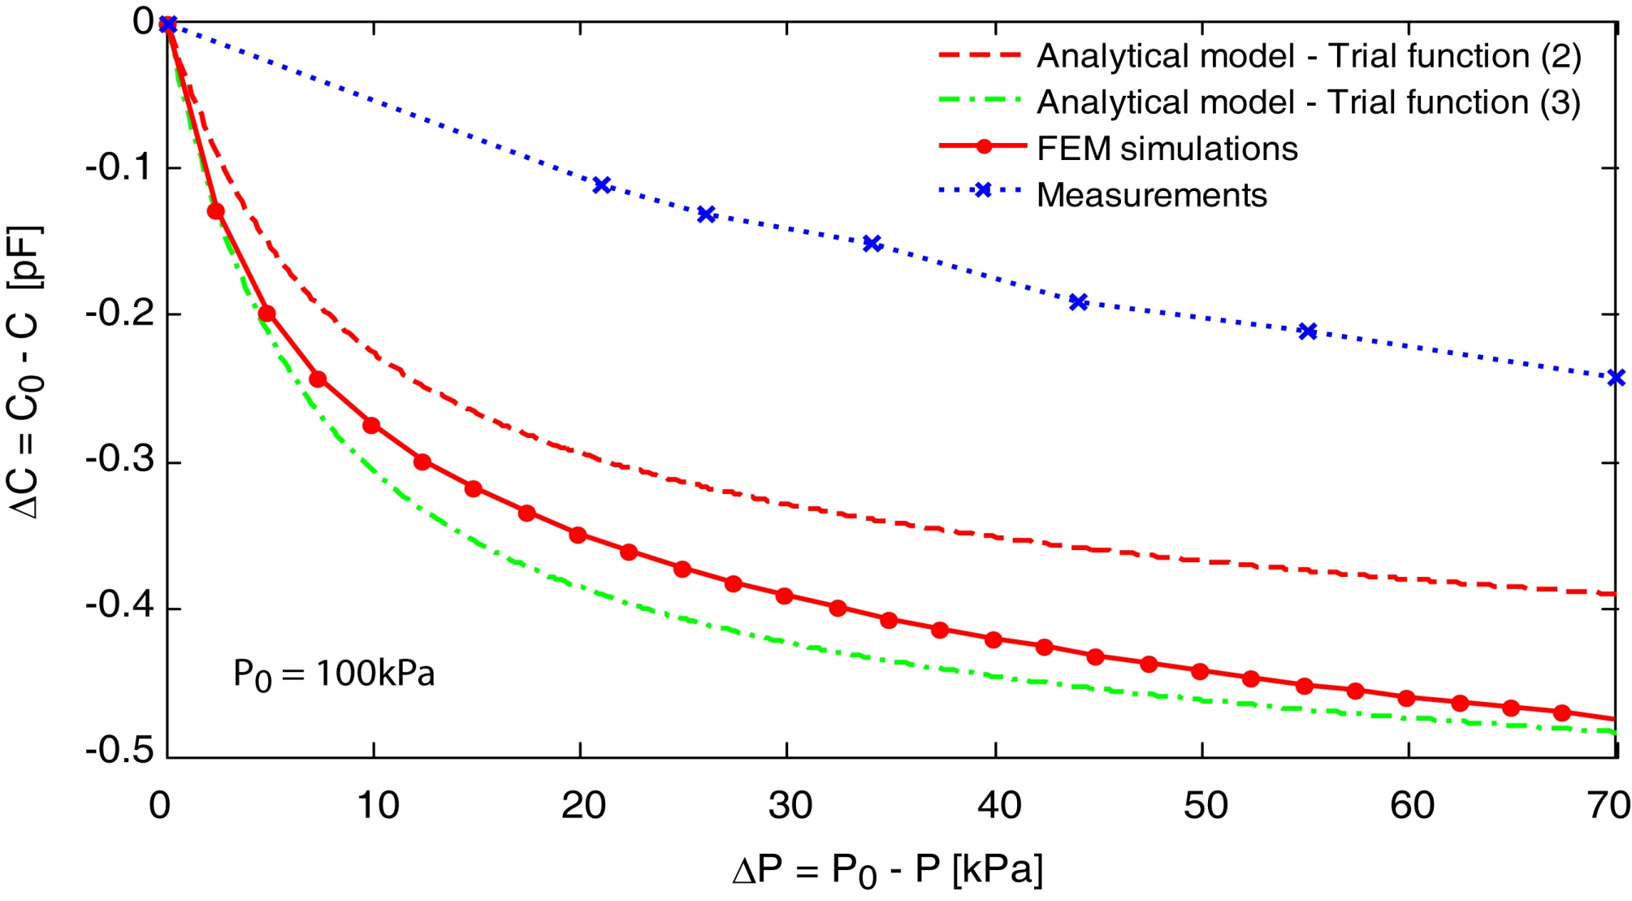
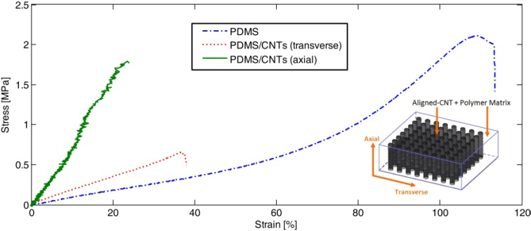
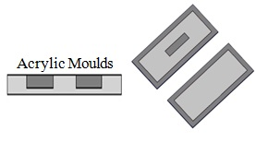
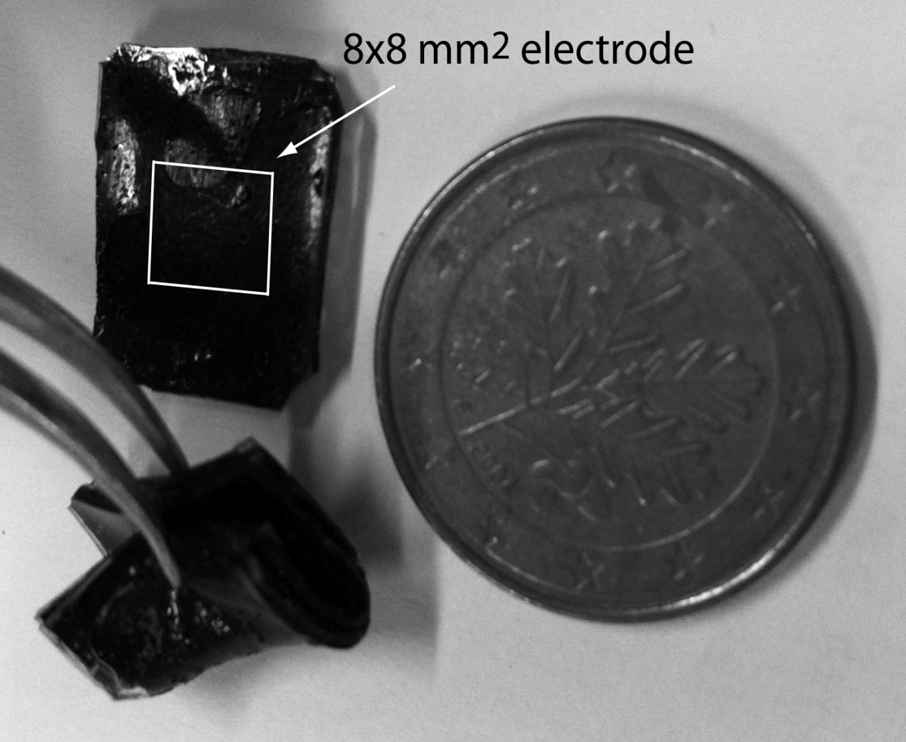
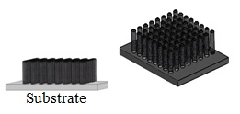
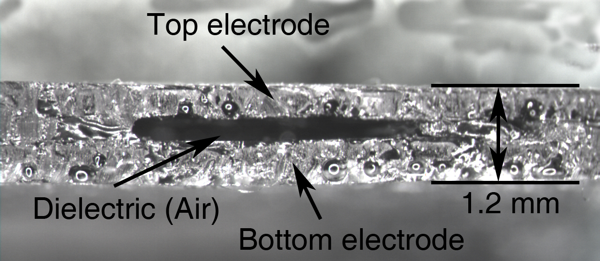
University of Minho School of Engineering Institute for Polymers and Composites/I3N
IMPLANTABLE FLEXIBLE SENSOR BASED ON ALIGNED-CARBON NANOTUBES FOR BLOOD PRESSURE MONITORING
Author* ALEXANDRA T. SEPÚLVEDA
Supervisors: António J. Pontes, Júlio C. Viana, Luís A. Rocha
* xanasepulveda@dep.uminho.pt
Introduction
Fabricated A-CNTs/PDMS prototype sensors were tested in a vacuum chamber. The results were compared with the respective sensor analytical model and a finite element modeling. The simulation results compare relatively well with the experimental data for large pressures differences.
We present a carbon nanotube (CNT)-based flexible capacitive sensor to measure the blood pressure within an aneurysm sac after an EVAR (endovascular repair) procedure.
PDMS filling
Given the specifications of EVAR, the device must be foldable, extremely flexible and characterized by a very small profile. Aligned-CNTs embedded in a flexible substrate of polydimethylsiloxane (PDMS) are used to fabricate the elements of the capacitive sensor (namely an inductor and the capacitor electrodes). Fabricated sensors prototypes validate our approach and show that A-CNTs/PDMS layered composites can be used to create highly flexible pressure sensors.
Layers Bonding
Capacitive changes vs. pressure assuming ambient pressure inside the dielectric
Results
The nanocomposites, molded into rectangular shapes with dimensions of 32x14x0.4mm³ (LxWxH), present an increase in the Young’s modulus in the transverse direction (1.7MPa). In the axial direction, the increase is very high (up to 8MPa);
Pure PDMS membranes were also tested for comparison and they have a Young’s modulus (in the linear region) of ~0.9MPa;
Materials & Methods
The flexible pressure sensor development involve the following steps:
Fabrication of the PDMS flexible membranes (dielectric) using acrylic moulds;
Growth of forests of vertically aligned-CNTs, via an atmospheric chemical vapor deposition (CVD) process (to build the electrical components);
Embedding of the aligned-CNTs into the polymeric matrix of PDMS;
Nanocomposite cure and bonding of the three thin layers (each one with a thickness of about 400 µm).
Stress-strain curves of pure PDMS and reinforced A-CNT/PDMS nanocomposites in the axial and transverse directions.
Conclusion
We demonstrate that a technology based on aligned-CNTs embedded in a flexible matrix of PDMS has proven successful in the development of flexible pressure sensors.
A surveillance mechanism based on pressure changes, to measure the pressure in an aneurysm sac, is an attractive solution to detect possible post-EVAR problems.
Future work includes the development of an inductor embedded in the nanocomposite using conductive fibers that enables the fabrication of a LC network for passive telemetry.
The measured electrical conductivity, using the Van der Pauw method, was of 0.35 S.m⁻¹ with a standard deviation of 0.37 S.m⁻¹;
Acknowledgments
Moulds Fabrication
A-CNTs/PDMS Flexible Pressure Sensors
Cross section of an A-CNTs/PDMS Pressure Sensor
The first author is supported by FCT – Fundação para a Ciência e Tecnologia, Portugal, through the grant SFRH/BD/42922/2008. This work is supported by FCT under the project MIT-PT/EDAM-EMD/0007/2008. CNT-based polymer composite materials were developed with funding from Airbus S. A. S., Boeing, Embraer, Lockheed Martin, Saab AB, Spirit AeroSystems, Textron Inc., Composite Systems Technology, Hexcel, and TohoTenax Inc. through MIT´s Nano-Engineered Composite aerospace STructures (NECST) Consortium.
A-CNTs Forest Growth
Uma Escola a Reinventar o Futuro – Semana da Escola de Engenharia - 24 a 27 de Outubro de 2011

