Slide 1
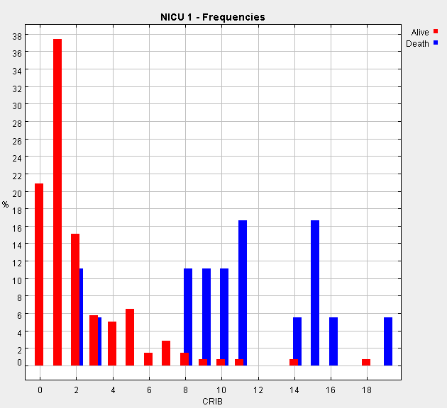
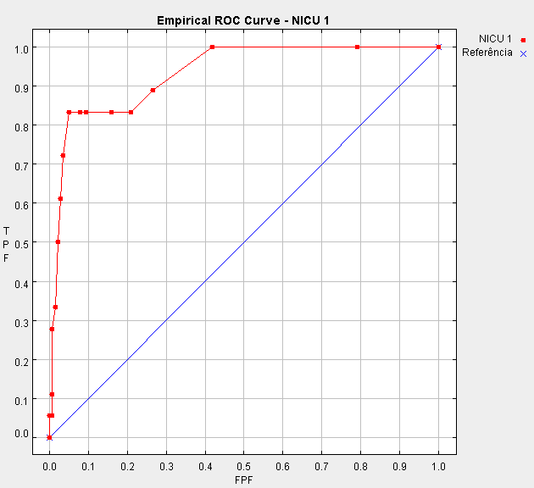
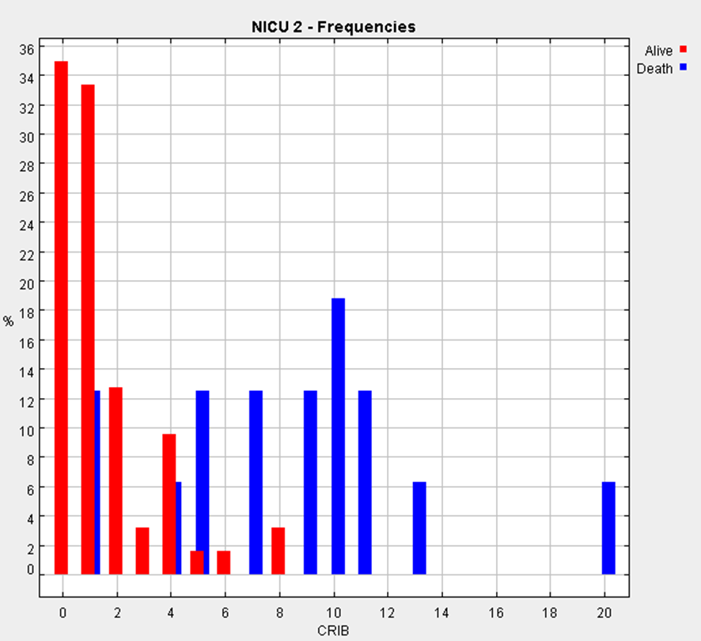
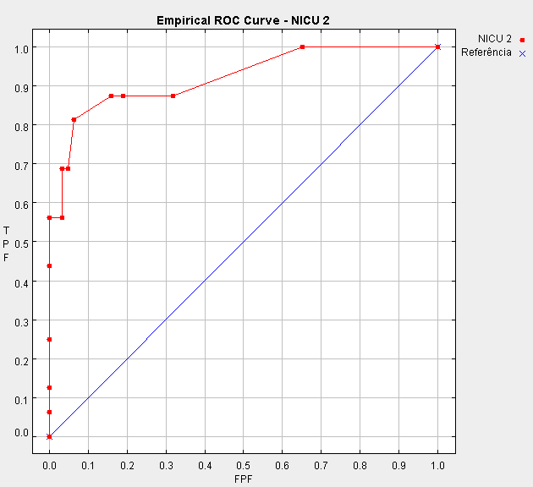
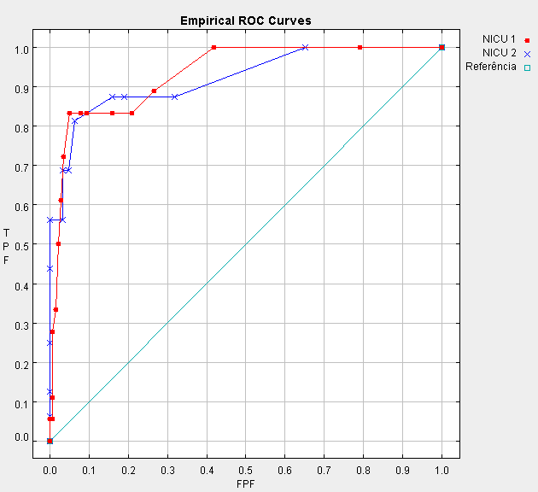
University of Minho School of Engineering Centro Algoritmi
ASSESSING THE PERFORMANCE OF NEONATOLOGY UNITS
Author* MARIA FILIPA MOURÃO
Supervisor: Ana Cristina Braga, Co-supervisor: Pedro Nuno Oliveira
* fmourao@estg.ipvc.pt
MOTIVATION
RESULTS
CONCLUSIONS
Mortality rates are considered one of the most important indicators for assessing the performance of neonatal care
Software: ROCNPA
The study involved 157 infants in NICU 1 (mortality rate of 11.46%) and 79 in NICU 2 (mortality rate 20.3%). Of the 236 newborns, 34 died (mortality rate of 14.41%) and 202 survived.
Evaluate the performance of the CRIB (Clinical Risk Index for Babies) in classifying the health status of newborns with very low birth weight in two Intensive Care Units of Neonatology and compare the performance of these two units
The NICU 1 with an AUC = 0.93 and SE = 0.028, it is closer to the upper left corner and consequently with better performance in the use of the scale CRIB [2]
With 5% significance level, there isn’t statistically significant difference (Z= -0.19, p-value =0.8494) in the quality of services provided by the two NICU's [3]
METHODOLOGY
FUTURE WORK
Wilcoxon area: 0.93 Standard Error (SE): 0.028
The ROC (Receiver Operating Characteristic) analysis is often used to evaluate the accuracy of the performance measures in medical diagnosis and the quality of medical service
How to evaluate the quality of indexes when the two curves cross?
One major advantage of using ROC curves is the possibility to compare different severity indexes, and so compare the quality of medical service
Using measures used to evaluate the performance of algorithms in multi-objective [1]
The relevant hypothesis to test is
REFERENCES
based on critical reason
Wilcoxon area: 0.92 Standard Error (SE): 0.042
[1} Braga, A. C, Costa, L. e Oliveira, P., Metodologia não paramétrica para a comparação global e parcial de curvas ROC (com referee), ISBN 972-8890-04-4 Carlos A. Braumann, Paulo Infante, Manuela M. Oliveira, Russell Alpízar-Jarra e Fernando Rosado, “Estatística Jubilar”, pág. 79-88, Edições SPE, Setembro 2005;
[2] Hanley, J.A., McNeil, B.J. (1982),”The meaning and use of the area under a receiver operating characteristic (ROC) curve”. Radiology, 143:29-36.
[3] Hanley, J.A., McNeil, B.J. (1983), “A method of comparing the areas under receiver operating characteristic curves derived from the same cases”. Radiology, 148:839-843.
[4] The International Network Group (1993), “The CRIB (clinical Risk Index for Babies) score: a tool for assessing initial neonatal risk and comparing performance of neonatal intensive care units”. Lancet, 342: 193-198.
Uma Escola a Reinventar o Futuro – Semana da Escola de Engenharia - 24 a 27 de Outubro de 2011

