Slide 1
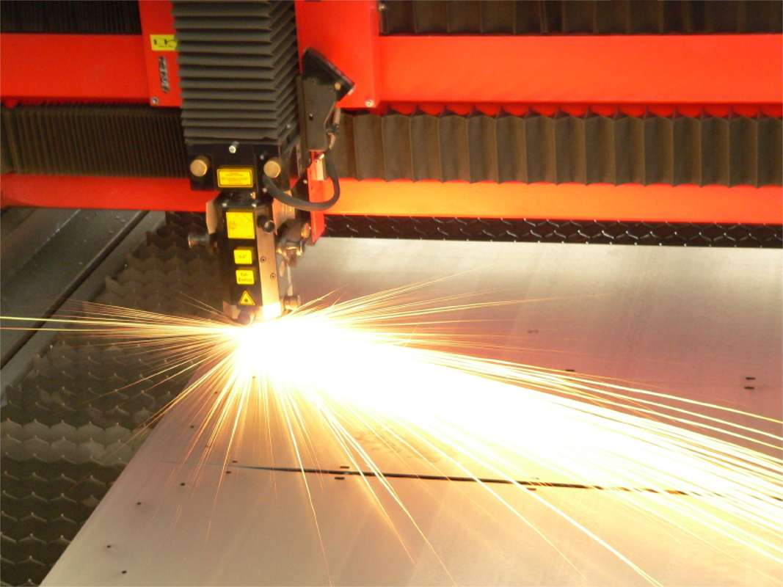
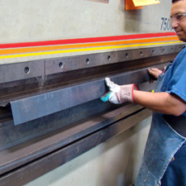
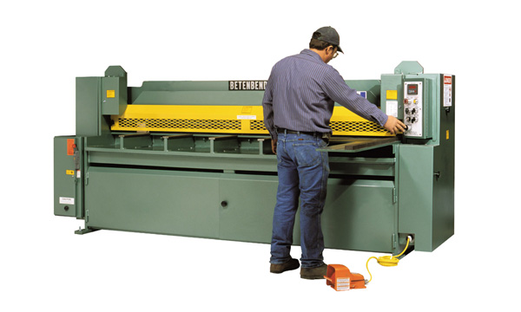
University of Minho School of Engineering CITEPE
SHEET METAL PROCESSING EQUIPMENT AND MARKETS UNDER UNCERTAIN FUTURE ENVIRONMENTS: A FRAMEWORK TO ASSIST TECHNOLOGY STRATEGY DECISIONS
CLÁUDIO SANTOS*
Supervisors: Madalena Araújo (UMinho), Nuno Correia (INEGI) and Jeremy Gregory (MIT)
* id2696@alunos.uminho.pt
Motivation
The current economic climate, characterized by the effects of globalization such as fierce competition and faster-paced introduction of new technologies, is forcing companies to constantly readapt their strategies in what concerns product development and technology investments. Being confronted with such forces, firms are facing difficulties in making the right decisions concerning new technological developments, for the objective of maximizing the value of their businesses.
Any complex decision is always associated with a certain level of uncertainty. In the case of technology strategy decisions, R&D investment might exceed the initial budget, supplies costs may increase, demand can be higher than expected, etc. A suitable approach to deal with uncertainty, capable to minimize losses and maximize gains, is highly desirable by firms dealing with technologies.
The aim of the present research is to define a proper framework of analyses that support the process of technology strategy formulation in firms. The developed framework will be tested and validated in a medium sized company in the business of sheet metal processing equipment.
A Systems Approach
Such machines incorporate multiple streams of technologies, ““made up of many interacting components and subsystems, belonging to different technical fields” whose nature is basically “multitechnological” (Prencipe, 1997, 1262).
Figure 1 – Generic technology strategies
But how is the firm positioned in terms of technological competencies and capabilities (strengths and weaknesses)? How will the expected technological evolution affect the performance of these systems? Which trends can we foresee in technologies and markets? Which technologies shall provide the firm with sustained competitive advantage?
In order to answer to these questions, firms should take a rational approach for the formulation of their technology strategies.
Figure 2 – Analyses and decisions during the process of technology strategy formulation, based on (Burgelman et al, 2004) and (Chiesa, 2001)
Research Methodology
The research is conducted along a number of stages, depicted in the Figure below.
Figure 3 – Stages in the Research Methodology
Preliminary Results
At the present state of the research and after an internship period at the company, a first draft of the method for evaluating technological competencies and capabilities has been developed, which shall be validated by specialists in the area of technology management and then implemented in the context of the company.
Acknowledgements
This research is supported by Fundação para Ciência e Tecnologia (scholarship reference SFRH / BD / 33727 / 2009), within the framework of the MIT Portugal Program.
References
BURGELMAN, R. A., CHRISTENSEN, C. M. & WHEELWRIGHT, S. C. 2004. Strategic Management of Technology and Innovation, McGraw Hill/Irwin.
CHIESA, V. 2001. R&D Strategy and Organization: Managing Technical Change in Dynamic Environments, London, Imperial College Press.
PRENCIPE, A. 1997. Technological competencies and product's evolutionary dynamics a case study from the aero-engine industry. Research Policy, 25, 1261-1276.
CONCENTRIC DIVESIFICATION
Identification, analysis and evaluation of the company’s technological competencies and capabilities
Internship period at the company
Maintain main technological systems
New applications (polymers, ceramics, composites, other metals)
Incremental improvements
Foresight techniques to explore the future of the technologies identified in the previous stage
Generic technology strategies
Change technology sub systems
Product architecture
Engineering systems
Generation of the technology development alternatives
New products
Change main technology systems
New technologies and systems from scratch
New products
Model to support decision-making over strategic alternatives
Ensure alignment with the corporate strategy during the process
CONGLOMERATE DIVESIFICATION
Economic evaluation model of technology projects in face of uncertainties
Laser cutting machines
Technology strategy
DECISIONS
Press brakes
Technology(ies) selection
Technological competencies and capabilities
development
Technology(ies) acquisition mode (internally, partnership or externally)
Timing of technology development and introduction
Investment level in technological developments
Management form for technological innovations
ANALYSES
Internal
External
Shears
Identify the firm’s technological base (capabilities, competencies, facilities, skills, etc.)
Evaluate the technological positioning of the firm (current state)
Conduct technology foresight
Develop a scenario of the future technological options
Uma Escola a Reinventar o Futuro – Semana da Escola de Engenharia - 24 a 27 de Outubro de 2011

