Slide 1
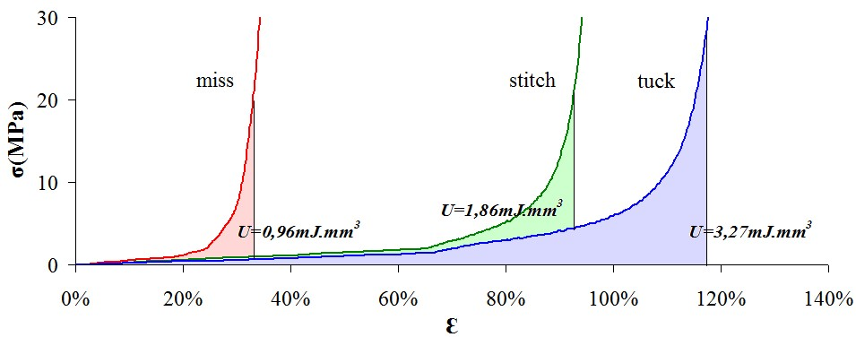
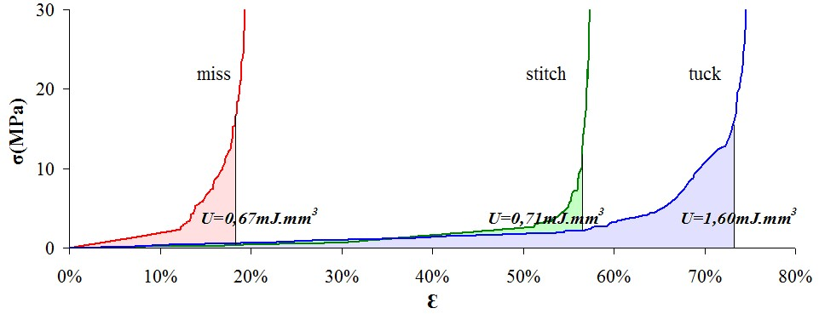
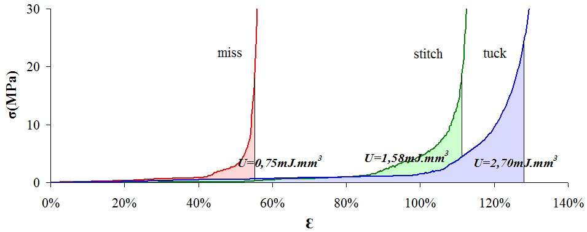
University of Minho School of Engineering Centro de Ciências e Tecnologia Têxtil
INFLUENCE OF THE LOOP TYPE ON THE ENERGY ABSORPTION PERFORMANCE OF WEFT-KNITTED FABRICS PRODUCED WITH NiTi WIRES
Author* José Ivan Medeiros
Supervisor⁺ Raúl Fangueiro
* ivanmedeiros@sapo.pt ⁺ rfang@det.uminho.pt
Capes Grant – Proc. nº BEX 0547/09-3
OBJECTIVE
To study the influence of the loop type on the energy absorption performance of weft-knitted fabrics produced with three different NiTi wires, in order to supporting future applications of this material in textiles structures.
KEYWORDS
SMA NiTi wire; Weft-knitted fabric; Loop types; Energy absorption.
ABSTRACT
This paper presents the research undertaken at the University of Minho, aiming to study the behaviour of weft-knitted fabrics produced with SMA NiTi wires type B (which shows SME at body temperature) with different diameters. Various samples of weft-knitted fabrics had been produced with different loop types, e.g. stitch, tuck and miss. The influence of the loop on the performance of the weft-knitted fabrics, in terms of energy absorption, had been analyzed. Tests were carried out on a tensile machine testing. The results aim to help future applications of SMA in the development of new textile structures.
INTRODUCTION
Ultimately, fibers, yarns, fabrics and other fibrous structures with added-value features have been successfully developed for specific applications as technical and/or high performance end-uses. Technical textiles have been promoted as alternative materials for an unlimited range of applications including medical, automotive, aerospace, civil and mechanical engineering, among others[1, 2].
Especially on clothing sector, high performance materials have attracted much interest for design and for the sport and protective clothing[1].
SMM´s have been considered as a ultra smart material, because they have the ability to sense stimuli and react according to the programmed way, by moving the internal molecular structure, leading the material for a pre-programmed shape[3].
EXPERIMENTAL
In this current work, were used NiTi wires type B (which shows SME at body temperature), with different diameters: 50µm, 127µm and 210µm, in order to produce weft-knitted fabrics with three different loop types: stitch, tuck and miss, figure 1 (a, b and c), respectively.
Figure 1. Knitted structures produced
The samples were produced on a flat knitting machine, with 8 needle/inch, based on a single jersey structure. The structural parameters are shown in table 1.
Table 1. Structural parameters of the samples
RESULTS AND COMMENTS
Figure 2. Deformation energy of 50µm NiTi wire for different type of loop structures.
Figure 3. Deformation energy of 127µm NiTi wire for different type of loop structures.
Figure 4. Deformation energy of 210µm NiTi wire for different type of loop structures.
Influence of the wire diameter in different loop types
As can be seen in figures 2, 3 and 4, the diameter of the NiTi® wire greatly influences the behaviour of the loops in their first part of the deformation, as the deformation up to the jamming point is varying according to this factor.
Influence of the loop type for different diameters
As expected, the results showed that the loop type, greatly influences the tensile behaviour of the NiTi wire and this is dependent on the alignment of the wire to the axial force being applied. In this way, the initial part of the curve for all NiTi® diameter wires is increasing from miss to tuck loops, as shown in figures 2, 3 and 4.
Energy absorption
Table 2. Energy absorption for different loop types.
CONCLUSIONS
Several conclusions could be taken considering the processability of the NiTi wires:
the 50µm wire showed to be too thin to be knitted in the flat knitted machine 8 gauge;
the 50µm wire does not represent great percentage of SMA in the knitted structure, which can avoid its smart effect.
the 210µm NiTi wire shown to be hard to process on the knitting machine due to its high stiffness.
Finally, for the same NiTi wire diameter, tuck loop presents the highest energy absorption capacity. Moreover, larger energy absorption capacity has been obtained for higher NiTi wire diameters.
The results obtained may be a good contribution to design weft-knitted structures with shape memory ability.
REFERENCES
[1] Tang, S., Stylios, G. K., (2006). An overview of smart technologies for clothing design and engineering, International Journal of Clothing Science and Technology, Vol. 18 Iss: 2, pp.108 - 128.
[2] Taís, N., Fangueiro, R., (2009). Design de Stents Híbridos Entrelaçados. Tese de Mestrado. 101 p., Universidade do Minho, Portugal.
[3] Tao, X., Smart fibres, fabrics and clothing: Fundamentals and applications. Woodhead Publishing Series in Textiles Nº. 20. 2001, Cambridge, UK: Woodhead Publishing Limited. 336 p.
Parameters | Miss loop |  |  | Stitch loop |  |  | Tuck loop
Wire diameter (µm) | 50 | 127 | 210 | 50 | 127 | 210 | 50 | 127 | 210
Loop Length (mm) | 3,7 | 4,9 | 4,2 | 4,9 | 6,7 | 6,1 | 5,4 | 7,2 | 6,9
Energy |  | NiTi wire diameter
 |  | 50µm | 127µm | 210µm
Loop type | Miss | 0,67mJ.mm³ | 0,75mJ.mm³ | 0,96mJ.mm³
 | Stitch | 0,71mJ.mm³ | 1,58mJ.mm³ | 1,86mJ.mm³
 | Tuck | 1,60mJ.mm³ | 2,70mJ.mm³ | 3,27mJ.mm³
Uma Escola a Reinventar o Futuro – Semana da Escola de Engenharia - 24 a 27 de Outubro de 2011

