Slide 1
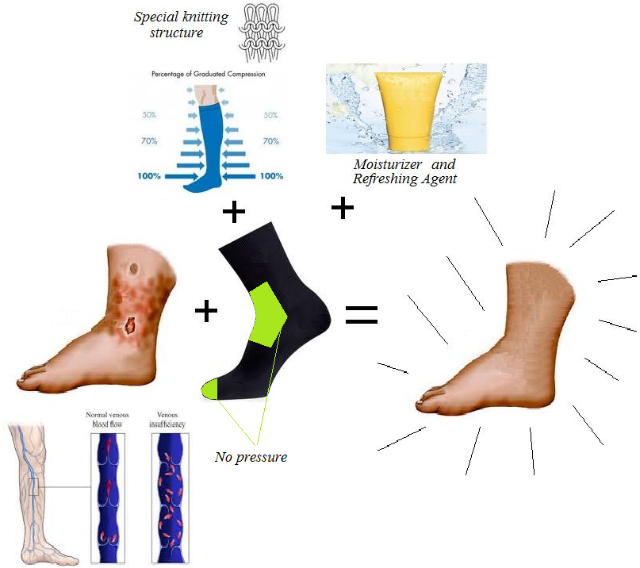
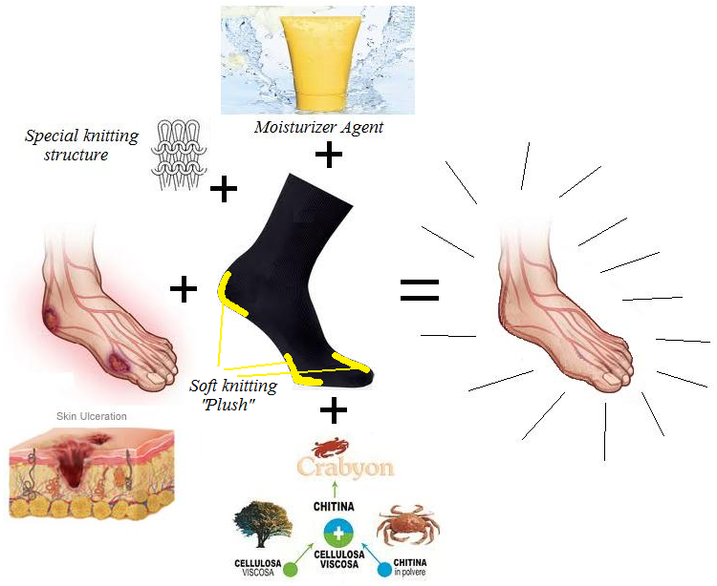
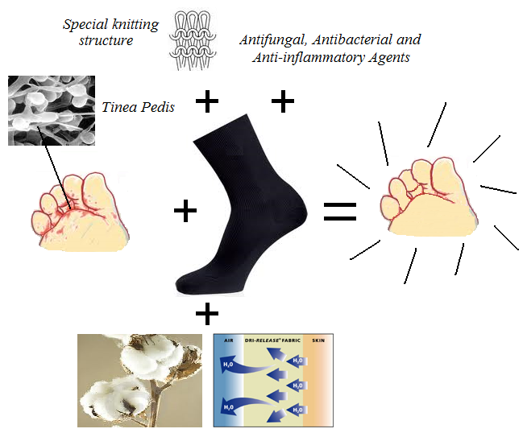
University of Minho School of Engineering 2c2t – Centre for Textile Science and Technology
APPLICATION OF FUNCTIONAL TEXTILES IN THE HEALTHCARE AREA
Author* PAULO JORGE PINTO RODRIGUES
Supervisor: Fernando Nunes Ferreira
* pjpr59@gmail.com
Abstract:
The use of multifunctional textile materials for health applications begins to show a great development, particularly in pathologies associated with skin.
The development of new products combining appropriate structures and finishing treatments, using for example, the proven technology of micro and nano encapsulation to promote gradual release of active ingredients such as moisturizers, therapeutic oils, or others, from the clothing to the skin so they can be absorbed, presents a great potential.
The socks are a type of textile garments in perfect contact with the skin. The skin is an organ that has the important function of protecting the body, is an important route of drug administration and the permeation of the stratum corneum, the outermost barrier of the skin, is a challenge to dermatological and transdermal treatment.
Various substances can be applied to the skin for therapeutic purposes, targeting in different layers of the skin and may exert different mechanisms of action, given the complexity and variety of organ functions.
This work is focused to investigate and develop therapeutic socks to prevent and treat different pathologies of the feet, including:
# Venous Insufficiency # Diabetic foot # Tinea Pedis ("Athlete's foot“)
AUTHOR BIOGRAPHY
PAULO RODRIGUES was born in Braga, Portugal, and made his graduation in Textile Engineering at Minho University (1990); Presently he is a PhD student at 2C2T - Centre for Textile Science and Technology of University of Minho.
Diabetic foot – Research:
The socks developed for this pathology have a special textile composition with organic cotton and crabyon fiber.
All socks are seamless to give comfort, and they have an innovative design and a knitting construction structure consisting of a white color in sole with plush (“terry”) in toes and heels to show easily blood stains and to cushion the feet, helping to reduce shock and friction at the sock/foot interface.
No knitting compressibility is allowed.
All socks were submitted to a functionalization moisturizer agent.
All patients recruited will use a special socks pack and they will be properly assessed for monitoring, control and validation features to will be achieved in order to know the results.
The following tests will be performed:
I - Determination of inflammation parameters.
II - Evaluation of physical-chemical parameters of the skin by skin biometrics.
Tinea Pedis (Athlectic foot”) – Research:
The socks developed for this pathology have a textile composition with organic cotton and Dri Release fiber.
All socks are seamless to give comfort, and they have an important knitting structure construction consisting in double-layer knitting structure construction. Inside, Dri Release PES with Amicor Plus, and in exterior, organic cotton.
All socks were submitted to a funcionalization agent with antifungal, antibacterial and anti-inflammatory properties.
All patients recruited will use a special socks pack and they be properly assessed for monitoring, control and validation features.
The following tests will be performed:
I - Determination of inflammation parameters.
II - Evaluation of physical-chemical parameters of the skin III - Evaluation of clinical signs and symptoms
IV - Laboratory evaluation. To guaranty no dermatophyte growth in culture.
Venous Insufficiency – Research:
The socks composition developed for this pathology will be organic cotton and elastane fiber.
All socks are seamless to give comfort, and they have an important knitting structure construction consisting in different elasticity of the knitting along the foot and leg in order to have different levels of compressibility, according to the anthropometric survey of the foot and leg of each patient.
All socks are knee-high.
All socks were submitted to a funcionalization moisturizer and refreshing agent.
All patients recruited will use a special socks pack and they will be properly assessed for monitoring, control and validation features.
The following tests will be performed:
I - Evaluation of physical-chemical parameters of the skin by skin biometrics.
II – Area of Cardiology - Venous plethysmography (detection of reflux) and distal pulses.
Uma Escola a Reinventar o Futuro – Semana da Escola de Engenharia - 24 a 27 de Outubro de 2011

