Slide 1

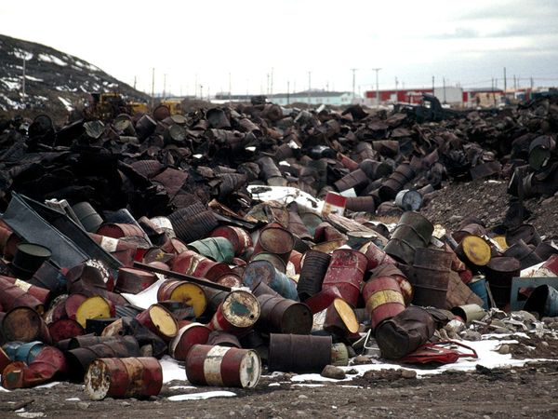
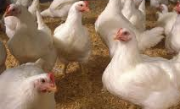
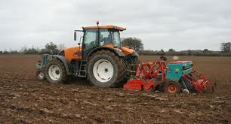

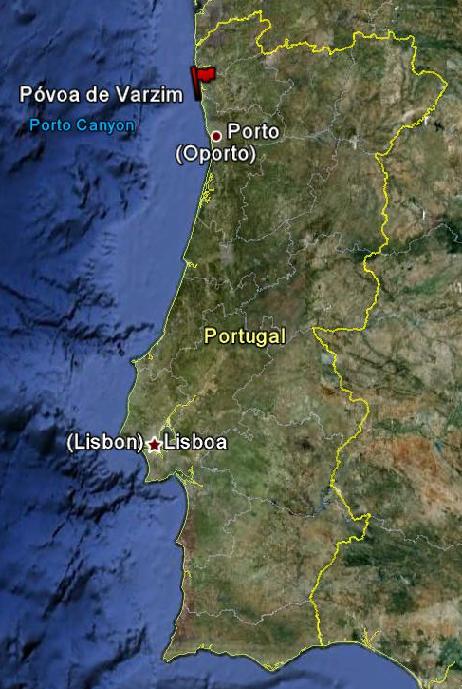

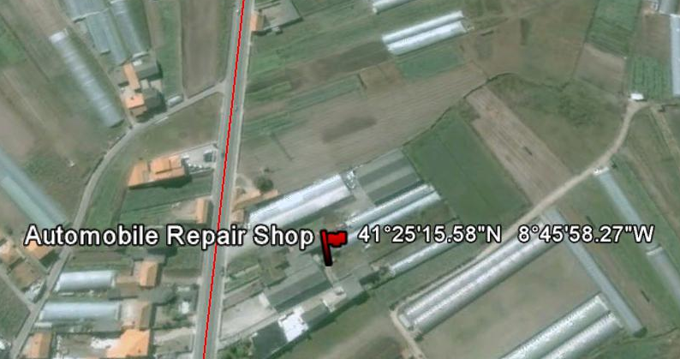


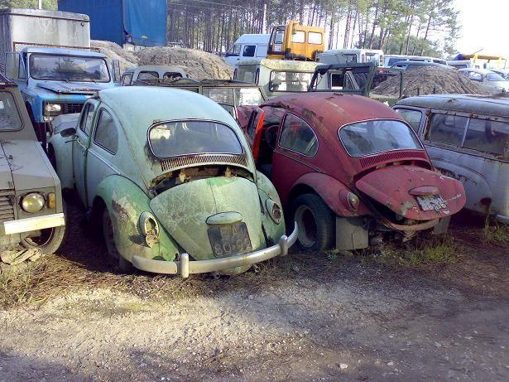
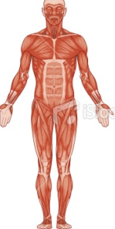
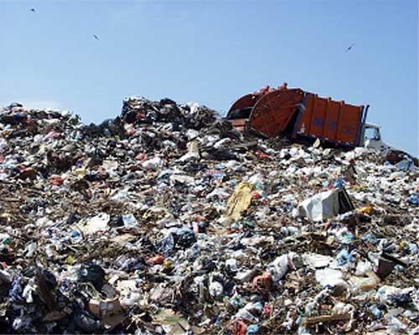
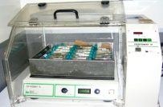
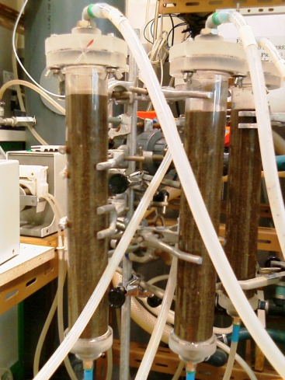
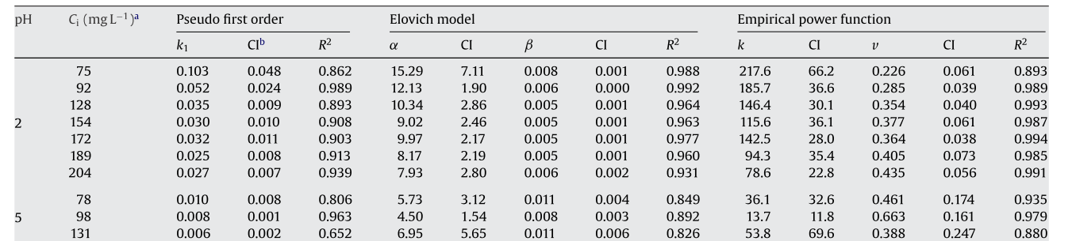
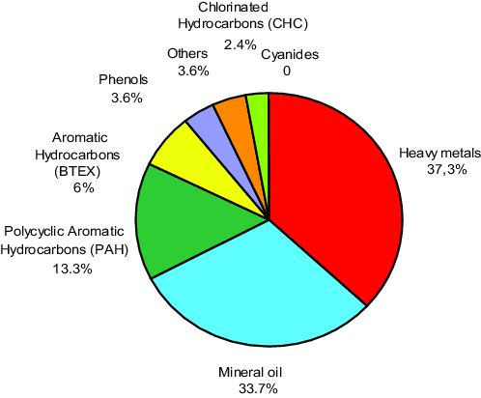
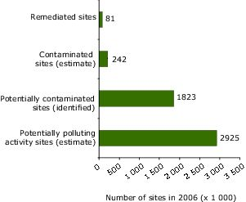





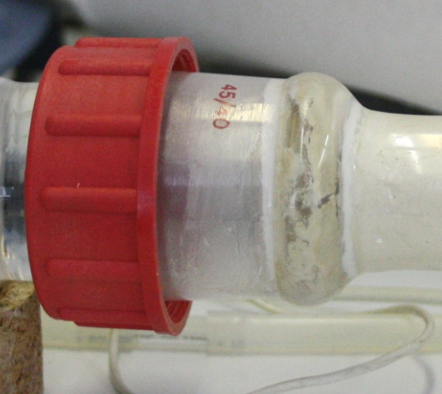
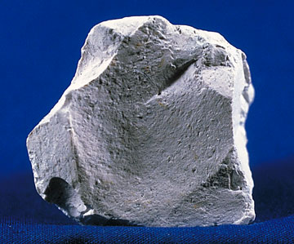
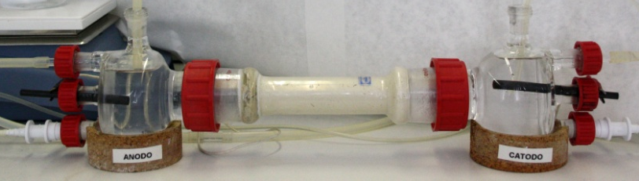


University of Minho School of Engineering Cnetr of Biological Engineering
SOILS CONTAMINATED WITH HEXAVALENT CHROMIUM - SORPTION, MIGRATION AND REMEDIATION
BRUNA FONSECA*
Supervisor: Maria Teresa de Jesus Simões Campos Tavares
* bfonseca@deb.uminho.pt
Why?
How?
Results (Highlights)
Sampling
Sorption and Migration
Bioacumulation of Heavy Metals
Main characteristics
Loamy sand soil
Slightly acidic [pH=5.9]
Poor in organic matter [3.5%]
Sorption kinetics: Single systems with Cr(VI)
Best fit
CAUSES
The soil was collected near an automobile repair shop, in a zone of great agricultural activity.
pH2
pH5
What about Europe?
Figure 2. Variation of mass o Cr(VI) adsorbed per mass of soil, for different initial solutions, at pH 2 and pH 5, respectively (C₁=75 mg L⁻¹;C₂=92 mg L⁻¹;C₃= 128 mg L⁻¹).
Sorption and Migration
Tested parameters
pH of the contaminant solution;
Concentration of the contaminant solution.
Competition with other heavy metals in solution;
The rate constant increases with the solution concentration
Batch tests
Flow tests
The maximum sorption capacity decreases with pH and concentration increasing
Mathematical Modelling
Electroremediation/Biobarriers
First order rate equation
Sorption kinetics
Two-site non-equilibrium adsorption model
Blank
Biobarriers
Recovery = 100 %
Power function
Freundlich equation
R = 77 %
Sorption equilibrium
Langmuir equation
Target
Figure 1. Overview of contaminants affecting soil and groundwater and the status of identification and clean-up of contaminated sites in Europe, as reported to the European Environment Agency through the EIONET priority data flows on contaminated sites.
Electroremediation/Biobarriers
Figure 3. Distribution of the Cr(VI) across the electrokinetic cell
Figure 4. Fraction of Cr(VI) reduced to Cr(III) - C/% - and total removal of the Cr(VI) - R/%.
Kaolinite
[Cr(VI)] = 50 mg kg⁻¹
Biobarrier
Analysis
Total Chromium
USEPA 3051
Microwave acid digestion
Flame Atomic Absorption
Hexavalent Chromium
USEPA 3060A
Alkaline digestion
USEPA 7196A
Colorimetric method
Cr(VI) oxyanions migrated towards the anode chamber.
In general…
Conversion_{18d} ≃ Conversion_{9d}
Removal_{18d} > Removal_{9d}
Bacteria:
Arthrobacter Viscosus
(Cr⁶⁺ → Cr³⁺)
Support:
Activated carbon or Zeolite
R_{carbon} > R_{zeolite}
For Activated Carbon…
Conversion_{18d} >Conversion_{9d}
Removal_{18d} > Removal_{9d}
Highly mobile
Hexavalent Chromium: Cr(VI)
Carcinogenic
Exists mainly as oxyanions
Toxic
Cr₂O₇²⁻
Cr₂O₇²⁻
Cr₂O₇²⁻
Acknowledgments
The author gratefully acknowledge the Fundação para a Ciência e Tecnologia, Ministério da Ciência e Tecnologia, Portugal by her PhD grant (SFRH/BD/27780/2006).
Cr₂O₇²⁻
CrO₄²⁻
HCrO₄²⁻
E = 10 V
Uma Escola a Reinventar o Futuro – Semana da Escola de Engenharia - 24 a 27 de Outubro de 2011

