Slide 1
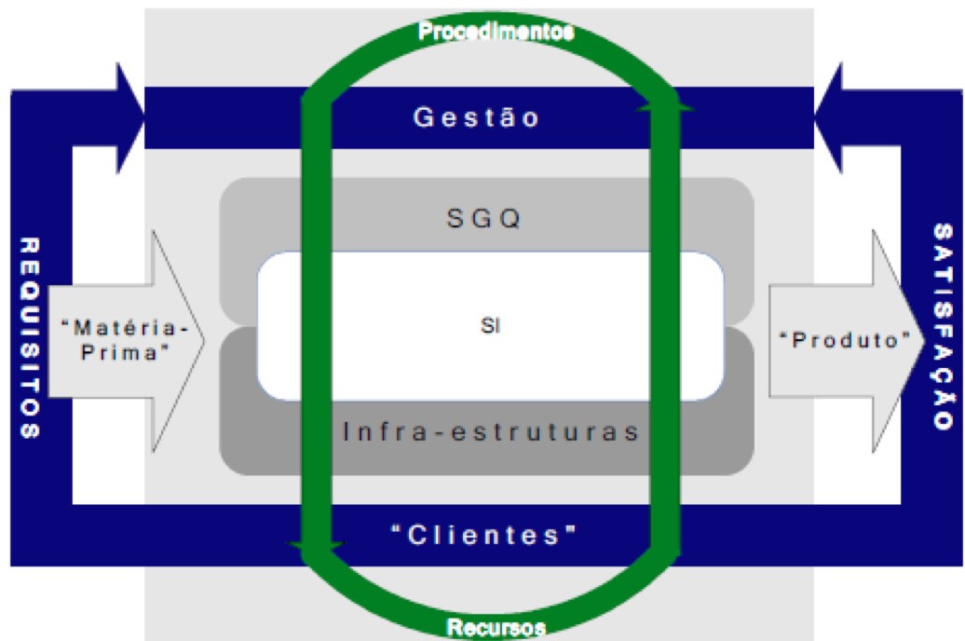
University of Minho School of Engineering Center Algoritmi
ARTICULATION BETWEEN INFORMATION SYSTEMS AND QUALITY MANAGEMENT SYSTEMS
Author*: SILVIA GLÓRIA GOMES FERREIRA*
Supervisor: João Álvaro Carvalho
* silviaggf@gmail.com
INTRODUCTION
Organizations on the one hand, are concerned with developing and implementing Information Systems (IS) suitable for their specific needs instead of purchasing software applications on the market, on the other, organizations acquire licensed software at the market that can support some specific Quality Management Systems (QMS) requirements, such as, auditing and document management.
Due to this problem, the issue that is the subject of research in this PhD project - Articulate information systems with quality management systems, is justified by the need to develop a method of organizational intervention or make an extension of an existing one that combines / articulates to improvement interventions driven by IT/IS with improvement interventions motivated by the QMS.
QMS AND ORGANIZATIONAL INTERVENTIONS RELATED TO ADOPTION OF IT
As quality management of products, services and business processes is a critical issue to the organization, IS development and implementation it is also for this reason: it is surprising that, despite the quality management and IS development requiring an intensive strategic analysis and engineering requirements, these two processes are viewed as completely independent processes in organizations (Lari, 2002). According to these authors, the efforts of many organizations in the development of independent projects for development and implementation of either the IS or the QMS, hiring different teams and using different methodologies, is being replaced by the joint development of these two systems
Despite the individual meaning that each system has in the organization, both directly depend on the mission and objectives of the organization and involve profound organizational changes. Organizations are increasingly looking to its IS have influence on processes associated with the QMS, that is, to actively participate in the QMS, through direct intervention in the processes, to enable specific features and concret applications that implement the ISO 9001, not being restricted to a relation of collection and storage of data from operational systems (Figueiredo & Cunha, 2008).
SYMBIOSIS BETWEEN IS AND QMS
The structure of ISO 9001 standard, defends the approach of management as a system, designed to encourage organizations to look at their activities as a process and reach beyond the scope of certification, the implementation of a QMS, which will benefit the operational performance of all organization.
The Model of organization based on this approach, is represented in Figure 1, which identifies the IS as an infrastructure of the organization and part of the QMS, becoming a main vehicle for implementing the procedures of the organization.
Figure 1: Organization model based approach by process to ISO 9000:2000.
Source: Figueiredo & Cunha (2005)
The organization, IS and QMS pursue common goals of providing a "product" and "customers" satisfaction by facilitating the association of these two systems on a common list of benefits.
This association must meet the following scenarios of the organization (Figueiredo & Cunha, 2005a) :
1. QMS implementation existing IS
2. IS implementation existing QMS
3. Implementation of QMS and IS
PURPOSE AND RESULT
This PhD project aims to seek scientific contributions anchored in the following research question: How to reconcile the organizational improvement interventions driven by the IT / IS with organizational improvement interventions motivated by the QMS?
Starting from main question, we have other key issues to manage the research: (i) Identify concerns and organizational improvement initiatives involving the IT / IS; (ii) Identify concerns and organizational improvement initiatives involving QMS; (iii) Determine the IS methodologies adopted by organizations; (iv) Determine which QMS methodologies adopted by organizations and (v) Identify new forms of organizational improvement through IT / IS, and it will take to achieve the desired outcome of the investigation: Develop a method or extend an already existing of organizational improvement intervention motivated by the adoption of IT / IS and QMS.
CONCLUSION
Given the lack of alignment between IS development and implementation of QMS, the potential organizational benefit for active participation of IS in the processes associated with the QMS, the possible and beneficial combination between organizational improvement interventions related to the QMS and the lack of a joint project between IS and the QMS, is proposed in this research plan, developing a method or extend an existing of organizational intervention that combines / articulate, the improving interventions motivated by IT / IS with improving interventions motivated by the QMS.
REFERENCES
Lari, A. (2002). An integrated information system for quality management. Business Process Management Journal. Vol. 8, N.º 2.
Figueiredo, S. & Cunha, P. (2005). Quality Management Systems and Information Systems: Getting More than the Sum of the Parts. Proceedings of the Eleventh Americas Conference on Information Systems, Omaha, NE, USA August 11th-14th.
Figueiredo, S. & Cunha, P. (2005a). Symbiosis of Information Systems and Quality Management System in the Organization: application to a case. VI Conference of the Portuguese Association of Information Systems. Bragança. 26, 27 and 28 October.
Figueiredo, S. & Cunha, P. R. (2008). Joint Design of the Information System and Quality Management System in an Organization: Theory and Illustration with a Field Case. Proceedings of ISOneWorld Conference.
Uma Escola a Reinventar o Futuro – Semana da Escola de Engenharia - 24 a 27 de Outubro de 2011

