Slide 1
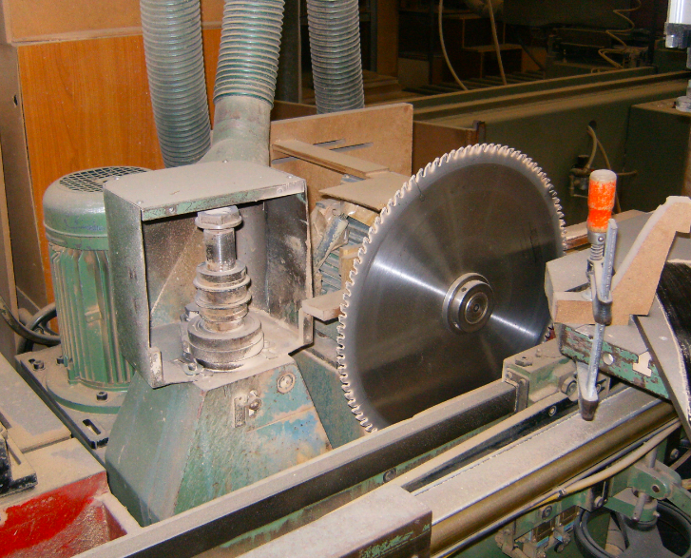
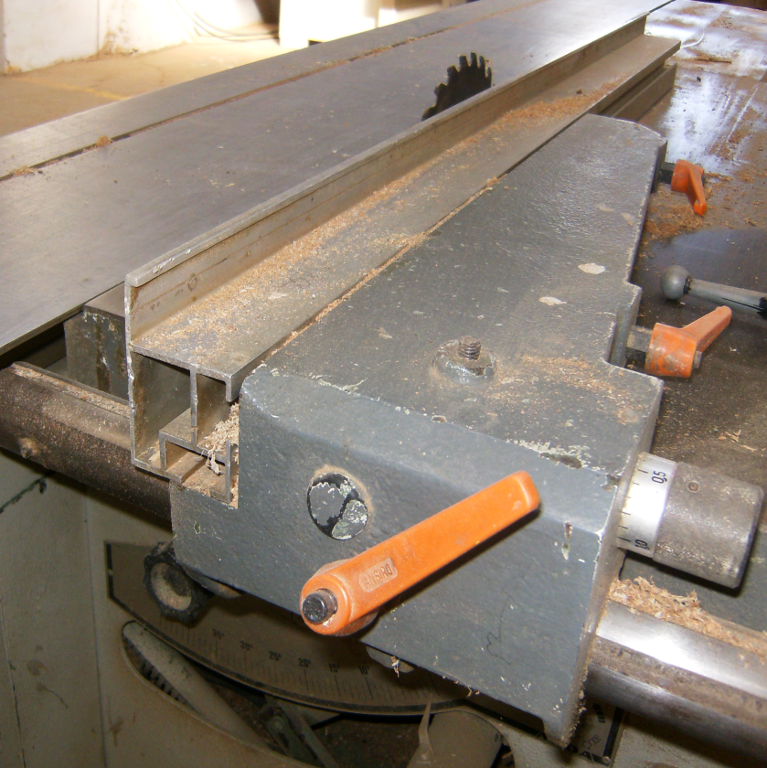
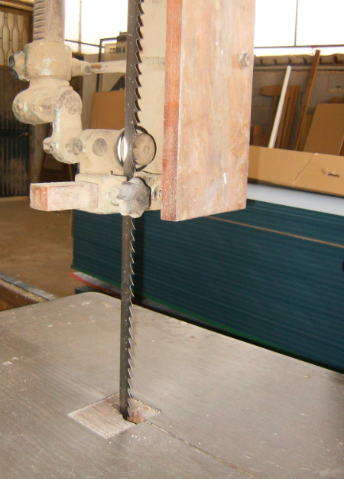
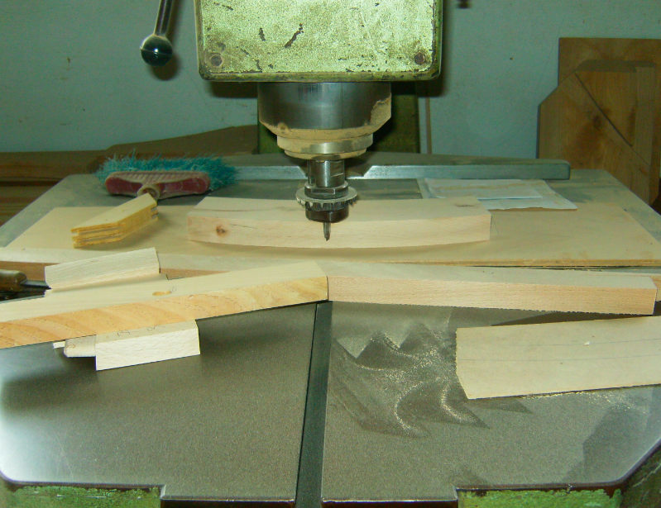
University of Minho School of Engineering CITEPE
RISK CHARACTERIZATION IN WOOD COMPANIES
MATILDE A. RODRIGUES*
Supervisors: Pedro M. Arezes, Celina P. Leão
* matilde.rodrigues@eu.ipp.pt
INTRODUCTION
The furniture sector is one of the biggest economic sector of the Portuguese economy. In these industries, the number of work accidents is high (GEP, 2010). So, it is important to reduce the risks, being the correct formulation of an acceptance criteria essential. For its formulation it is important to consider the type of risk, the safety goals and the available accidents data (Kjellén & Sklet, 1995; ISO 31000:2009). Thus, one of the main important aspects is to know the main risks and its characteristics. According to Miguel et al. (2005) it is possible to find in this sector a great diversity of risks, as contact with saws, pinch, projections, excessive noise, excessive effort, chemical agents exposure, falls, collisions and contact with hot surfaces. These risks can lead to different damages, such as injuries, fatalities and illness.
OBJECTIVE
To identify the hazards and to characterize the main risks in furniture and pallets industries, in order to help in the process of formulation of the acceptance criteria for the furniture sector.
METHODOLOGY
This study was developed in five wood companies: one pallets and four furniture companies, all located in the region North of Portugal. Three steps were applied (Figure 1).
RESULTS AND INTERPRETATION
For each of the identified hazard, the corresponding risk was characterized. Table 1 shows the main risks that were identified and the number of hazards related to the respective risk.
Table 1: Risks and number of hazards by company (A: pallets company; B, C, D and E the four furniture companies).
In furniture industries the main risks are related to contacts with saws, blame, drill, and milling cutter. Generically, this risk was related with: saws, drill and milling cutter without protector protection raised (Figure 2); non-use of the driving-bar for cutting small pieces; pieces blocked in machines removed with the hands.
CONCLUSIONS
This study highlighted that in the wood sector the risks are diverse, however, it is essential to include all these risks in the formulation of the acceptance criteria. Given these results, it is important that the criteria allows to decide the acceptability of risks with different types of gravity and probability, in an easy and clear way. Include the criterion in a risk matrix seems to be the best approach for this sector. However, it is still important that in the future, based on the probability and severity of these risks, organizations can be able to define the limits of their acceptability.
REFERENCES
Gabinete de Estratégia e Planeamento (GEP). (2010). Séries Cronológicas acidentes de trabalho 2000 - 2007. Portugal: Ministério do Trabalho e da Solidariedade Social. (in Portuguese).
ISO 31000:2009. Risk management - Principles and guidelines. International Organization for Standardization.
Kjellén, U. & Sklet, S. (1995). Integrating analyses of the risk of occupational accidents into the design process. Part I: A review of types of acceptance criteria and risk analysis methods. Safety Science, 18, pp. 215-227.
Miguel, A.S., Perestrelo, G., Machado, J.M., Freitas, M., Campelo, F. et al. (2005). Manual de segurança higiene e saúde no trabalho para as industrias da fileira da madeira. Associação das Indústrias de Madeira e Mobiliário de Portugal (AIMMP). Porto. (in Portuguese).
Risk | Number of hazards
 | A | B | C | D | E
Falls at the same level | 1 | 2 | 1 | 4 | 4
Falls from height | 1 | 0 | 0 | 0 | 0
Collision with fixed objects | 2 | 1 | 1 | 1 | 0
Collision with mobile objects | 3 | 0 | 0 | 0 | 1
Falls of equipment and tolls | 0 | 1 | 2 | 1 | 1
Falls of the forklift loads | 0 | 0 | 0 | 0 | 1
Lack of access to the means of firefighting | 1 | 1 | 1 | 1 | 1
Fire/explosion | 7 | 2 | 2 | 3 | 1
Noise exposition | 3 | 3 | 3 | 3 | 3
Excessive effort | 1 | 4 | 3 | 3 | 4
Hand contact with cutting surfaces | 1 | 0 | 1 | 0 | 0
Hand contact with saws, blades, drill and milling cutter | 0 | 7 | 4 | 7 | 7
Hand contact with manual tools | 0 | 1 | 1 | 1 | 1
Hand contact with machine moving parts | 0 | 1 | 3 | 2 | 1
Components projection (saws, milling cutter, objects and other components) | 0 | 4 | 9 | 6 | 5
Squeeze | 0 | 3 | 2 | 2 | 1
Particles projection | 2 | 3 | 4 | 4 | 4
Particles inhalation | 3 | 3 | 4 | 4 | 4
Chemical inhalation | 0 | 1 | 0 | 1 | 1
Figure 2: Machines without protection
Hazards identification
Cheklist application:
Space structure;
Organization;
Environmental factors;
Machines
Characterization of the level of deficiency of each hazard
Some differences in the identified risks between the pallets and furniture companies were found.
In pallets companies, the main identified risks were related with fire and explosion. This was related with the process, the raw material (wood particles) and a great quantity was stored in the production area, where existed some ignition sources, in particular a forklift without any flameproof protection.
Characterization of the risks related with hazards
Figure 1: Steps applied
Uma Escola a Reinventar o Futuro – Semana da Escola de Engenharia - 24 a 27 de Outubro de 2011

