Slide 1
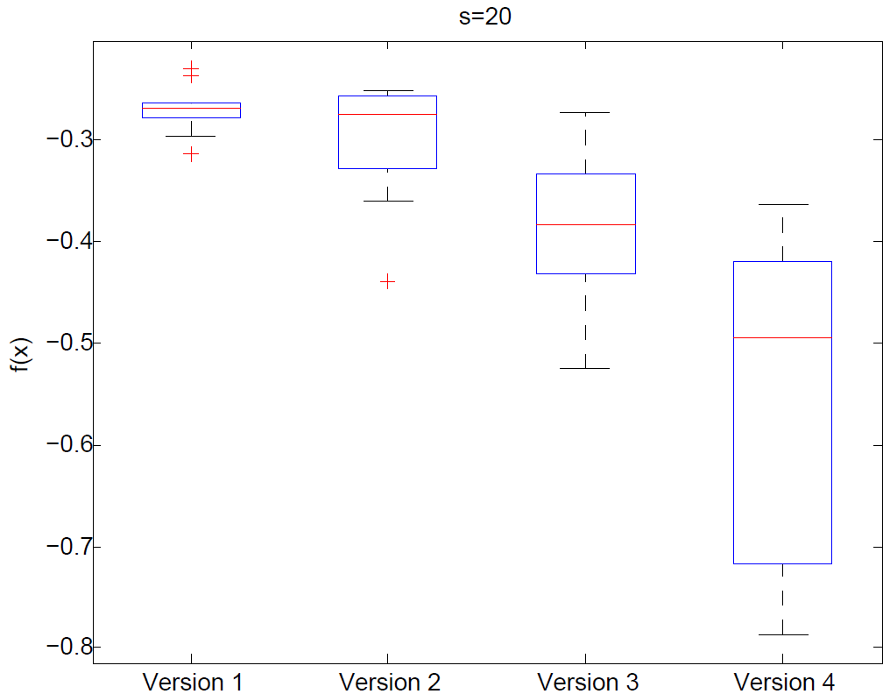
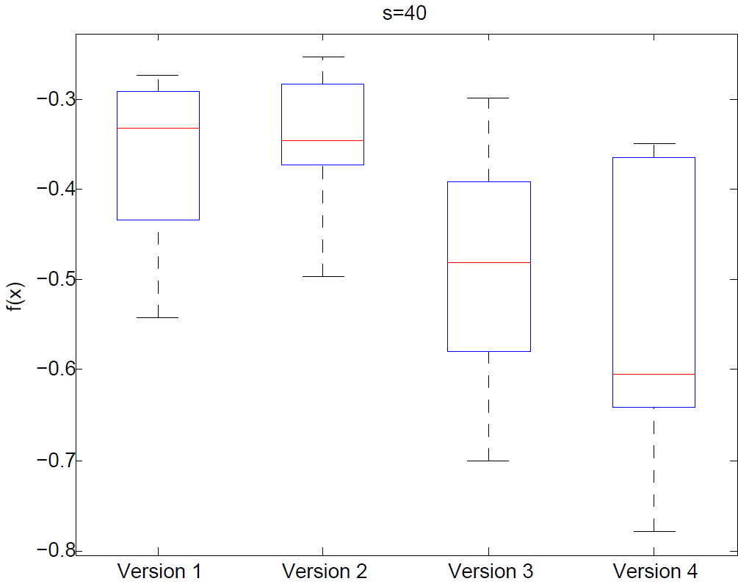
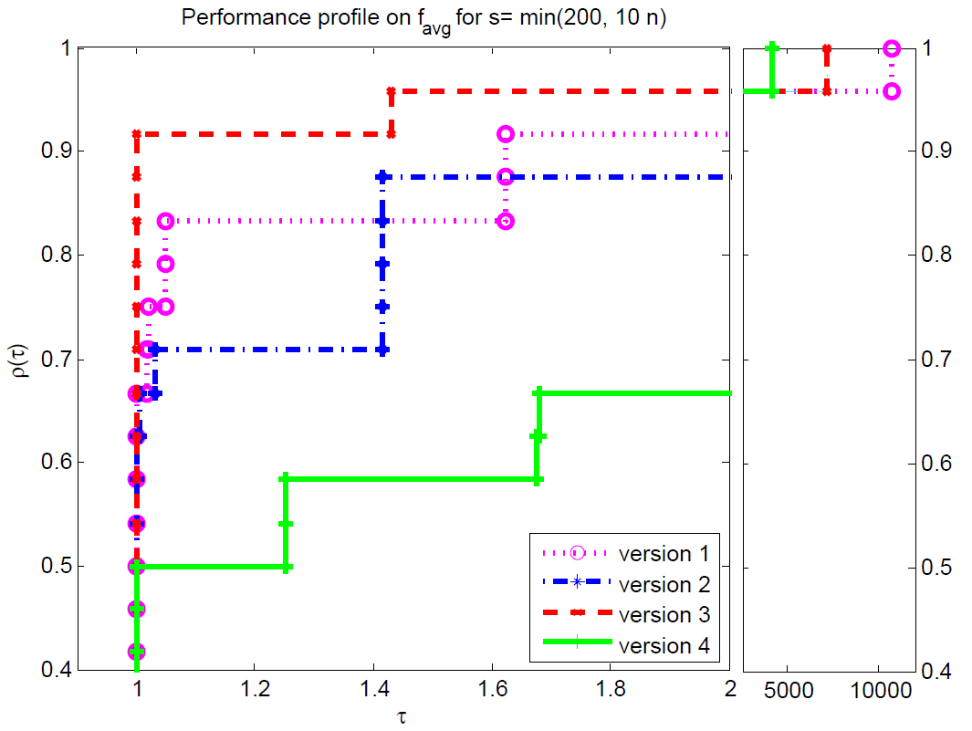
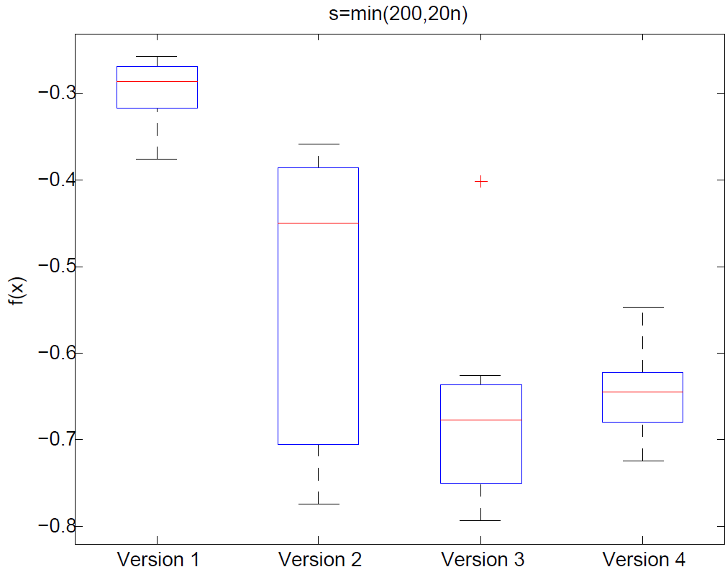
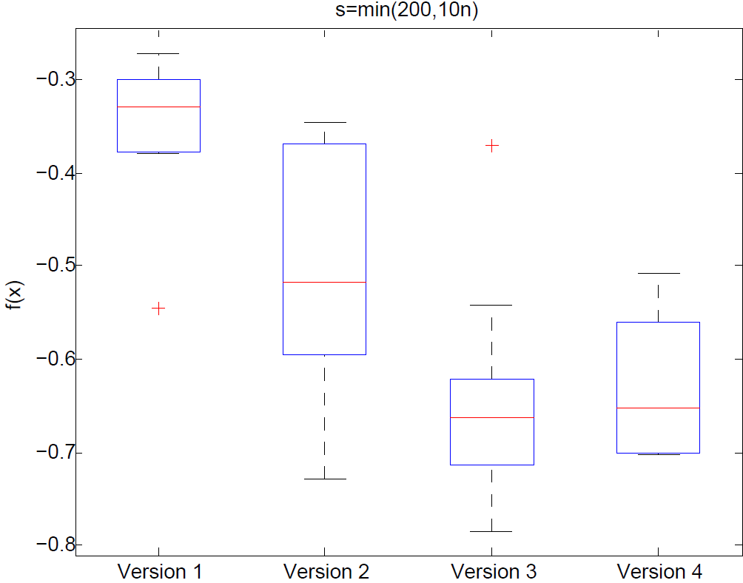
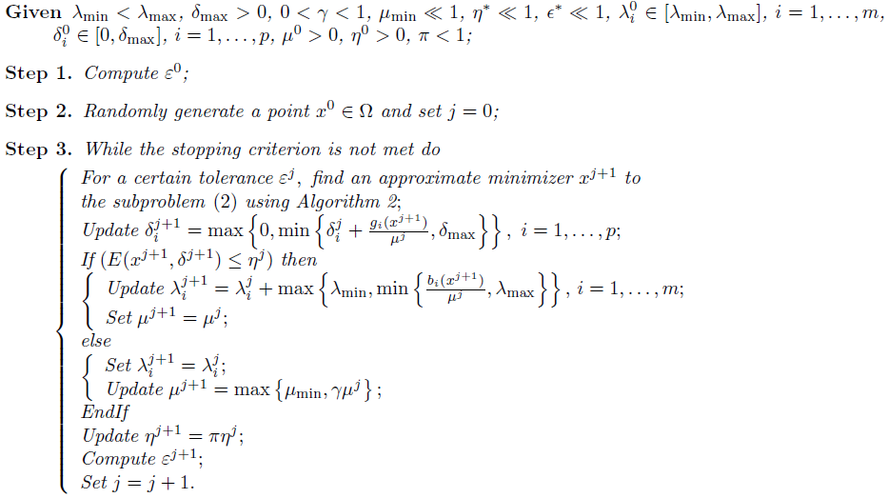
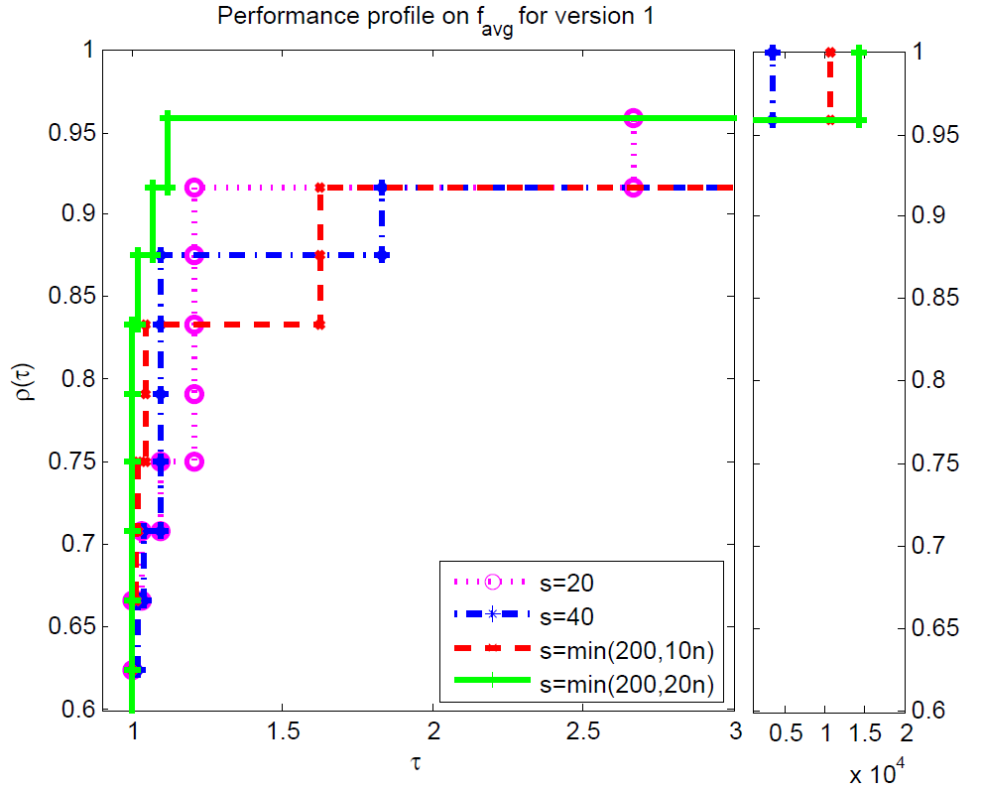
University of Minho School of Engineering <Center Algoritmi>
Hybridization of a Genetic Algorithm with a Pattern Search Augmented
Lagrangian Method
Author* Roman Denysiuk
Supervisors: Lino Costa, Isabel Espírito Santo
* denysiukr@gmail.com
Abstract
Problem g02
Genetic algorithms as most population based algorithms are good at identifying promising areas of the search space (exploration), but less good at fine-tuning the approximation to the minimum (exploitation). Conversely, local search algorithms like pattern search are good at improving the accuracy of that approximation. Thus, a promising idea is combining local and global optimization techniques. We propose a new hybrid genetic algorithm based on a local pattern search that relies on an augmented Lagrangian function for constraint-handling. In this study, we test different hybridization schemes concerning population-handling, as well as local search refinements for a better point. We use performance profiles as proposed by Dolan and Moré in 2002 and a benchmark set of global problems to evaluate the effect of the proposed hybrid algorithms. Population size effect on the algorithm is also assessed.
Algorithm 3 Genetic Algorithm
Tournament selection;
SBX crossover;
Polynomial mutation;
Elitism.
Results
24 benchmark problems were considered;
The problems were coded in MatLab;
There were performed 10 runs for each problem.
Algorithm 1 - HGPSAL
Version 1 that improves the best population point found by GA with HJ;
Version 2 that improves the best 10% population points found by GA with HJ;
Version 3 that improves the best 25% population points found by GA with HJ;
Version 4 that improves the best 50% population points found by GA with HJ.
Conclusions
In this paper, we proposed four hybridization schemes for constrained global optimization that combines the augmented Lagrangian technique for handling constraints with a genetic algorithm as global optimizer and a pattern search as local optimizer. We performed a comparative analysis on the population size effect, as well as on the population-handling on the hybridization schemes.
We show that a population size of s = min(200; 10n) seems to be the more appropriate for the generality of the problems. In general, using an excessive number of points of the population to improve by HJ leads to poor results.
As future work, we intend to perform comparisons with other stochastic approaches and solve other benchmark problems, to improve the integration of global and local search, as well as tuning the parameters of the algorithm. We also intend to test other global and local strategies.
Algorithm 2 - Hybrid Genetic Pattern Search Bound Constrained Algorithm
Uma Escola a Reinventar o Futuro – Semana da Escola de Engenharia - 24 a 27 de Outubro de 2011

