Slide 1
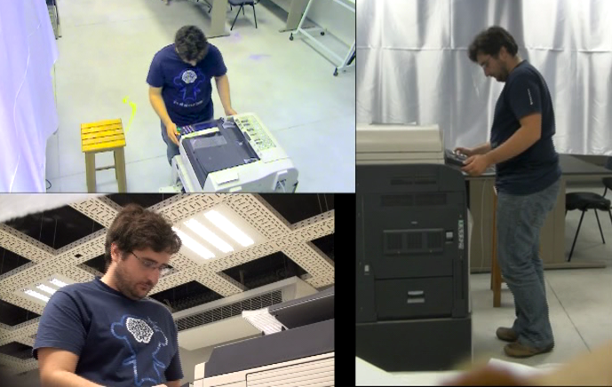
University of Minho School of Engineering Algoritmi Centre
SOCIAL SIGNALS PROCESSING IN HUMAN-COMPUTER INTERACTION
NUNO BRANCO*
Supervisor: Pedro Branco
* nuno_br@hotmail.com
Processing Social Signals in Human-Computer Interaction
PTDC/EIA-EIA/098634/2008
INTRODUCTION
Humans display a lot of non-verbal behavioral language when interacting with each other. Body postures, gestures and facial expressions, all these are social signals.
Humans are good at reading those signals and rely on that ability. Computers however are completely clueless about those signals, missing what may be very relevant information on the user state, attitude and perception of a system. What if the computer could recognize those signals?
Social Signals Processing (SSP) is an innovative and multidisciplinary field of research that has the goal of providing computers with the ability to sense and reason about human social signals, in a similar way to the one a human does in appraising another’s emotions. SSP has therefore the potential to change the way we interact with computers, allowing for better, more effective and efficient Human-Computer Interaction (HCI).
RESEARCH PROBLEM
Recent work in the integration of a variety of sensing modalities in HCI opens an opportunity for the interface to step up and become more aware of the user, his/hers emotions, difficulties and needs. This approach relies on the user’s natural communication channels that, despite research in recent years, are still underexplored in HCI. We seek to observe behavioral patterns of nonverbal language that are tellers about the user and the user’s reactions. In short, the main question driving this research effort is:
What is the relevance of social signals in human-computer interaction contexts, and what is the set of social signals that are most relevant in predicting a user’s level of experience, the quality of an interaction, and the outcome (positive or negative) of that interaction?
PRELIMINARY RESULTS
In a first study, people acting as evaluators determined users’ expectations based on non-linguistic social signals in short video clips of volunteers using a photocopier. Early results suggest that those short seconds of video were enough for most evaluators to make fairly accurate predictions about the level of difficulty the volunteers expected to have performing a task. This study, performed in collaboration with other colleagues was submitted and accepted as a “Work-In-Progress” paper at the 2011 Conference on Human Factors in Computing Systems (CHI 2011).
EXPECTED RESULTS
A system with built-in heuristics has the potential to be able to detect or predict a user’s problematic interactions and determine the quality of an interaction just by “watching” the user’s reactions. This ability could provide a mechanism that would allow for the detection of adverse events, a necessary first step to solving them.
Studying if, and how, others can assess or predict about the quality of human-computer interaction from the observation of users’ behavior dynamics would allow for the development of systems oriented towards those behavioral features that are most relevant. Summarizing, the contribution of the proposed work is expected to be:
Identification of the existing social signals in a HCI context;
Development of a model to assess a user’s experience level, quality of interaction and occurrence of critical incidents;
Implementation of this model into a device;
Deployment of this device for testing and evaluation.
FINAL CONSIDERATIONS
SSP has the potential to change the way we interact with computers by making it possible for the computer to observe a user’s social signals during an interaction, and reason about them, such as a human would do. It is the goal of this research to develop a system capable of detecting or predicting a user’s problematic interactions and determine the quality of an interaction just by “watching” the user’s reactions. There is a strong belief that this will provide the ground to allow the computer to deliver better responses, thus providing better interaction quality and becoming more effective and more efficient, important factors for user engagement.
Uma Escola a Reinventar o Futuro – Semana da Escola de Engenharia - 24 a 27 de Outubro de 2011

