Slide 1
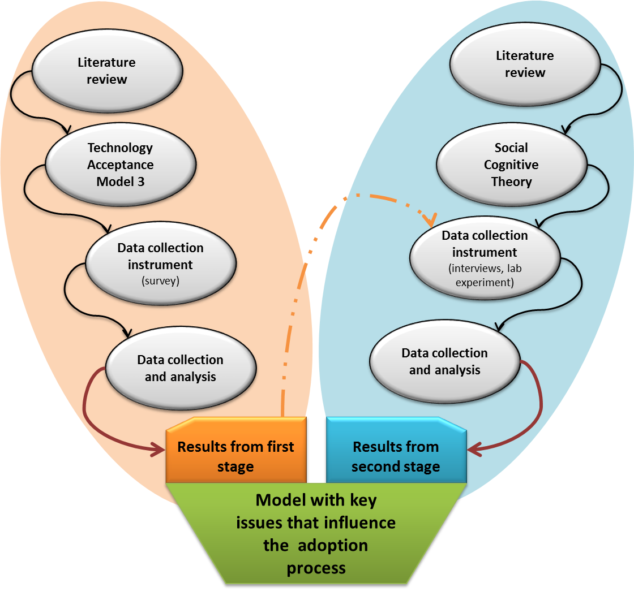
University of Minho School of Engineering Centre Algoritmi
USERS' PERCEPTIONS REGARDING THE USE OF BIOMETRIC AUTHENTICATION TECHNOLOGIES IN THE ACCESS TO HEALTH SERVICES
PAULO RODRIGUES*
Supervisor: Henrique Santos
* paulomrrodrigues@gmail.com
Resume
We are witnessing a generalization of the concept of digital identity due to the spread of information technologies. From the perspective of system administrators, users are the weakest link in the security chain. Users usually show concern for the safety and privacy, but at the same time eager to use simple mechanisms to facilitate their authentication process before a particular system. The authentication technologies using biometrics already play a major role in the context of security systems. Some techniques are used in various services not only to ensure physical access to facilities but also to provide some rigor in access. This study addresses the perception of users regarding the use of biometric authentication technologies in access to health services. Preliminary results derived from a survey by questionnaire indicate a trend of acceptance of such technologies in access to health services. It is expected that the final results of this study support the possible implementation of such technologies,
Introduction
The growing sense of insecurity in society means that researchers in the field of security of information systems feel the need to implement safer ways to use and manage access to services that they provide. Society is increasingly dependent on new authentication technologies. The name of a person or his presence no longer meet the requirements of validating the identity of a particular individual(Laux 2007).
Information systems in health care are increasingly complex. With different implementations, it is necessary to integrate and operate platforms in order to ensure their interoperability. These constraints contribute to the difficulty that exists to ensure the privacy and rights of users of these systems.
Nowadays it is common to hear stories about mistakes made within our health system. Clinical records exchanged, confusing receipts, wrong medication given to wrong patients and improper access by unauthorized users. We are witnessing a desperate race with the aim of finding the best method of protecting data and prevent errors with consequences ranging from embarrassment to risk situations, sometimes fatal. Access should be granted only to authorized users who can view the clinical data being passed and stored in the information system, never forgetting the context of service provided to patients.
In this field, biometric authentication technologies would be more reliable alternative (but not infallible) in the process of identification / verification of individuals at the expense of traditional methods (eg: paper, electronic documents without verification).
Problem Definition
Considering these, it is really necessary to delve into the factors that may influence the adoption of this technologies, leaving for a more comprehensive and detailed study. Through the theories and techniques available to measure and interpret the factors influencing the adoption of these technologies, enabling the development of a model that can positively influence the rate of adoption of biometric authentication in access to health services. Given this, the main research question formulated was the following:
- With regard to biometric-based authentication technologies, factors that influence (and how) the citizens in the use of public health?
From the work that is currently being developed is expected the following contributions:
- An identification and characterization of the key issues that influence the adoption process;
- The proposal of a value model with the aim to help widespread adoption of these technologies.
Research design
In this type of research, we deal with processes of technology adoption the quantitative methods view does not satisfy some of the aspects of human behavior and its interactions with its environment. Hence, the choice of mixed methods is more appropriate for the study and the research plan set. On the one hand, a data collection instrument (questionnaire) in which it intends to monitor the use and perception of perceived ease of use and the other, an instrument (semi-structured interviews), which gives explanations of groups of individuals previously selected after analysis of data from the first instrument, and laboratory experience with the subject.
Conclusions and future work
According to the preliminary results, the majority is predisposed to adopt, sees advantages in the process and reinforces expectations towards the willingness to adopt such systems. But we also found that some respondents reluctant when it comes to issue an opinion on the items evaluated in various constructs and items shown.
It will be important in the second phase of this study to examine the arguments and strategies that can influence the adoption process. We can only measure which could be decisive in decision-making on the part of respondents without an opinion on the various items.
It is hoped that a comprehensive reading problems associated with the adoption of such technologies, will provide a model that can optimize the process of acceptance and without calling into question the ethical principles, safeguarding the privacy and human dignity
Figure 1 - Research plan and expect results
References
Compeau, D. R., and Higgins, C. A. "Application of Social Cognitive Theory to Training for Computer Skills," Information Systems Research (6:2) 1995, pp 118-143.
James, T., Pirim, T., Boswell, K., Reithel, B., and Barkhi, R. "Determining the Intention to Use Biometric Devices: An Application and Extension of the Technology Acceptance Model," Journal of Organizational & End User Computing (18:3) 2006, pp 1-24.
Jones, L. A., Antón, A. I., and Earp, J. B. "Towards understanding user perceptions of authentication technologies," in: Proceedings of the 2007 ACM workshop on Privacy in electronic society, ACM, Alexandria, Virginia, USA, 2007, pp. 91-98.
Laux, D. D. "A study of biometric authentication adoption in the credit union industry," Iowea State University, 2007, p. 62.
Venkatesh, V., and Bala, H. "Technology Acceptance Model 3 and a Research Agenda on Interventions," Decision Sciences (39:2) 2008, pp 273-315.
Uma Escola a Reinventar o Futuro – Semana da Escola de Engenharia - 24 a 27 de Outubro de 2011

