Slide 1
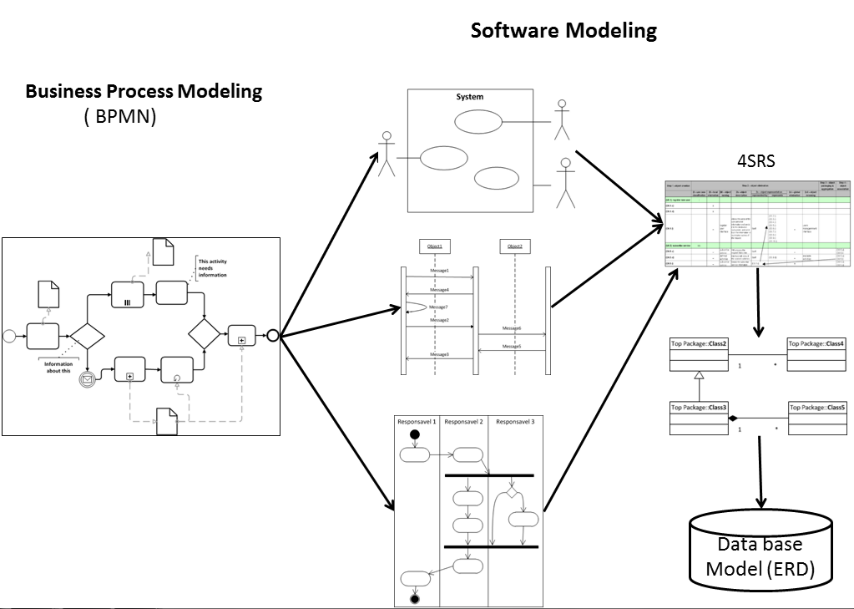
University of Minho School of Engineering Algoritmi Centre
Design Software Systems from Business Process Modeling
Author* ESTRELA FERREIRA DA CRUZ
Supervisors: Ricardo J. Machado, Maribel Y. Santos
* id3233@alunos.uminho.pt
Introduction/Motivation
Motivating facts:
Currently companies have to deal with a large number of processes involving different domains, organizations and tasks.
Business Process Management (BPM) enables the optimization of organizations business process activities [1].
Business Process Management and modeling is increasing its relevance.
The software often does not do what it is supposed to do or does something it is not supposed to do[2].
Software development teams still have serious difficulties in defining the applications requirements properly.
The BPMN is a standard created by the OMG, one of the best known and actually used in this area [3].
The UML (Unified Modeling Language) is a standard for software modeling and designing adopted by OMG in 1997 [4];
The 4SRS (4-step rule set) is a technique that enables the generation of UML object diagrams from the UML use case diagrams[5].
Research goals:
In the context of model based software development, some aspects of the software model should then be derived from existing features in the model of the business process of an organization.
The main research objective is to reduce the gap between the Business Process Modeling and the software development through the generation of software models (UML) from business process models (BPMN), as is represented on the figure.
Expected Results
The main expected result is a method for generating software models from business process models.
This way it will be easy to:
Be sure that the software application does what it has to do, in other words, that the software application really meets the company needs;
Ensure that the software application is aligned with the business processes and it is easy to adapt to necessary changes;
Optimize resources by joining efforts between the BPM analysis and the requirements definition of software applications that support the business.
Work Plan
The PhD research work plan is scheduled to proceed as follows:
2011/2012 – State of art study and write the PhD proposal;
2012/2013 - Integration of BPMN and 4SRS;
2013/2014 - Complete all steps from BPMN to database design (ERD - Entity-Relationship Diagram);
2014/2015 - Write the PhD thesis report
Conclusion
The Business Process Management and Modeling is nowadays well-established and well-known in companies. At the same time software development still has some difficulties on requirements definition. So it is natural to think that BPM and software development should work together or, at least, very closer. As a result we could have software applications that really match organizations needs and reduce resources and time by joining efforts.
References
[1] Wil van der Aalst. Business process management demystied: A tutorial on models, systems and standards for workow management. Springer Berlin / Heidelberg, 2004.
[2] Pankaj Jalote. A concise Introduction to Software Engineering. Springer, 2008.
[3] Vitus Lam. Equivalences of bpmn processes. Service Oriented Computing and Applications, 2009
[4] Nick Russell, Wil M. P. van der Aalst, Arthur H. M. ter Hofstede, and Petia Wohed. On the suitability of uml 2.0 activity diagrams for business process modelling. In Proceedings of the 3rd Asia-Pacic conference on Conceptual modelling, 2006.
[5] Ricardo J. Machado, João M. Fernandes, Paula Monteiro, and Helena Rodrigues.Transformation of uml models for service-oriented software architectures.Engineering of Computer-Based Systems, IEEE International Conference, 2005.
Research Questions
There are several questions that can be posed for justifying the proposed research, some of them are listed next:
How can software development take advantage from business process modeling?
Can we generate software models from business process models?
How can we be sure that the application requirements really meet the organization needs?
Uma Escola a Reinventar o Futuro – Semana da Escola de Engenharia - 24 a 27 de Outubro de 2011

