Slide 1
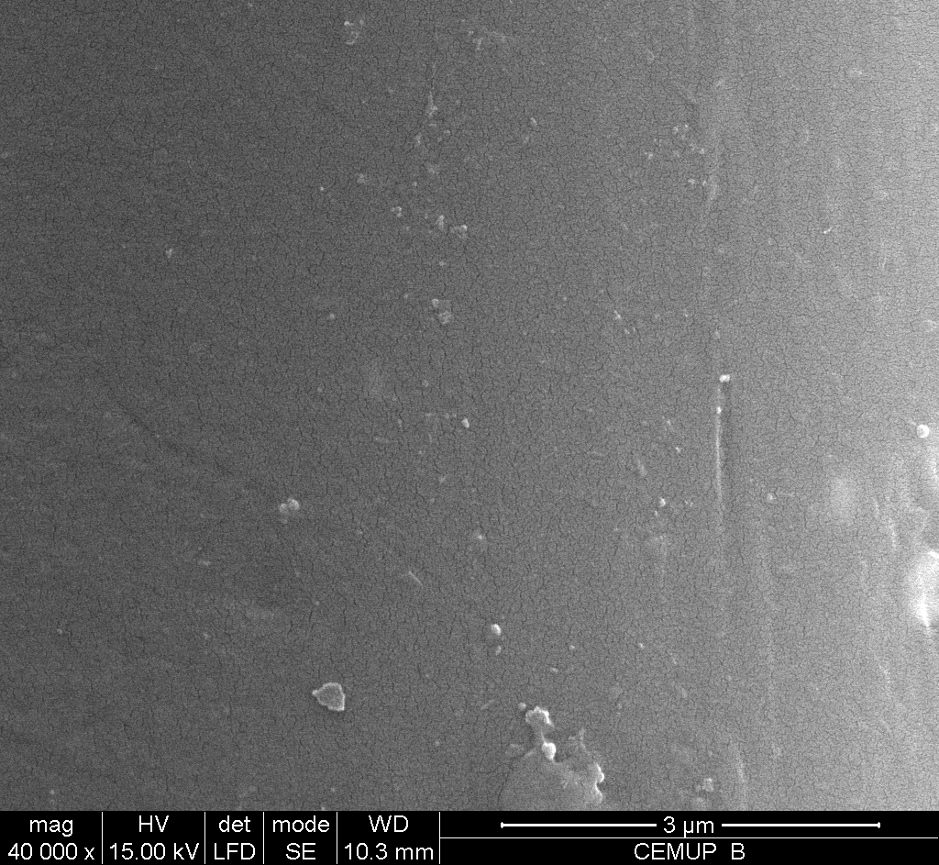
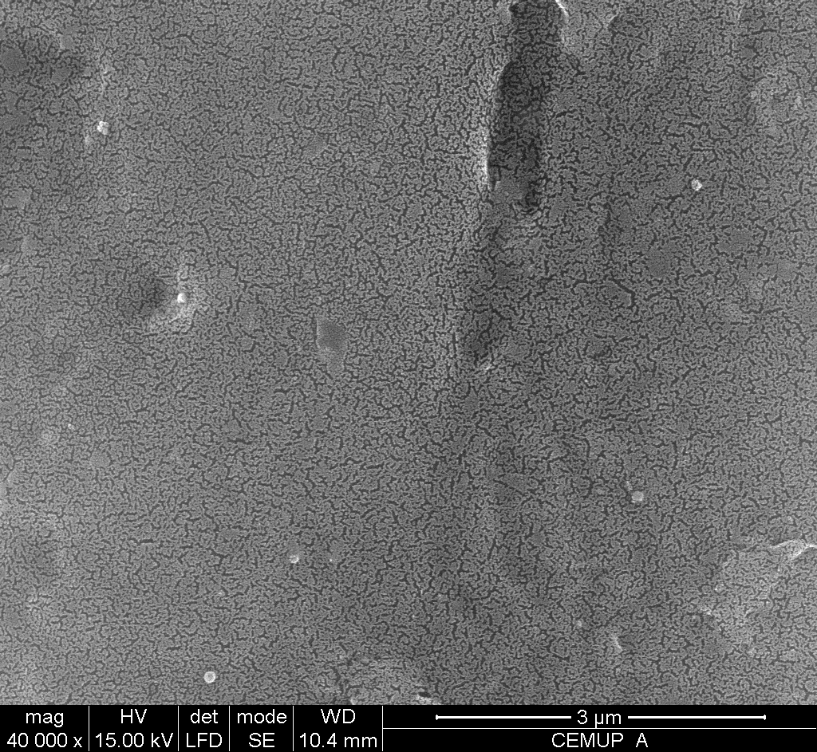
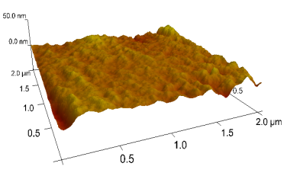
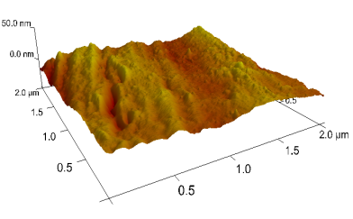
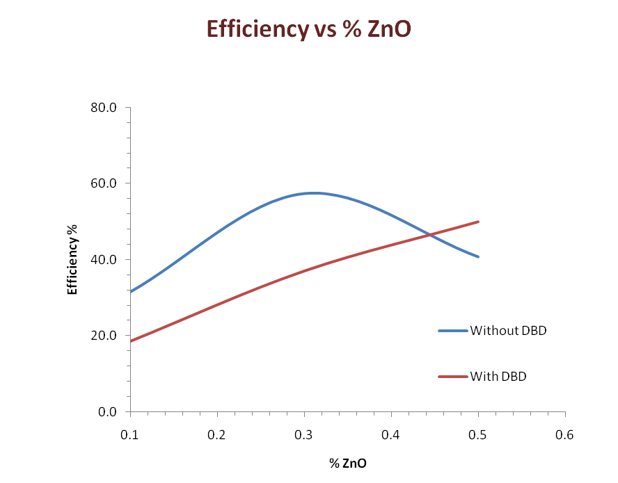
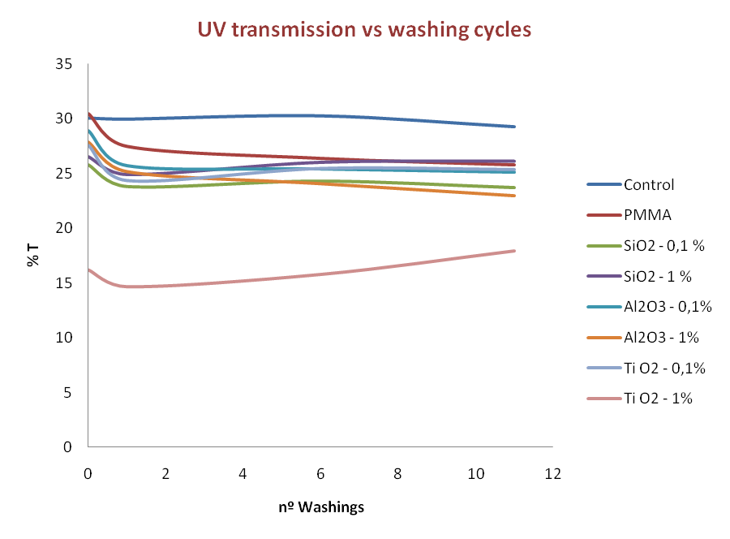
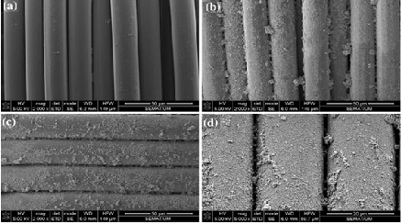
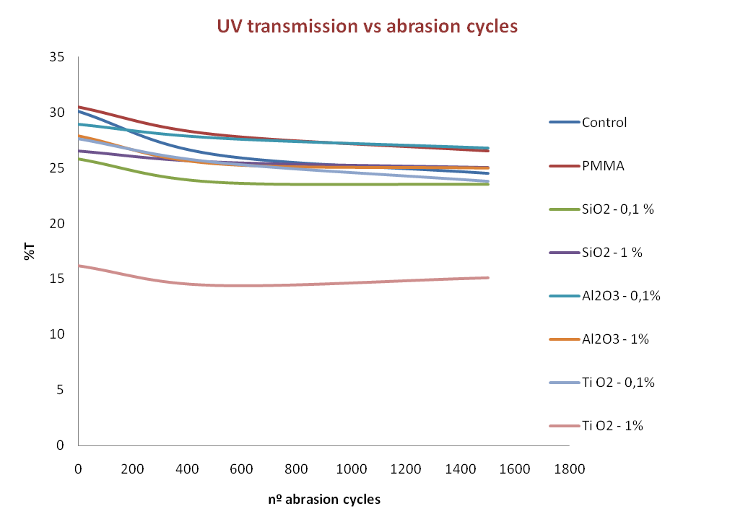
University of Minho School of Engineering <2C2T>
UV protection of polyamide fabrics with polymeric nanocomposites
Author* SANDRA VENTURA
Supervisor: Noémia Maria Ribeiro de Almeida Carneiro Pacheco
* id2520@alunos.uminho.pt
Summary
The present work shows results for UV protection with thin and thick polyamide 6.6 textile fabrics treated with different polymeric nanocomposites. Tests with different concentrations of ZnO, Al₂O₃, SiO₂ and TiO₂, dispersed in polymethylmehacrylate (PMMA) were performed. Effective protection has been evaluated and durability has been tested in the case of ZnO nanocomposite. Good dispersion of nanoparticles in the polymer has been achieved giving well distributed values for UV protection factor.
Materials
100% polyamide 6.6 plain weave (58 g/m²)
100% polyamide 6.6 plain weave (155 g/m²)
Al₂O₃, SiO₂ and TiO₂ nanoparticles were commercially acquired from Aldrich S. A.
ZnO nanoparticles were synthesized following the reactions:
Plasma treatment
The plasma dosage of 2400 W.min/m² was chosen to discharge the samples, with power of discharge – 1500W; speed – 2,5 m/min; nº of passages – 2.
Samples
Preparation of stock solution of 5 wt% of PMMA in toluene;
Diferent percentages of each nanoparticle were added;
Fabric samples were immersed in the solutions under ultrasonic vibrations;
Samples were padded for uniform impregnation.
Methods
Analysis of surface morphology (SEM and AFM);
UV transmission – % of UV light transmission;
Durability tests like:
Washing process – samples were washed with 4 g/L of non- ionic ECE detergent at 30°C for 30 min and then rinsed with water for 15 min – 1 washing cycle;
Abrasion tests- performed in a Martindale abrasion tester.
Results and Discussion
SEM and AFM analysis of treated and untreated samples show that DBD causes physical changes by creating roughness on the surface.
Figure 1. Scanning electron micrographs and AFM of PA 6.6 (a, c) before (b, d) after DBD plasma treatment.
Nanoparticles and plasmatic treatment are both able to modify morphology of surface giving high contribution to influence some functionalities.
In thicker fabrics the transmmited UV radiation is low, but even so differencies caused by washing are noted. Without ZnO nanoparticles dispersed in the PMMA coating the fabric, the UV transmission is higher than for the cases where the nanocomposite was used, meaning that nanoparticles are responsible by UV protection functionality.
The UV protection obtained by ZnO–PMMA nanocomposite in a denser polyamide fabric is not affected by the first five washing cycles. Higher performance is even obtained in DBD treated fabrics, which indicates that a better adhesion occurs. This functionality becomes less effective for more than ten washing cycles.
Results and Discussion
The efficiency of nanocomposites for the achievement of UV protection functionality is linearly higher for higher concentration of ZnO nanoparticles in PMMA matrix, when DBD treament is applied to the substrate.
The decrease in efficiency for contents of ZnO in PMMA higher than 0.3%, when no DBD is applied demonstrates that the application of the plasmatic treatment is probably responsible for a better distribution of the nanocomposite in the polyamide substrate, avoiding aggregation for higher concentrations.
In the thinner fabric, UV transmission is higher when compared to heavier substrate, to the fabric with PMMA and to the fabrics finished with the nanocomposites.
TiO₂-PMMA nanocomposites reveal better protection with higher percentage (1%) of TiO₂ .
A slight decrease in UV transmission is noticed for the first washing, in all the cases, meaning a possible contraction in fabric structure.
UV protection is assured at least for the tested washing cycles, giving good indications of resistance to normal use.
Conclusions:
High level of UV protection is achieved in polyamide 6.6 fabrics using polymeric nanocomposites such as ZnO-PMMA, Al₂O₃-PMMA, SiO₂-PMMA and TiO₂-PMMA;
The increase in UV protection functionality is generally higher for higher concentration of nanoparticles in PMMA matrix and lower with the thickness of the fabric;
ZnO-PMMA and TiO₂-PMMA showed more effective UV protection in thinner polyamide fabric;
Durability of UV protection stands up to ten washing cycles becoming less effective for more than ten washing cycles with ZnO-PMMA.
a)
b)
c)
d)
Zn(NO₃).6H₂O+2NaOH Zn(OH)₂ + NaNO₃
Zn(OH)₂ + H₂O₂ ZnO₂ + 2 H₂O
Figure 2. a) SEM micrograph of the untreated polyamide fabric; SEM micrograph of polyamide fabric treated with b 0.1% ZnO,c 0.5% ZnO, d 1% ZnO.
ZnO₂ + 2H₂O ZnO
Best performance in UV protection is achieved with TiO₂ (1%)-PMMA.
No negative influence in UV protection is detected with 1500 abrasion cycles.
The slight improvement at 500 abrasion cycles in all samples is explained with compression of the fabric that increases shield effect to UV radiation.
Bibliografia
1. Carneiro, N., Souto, A.P., Silva, E., Marimba, A., Tena, B., Ferreira, H., Magalhães, V., Color Technology, 2001,117, 298-302.
2. Carneiro, N., Souto, A.P., Nogueira, C., Madureira, A., Krebs, C., Cooper, S., J Nat Fibers, 2005, 2(4), 53-65.
3. Cassie, A.B.D., Baxter, S., Trans Faraday Soc, 1944, 40:46.
4. Hoefnagels, H.F., Wu, D., Dewith, G., Ming, W., Langmuir, 2007, 23:13158.
5. Cho, M.S., Lim, S.T., Jang, I.B., Choi, H.J., Jhon, M.S., IEEE Trans Magn, 2004, 40:3036.
6. Cho, M.S., Choi, H.J., Mater Sci Forum, 2004, 449:1201.
7. Gowry, V.S., Almeida, L., Amorim, M.T.P., Carneiro, N., Souto, A.P., Esteves, M.F., Sanghi, S.K., J. Mater. Sci., 2010, 9:45:2427.
Uma Escola a Reinventar o Futuro – Semana da Escola de Engenharia - 24 a 27 de Outubro de 2011

