Slide 1
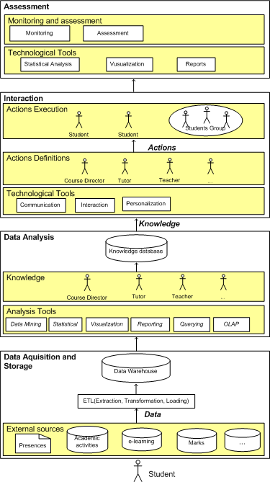
University of Minho School of Engineering Algoritmi Center
Business Intelligence supporting Higher Education Institutions: The case of Student Relationship Management
Author* MARIA BEATRIZ G. PIEDADE
Supervisors: Maribel Yasmina Santos
* bea@estg.ipleiria.pt
Introduction
It is largely accepted that a way to promote the students’ success is by implementing processes that allows the students’ closely monitoring, the evaluation of theirs success and the approximation to theirs day-by-day activities.
The implementation of these processes does not take place in many Higher Education Institutions (HEI), due to the lack of appropriate institutional practices and an adequate technological infrastructure to support these practices.
To overcome these conceptual and technological limitations, it is proposed a system designated by Student Relationship Management system (SRM system).
The SRM system supports the SRM concept and the SRM practice, also proposed, in the scope of this project, and it is implemented using the technological infrastructure that supports the Business Intelligence (BI) systems.
SRM concept and practice validation methodology
Semi-structured interviews.
Interviews analysis based on the Grounded Theory principles and supported by a Computer Assisted Qualitative Data Analysis Software (NVivo)
SRM system structural framework
The students data was stored in a data warehouse.
The data was analysed using appropriate data analysis tools (OLAP, data mining) to obtain knowledge about the students and theirs academic behaviour.
A set of actions was automatically carried out over the student or a group of students, when a specific situation or behaviour was detected.
The impact of all the actions was assessed.
SRM system architecture
Based on the BI technological infrastructure;
Includes the components (Figure 1):
Data Acquisition and Storage - store student’s data;
Data Analysis - obtain student’s knowledge;
Interaction - effective student - institution relationship ;
Assessment - assess actions impact.
SRM system validation methodology
Prototype implementation - to demonstrate the SRM system feasibility;
Application case - to demonstrate the SRM system utility in the SRM concept and in the SRM practice support, particularly in:
The students knowledge acquisition process;
The decision-making process;
The students interaction process.
Application Case
Undertaken in a Portuguese Higher Education institution.
Tasks involved:
Scenario identification;
Data acquisition and data selection;
Data warehouse design and implementation;
ETL process implementation;
Data analysis (OLAP, data mining);
Results interpretation;
Specific action included in the SRM Practice definition;
SRM Practice specific actions implementation (through a web-SRM application);
Automatic actions execution over the students;
Actions impact assess.
Conclusions and Future Work
In the present HEI context, there still exist a high rate of failure and abandon, mainly in the first year of the graduation courses.
In this scenario, it is essential the design and the implementation of mechanisms that facilitates the monitoring and the supervising of the students’ academic activities.
We believe that the SRM concept and the SRM practice implementation, supported by the SRM system, create an advantage towards the students success promotion, and, therefore, in the institution success, ensuring an effective student - institution relationship.
Dissertation conclusion.
Figure 1 - The SRM system’s architecture
SRM system implementation
BI tools;
Web development tools.
Uma Escola a Reinventar o Futuro – Semana da Escola de Engenharia - 24 a 27 de Outubro de 2011

