Slide 1
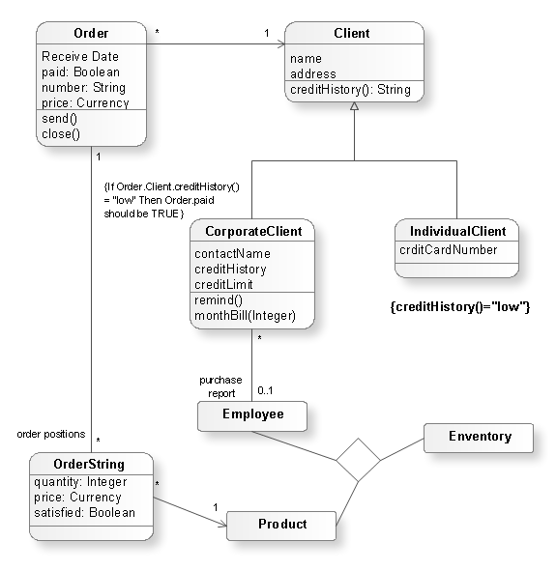
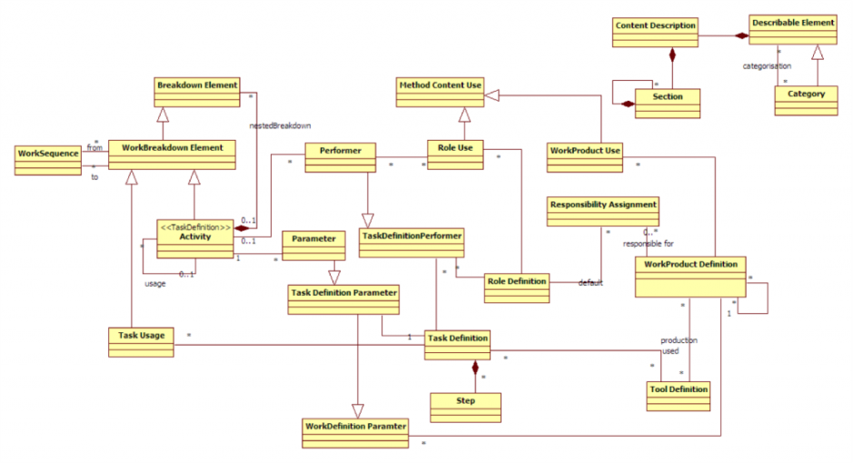
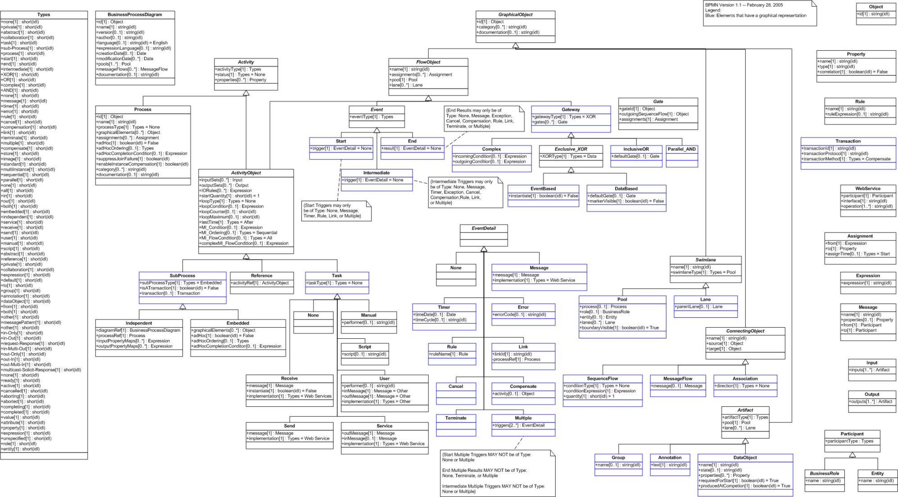
University of Minho School of Engineering <Nome do Centro>
FORMALIZING A MODELING BUSINESS ORGANIZATION METHODOLOGY (MLEARN)
CARLOS SALGADO
Supervisor: Ricardo J. Machado
* id3230@alunos.uminho.pt
Business Organization modeling
Business organization modeling has long been an important issue on Information Systems research. Far from the popular frameworks (Zachman) or theories (Work System) thoroughly studied in the academic medium, less know methodologies like MLearn, locally developed and studied at Universidade do Minho, awaits its turn to take part on this world.
Inspired in similar studies on the popular trends, we aim to formalize the MLearn methodology, using and extended, if needed, the UML, SPEM and BPMN notations.
Research Objectives
The objective of this research is to formalize, using notations as UML, SPEM and BPMN, the entire MLearn business organizations modeling methodology, publicizing it to the world. This will allow it to be studied, compared, criticized, extended and used in the future by other people, technological or business based.
The availability of metamodels to describe the methodology elements and its deployment applicability, illustrated with sample cases, will allow for reproducibility of the methodology on the field by other people other than its creator and specialized consultants, being one of the major contributions of this study.
In order to overcome any impossibility of UML/SPEM to completely define the metamodels needed, the extension of one or both of these languages will be provided for, resulting in a scientific innovation which will strengthen this work.
Research Activities
After attending the base subject courses of the doctoral program on Information Systems and Technology at Universidade do Minho, the next step comprises the preparation of a literature review on the subjects of the thesis, defining well the terms to be used along its writing, and a research plan, ending with the presentation and defense of the research proposal. The literature review will focus on frameworks, theories and methodologies for business organization modeling, and also on the usage of the UML language and the SPEM metamodel in formalization processes.
Next step will be to formalize, using UML, the objects, entities and artifacts identified in each phase of the MLearn methodology, and formalize, using SPEM, the dynamics of the different phases for deploying it. Metamodels on each of these phases will constitute the deliverables of the study, illustrating their applicability using real cases of business organizations or simulated ones, as appropriate.
Dissertation writing will be done incrementally during the entire process of research and, as result of the work being carried out, some articles and conference communications are planned periodically.
MLEARN
UML
SPEM
UML
SPEM
BPMN
UML
SPEM
Uma Escola a Reinventar o Futuro – Semana da Escola de Engenharia - 24 a 27 de Outubro de 2011

