Slide 1





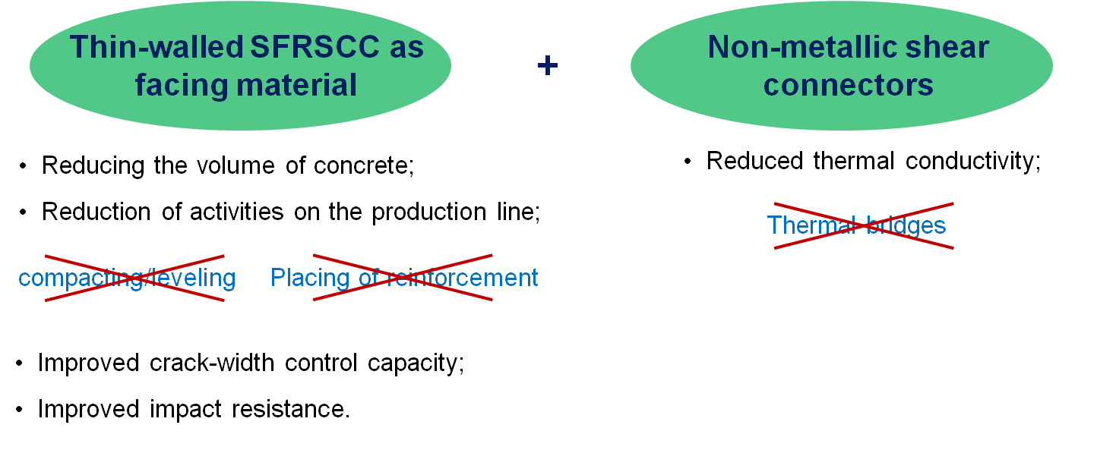
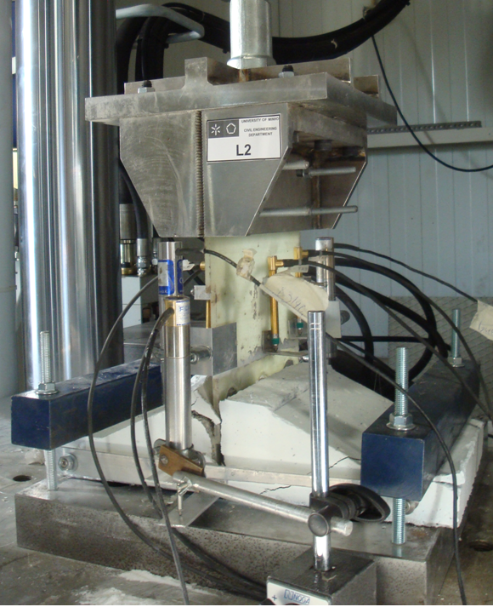
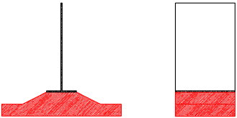
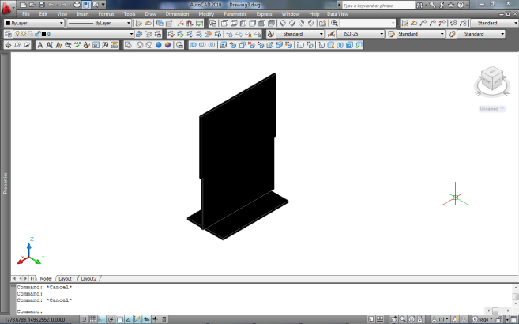
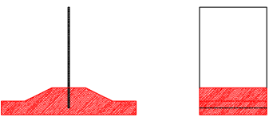
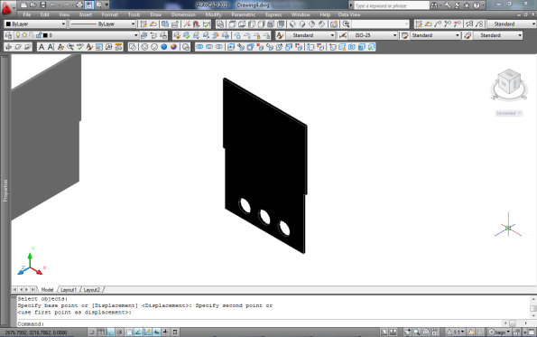
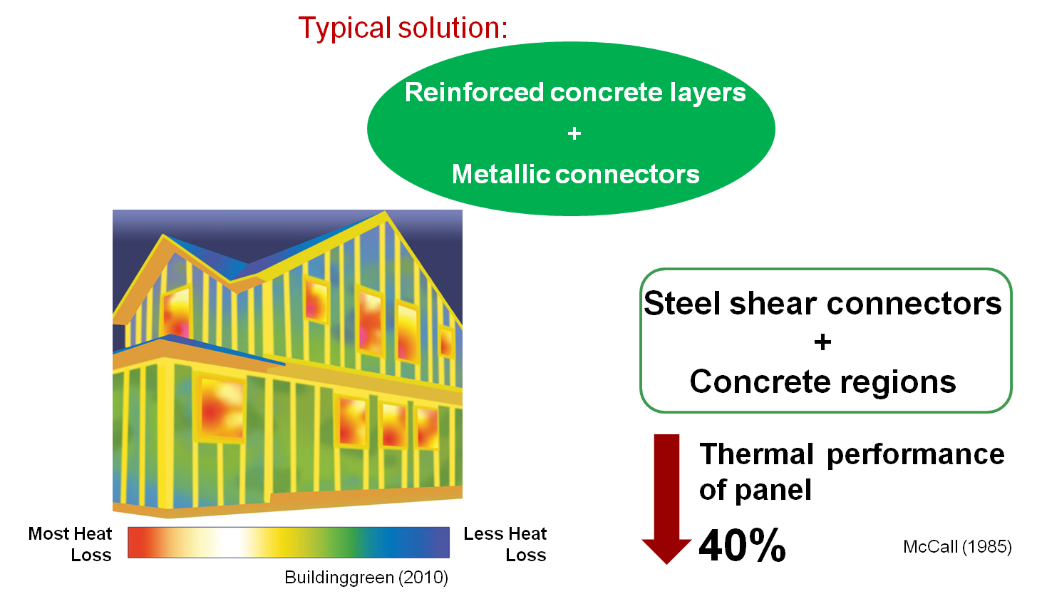
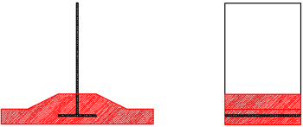
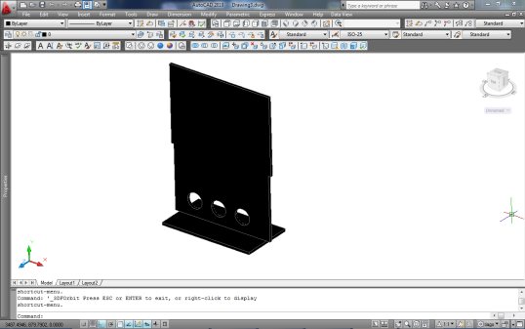
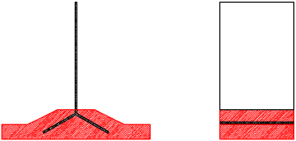
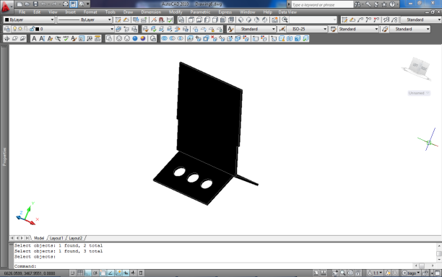
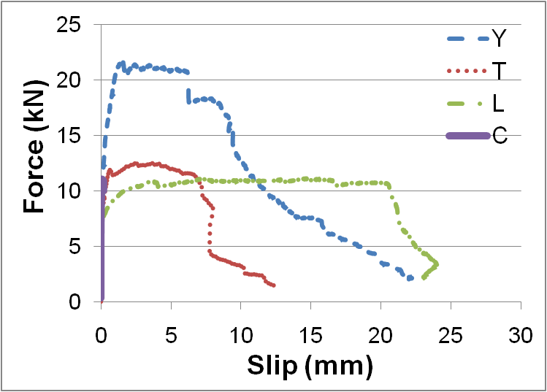
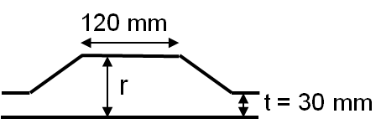
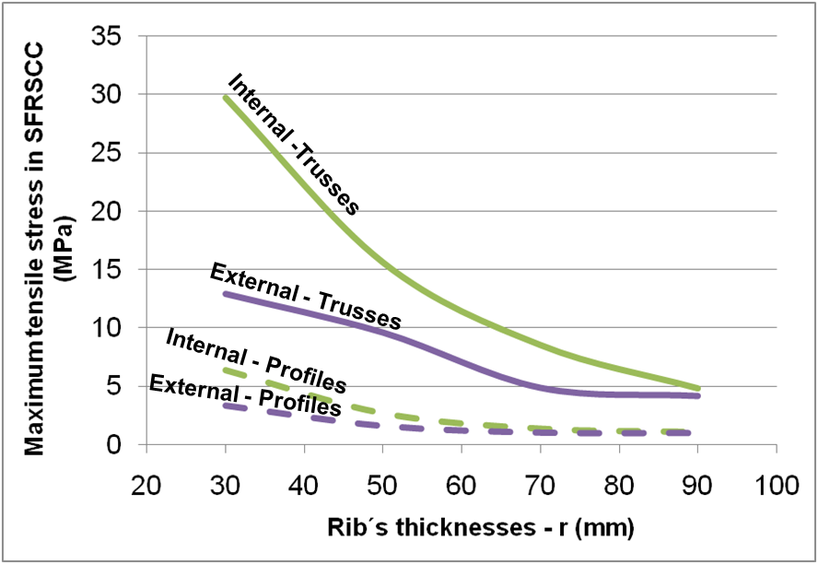
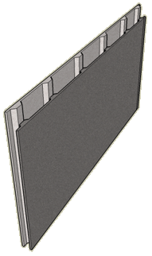
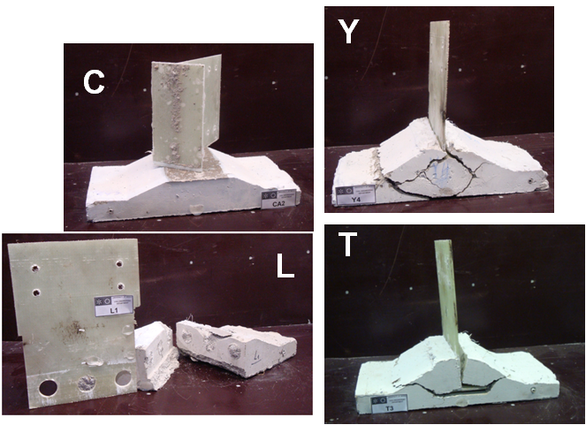
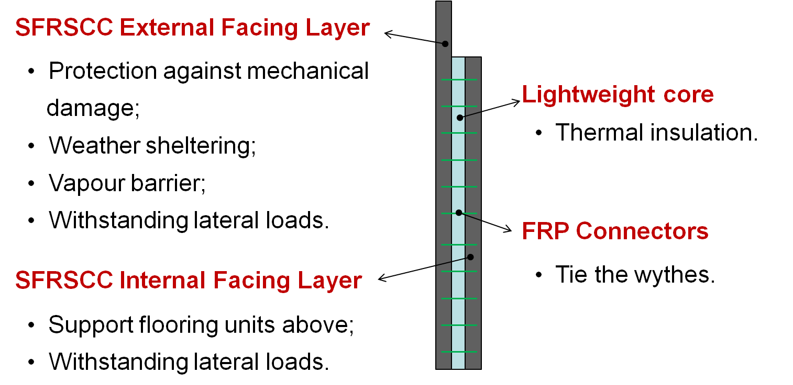
University of Minho School of Engineering ISISE, Departament of Civil Engineering
SANDWICH STRUCTURAL PANELS COMPRISING THIN-WALLED STEEL FIBRE REINFORCED SELF-COMPACTING CONCRETE (SFRSCC) AND FIBRE REINFORCED POLYMER (FRP) CONNECTOR
RODRIGO LAMEIRAS*
Joaquim Barros, Miguel Azenha and Isabel Valente
* rmlameiras@civil.uminho.pt
Introduction
The main interest on using construction sandwich panels is related to the structural and thermal efficiency that can be achieved with this technology. Traditionally, these sandwich panels adopt two conventionally reinforced concrete layers (also known as wythes) and metallic connectors between both of them. Due to their high thermal conductivity, the metallic connectors in these insulated wall panels generally cause thermal bridges on the building envelope that increase heat flow.
Aim
The present research work aims to propose an innovative thermally efficient prefabricated structural sandwich panel composed by external thin steel fibre reinforced self-compacting concrete (SFRSCC) layers, a lightweight thermally insulating core material, and fibre reinforced polymer (FRP) shear connectors.
Optimization of the Sandwich Panel Concept
The optimization of sandwich panel concept was done by numerical modelling with recourse to linear FE analysis (FEMIX). Panels with 5,0m width and 2,5m tall were studied, with concrete layers represented by shell elements and the connectors by shell and beam elements.
The results shown that the use of trusses as connectors leads to higher stress levels on the SFRSCC layers. Increasing the thickness of the concrete in the vicinity of the connections is an effective solution to reduce tensile stresses in the wythes, which provides wider safety margins for cracking.
Connections between FRP and SFRSCC – Pull out tests
A preliminary experimental program was performed to compare the mechanical behaviour of several connector configurations through pull-out tests. One type of adhesively bonded (C) and 3 types of embedded connections (referred to as L, T and Y) were tested.
Figure 5: Experimental setup for the pull-out tests and types of connectors studied. To increase the connection load capacity, circular holes were devised in embedded connectors.
These preliminary tests evidence the possibility of attaining a pullout load that is considered enough for expected stress levels in the present application. Contrary for what is observed for the bonded connections, the embedded connections have shown a quite large ductility.
ACKNOWLEDGEMENTS
The first author would like to thank the FCT for financial support through the PhD grant SFRH/BD/64415/2009. The Authors acknowledge the support of the QREN research project number 5387.
Adhesively bonded
C
Embedded
L
T
Figure 3: Proposed load-bearing sandwich panel.
Y
Figure 6 : Force versus slip diagrams for pull out tests performed with different types of connectors.
Figure 4 : Initial optimization consisted in evaluating two solutions: (i) adopting ribbed wythes to minimize stress concentration along connectors; (ii) using either trusses or profiles as connectors.
Figure 1: Typical sandwich panels and problems related to their use.
Figure 7: Typical failure modes obtained for the adhesively bonded (C) and embedded connections (L, T and Y).
Figure 2: Concrete sandwich panel components and their functions.
Uma Escola a Reinventar o Futuro – Semana da Escola de Engenharia - 24 a 27 de Outubro de 2011

